Slide 1


IOT based smart wearable safety gadget
Submitted By:
Shweta(747925)

Slide 2
Task
Interfacing with Cloud Services

Slide 3

Introduction
In our project, when device gets activated , the image of the person in front is captured by ESP32 Cam and gets transferred to Blynk along with notification.
Blynk is an application for storing data to cloud
By this ,hardware projects can be controlled and monitored from IOS and Android device.

Slide 4
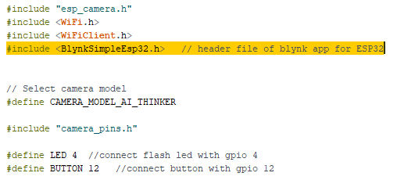
Coding….

Slide 5
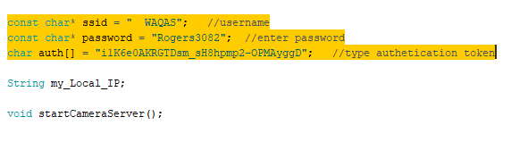
Continued…

Slide 6
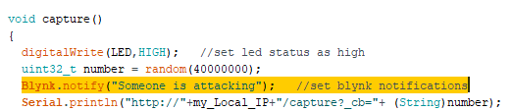
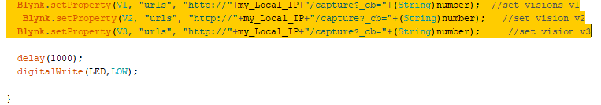
Continued…

Slide 7
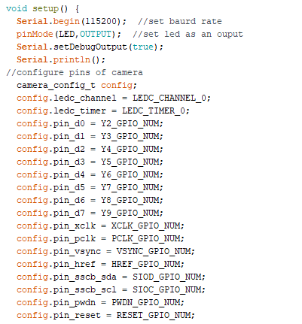

Slide 8
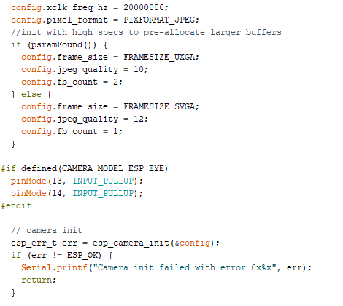

Slide 9
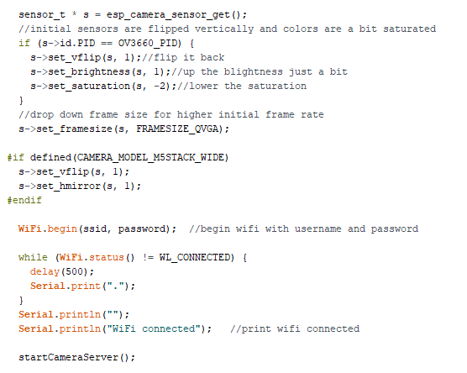

Slide 10
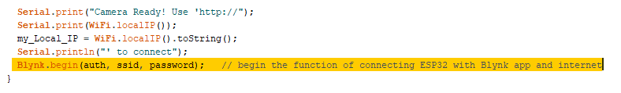
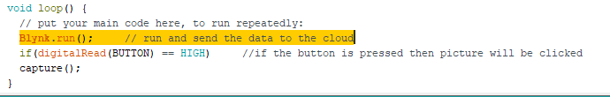
Continued…

Slide 11
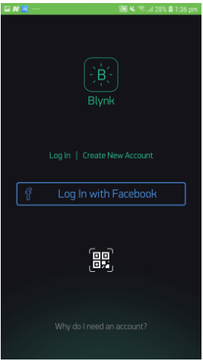
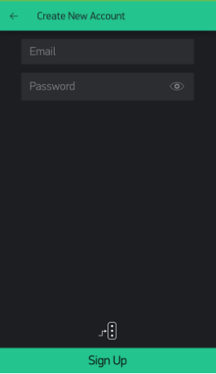
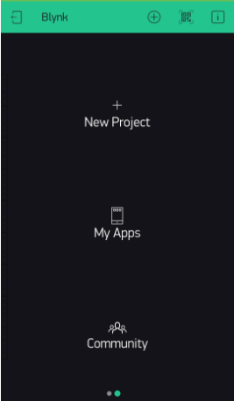
Steps to start up Blynk…

Slide 12
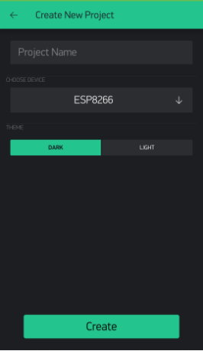
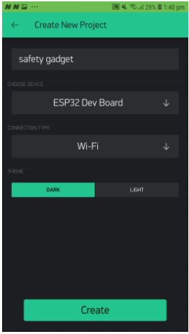
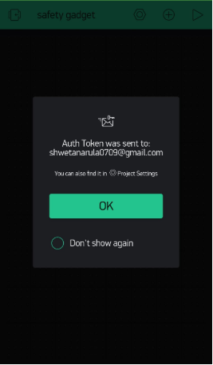
Continued…

Slide 13
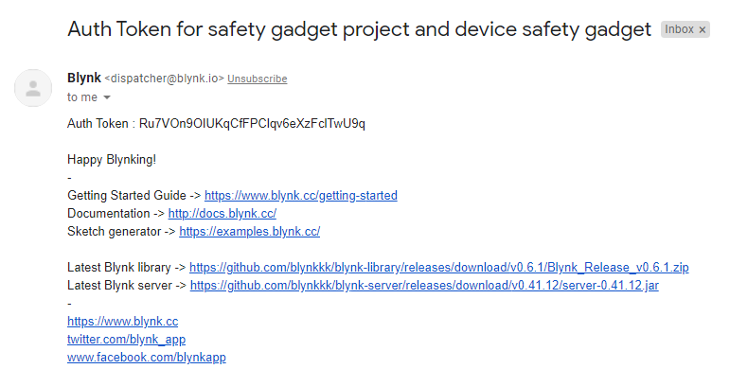
Authentication Code sent to email

Slide 14
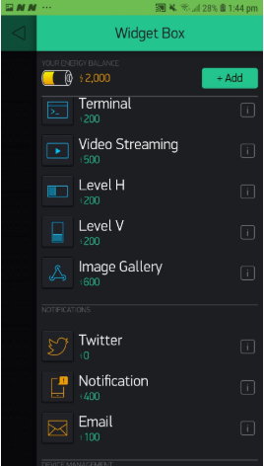
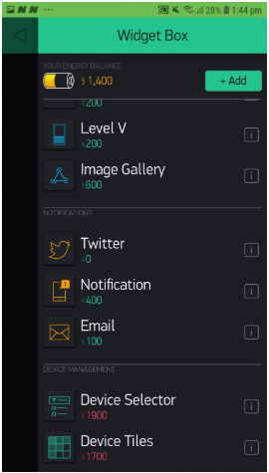
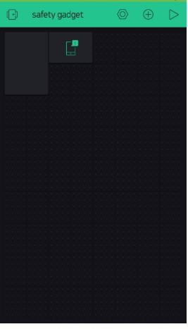
Continued…

Slide 15
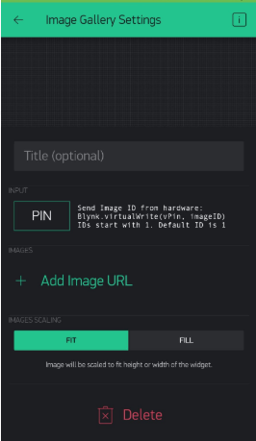
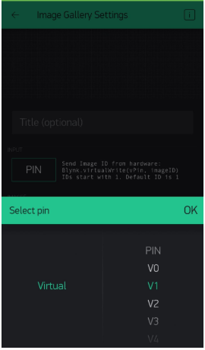
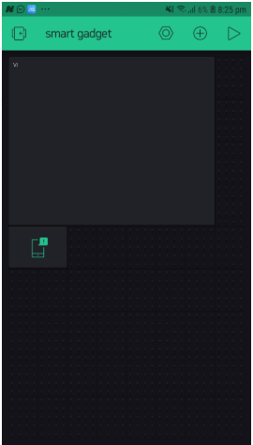
Continued…

Slide 16
References
Blynk Help Center--Getting Started http://help.blynk.cc/en/articles/511642-getting-started
Techiesms[2020]-Smart Door Bell using Blynk ESPEYE https://github.com/techiesms/Smart_Door_Bell_using_Blynk-ESPEYE/blob/master/Smart_Door_Bell_using_Blynk_ESPEYE/Smart_Door_Bell_using_Blynk_ESPEYE.ino
Techiesms[2020]-Smart Door Bell using ESP32 Cam/ESP-Eye & Blink https://www.youtube.com/watch?v=gV3Pr2VrkFg

