Slide 1

IOT Based Smart Wearable Gadget
Group 7:
Shweta(747925)

Slide 2
Task
Interfacing of Pulse Rate Sensor with LPC2148

Slide 3
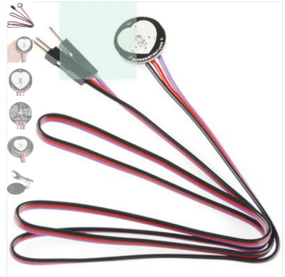
Introduction
In panic situation, Pulse Rate is higher than normal
A value is set as threshold
When pulse rate goes higher than that ,Device get enabled automatically.

Slide 4
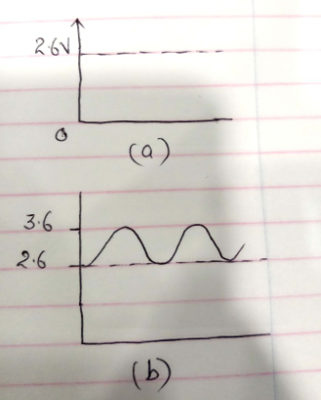
Concepts used…..
Normally when pulse is not there,means not attached to body ,this sensor gives DC value of around 2.6V
When attached It goes upto around 3.6 and low continuously.

Slide 5

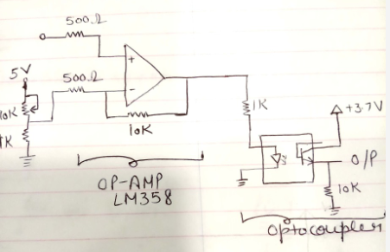
Continued……
Here op-amp is used as differential amplifier .It gives output as series of pulses having high voltage as 3.7 and low as around 0.6 v.
To bring it more accurate an optocoupler is used to get a square wave of 3.7 voltage and low voltage as 0.

Slide 6
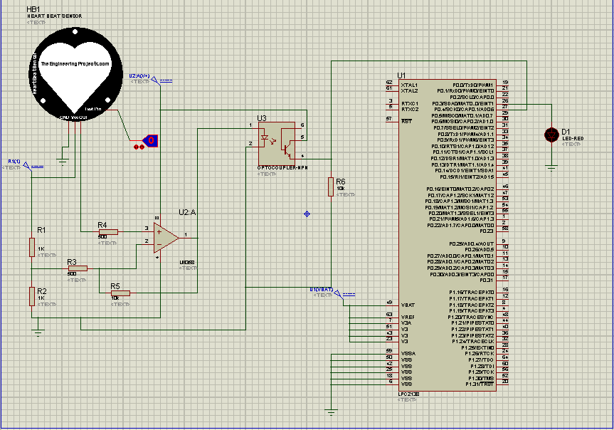
Schematic Diagram

Slide 7

Important Registers
T0IR(Timer 0 Interrupt Register)
8-Bit Read Write
If Interrupt generated, Corresponding bit will be high

Slide 8
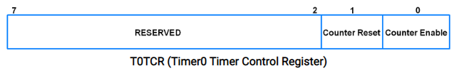
Continued..
T0TCR(Timer0 Timer Control Register)
8- bit Read-Write Register
Control the operation of Timer Counter

Slide 9
Continued…
TOCR0-T0CR3
32 Bit Read Only Register
1 Pin-1 Capture Register
Loaded with TC value on Specific Event
CCR decides Whether This function is active and on which event it will take place

Slide 10
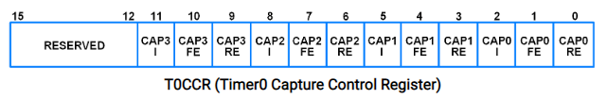
CoNtinued
T0CCR (Timer0 Capture Control Register)
Bit0- Capture on Rising Edge
TC value will be loaded to capture register
Bit1- Capture on Falling Edge
Bit2-Interrupt on Capture

Slide 11
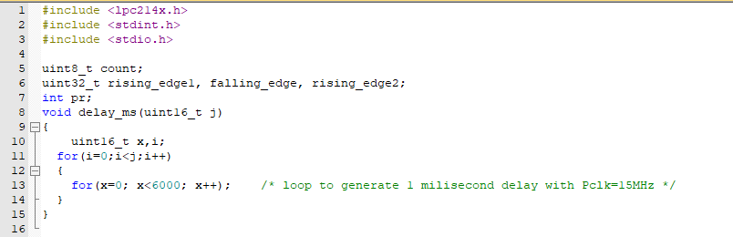
Coding

Slide 12
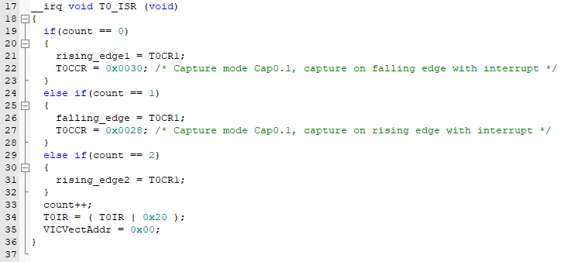
Continued….

Slide 13
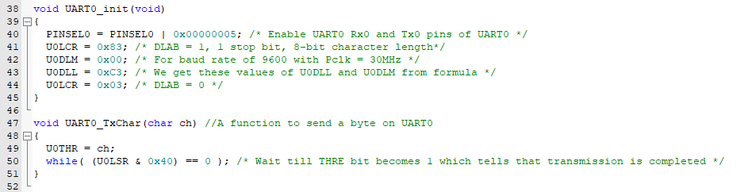
Continued

Slide 14
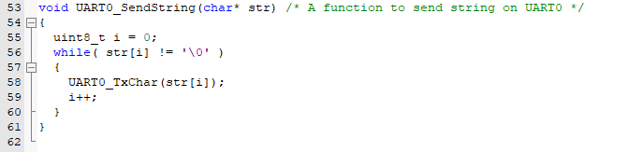

Slide 15
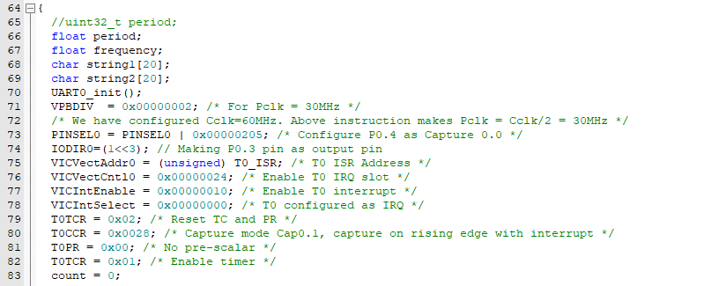
Continued

Slide 16
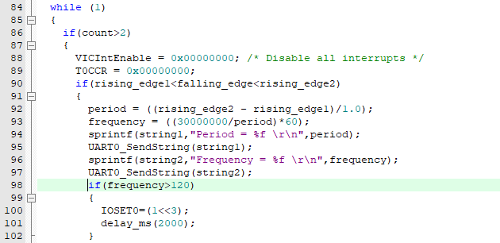
Continued

Slide 17
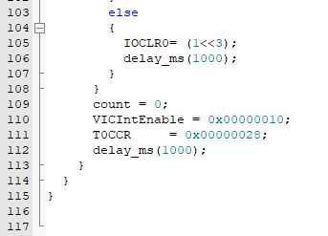
Continued

Slide 18
References
Electronic Wings(2019),LPC2148 Timer Input Capture Mode, https://www.electronicwings.com/arm7/lpc2148-timer-input-capture-mode
Electronics123(2018),LM358(OPAMP), http://www.electronics123.net/amazon/projects/LM358_op_amp.pdf
Components101(2018),MCT2E-Phototransistor Optocoupler IC
https://components101.com/ics/mct2e-phototransistor-optocoupler-ic#:~:text=MCT2E%20is%20a%20phototransistor%20Optocoupler,based%20on%20light%20(photon).&text=This%20IC%20is%20used%20to,the%20other%20to%20Photo%2Dtransistor.

