Slide 1
IOT Based Smart Wearable Gadget
Submitted By:
Group 7
Shweta(747925)

Slide 2
TASK
INTERFACING OF GPS MODULE WITH LPC2148

Slide 3


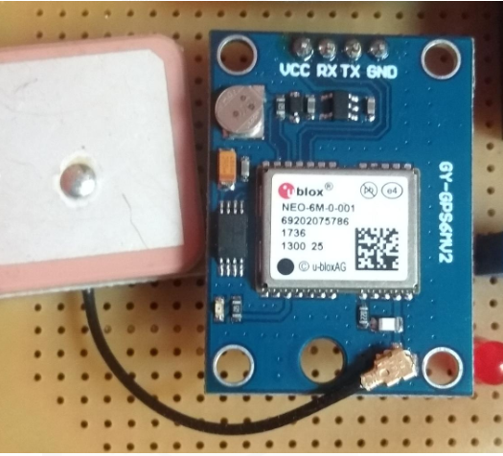
Introduction
Once device gets enabled, Live Location of person is sent to preregistered contacts.
GPS(Global Positioning Satellite) receiver provide information related to location of person which is very beneficial.
With signals from satellites(3 or more),it can determine 2D position on Ground
And if get signals from 4 or more satellites , it can provide 3D position(Latitude, Longitude and Elevation)

Slide 4
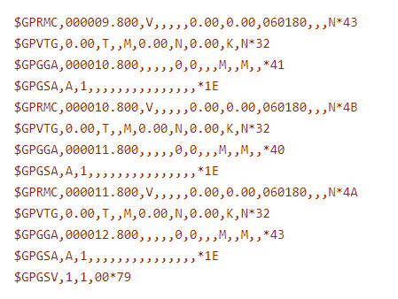
GPS Data Format
Normally , output is shown as:-
If contents missing b/w commas, that means signal is not proper
Such sentences are called NMEA ,Which has different types.
And the information we look for is available in $ GPRMC or $GNRMC Sentence

Slide 5
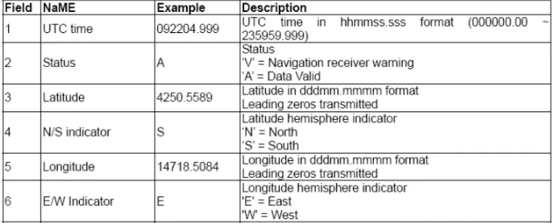
Explanation of Fields
With proper signal , data is like:

Slide 6
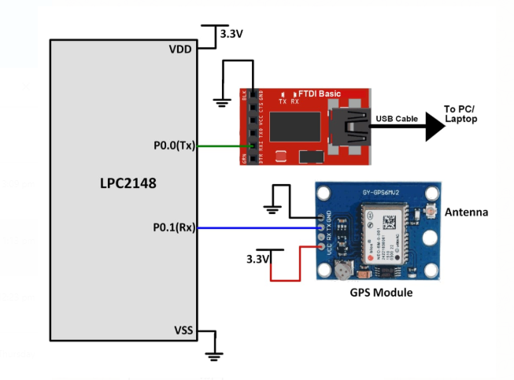
Interfacing

Slide 7
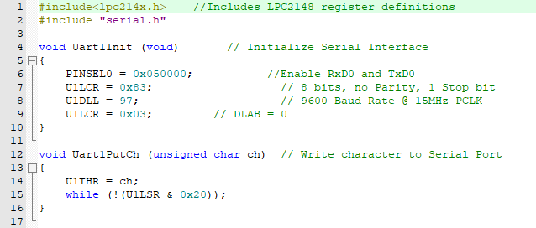
IMPORTANT FILE FOR CODING(serial.c)

Slide 8
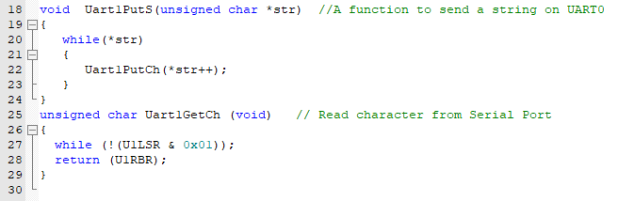
Continued…

Slide 9
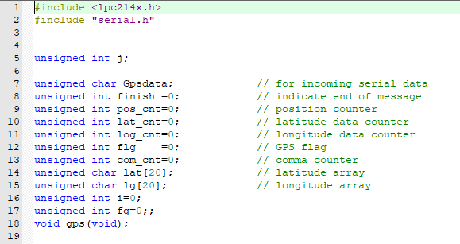
Main File for coding(main.c)

Slide 10
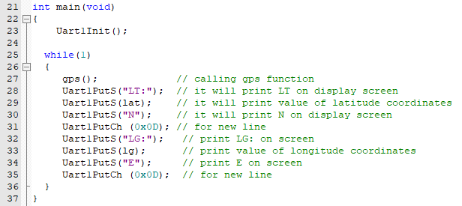
Continued…..

Slide 11
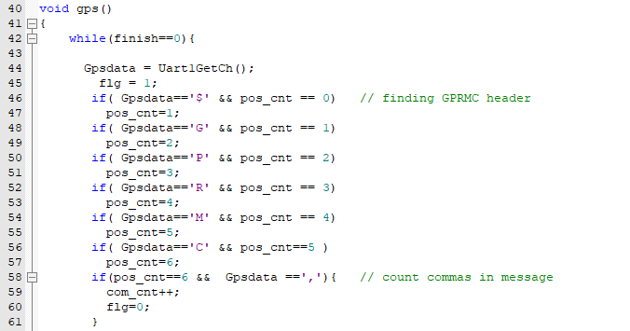
Continued….

Slide 12
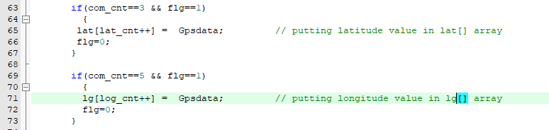
Continued…..

Slide 13
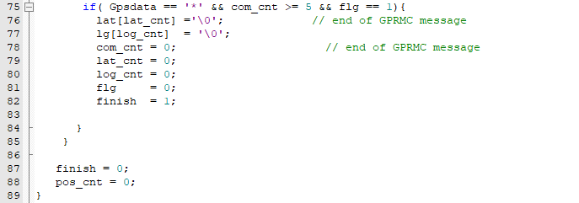
Continued……

Slide 14
References
EmbeTronicX,LPC2148-GPS Interfacing https://embetronicx.com/tutorials/microcontrollers/lpc2148/gps-interfacing-with-lpc2148/
WikiNote[2020], GPS Module Interfacing
https://www.wikinote.org/mod/page/view.php?id=374
Elprocus,ARM7 Based (LPC2148) Microcontroller Pin Configuration
https://www.elprocus.com/arm7-based-lpc2148-microcontroller-pin-configuration/

