Slide 1

Analysis of Hardware Components
Group-7
Ronakkumar Sharma(747019)

Slide 2
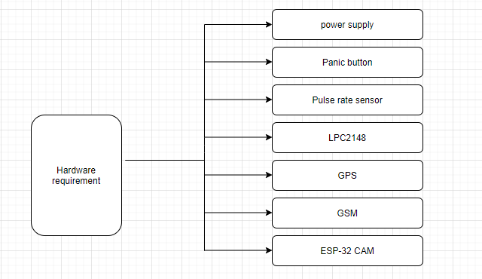
Hardware Requirement

Slide 3
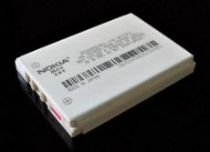
Lithium Ion battery
Easily rechargeable
Low weight
Long lifespan
Power management
Low maintenance

Slide 4
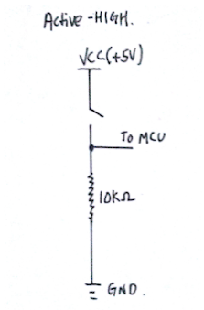
Panic Button
Specifications
Active high Button
Pull Down Resistor is used with it
Two terminals-one connected to power supply and another to GPIO pin of LPC2148

Slide 5
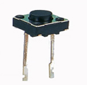
Requirement in Project
When pressed ,MCU will be connected to Vcc.
MCU will get enabled.
When pressed ,pin gets 1 otherwise 0.

Slide 6
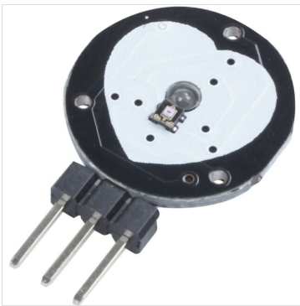
Pulse Rate Sensor
It measures the beats per minute
Uses Optical LED Light source and an LED Light sensor
Voltage Required-3 To 5 V
3 Pins—one is connected to ADC pin of LPC2148,One to Vcc ,one to ground

Slide 7
Requirement in Project
Its high value indicates panic situation.
A value is set as threshold ,when the output of sensor meets that value ,the device gets enabled.
Pulse Rate is also sent along with message

Slide 8
LPC2148
Specifications
32- bit RISC ARM7TDMI-S Processor
40 KB of on-Chip Static RAM
512 KB of on-Chip flash program memory
High Speed 60 MHz operation
Two 10 –bit A/D Convertors(AD0 and AD1)
Single 10-bit D/A Convertor
CPU operating Voltage Range-3.0 to 3.6V

Slide 9
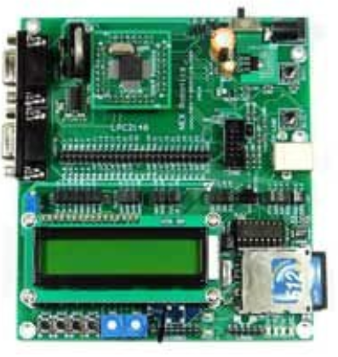
Image of LPC2148

Slide 10
Requirement in Project
The main component
Takes input from Panic button and Pulse Rate Sensor.
Transmits the information regarding location and alert message through GSM
Enables ESP32 during Emergency to take the picture and send it to cloud

Slide 11
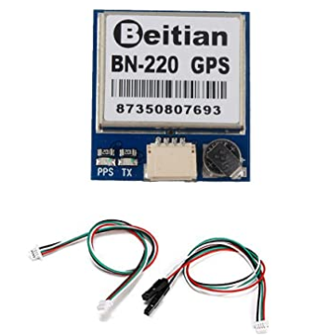
Beitian BN-220 GPS module
Power consumption is between 3V-5V.
Data rate is considered from 4800bps to
9216000bps.
Pins : VCC,TX input, RX output, GND

Slide 12
More suitable for
Trace the location of a person with help of GPS co-ordinates. In the case of emergency GPS co-ordinates are sent with alert message to the stored contact numbers.

Slide 13
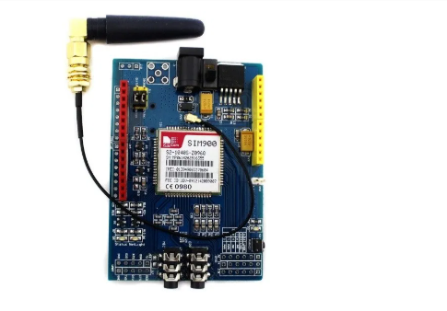
SIM900 GSM module
12 general purpose input /output pins.
Supports UART interfacing.
It can work as per AT commands.
For calling predefined number,
microphone well as headphone
jack is available.

Slide 14
More suitable for
One can transmit or receive messages.
It is helpful to make phone calls.

Slide 15
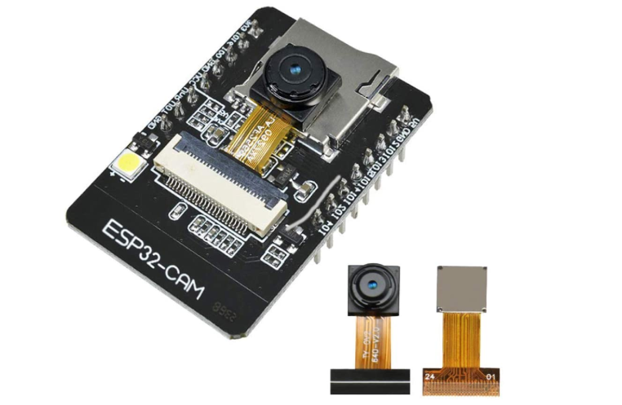
ESP-32 CAM
Specifications:
Smart small camera which is considerable for
IOT applications.
32 bit CPU which work on 240Mhz.
Inbuilt 520 Kb SRAM
I2C,SPI,UART,PWM,ADC,DAC are supported
with this module.
Multiple sleep modes.

Slide 16
More suitable for
Best use for Industrial wireless control, smart Home appliances, Surveillance purposes.
Pictures of victim can be taken with this module which will be stored on Cloud.

Slide 17
Reference
Amazon.(2020). ESP32-CAM Camera WiFi + Bluetooth Module 4M PSRAM Dual-core 32-bit CPU Development Board with OV2640 2MP Camera Module Support Image WiFi Upload. https://www.amazon.ca/dp/B07WTBTKDM/ref=pe_3034960_233709270_TE_item
Random NERD tutorial.(2020). SIM 900 GSM module.
https://randomnerdtutorials.com/sim900-gsm-gprs-shield-arduino/

Slide 18
Amazon.(2020). Beitian BN-220 Dual GPS Glonass Module Navigation TTL Level 9600bps + GPS Passive Antenna for Arduino Raspberry Pi Pixhawk F3 CC3D Betaflight F4 Flight Control Geekstory.
https://www.amazon.ca/dp/B07PRDY6DS/ref=pe_3034960_233709270_TE_item
B.H.(2020). LP-E12 Lithium-Ion Battery Pack (7.4V, 800mAh).
https://www.bhphotovideo.com/c/product/908219-REG/watson_b_1537_replacement_battery_pack_for.html
.

Slide 19
Continued….
Elprocus,ARM7 based LPC2148 Microcontroller Pin Configuration
https://www.elprocus.com/arm7-based-lpc2148-microcontroller-pin-configuration/
Vinctronics,Active High Versus Active Low Button
http://vinduino.blogspot.com/2013/07/active-high-vs-active-low-button.html#:~:text=Active%2DHIGH%20button%20means%20that,be%20directly%20connected%20to%20VCC.

Slide 20
Continued…
Instructables circuits,Pulse sensor with Arduino Tutorials
https://www.instructables.com/id/Pulse-Sensor-With-Arduino-Tutorial/

