Slide 1

IOT based Smart wearable safety gadget
Group-7
Ronakkumar Sharma(747019)

Slide 2
Installing micro vision keil and Porting with RTOS

Slide 3
Software Requirement
1. Keil IDE for ARM
2. FreeRTOS exe File
3. FreeRTOSConfig.h
4. Startup.s

Slide 4
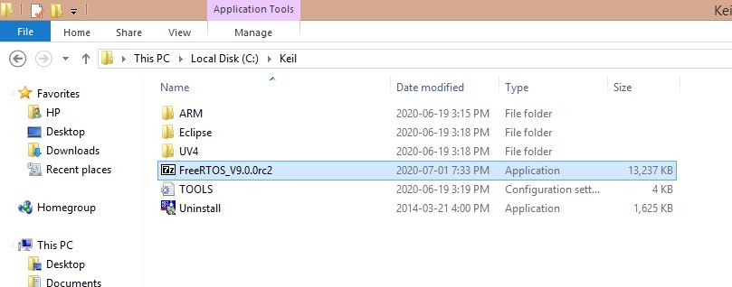
Installations is done with these two required steps:
Firstly, FreeRTOS exe is extracted to the C:\Keil\

Slide 5
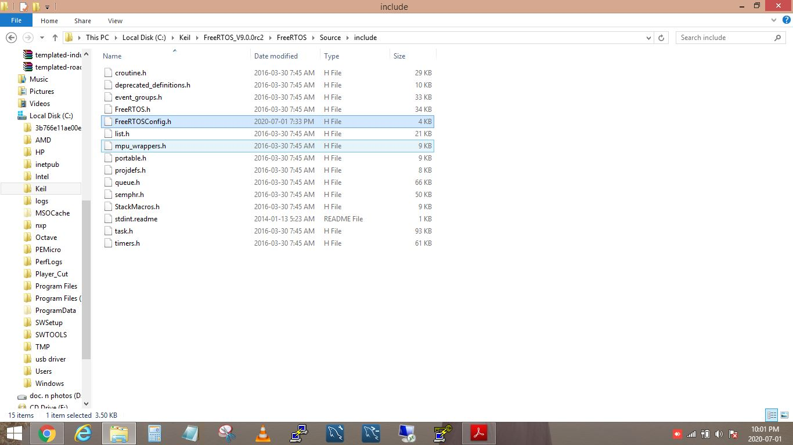
2. Then FreeRTOSConfig.h file is pasted in include folder of source in FreeRTOS folder.

Slide 6
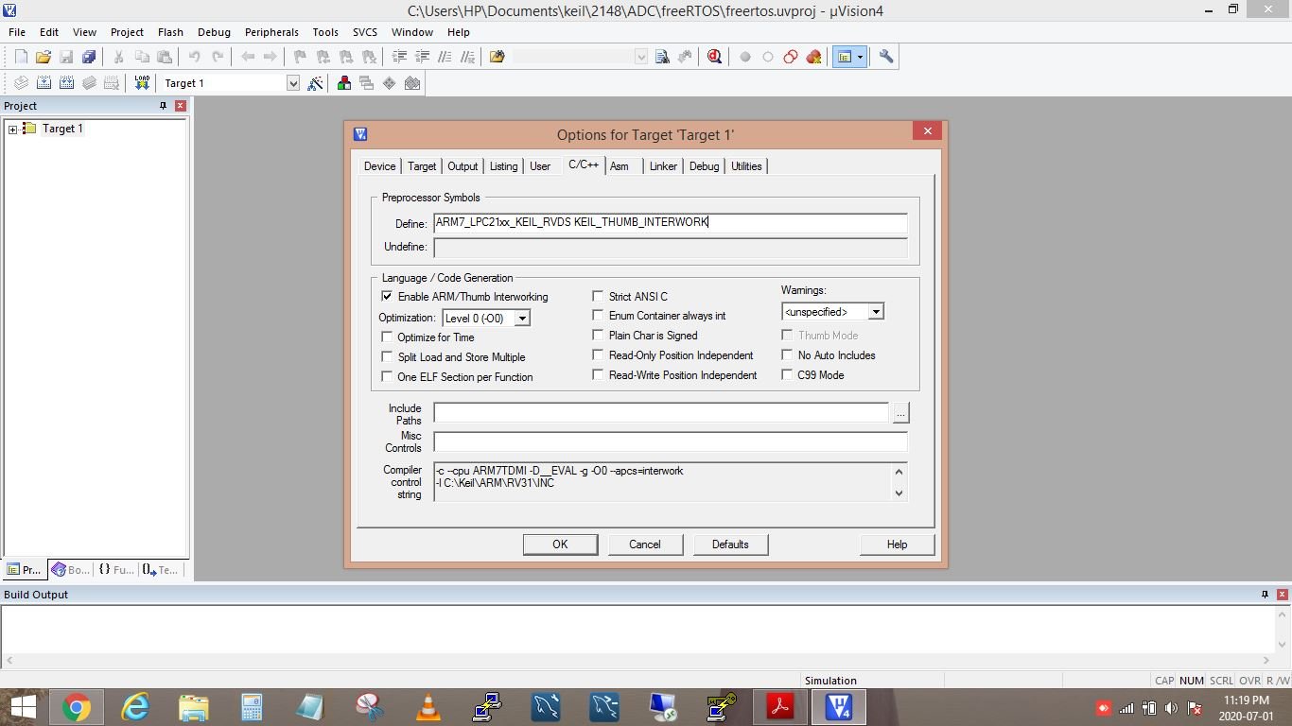
Open keil4uvision ,click on new in which new project is created, then click on the options icon, for Target ‘Target 1’.
Click on Define and type the required context below.
ARM7_LPC21xx_KEIL_RVDSKEIL_THUMB_INTERWORK

Slide 7
Then add paths in include paths as following.
C:\Keil\FreeRTOS_V9.0.0rc2\FreeRTOS\Demo\Common\include
C:\Keil\FreeRTOS_V9.0.0rc2\FreeRTOS\Source\portable\RVDS\ARM7_LPC21xx
C:\Keil\FreeRTOS_V9.0.0rc2\FreeRTOS\Source\include

Slide 8
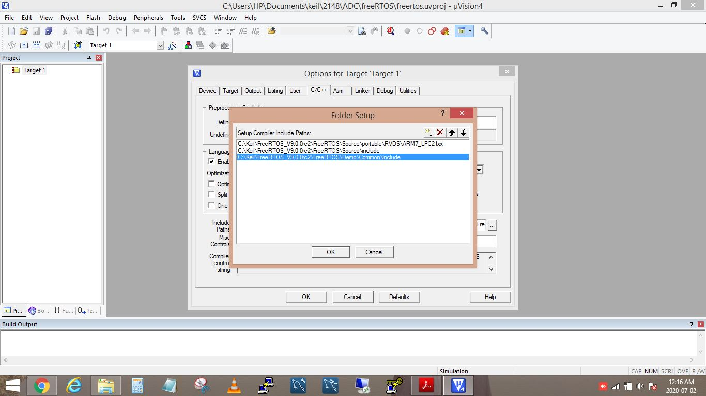

Slide 9
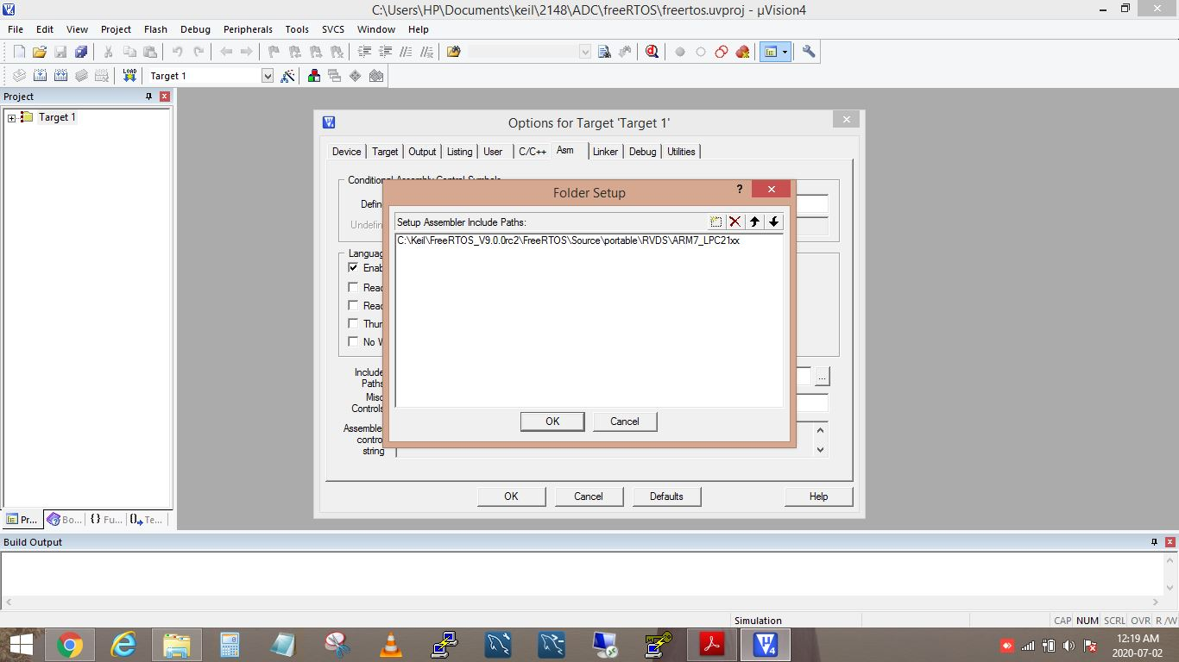
Then click Asm and in include paths paste the path as mentioned below:
C:\Keil\FreeRTOS_V9.0.0rc2\FreeRTOS\Source\portable\RVDS\ARM7_LPC21xx

Slide 10
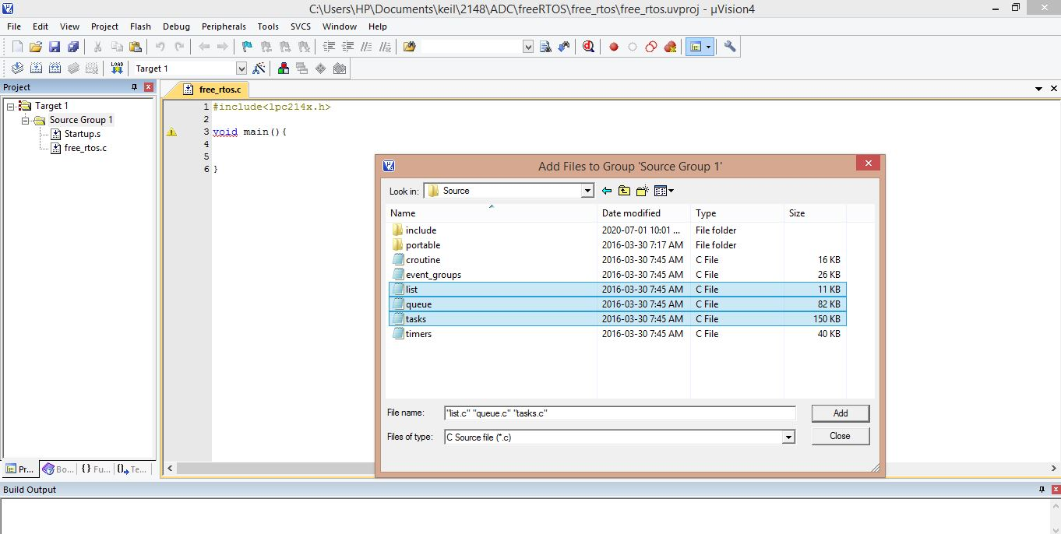
After that following files are added to the project from C:\Keil\FreeRTOS_V9.0.0rc2\FreeRTOS\Source
1.Task.c 2. List.c 3. Queue.c

Slide 11
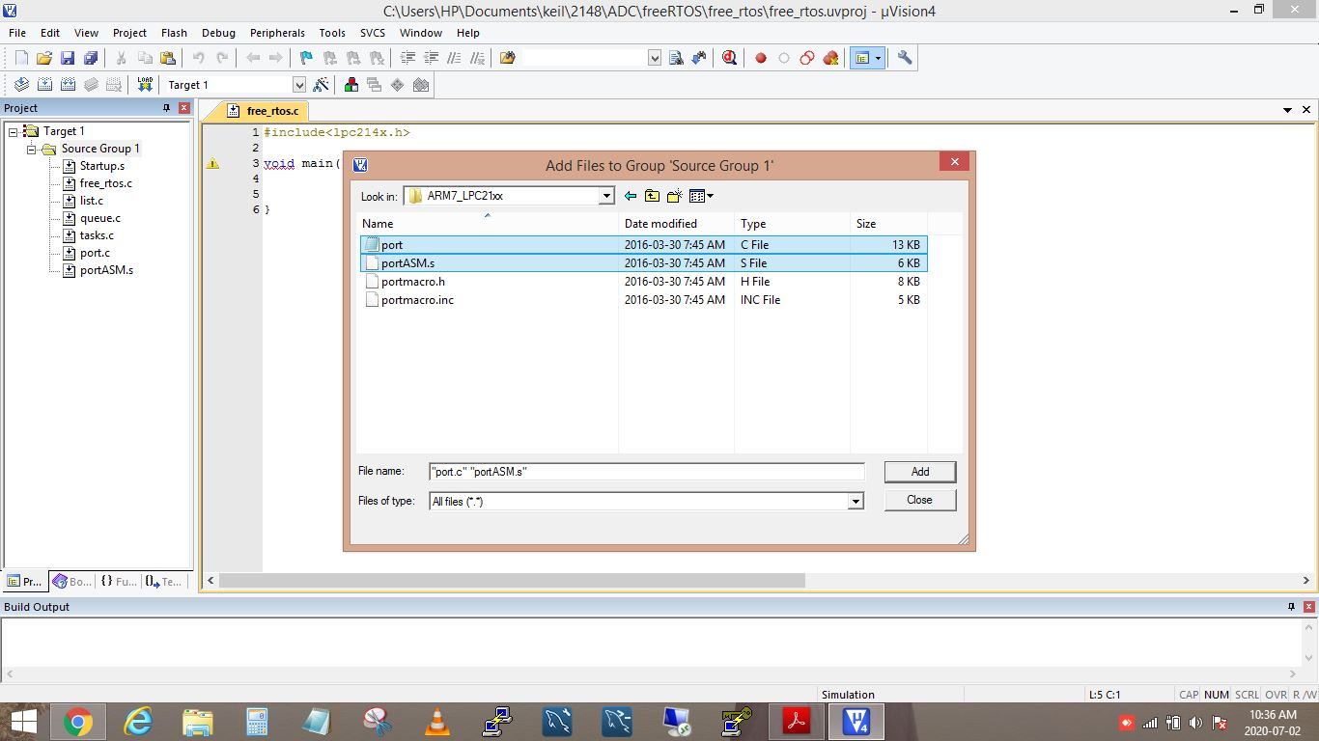
Then add following files to the project from
C:\keil\FreeRTOS_V9.0.0rc2\FreeRTOS\Source\portable\RVDS\ARM7_LPC21xx
1. Port.c 2. portASM.S ( when we select “all files” in file type only then the file “portASM.S” appears).

Slide 12
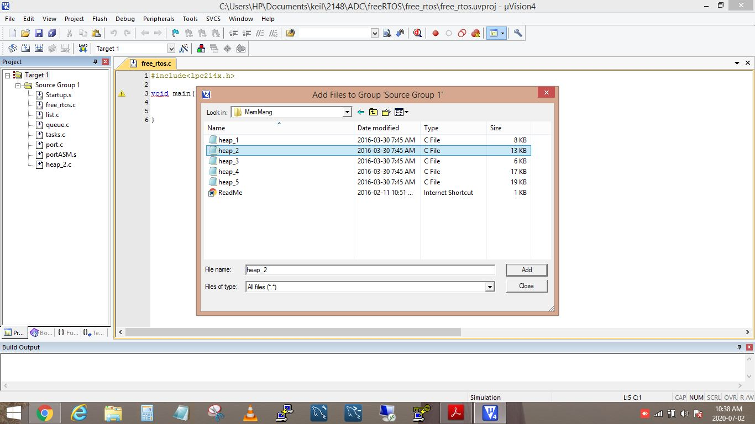
Then add following file from
C:\keil\FreeRTOS\FreeRTOS_V9.0.0rc2\FreeRtos\portable\memmang
1. heap_2.c

Slide 13
Final step. The whole content in downloaded startup.s file is copied and pasted into the startup file which is attached in the project.

Slide 14
Reference…
Owl(2018),LPC2148-FreeRTOS Porting with Keil IDE https://embetronicx.com/tutorials/rtos/freertos/freertos-porting-for-lpc2148-using-keil/amp/

