Slide 1

Latest technologies in Real-time embedded system
Group-7
Amandeep Kaur(748434)
Shweta (747925)
Ronakkumar Sharma(747019)

Slide 2
Real time embedded system technologies
Operating
System
Connecting cloud service to IOT
Hardware

Slide 3
Microcontrollers
The main component of embedded system is microcontroller.
It is a device which is capable of controlling other portions of electronic system
Many types of microcontrollers are being in use today like beaglebone, Raspberry Pi, LPC series etc.

Slide 4
BeagleBone Black Wireless
Main Features
Processor-1GHz ARM Cortex A8 Processor
Onboard WiFi and Bluetooth
4 GB onboard eMMC memory With Debian Linux preinstalled so can be booted in 10 seconds.
Run OpenCV and Open NI etc. to recognize the objects.

Slide 5
Advantages and Disadvantages
Advantages:
Cost Effective
Enough Processing power for IOT tasks
Consume low power
Disadvantages:
It is not the best for complex multimedia and Linux based Projects.

Slide 6
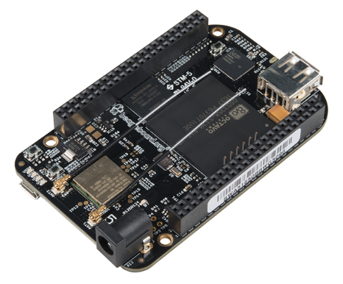
More Suitable for….
Projects that require input from
external sensors, commanding
actuators and networking can be made
more efficiently using a beaglebone black.

Slide 7
Raspberry Pi 4
Main Features:
Quadcore Cortex A-72 (ARM v8) 64-bit Microprocessor
USB –C for power connector –Support an extra 500 mA of current
Offers ability to run 3D application

Slide 8
Advantages & Disadvantages
Advantages:
Faster and more capable than predecessors
Built in WIFI and Bluetooth
Can be booted Directly from USB attached hard drive or pen drive
Disadvantages:
Lack of Internal Storage
Can run Windows Desktop Apps but quality is poor

Slide 9
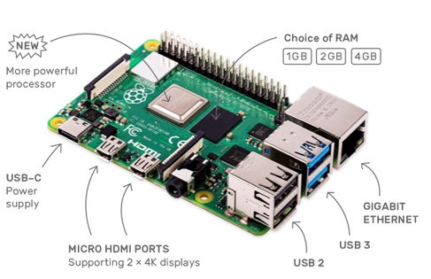
More Suitable for…
Projects like home automation
System, network monitoring tool ,
Raspberry Pi Robot etc.

Slide 10
Free RTOS
Amazon Free RTOS.
Fast in a nature.
Deadline driven approach.
User friendly.
Reusability of code is possible.
Selection of priority is based on the rate monotonic and earliest deadline first.

Slide 11
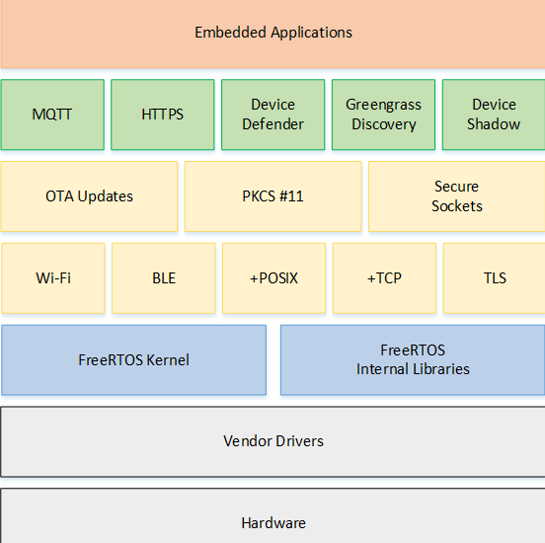
Architecture of FreeRTOS

Slide 12
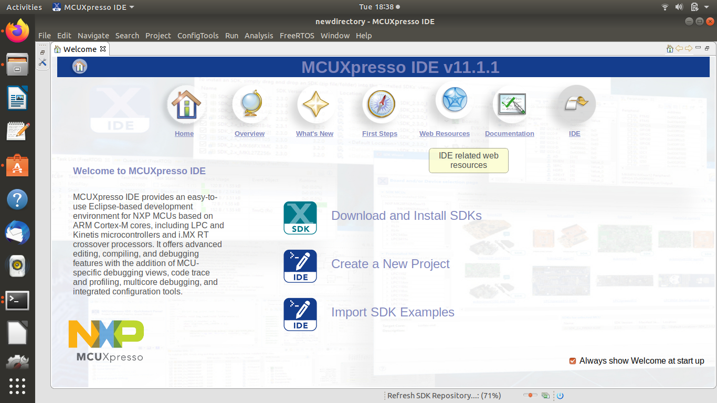
Free RTOS
Hardware platform : LPC family for instance LPC 17969.
Software: Mcuxpresso

Slide 13
LPC 1769
Main Features:
Core-Arm Cortex-M3
70 GPIOs
Ultra power Real time Clock with separate battery supply
Operates at CPU frequency of upto 120 MHz
512 KB Flash Memory

Slide 14
Advantages
Advantages:
Low Power Consumption
Processor has enhanced debug features

Slide 15
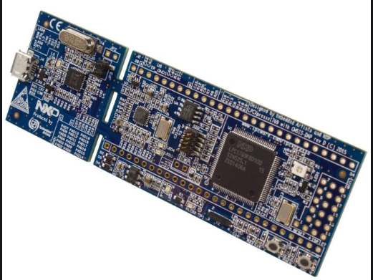
More Suitable for….
Projects like industrial networking,
and those which involve alarm
systems ,motor control etc.

Slide 16
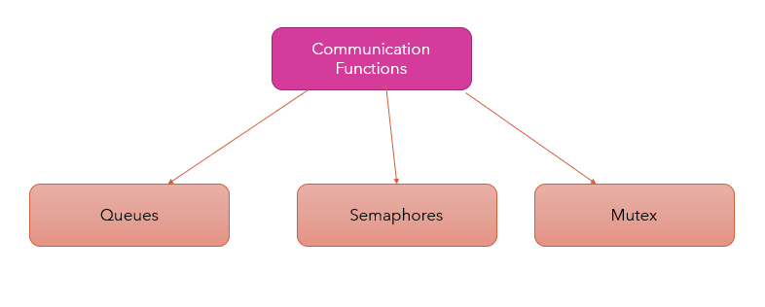

Slide 17
What is Cloud Computing ? :
Cloud computing is a need of the hour as it includes servers, storage, databases, networking, software, analytics , and intelligence – over the Internet services.
Azure and Amazon is earning good amount as one should be payable for their services.

Slide 18
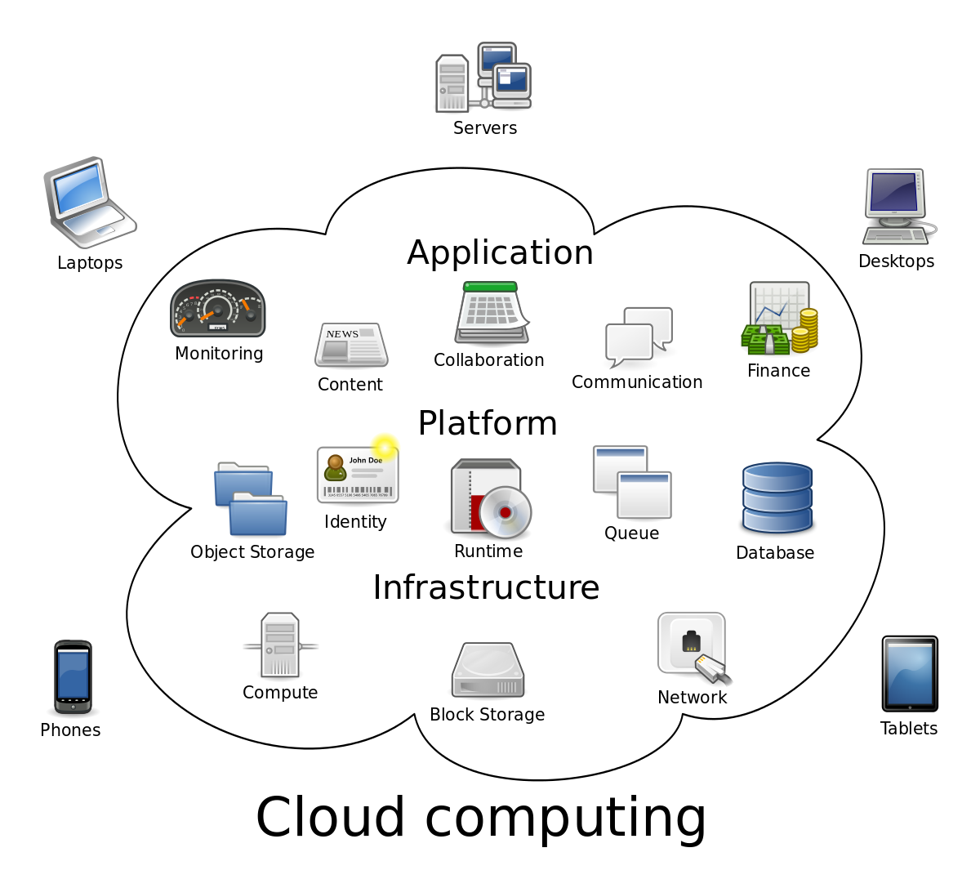
Cloud Computing

Slide 19
Types of cloud storage
Object storage
Block storage
File storage

Slide 20
Connecting IoT Devices to Cloud Services
Number of developers are accountable for distributing the computing between the edge and remote digital devices.
Strong two-way communications is established from the first layer to the last layer of OSI model.

Slide 21
Connecting IoT Devices to Cloud Services
TCP
UDP
HTTP

Slide 22
Reference
Amazon.(2020).Freertos latest user guide . https://docs.aws.amazon.com/freertos/latest/userguide.
Amazon.(2020). What is cloud storage.
https://aws.amazon.com/what-is-cloud-storage/
Mistry.R.(2019) .connecting iot devices to cloud service .embedded computing.
https://www.embedded-computing.com/guest-blogs/connecting-iot-devices-to-cloud-services

Slide 23
Reference
Sparkfun Electronics(2017). BeagleBone Black Wireless https://www.sparkfun.com/products/14162
Berry.R.(2016). Mastering the Free RTOS™ Time Kernel. data.https://freertos.org/Documentation/161204_Mastering_the_FreeRTOS_Real_Time_Kernel-A_Hands-On_Tutorial_Guide.pdf.
Young Wonks Team(2019) .Top 10 IOT Boards for Development and Prototyping in 2020 https://www.youngwonks.com/blog/Top-10-IoT-boards-for-2019
NXP Semiconductor N.V.(2020). LPC1769/68/67/66/65/64/63 https://www.nxp.com/docs/en/data-sheet/LPC1769_68_67_66_65_64_63.pdf

