Slide 1
Crowd monitoring and surveillance system
RONAK SHARMA
C0747019
EMBT TERM 3

Slide 2
INTRODUCTION
Automated process for crowd analysis using cameras.
Using automation to monitor the density in particular places like shopping malls and subway stations etc.
This system estimates the no. of people and generates graphical reports.
This system would assist various agencies to take effective decisions.

Slide 3
Need of the system
Although CCTVs are working well, but they are not fully automated.
FLIR (Forward looking Infrared ) Cameras for monitoring and estimating the density of crowd in real time
Crowd monitoring is needed to measure the density of the group.
It helps to regulate and keep a check on unethical happenings.
Matlab for Image processing.

Slide 4
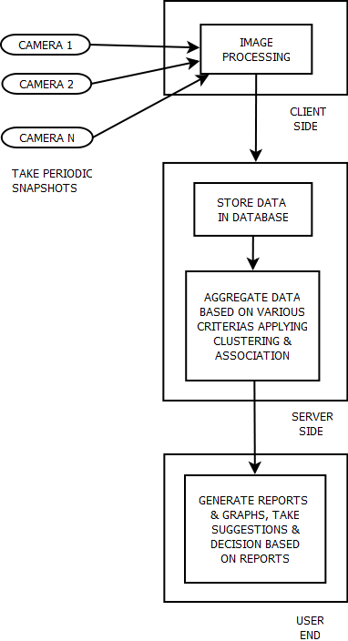
SYSTEM ARCHITECTURE :

Slide 5
Flowchart for the proposal
Input periodic snapshot from CCTV
Extract Foreground
Set Region of Internet
Low density crowd
High density crowd
Background Removal Technology
Pattern Recognization Technology
Combine count of all the regions
DISPLAY & IoT
Estimate the size of crowd
DSP
FIND ALTERNATE SOLUTIONJ

Slide 6
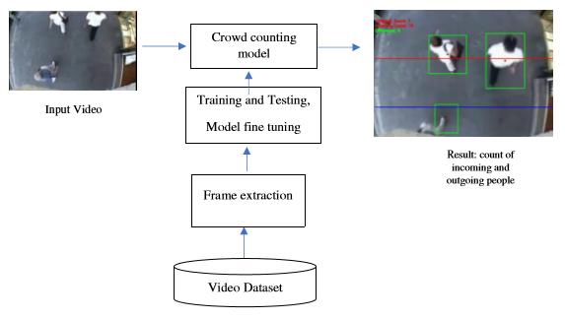
HOW IT ACTUALLY WORKS

Slide 7
TECHNOLOGIES USED
BACKGROUND REMOVAL TECHNOLOGY: It is an image processing system based on pixels, estimates crowd density with no. of forehead pixels. It is effective for small crowd.
PATTERN RECOGNITION TECHNOLOGY: It uses texture analysis for crowd estimation. It overcomes the problem of overlapping. So, it is quite effective when there is high density of people. But, the results are not that promising for less crowd.
INFORMATION FUSION: The Kalman filtering method is used, it makes use of boundary technology and background removal technology.
COMBINATION OF PIXEL AND TEXTURE ANALYSIS: It is most effective because it measures the density using pixel technology and texture analysis. It is the most effective method.

Slide 9
TECHNOLOGIES USED AND MODIFICATIONS: -
BACKGROUND REMOVAL TECHNOLOGY: It is an image processing system based on pixels, estimates crowd density with no. of forehead pixels. It is effective for small crowd.
PATTERN RECOGNITION TECHNOLOGY: It uses texture analysis for crowd estimation. It overcomes the problem of overlapping. So, it is quite effective when there is high density of people. But, the results are not that promising for less crowd.
INFORMATION FUSION: The Kalman filtering method is used, it makes use of boundary technology and background removal technology.
COMBINATION OF PIXEL AND TEXTURE ANALYSIS: It is most effective because it measures the density using pixel technology and texture analysis. It is the most effective method.
MODIFICATION:
In addition we can use one more DSP unit and try to find alternate way or solution to direct crowd in another way,
Using IoT we can connect to a software like Google map to guide people
Using some data analysis we can predict and help to the people for some religious places and some crowd places

Slide 10
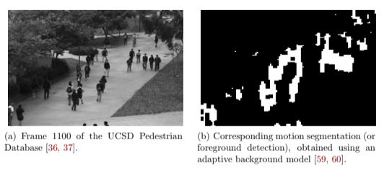
AN EXAMPLE OF THE PRACTICAL WORKING

Slide 11
CONCLUSION
This system will be generic and thus can be used by multiple businesses including shopping malls,
supermarkets, hotels and so on.
It will be able to rival existing surveillance and monitoring systems by providing more in depth details and information to the concerned personnel involved in the running of the institute.
Owners of the shopping store will be able to make fair business decisions using the automated system compared to the existing sys- tem which is prone to human error.
Optimized business strategies can be developed to increase business potential and profits.

Slide 12
REFERENCES
[1] Irshad Ali and Matthew N. Dailey. Multiple human tracking in high density crowds. Computer Science and Information Management Asian Institute of Technology,, 2008. http://www.ijcsit.com/
[2] Ming Jiang, Jingcheng Huang, Xingqi Wang, Jingfan Tang, and Chunming Wu. An approach for crowd density and crowd size estimation. JOURNAL OF SOFTWARE, 2014.
[3] Wei Li, Xiaojuan Wui, Raffaele Cappelli, Koichi Matsumoto, and Hua-An Zhao. Crowd density estimation: An improved approach IEEE, 2010.

