Slide 1
Software Architecture
RONAK SHARMA
C0747019
EMBT TERM 3

Slide 2
What is software architecture
When people in the software industry talk about “architecture”, they refer to a hazily defined notion of the most important aspects of the internal design of a software system. A good architecture is important, otherwise it becomes slower and more expensive to add new capabilities in the future.
People in the software world have long argued about a definition of architecture. For some it's something like the fundamental organization of a system, or the way the highest level components are wired together.
Architecture is a tricky subject for the customers and users of software products - as it isn't something they immediately perceive. But a poor architecture is a major contributor to the growth of cruft - elements of the software that impede the ability of developers to understand the software.

Slide 3
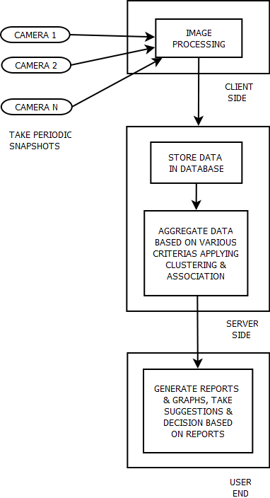
SYSTEM ARCHITECTURE :

Slide 4
Flowchart for the proposal
Input periodic snapshot from CCTV
Extract Foreground
Set Region of Internet
Low density crowd
High density crowd
Background Removal Technology
Pattern Recognization Technology
Combine count of all the regions
DISPLAY & IoT
Estimate the size of crowd
DSP
FIND ALTERNATE SOLUTIONJ

Slide 5
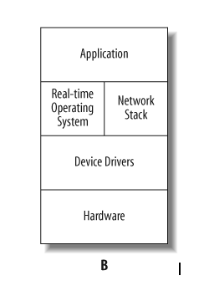
Basic EMBEDDED SOFTWARE ARCHITECTURE:-
Nanonets
to drive cameras API : GPIO + I2C+
INPUT devices SPI Interface output devices
DSP
DVR or NVR
IoT & N/W
Beagle Bone Black
Cam 1
Cam 2
Cam N
Display 1
Display 2

Slide 6
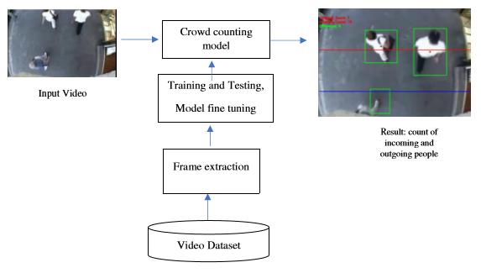
HOW IT ACTUALLY WORKS

Slide 7
REFERENCES
https://martinfowler.com/architecture/
https://nanonets.com/blog/crowd-counting-review/#crowd-counting-with-nanonets
https://app.nanonets.com/#/
https://github.com/beagleboard/cloud9-examples

