Slide 1
Bluestock Mutual Fund Analytics
Capstone Project Presentation
Objective: Analyze mutual fund performance, investor behavior, risk metrics and market trends

Slide 2
Problem & Objectives
Problem: Mutual fund datasets contain large volumes of NAV, transaction and performance data.
Objectives:
• Build data cleaning and ETL pipeline
• Analyze fund performance and risk
• Understand investor behavior
• Create interactive dashboard

Slide 3
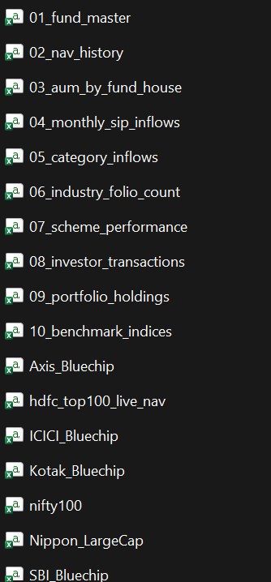
Data Sources

Slide 4
Data Architecture & ETL Design
Pipeline:
Raw CSV Files
↓
Python Cleaning & Validation Scripts
↓
Processed Datasets
↓
SQLite Analytical Database
↓
Power BI Dashboard
.

Slide 5
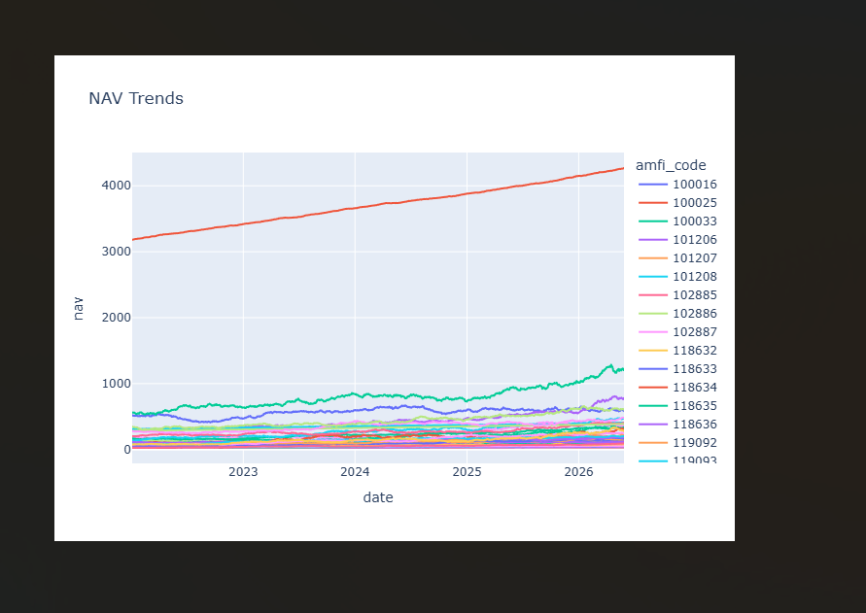
EDA Highlights - NAV & SIP Trends
Analysis performed:
• Daily NAV trend analysis for mutual fund schemes
• SIP inflow trend analysis
• Market movement observation
nav_trend.png

Slide 6
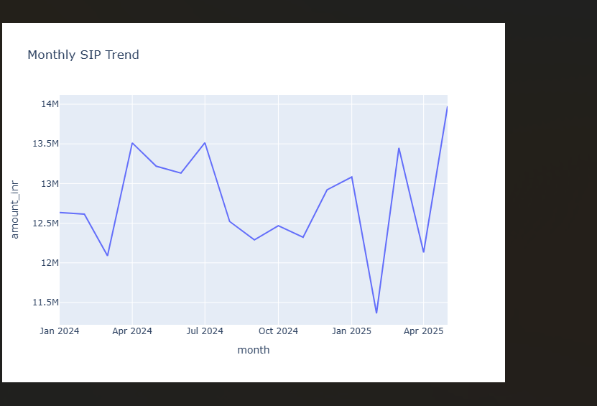
EDA Highlights - NAV & SIP Trends
sip_trend.png

Slide 7
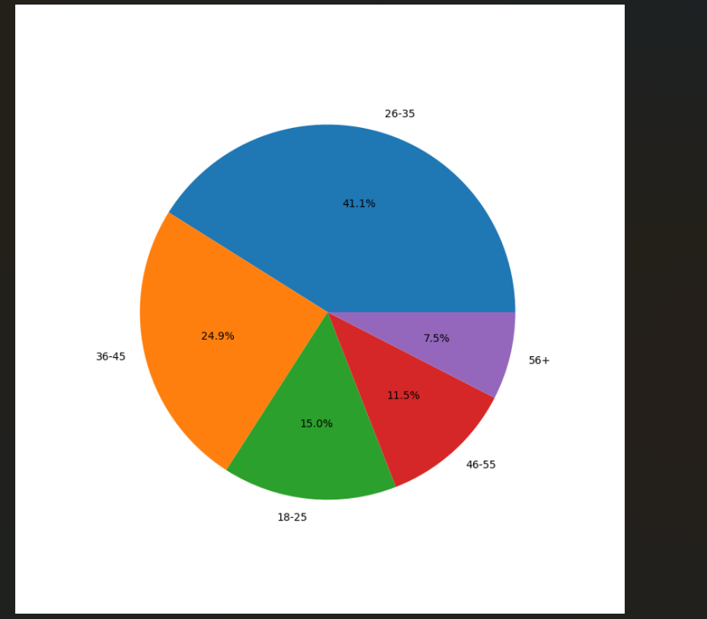
EDA Highlights - Investor Analytics
Analyzed:
• Investor age distribution
.

Slide 8
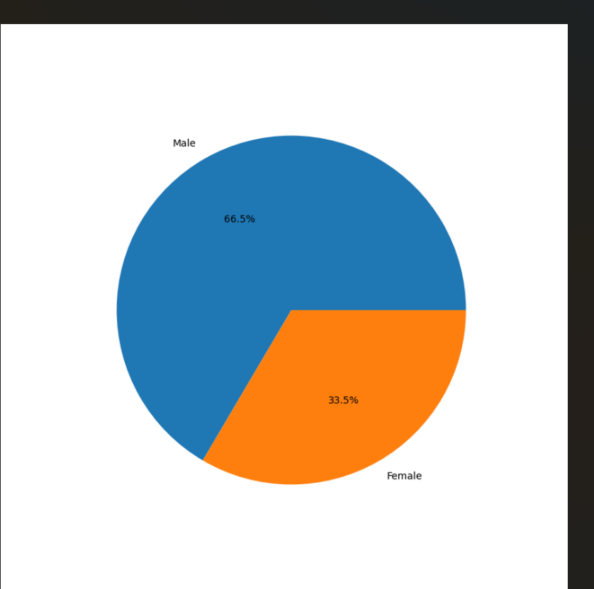
EDA Highlights - Investor Analytics
Gender split
.

Slide 9
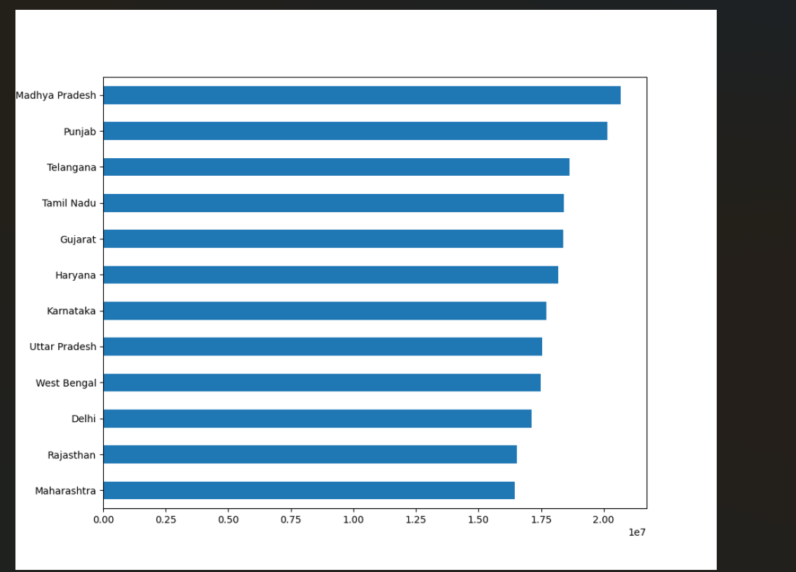
EDA Highlights - Investor Analytics
State-wise investment patterns
.

Slide 10
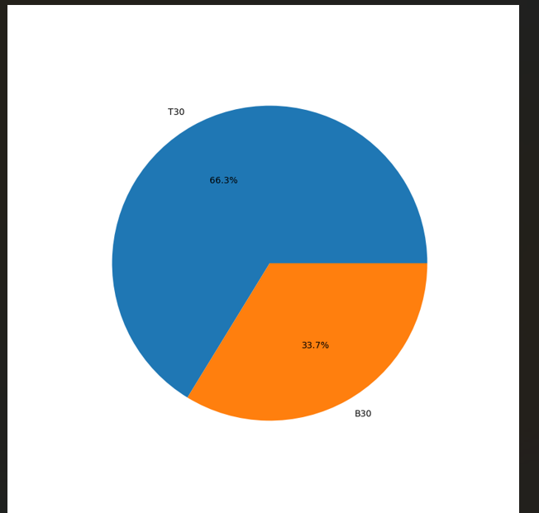
EDA Highlights - Investor Analytics
City tier analysis
.

Slide 11
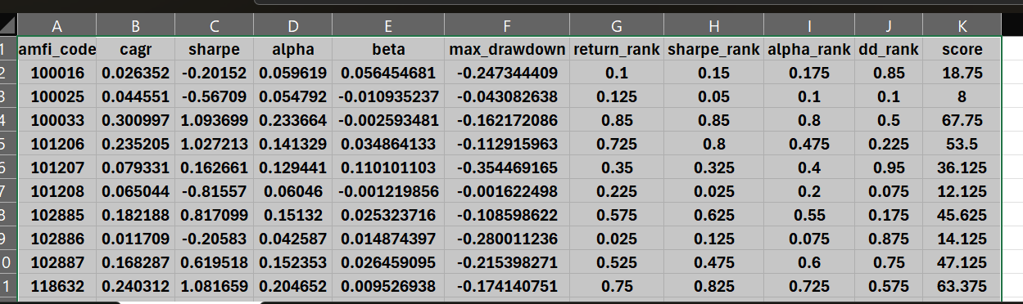
Performance Metrics - Returns & Risk
Computed:
• Daily returns
• CAGR (1Y/3Y/5Y)
• Sharpe Ratio
• Sortino Ratio
• Maximum Drawdown

Slide 12
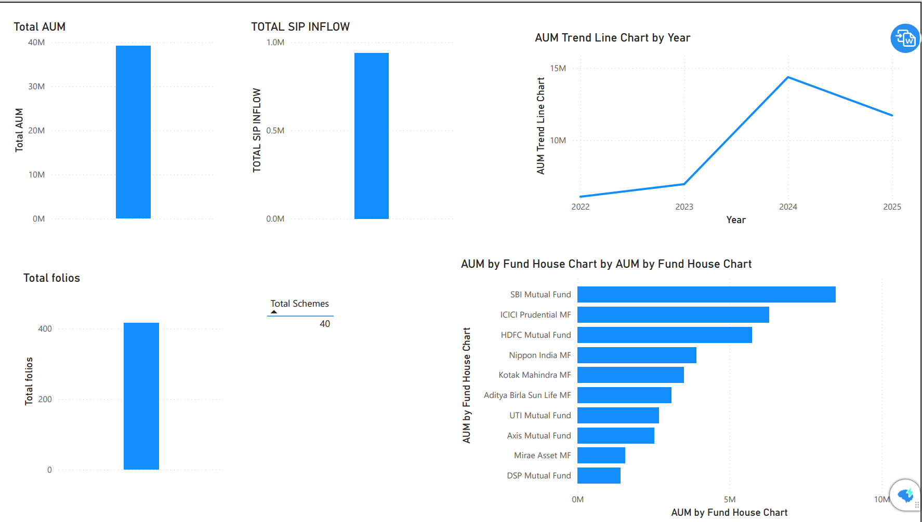
Power BI Dashboard - Industry Overview
Dashboard Page 1:
• Total AUM KPI
• SIP inflows KPI
• Folio growth
• Scheme count
• AMC-wise AUM chart

Slide 13
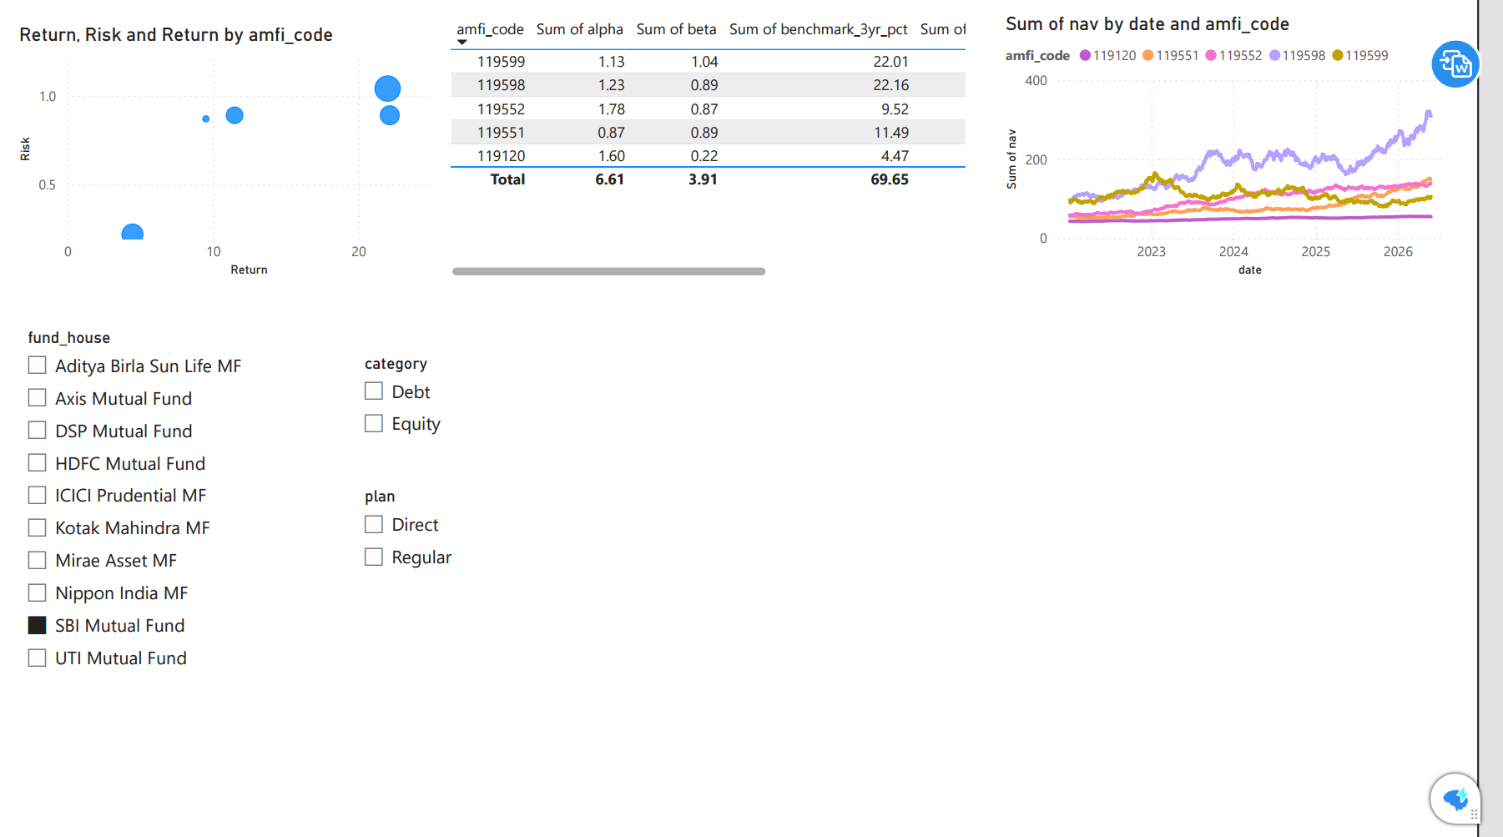
Power BI Dashboard - Fund & Investor Analytics
:
• Fund performance comparison

Slide 14
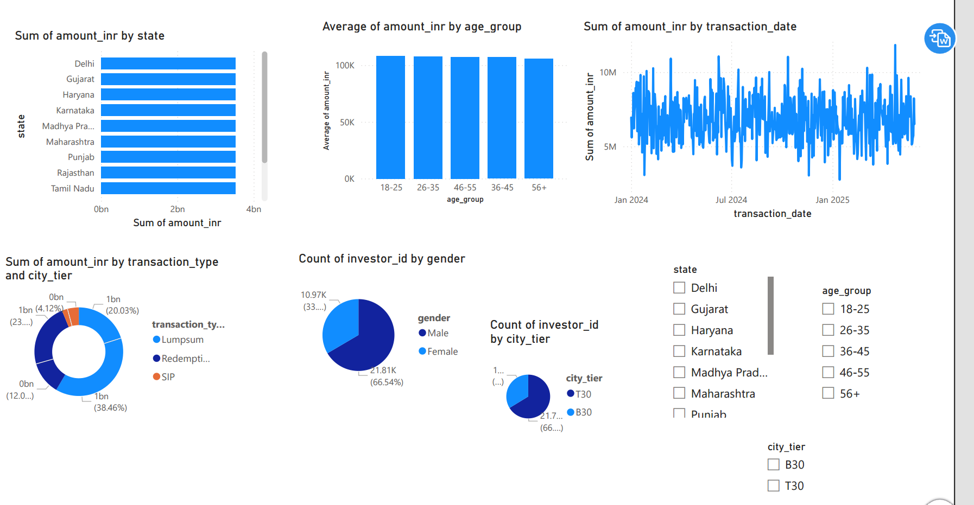
Power BI Dashboard - Fund & Investor Analytics
:
• Investor transaction analysis

Slide 15
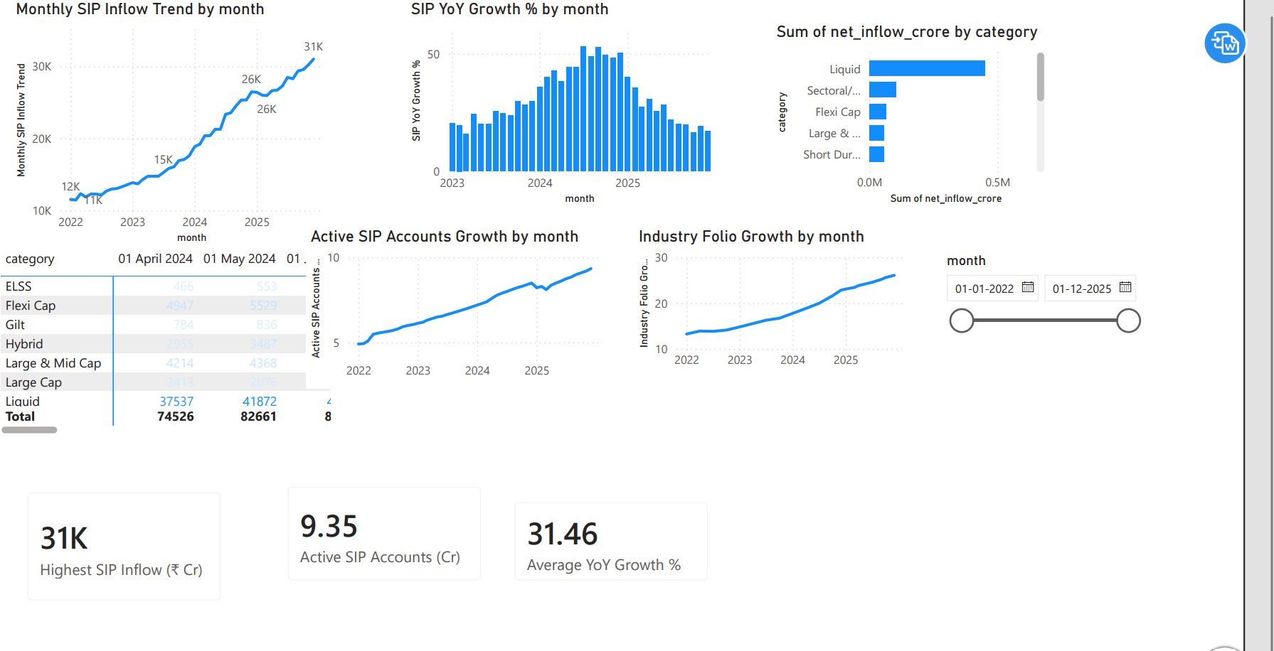
Power BI Dashboard - Fund & Investor Analytics
:
• Sip and market trends

Slide 16
Key Findings & Recommendations
Key Findings:
• Risk-adjusted metrics provide better comparison than returns alone
• SIP behavior indicates long-term investor participation
• Portfolio diversification reduces concentration risk
Recommendations:
• Evaluate Sharpe, Alpha and Drawdown before investment decisions
• Maintain diversified portfolios

Slide 17
Thank You
Bluestock Mutual Fund Analytics
Name: Shivani Sharma
https://github.com/sharmashivi19/mutual-fund-analytics

