Slide 1
TELECOM CUSTOMER CHURN PREDICTION

Slide 2
TELECOM CUSTOMER CHURN
Telecom customer churn refers to the rate at which subscribers or users discontinue or terminate their services with a telecommunication provider.

Slide 3
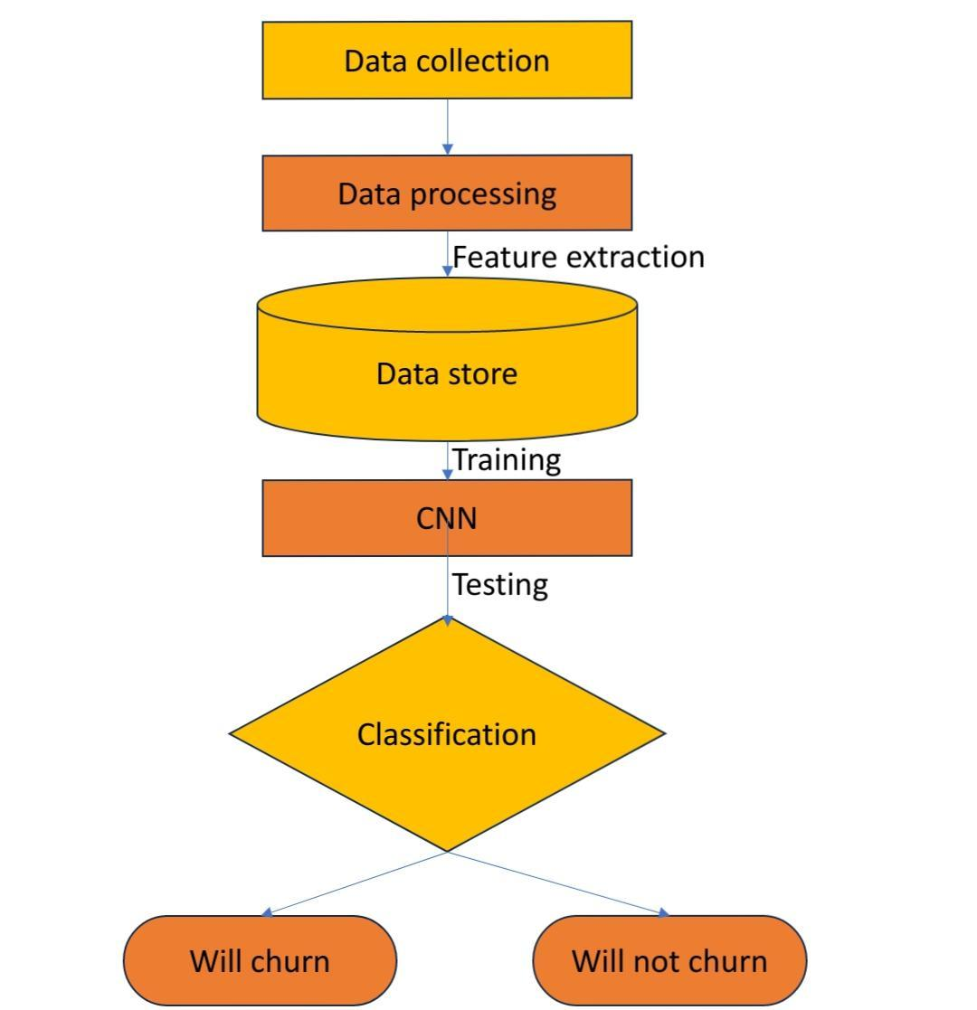
METHODOLOGY

Slide 4
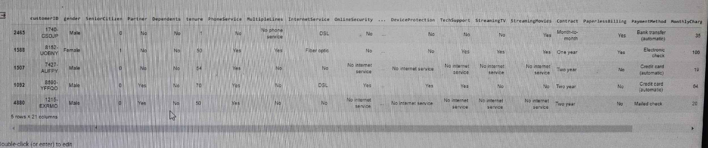
DATA COLLECTION
We use telco customer churn Dataset from kaggle
https://www.kaggle.com/blastchar/telco-customer-churn

Slide 5
DATA PREPROCESSING AND DATA EXPLORATION
Explore and pre-process the Kaggle dataset, handling missing values, encoding categorical variables, and normalizing numerical features.
Create sequential representations of customer data to capture temporal patterns.

Slide 6
CNN MODEL ARCHITECTURE
Design a CNN architecture suitable for sequential data analysis. Configure input layers to handle sequential customer data. Experiment with different convolutional layers, pooling layers, and fully connected layers to optimize feature extraction.

Slide 7
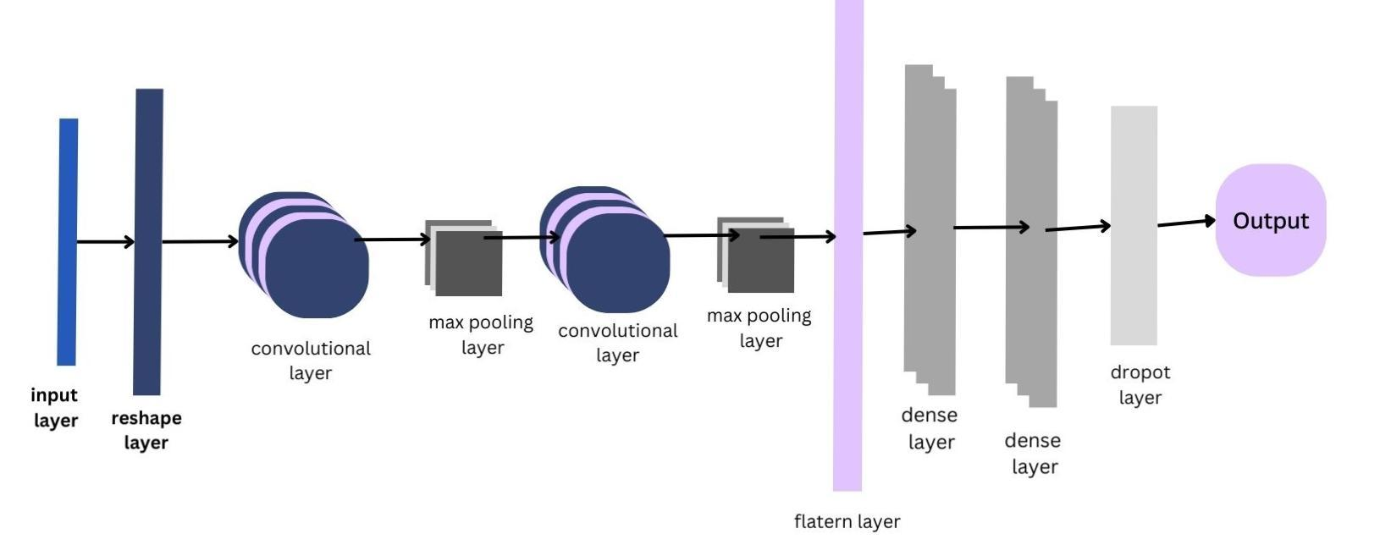
SYSTEM ARCHITECTURE

Slide 8
DATA SPLITTING AND MODEL TRAINING
Split the dataset into training and validation sets. Train the CNN model using the training data and validate its performance using the validation set.

Slide 9
EVALUATION METRICS
Evaluate the model using metrics like accuracy, precision, recall and F1-score
Utilize confusion matrix analysis to understand the model’s ability to predict churn and non-churn instances.

Slide 10
CONFUSION MATRIX
A confusion matrix evaluates classification model performance by comparing predictions to actual outcomes. It’s crucial for multi-class problems, revealing correct predictions and errors. Visualizing it aids in understanding prediction distributions, enhancing model evaluation and refinement.

Slide 11
IMPLEMENTATION
Our project report includes a Gradio GUI for better user interaction. We use a powerful system with multi-core processor and 8GB RAM for smooth computation. SSD storage ensures fast data loading and model training. Our user-friendly GUI features sliders and textboxes for easy input and clear output presentation, improving overall accessibility and usability.

Slide 12
CONCLUSION
From the result of our study, we conclude that Machine learning is a useful approach for prediction of customer. This project aimed to predict customer churn in the telecom industry using a machine learning model. Preparing a solid base for future Marketing analysis.

Slide 13
REFERENCE
1) A Novel Approach for Churn Prediction Using Deep learning by Abinash Mishra
Research scholar Department of Computer Applications National Institute of
Technology Tiruchirappalli, Tamil Nadu and U. Srinivasulu Reddy Assistant
Professor Department of Computer Applications National Institute of Technology
Tiruchirappalli, Tamil Nadu.
2) Customer churn prediction in Telecommunication industry using machine learning
algorithms by Sachin Kumar, M L Mittal and Y K Sharma . Published in the
International Journal of Computer Applications (2018).

Slide 14
THANK YOU

