Slide 1
Automated Traffic Violation Detection and Identification System
Team Members
• S Sidharth Sharma – Team Lead
• Disha Dubey – Team Member

Slide 2
Problem Statement
• Manual inspection of traffic images is time-consuming
• Large-scale surveillance generates huge image volumes
• Need automated violation detection and documentation

Slide 3
Proposed Solution
• AI-powered traffic image analysis
• Vehicle & road user detection
• Violation detection
• License plate recognition
• Evidence generation & reporting

Slide 4
System Architecture
Traffic Image
Preprocessing
Detection
Violation Engine
ANPR
Evidence
Dashboard

Slide 5
Prototype Implementation
Implemented:
• Vehicle Detection
• Helmet Detection
• Triple Riding Detection
• License Plate Recognition
• Evidence Generation
• Dashboard

Slide 6
Technology Stack
YOLOv8
OpenCV
EasyOCR
Flask
Python
JupyterLab

Slide 7
Experimental Results
Vehicle: mAP50 0.562
Helmet: mAP50 0.788
Triple Riding: mAP50 0.953
License Plate: mAP50 0.903

Slide 8
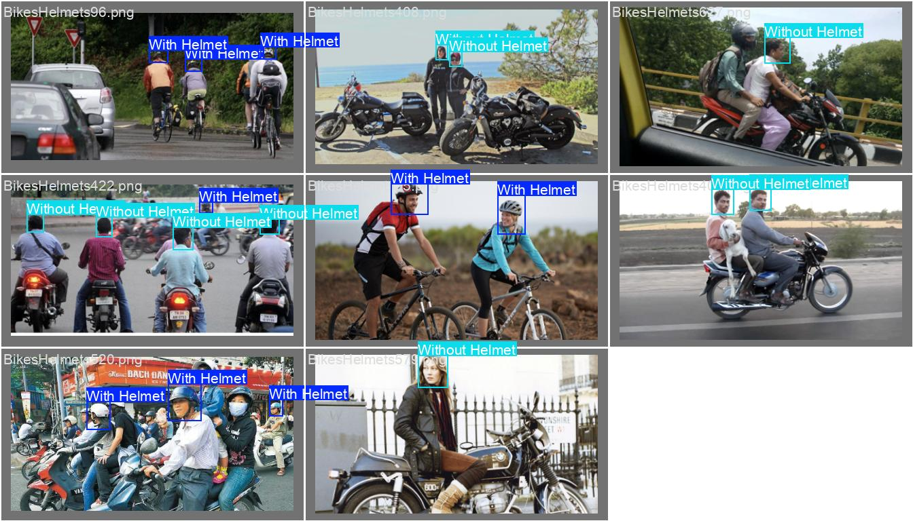
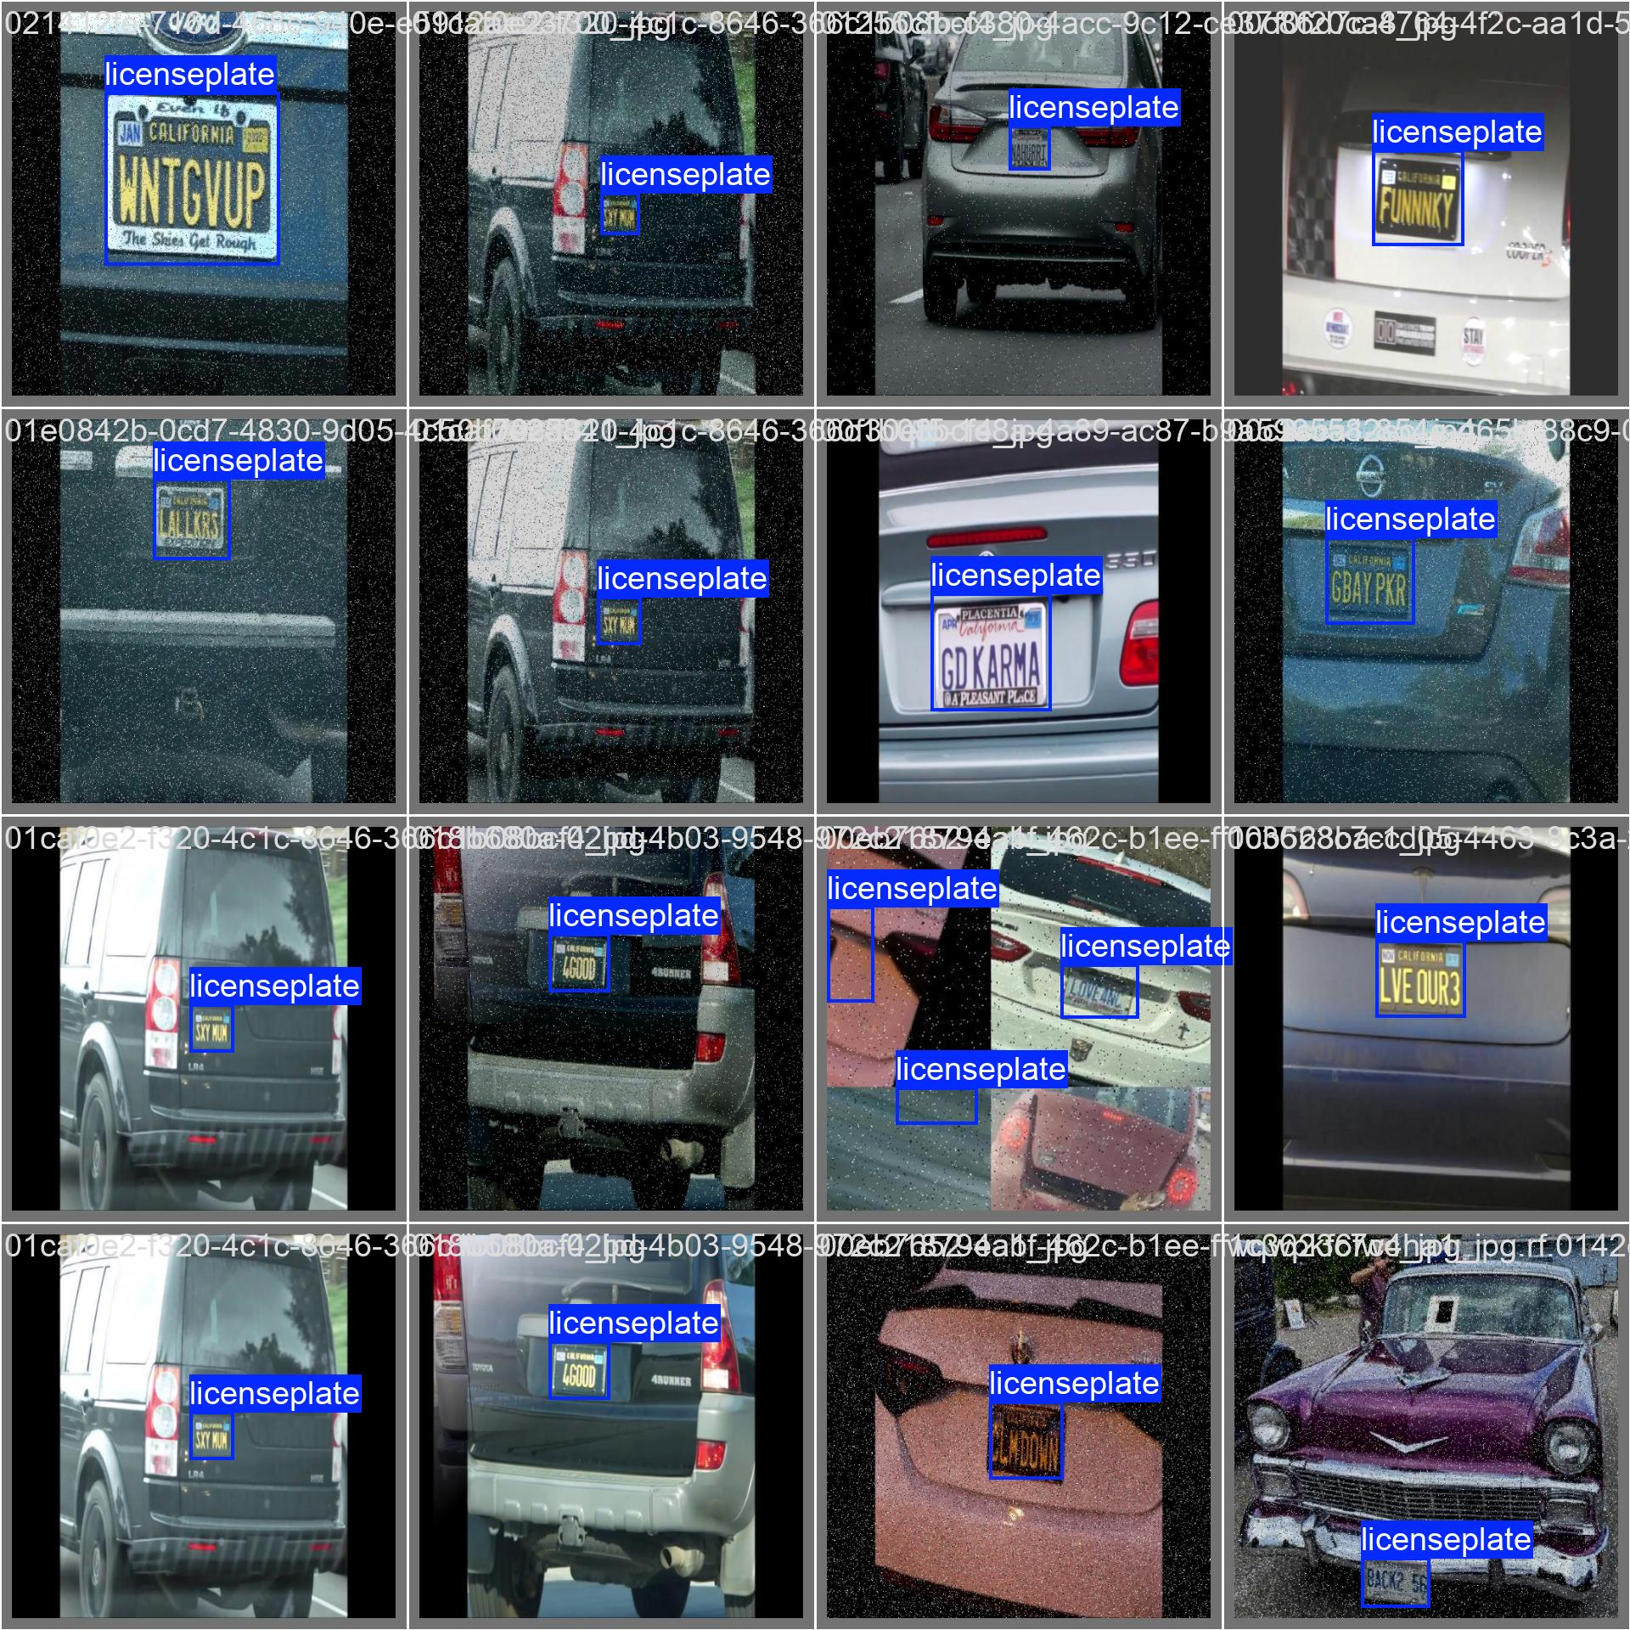
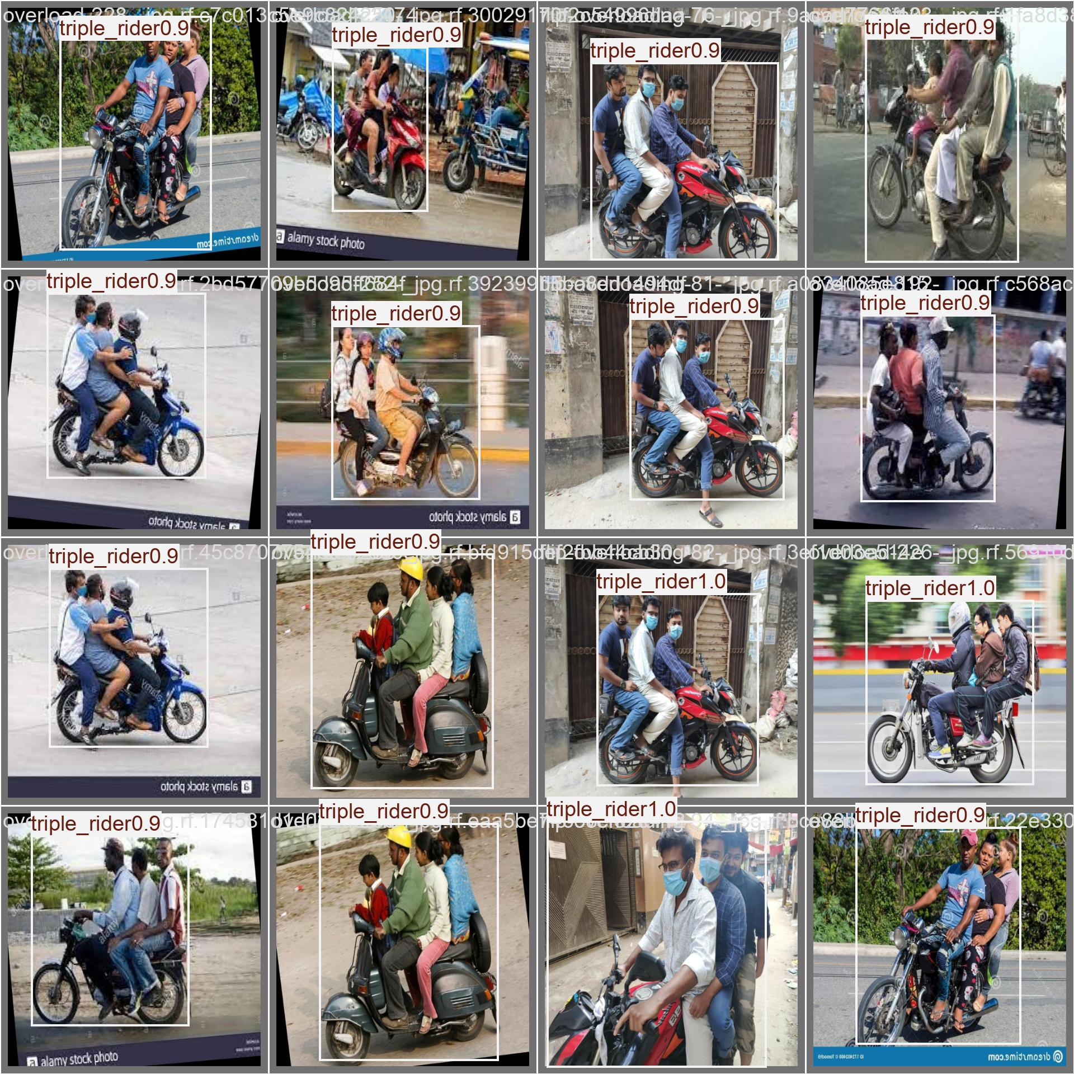
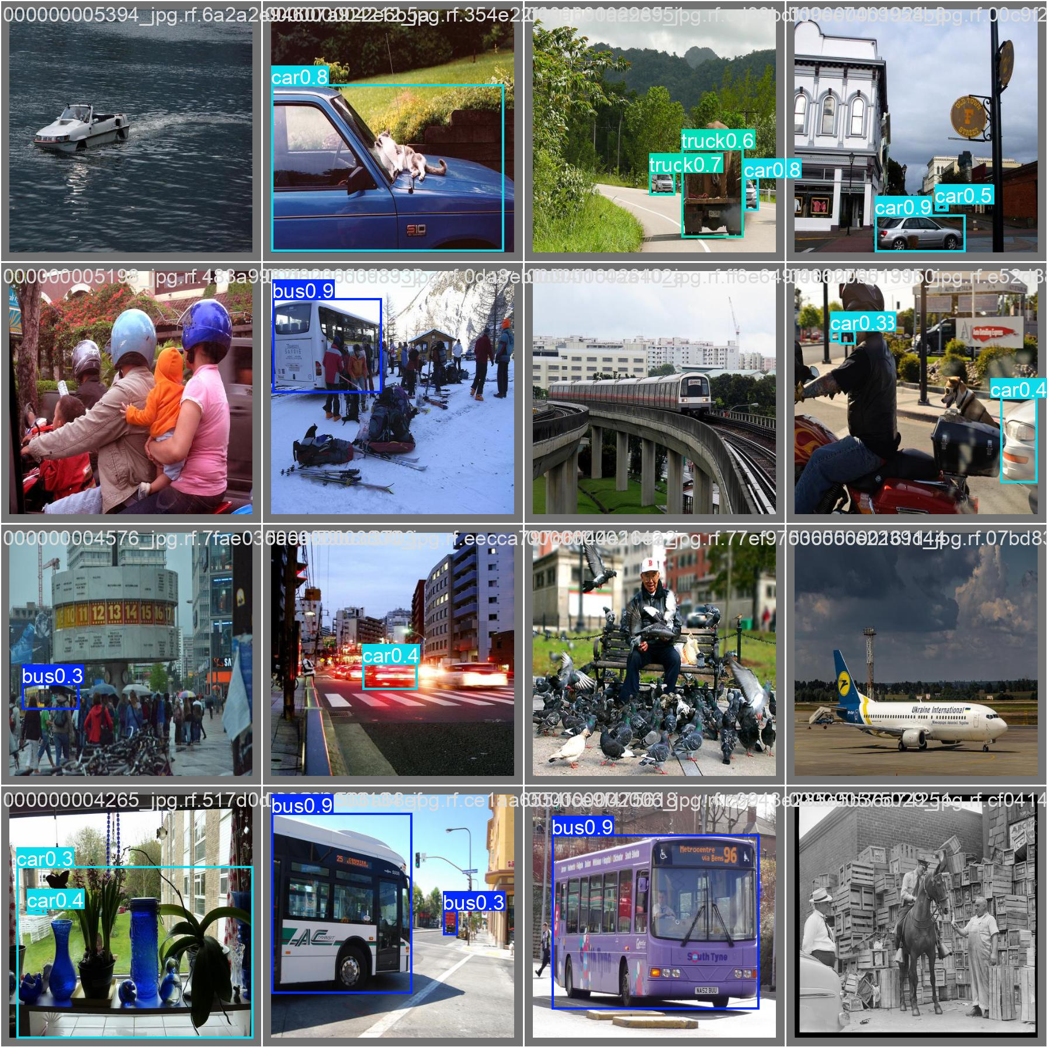
Prototype Validation
Helmet detection output
Plate detection output
Triple detection output
Vehicle detection output

Slide 9
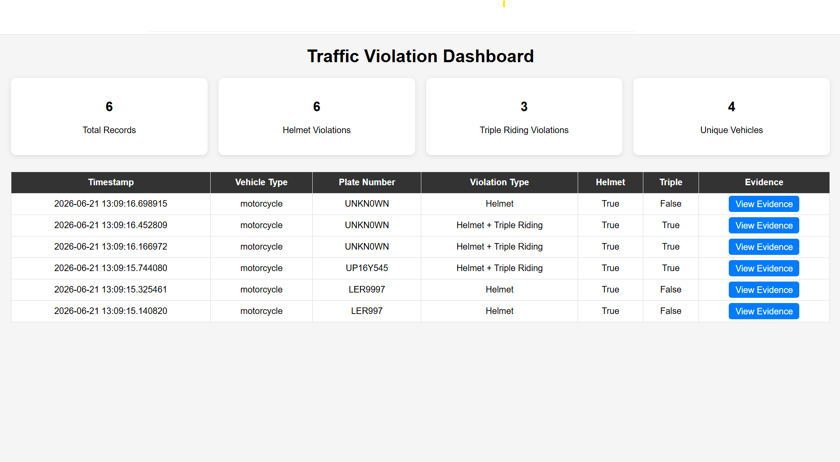
Prototype Validation
Dashboard

Slide 10
Future Scope
• All vehicle categories
• Seatbelt detection
• Red-light violation
• Wrong-side driving
• Illegal parking
• Grievance portal
• Automated challans

Slide 11
Conclusion
Working proof-of-concept developed with promising results.
Scalable architecture for smart traffic enforcement.

