Slide 1
Virtualization
KVM

Slide 2


Platform Virtualization in a Nutshell Separating Operating System from Hardware
Traditional
1 Server HW = 1 OS
Flexible and shared HW deployment powered by
Platform Virtualization
Virtual Machine 1
Virtual Machine N.
Creates multiple isolated virtual computing environments, Virtual Machines (VM)
OS Process
OS Process
OS process
OS Process
OS Process
OS Process
OS Process
OS Process
OS Process
Guest OS
Guest OS
DMX
Generic HW Drivers
Generic HW Drivers
Partitions the hardware resources
OS
Virtual Machine Monitor (VMM) / Hypervisor
HW Drivers
Virtual HW
Virtual HW
Decouples the OS from the HW
Host HW
HW Drivers
Host HW

Slide 3



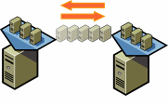
Platform Virtualization in a Nutshell Key Features / Benefits Revisited
Partitioning
Isolation
Run multiple virtual machines simultaneously on a single HW.
The Virtual Machine (VM) is isolated from other VMs or the Virtual Machine Monitors (VMM).
Encapsulation
HW Independence
Entire virtual machine is saved in files. Can be moved and copied like any other file.
Run a virtual machine on any HW without modification. Break dependence between OS & HW.
Notes:
3

Slide 4
Use Cases for Virtualization
Application scalability
Continuous hardware adaptation
Resource utilization efficiency (blade level)
Transparent multi application support
Increased flexibility and efficiency in operations (cluster level)

Slide 5
Qemu/kvm overview
A virtual machine is a software program that pretends to be real hardware to its users
A hypervisor is a piece of software that creates the virtual machine
In Linux, the Qemu (user-space) program and the kvm kernel module together with the Linux kernel combine as a hypervisor

Slide 6
Different OS!
$ uname -a
Linux eskara3a-dhcp-03232.emea.nsn-net.net 3.14.4-200.fc20.x86_64 #1 SMP Tue May 13 13:51:08 UTC 2014 x86_64 x86_64 x86_64 GNU/Linux

Slide 7
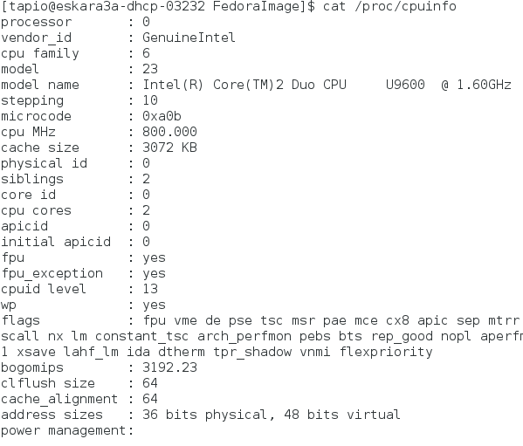
Host hardware

Slide 8
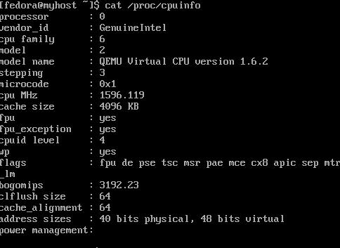
Guest hardware

Slide 9
Magic?

Slide 10
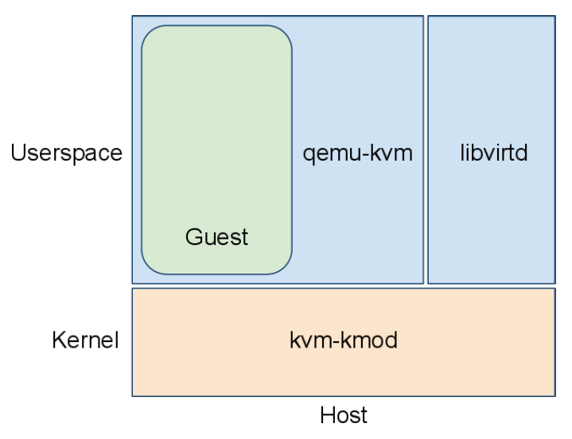
Libvirtd is helping to set things up
Guest is the VM
Host is the real hardware and the OS

Slide 11
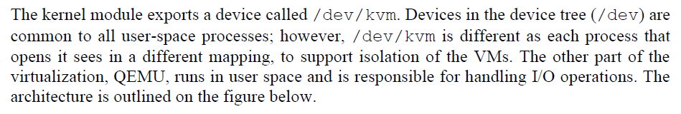
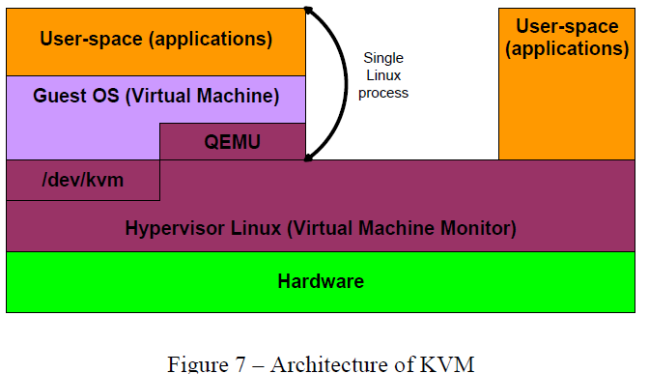
Architecture of KVM

Slide 12
Architectural Advantages of the KVM Model
Proximity of guest and user space hypervisor
Only one address space switch: guest ↔ host
Less rescheduling
Massive Linux kernel reuse
Scheduler
Memory management with swapping (though you don't what this)
I/O stacks
Power management
Host CPU hot-plugging
…
Massive Linux user land reuse
Network configuration
Handling VM images
Logging, tracing, debugging

Slide 13
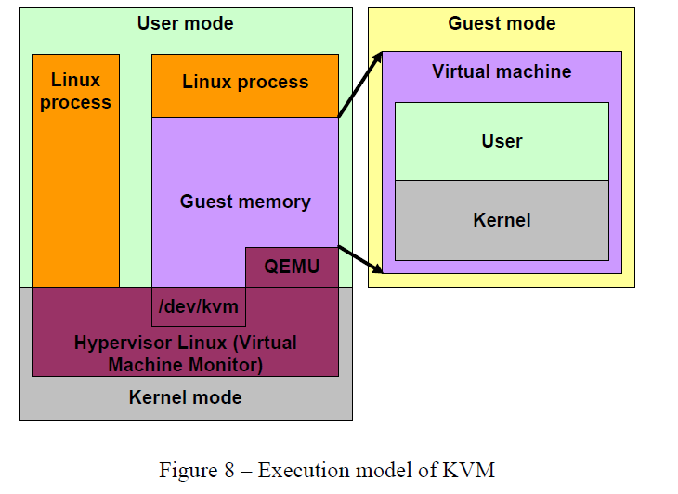
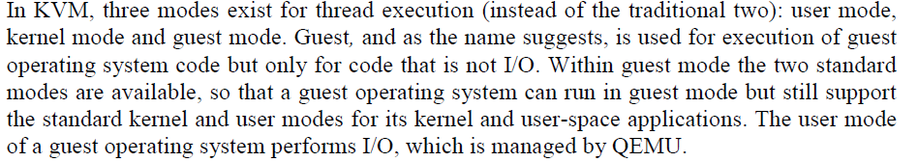
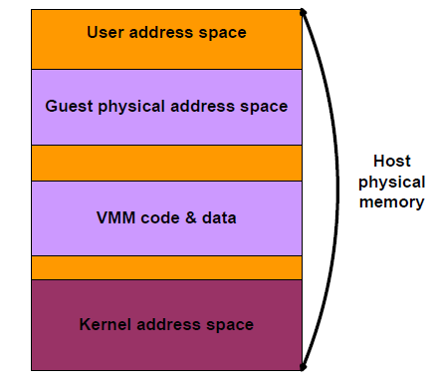
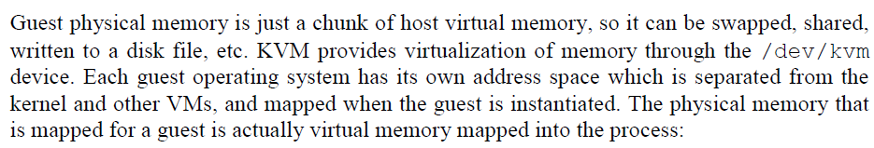
Execution Model
Memory Model

Slide 14
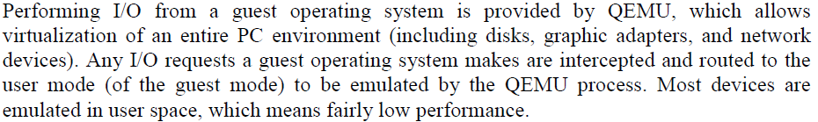
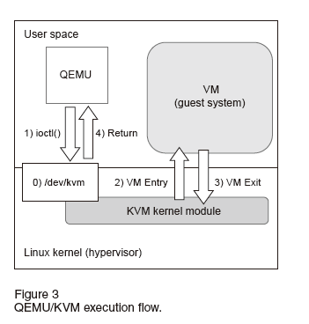
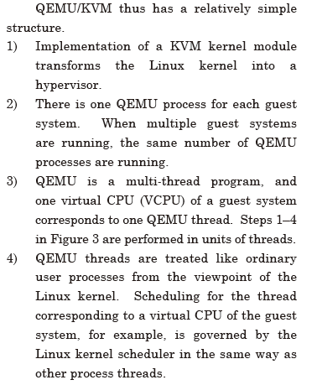
KVM/QEMU

Slide 15
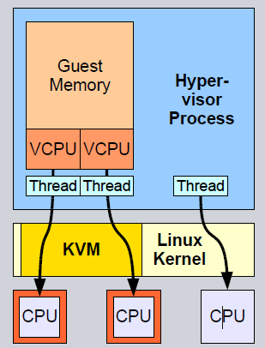
KVM Model
Processes can create virtual machines
VMs can contain
Memory
Virtual CPUs
In-kernel device models
Guest physical memory part of creating process' address space
VCPUs run in process execution contexts
Process usually maps VCPUs on threads
Qemu
This mapping is done by the Linux scheduler
Real CPUs

Slide 16
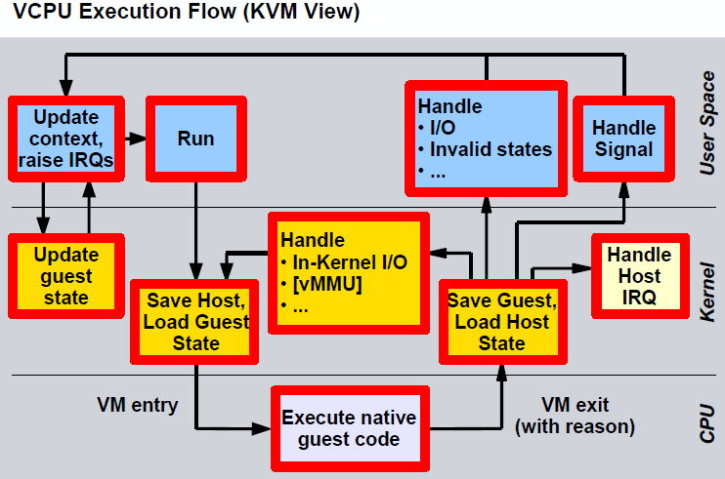
Why So Complicated
In theory, Qemu is enough
In practice, Qemu is incredibly slow without kvm
Kvm allows to run VM native code directly on the CPU
Kvm uses processor hardware for very optimal memory access
Kvm implements performance-critical timer and interrupt handling in kernel space

Slide 17
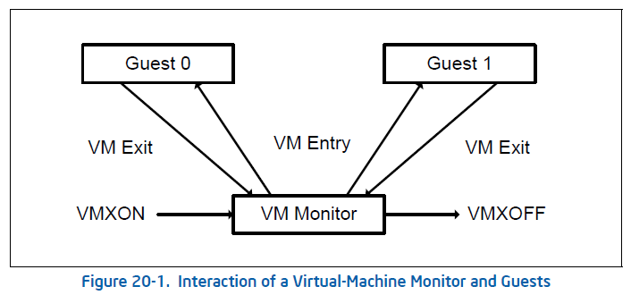
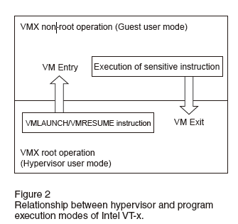
Intel processor technologies for virtualization: VMX
Intel VT-x can be viewed as a "Fucntion that switches processing to the hypervisor on detecting the execution of a sensitve instruction by the CPU"
Hypervisor is a control program for operating VMs (Guest systems) on a physical machine.
1) control sensitive instructions attempt to change the state of system resources
2) behavior-sensitive instructions operate in accordance with the state of the system resources.
if a program attempts to execute these instructions on a guest system without any intervention, it will cause serious problem for hypervisor and guest. VT-X developed to support that CPU should detect execution of sensitive instructions and to direct hypervisor to execute that on behalf of program.
Intel VT-x adds two program execution modes: VMX root operation and VMX non-root operation.
The main role of KVM is handling of VM-Entry & VM-Exit instructions

Slide 18
Done?

