Slide 1
Sentiment Analysis
on
Customer Reviews of Fastrack Watches

Slide 2
Objective.
The objective of a project on sentiment analysis of customer reviews of watches is to extract meaningful insights and sentiment from customer reviews related to watches. The project aims to use natural language processing techniques and deep learning algorithms to analyze customer reviews and determine the sentiment behind them.
Methodology
Introduction
EDA
Text Preprocessing and Keyword Extraction
Model Building
Evaluation

Slide 3


Sentiment Analysis
Sentiment Analysis on Customer Reviews of Fastrack Watches can provide the valuable insight about how a customer feel about a particular brand.
Overall Sentiment
Specific Features
Brand Reputation
Customer Loyalty
Competitive Analysis

Slide 4
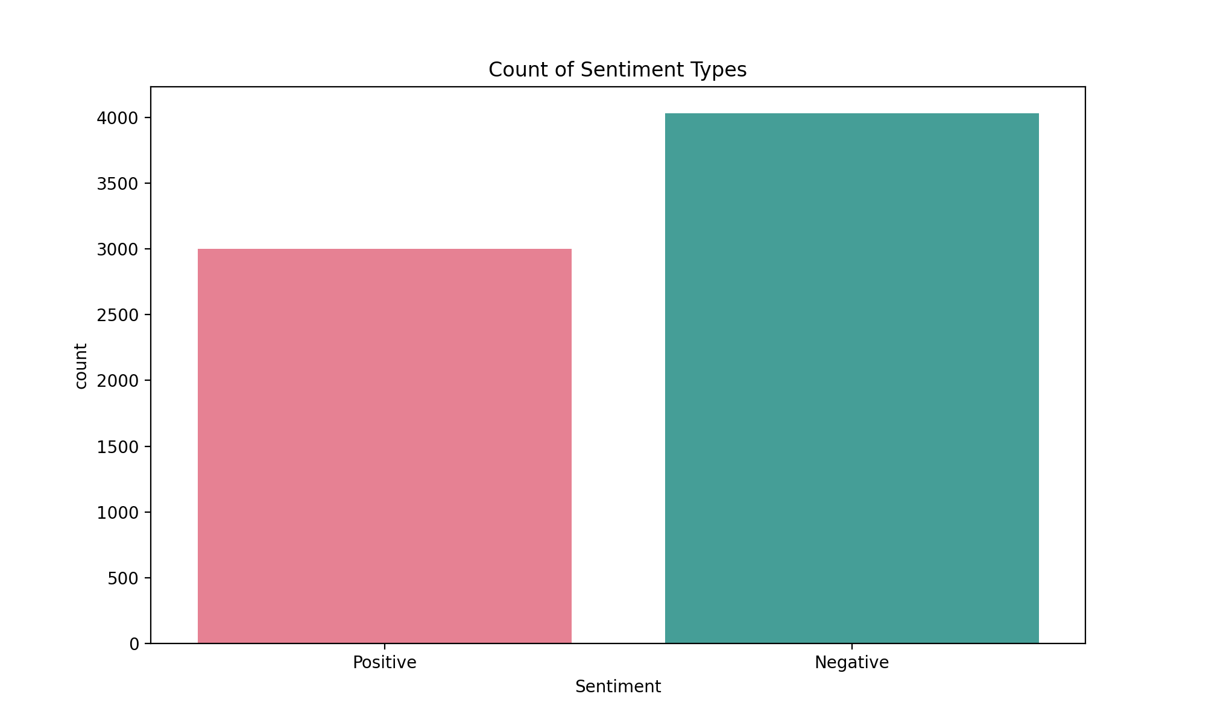
EDA(Exploratory Data Analysis)
1. Count Plot

Slide 5
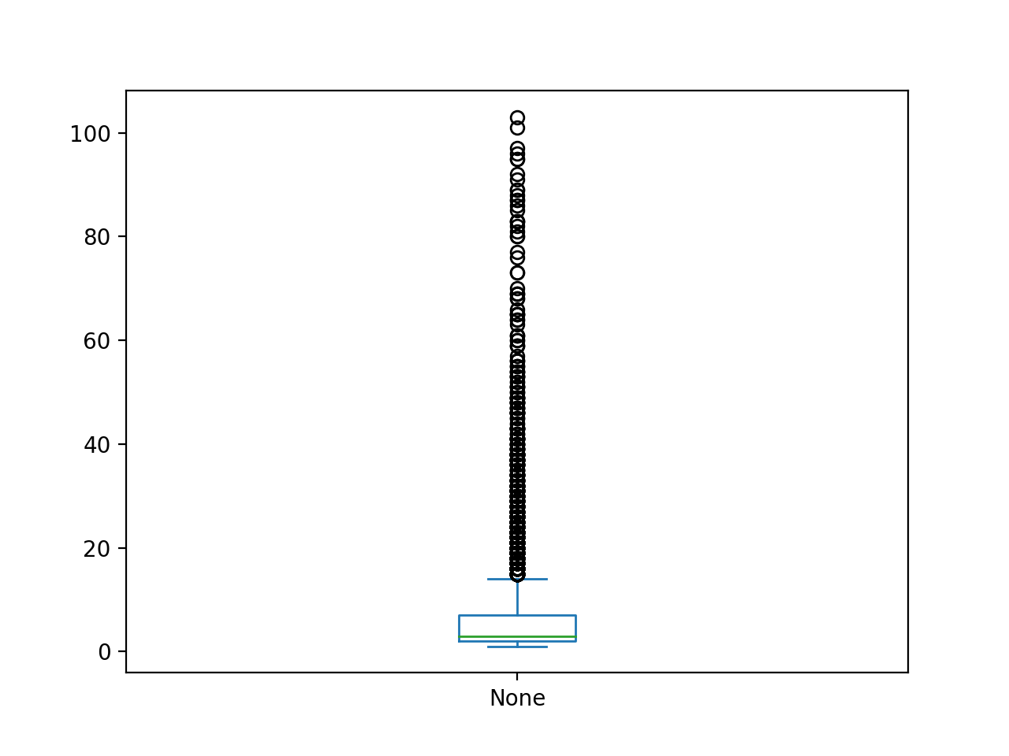
2. Box Plot
The box plot helps to understand the distribution of review lengths, which can be useful for identifying potential outliers and understanding the range and variability of review lengths in the dataset.

Slide 6
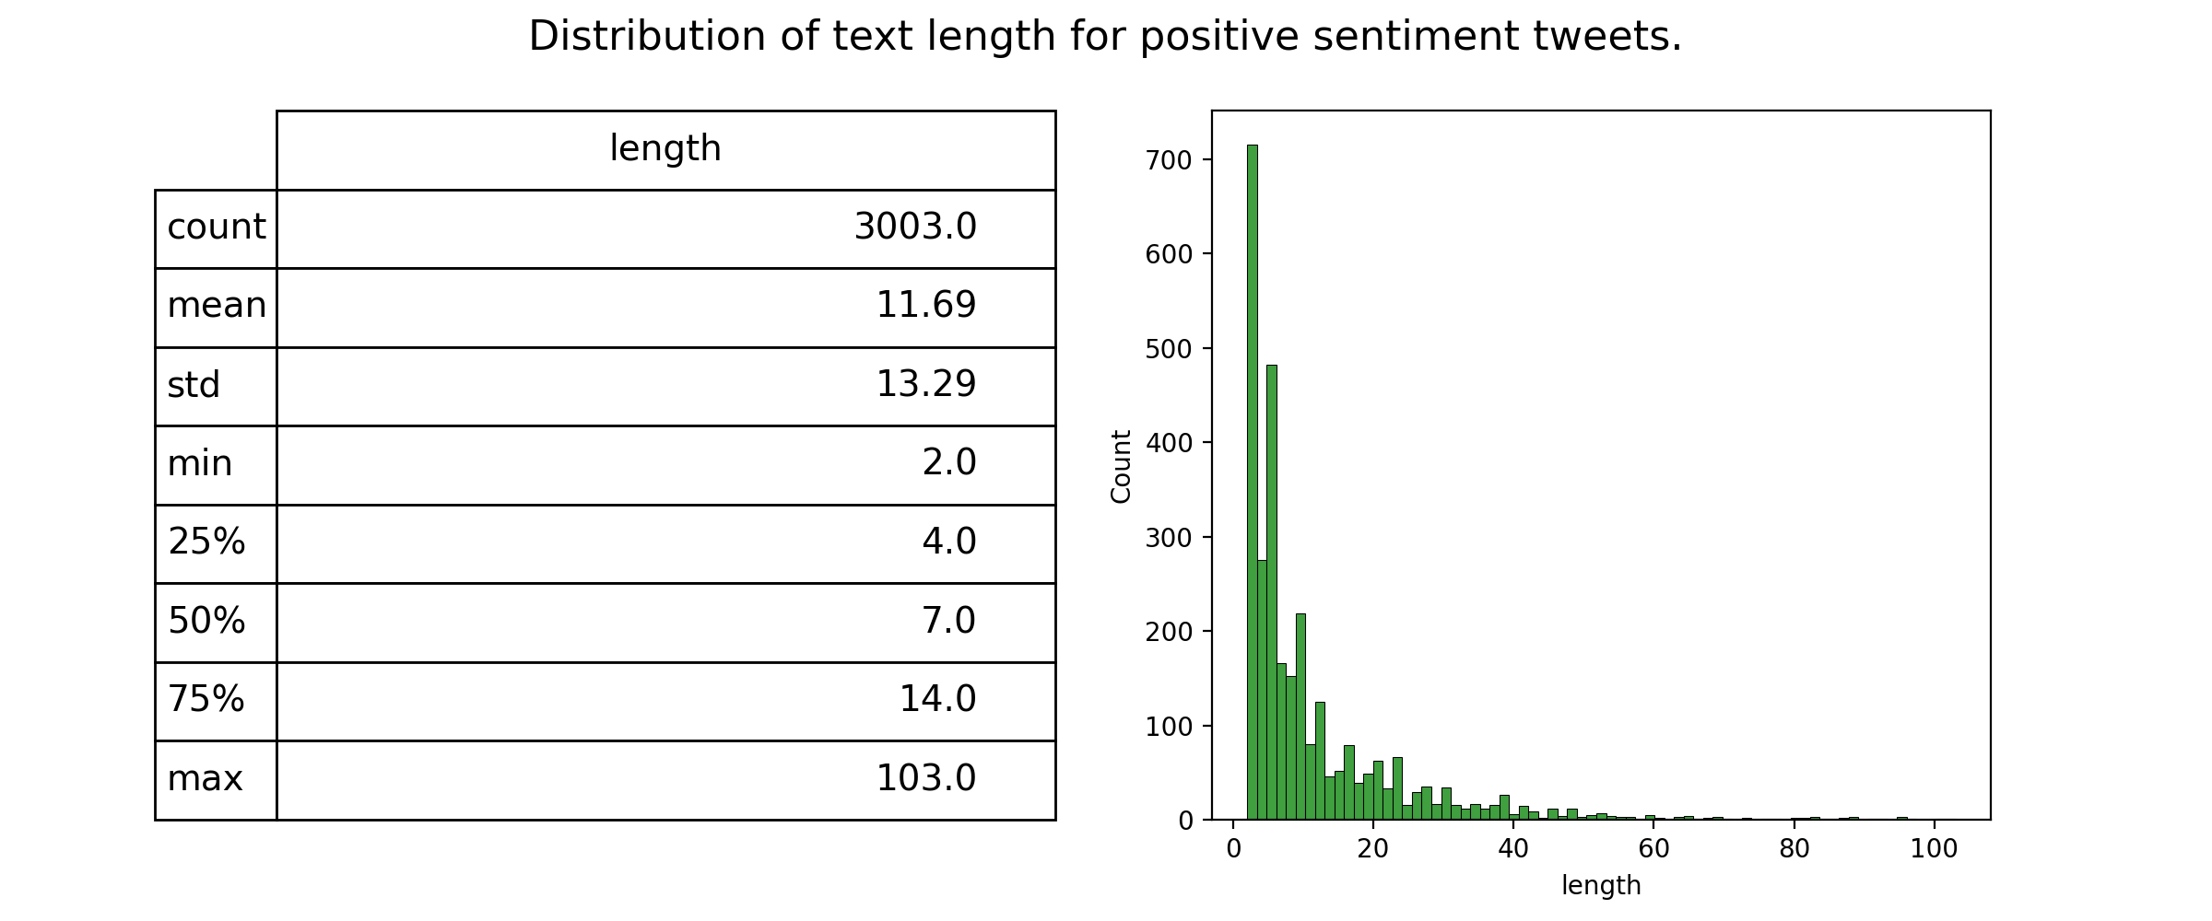
3. Plotting the distribution of text length for positive sentiment
this graph provides an informative visualization and summary statistics of the text length distribution for positive sentiment

Slide 7
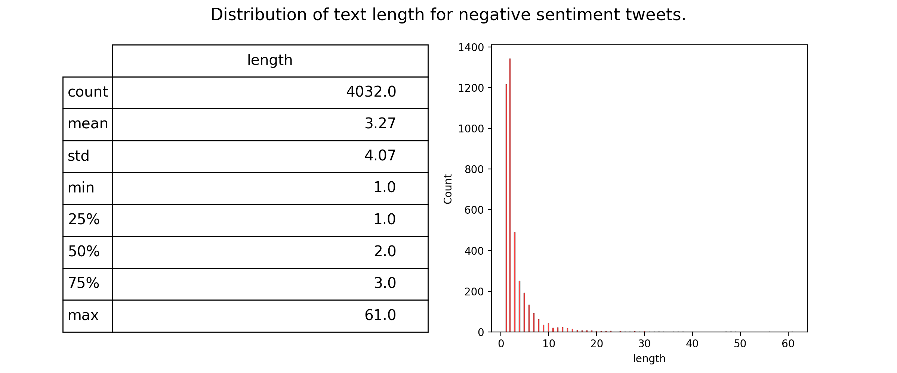
4. Plotting the distribution of text length for Negative Sentiment
this graph provides an informative visualization and summary statistics of the text length distribution for negative sentiment

Slide 8
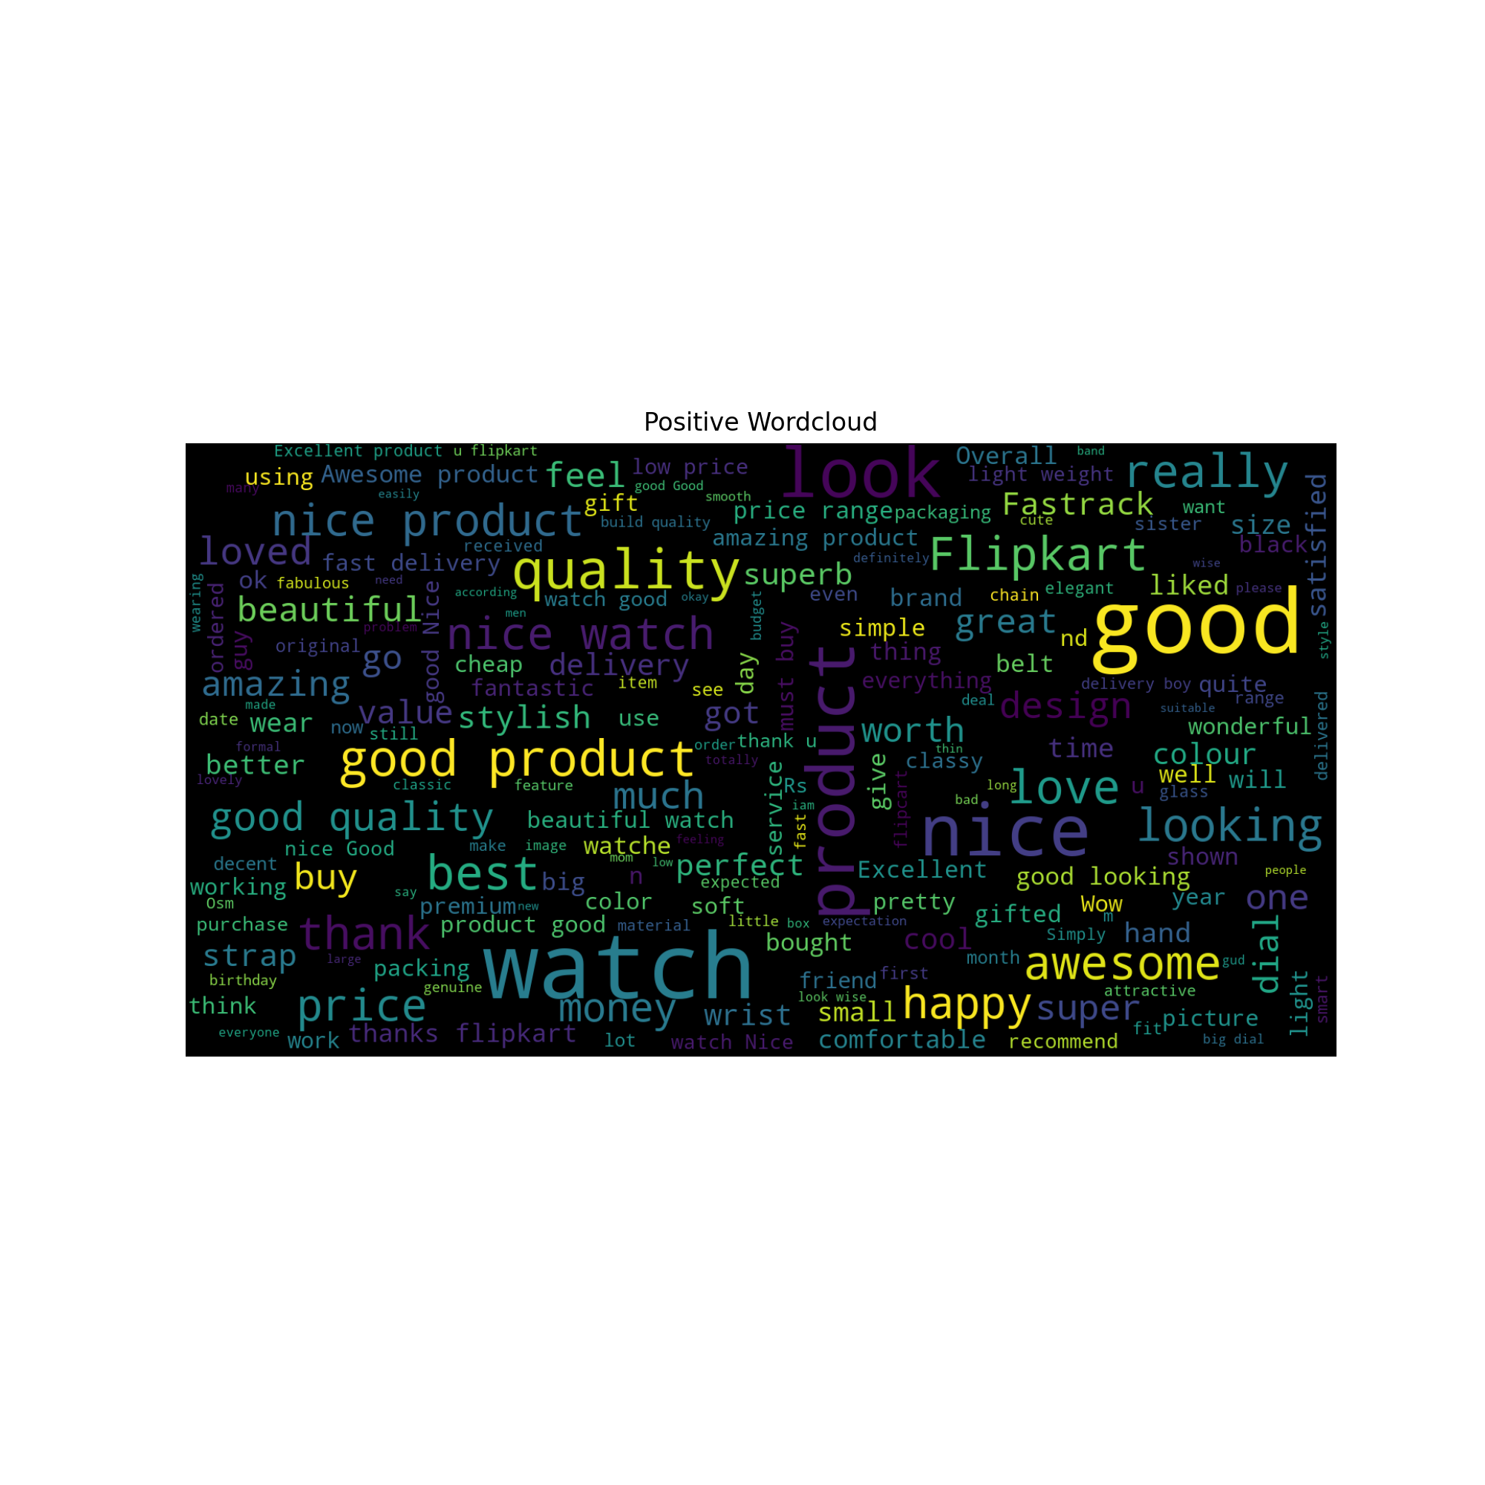
5.WordCloud
The resulting graph is a visual representation of the most common positive words found in the customer reviews dataset.

Slide 9
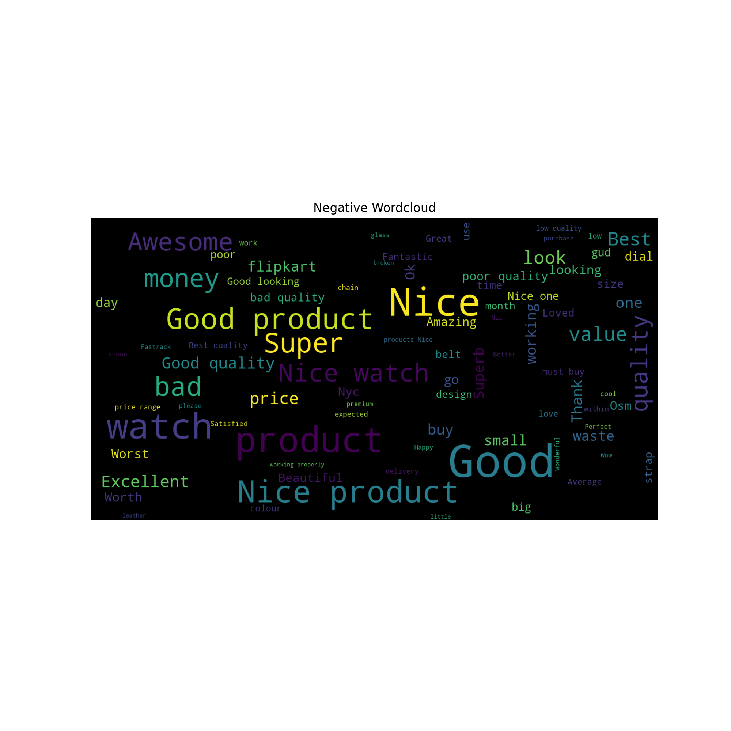
6.WordCloud
The resulting graph is a visual representation of the most common Negative words found in the customer reviews dataset.

Slide 10
Text Preprocessing
Lowering the text and Contractions
Remove Accented Characters
Remove Emails
Remove Punctuations
Multiple Spaces Remove
HTML Tags Remove
Remove Stop Words
Remove all Emojis

Slide 11
Word Embedding
Word embedding refers to a technique used in natural language processing (NLP) to represent words as numerical vectors in a high-dimensional space. This technique is used to capture the semantic meaning of words and their relationships with other words in a corpus of text.
Count-based methods: These methods create embeddings based on the frequency of co-occurrence of words in a corpus of text. Examples include Latent Semantic Analysis (LSA) and Hyperspace Analogue to Language (HAL).
Prediction-based methods: These methods use neural networks to predict the probability of a word occurring in the context of other words. Examples include Word2Vec, Global Vectors (Glove).

Slide 12
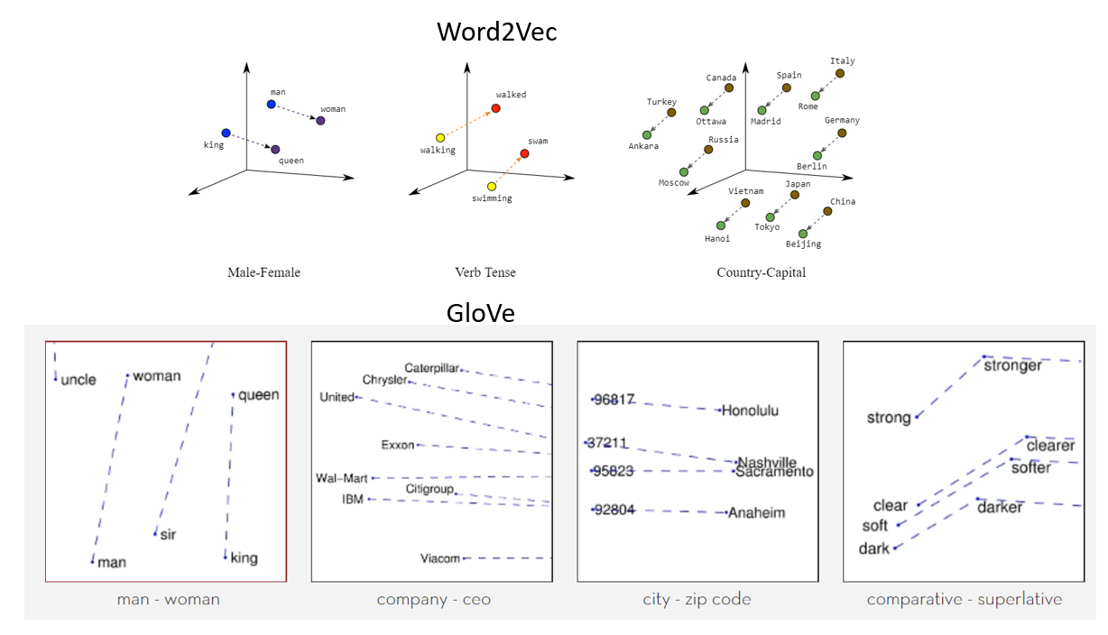
Glove
Glove, short for Global Vectors, is a word embedding model developed by researchers at Stanford University. It is a type of unsupervised machine learning technique that maps words to vectors of real numbers in a high-dimensional space.
The Glove model is trained on large corpora of text and uses co-occurrence statistics to learn vector representations for words. It tries to capture the meaning of words by looking at how often they appear together in a text corpus. Words that appear frequently together will be closer in the high-dimensional space than words that rarely appear together.

Slide 13
Word2Vec
Word2Vec is based on the idea that words that appear in similar contexts tend to have similar meanings. It trains a neural network on a large corpus of text, such as Wikipedia or a collection of news articles, to predict the probability of a word given its neighboring words. This results in a set of vector representations, or embeddings, that capture the semantic relationships between words in the corpus.
CBOW(Continuous Bag of Words)
Skip Gram

Slide 14
Model
Building

Slide 15
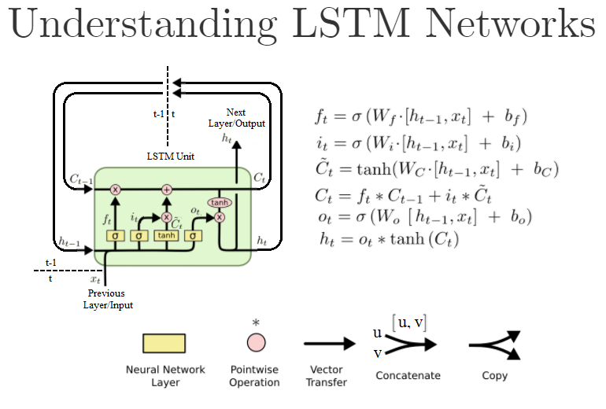
1. LSTM
Long Short-Term Memory (LSTM) is a type of recurrent neural network (RNN) that is designed to overcome the vanishing gradient problem that occurs in standard RNNs. The vanishing gradient problem occurs when the gradients in the backpropagation algorithm become smaller and smaller as they propagate backwards through the network, making it difficult to train the network on long sequences of data.
Memory cell: A cell that stores information over a long period of time and has connections to other cells in the network.
Input gate: A gate that controls the flow of information into the memory cell.
Forget gate: A gate that controls the flow of information out of the memory cell.
Output gate: A gate that controls the output of information from the memory cell

Slide 16
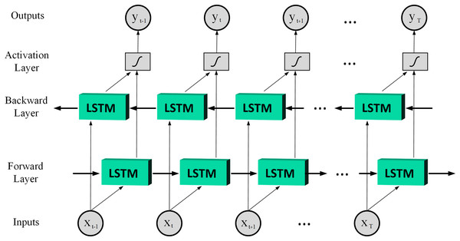
2. Bidirectional LSTM
Bidirectional LSTM is a type of LSTM architecture that processes input data in both forward and backward directions through time, combining information from past and future states of the input sequence. In a standard LSTM, the input sequence is processed only in the forward direction, which can limit the ability of the network to capture dependencies between future and past events.

Slide 17
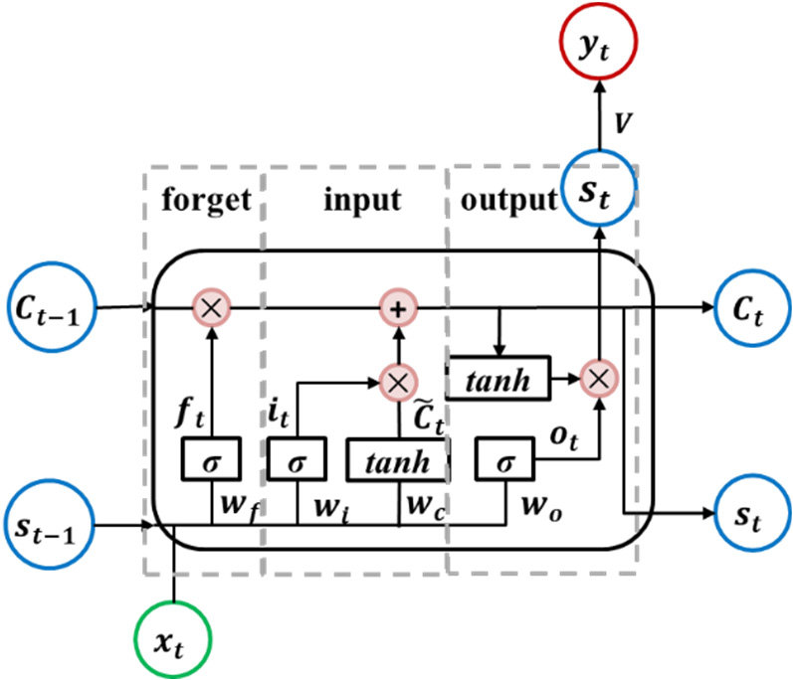
3. GRU(Gated Recurrent Unit)
The main idea behind GRU is to use gating mechanisms to control the flow of information through the network, similar to LSTM. However, GRU has a smaller number of gates than LSTM, which makes it faster to train and easier to implement. Specifically, GRU has two gates:
Reset gate: Controls how much of the previous hidden state to forget.
Update gate: Controls how much of the new information to add to the previous hidden state.

Slide 18
Evaluation in Sentiment Analysis
Accuracy measures the proportion of correctly classified instances out of all the instances in the dataset.
The F1 score is a weighted average of precision and recall that balances both metrics.
Model | Validation Accuracy | Training Accuracy | Test Accuracy | F1 Score
LSTM | .80 | .87 | .82 | .82
GRU | .79 | .79 | .79 | .79
Bidirectional-LSTM | .78 | .79 | .78 | .78

Slide 19
Conclusion
From our Models we can conclude that LSTM with Glove Embedding is performing the best among others .

Slide 20
Thank You ..

