Slide 1
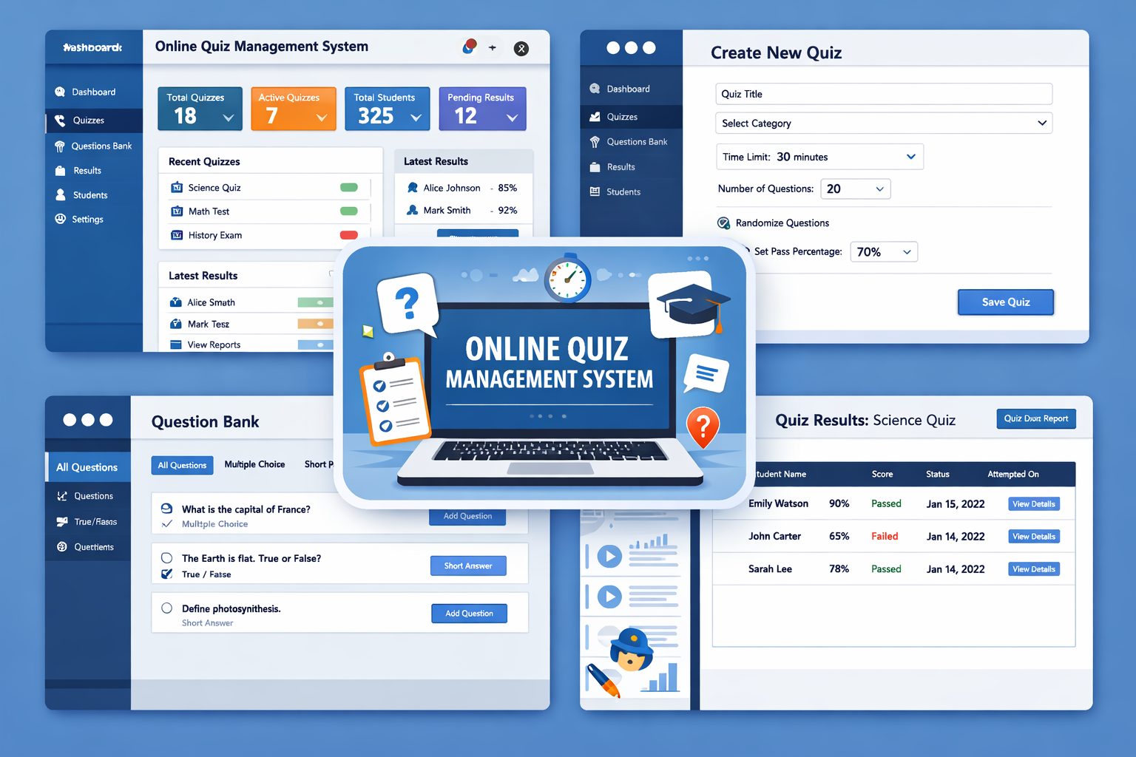

Slide 2
The purpose of building an Online Quiz Management System is to provide a modern, interactive, and reliable platform for conducting assessments. In today’s digital-first world, education and training demand tools that are:
Efficient – Automates quiz creation, evaluation, and result generation.
Accessible – Allows learners to participate anytime, anywhere, on any device.
Engaging – Supports multiple question formats (MCQ, True/False, short answers) to keep learners motivated.
Transparent – Ensures fair scoring and secure handling of user data.
Scalable – Suitable for schools, universities, corporate training, and competitive exams.
✨ By choosing this project, we aim to bridge the gap between traditional paper-based exams and digital learning solutions, making assessments faster, smarter, and more learner-friendly.

Slide 3
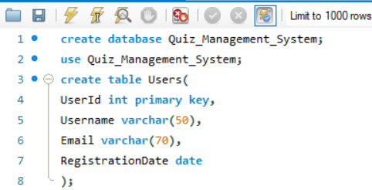
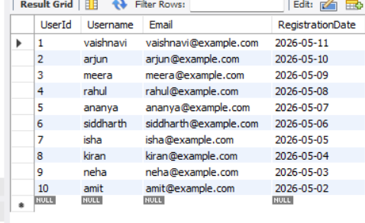

Slide 4
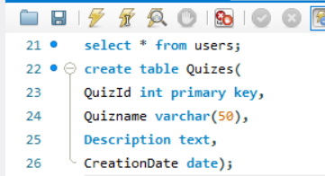
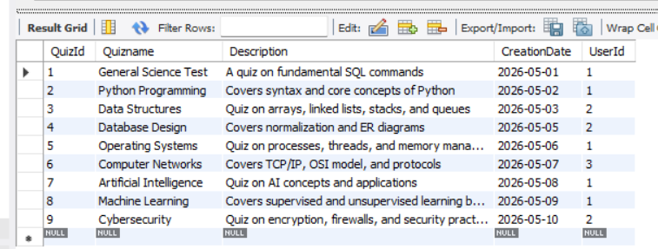

Slide 5
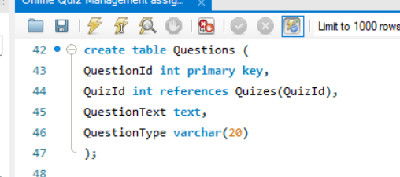
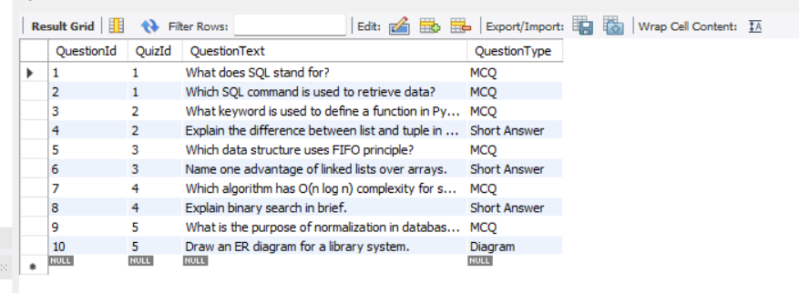

Slide 6
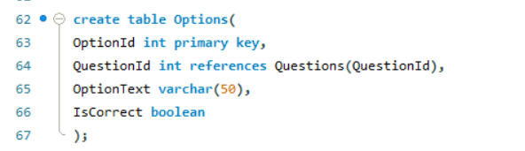
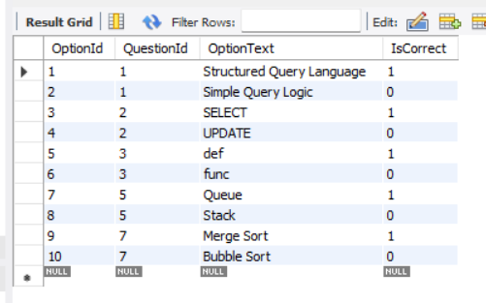

Slide 7
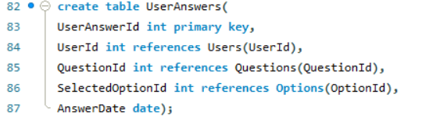
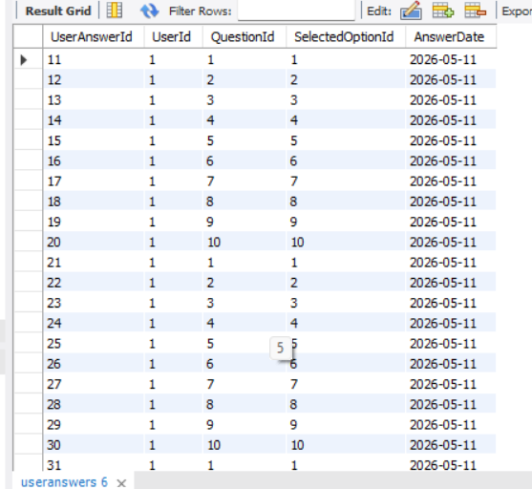

Slide 8
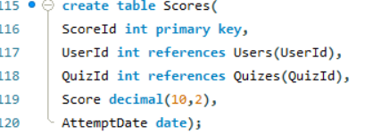
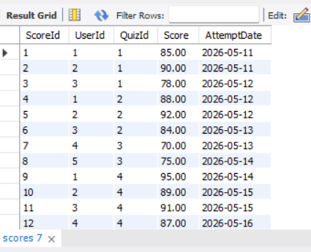

Slide 9
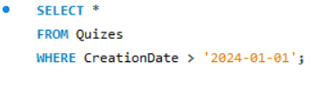
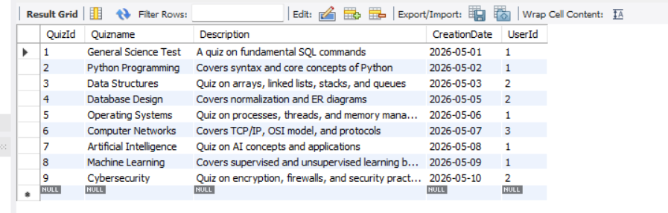
Write a query to select all quizzes created after January 1, 2024, from the Quizzes table.

Slide 10
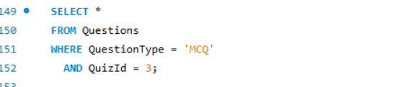

Write a query to select all questions where the Question Type is 'Multiple Choice' and the Quiz ID is 3.

Slide 11
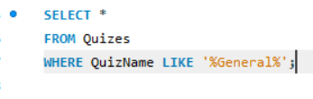
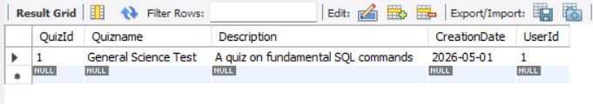
Write a query to select all quizzes where the Quiz Name contains 'General'.

Slide 12
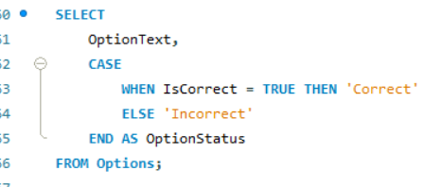
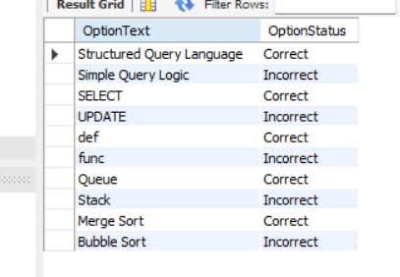
Write a query to select Option Text and a new column Option Status from the Options table. If Is Correct is TRUE, set Option Status to 'Correct', otherwise 'Incorrect'.

Slide 13
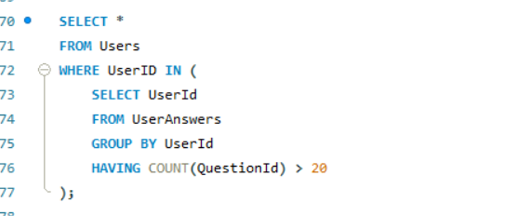

Write a query to find all users who have answered more than 20 questions. Use a subquery in the WHERE clause to find these User IDs.

Slide 14

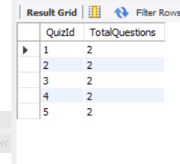
Write a query to get the total number of questions for each quiz. Group the results by Quiz ID.

Slide 15
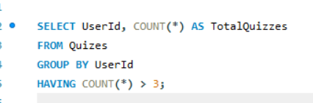
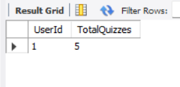
Write a query to get the total number of quizzes created by each user, but only include users who have created more than 3 quizzes. Use the HAVING clause.

Slide 16
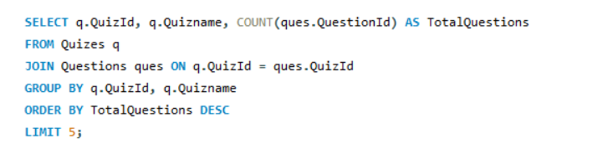
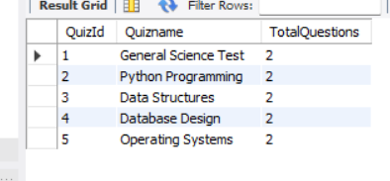
Write a query to select the top 5 quizzes with the highest number of questions.

Slide 17
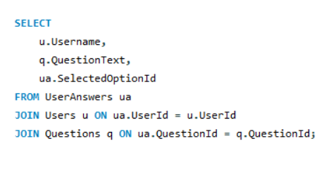
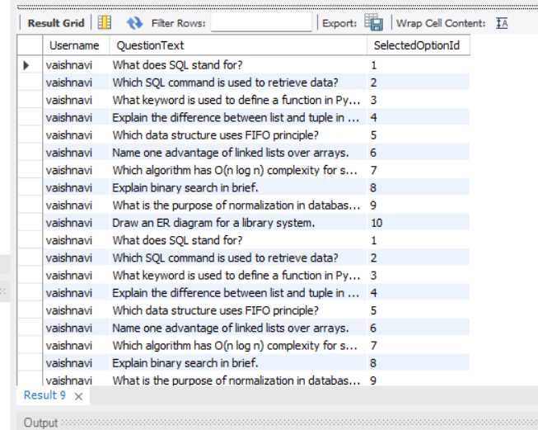
Write a query to join User Answers with Questions to get a list of all user answers including Username, Question Text, and Selected Option ID.

Slide 18
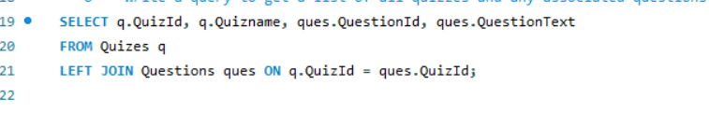
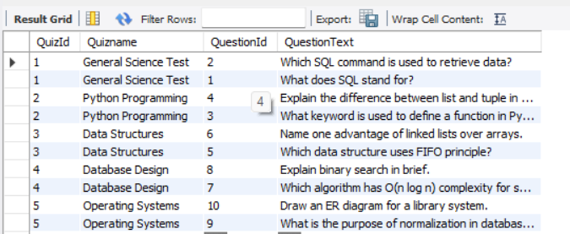
Write a query to get a list of all quizzes and any associated questions. Include quizzes that might not have any questions.

Slide 19
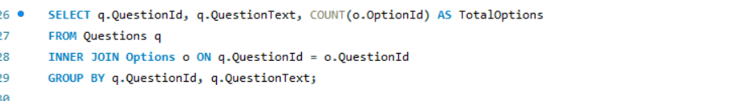
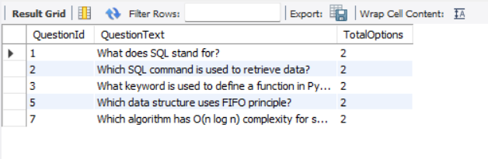
Write a query to get the total number of options for each question. Use an INNER JOIN between Questions and Options, and group by Question ID.

Slide 20
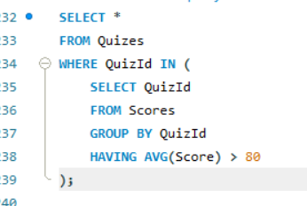
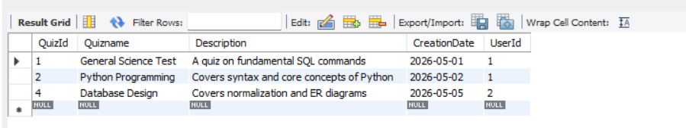
Write a query to find all quizzes where the average score for all users is higher than 80. Use a subquery in the WHERE clause to find these Quiz IDs.

Slide 21
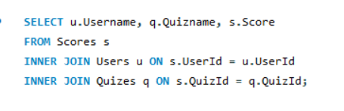
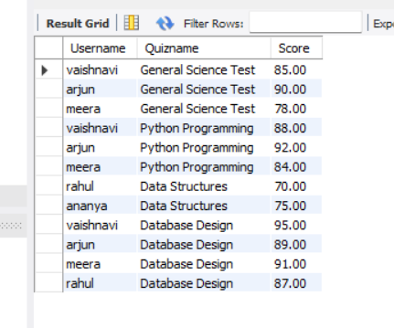
Write a query to list Username, QuizName, and Score for all users who have completed a quiz. Use INNER JOIN and LEFT JOIN as necessary to get all required details.

Slide 22
Thank You ! Vaishnavi Sharma.

