Slide 1
REACT & APIS
useEffect Hook
Understand how React manages operations that happen outside the normal rendering cycle.
React useEffect & APIs
Side Effects
Learn what side effects are, why they exist, and how to handle them cleanly in React.
A deep dive into side effects, the useEffect hook, what APIs are, and how REST APIs work — building from the ground up.
APIs & REST
Discover what APIs are, how REST works, and how to fetch data in your React components.

Slide 2
REACT BASICS
What is useEffect?
Key Facts
How It Works
Hook
useEffect accepts two arguments: a callback function and a dependency array.
It's a React Hook
Step 1 — Render: React renders your component to the DOM first.
1
Introduced in React 16.8 alongside all other hooks.
After
2
Step 2 — Effect Runs: useEffect's callback executes after the render is painted.
Runs After Render
useEffect always runs after the component renders to the screen.
Step 3 — Cleanup: On re-render or unmount, the cleanup function is called.
3
Auto
Automatic Cleanup
Can return a cleanup function to avoid memory leaks.

Slide 3
CORE CONCEPT
What is a Side Effect?
A side effect is any operation that reaches outside the React component's pure rendering logic — anything that interacts with the outside world or changes something beyond returning JSX.
🌐 Data Fetching
⏱️ Timers & Intervals
Calling an API to load data from a server. The network request happens outside React's render cycle — React has no control over when the response arrives, making this a classic side effect.
Using setTimeout or setInterval to schedule work. These run asynchronously and persist beyond a single render, so React can't manage them automatically without useEffect.
📄 DOM Manipulation
🔔 Subscriptions & Events
Directly accessing or modifying the DOM (e.g. document.title, focus management, third-party libraries). React manages the virtual DOM — direct DOM access is a side effect.
Listening to WebSocket events, browser resize events, or any external subscription. These must be set up and torn down carefully — useEffect's cleanup function handles this perfectly.

Slide 4
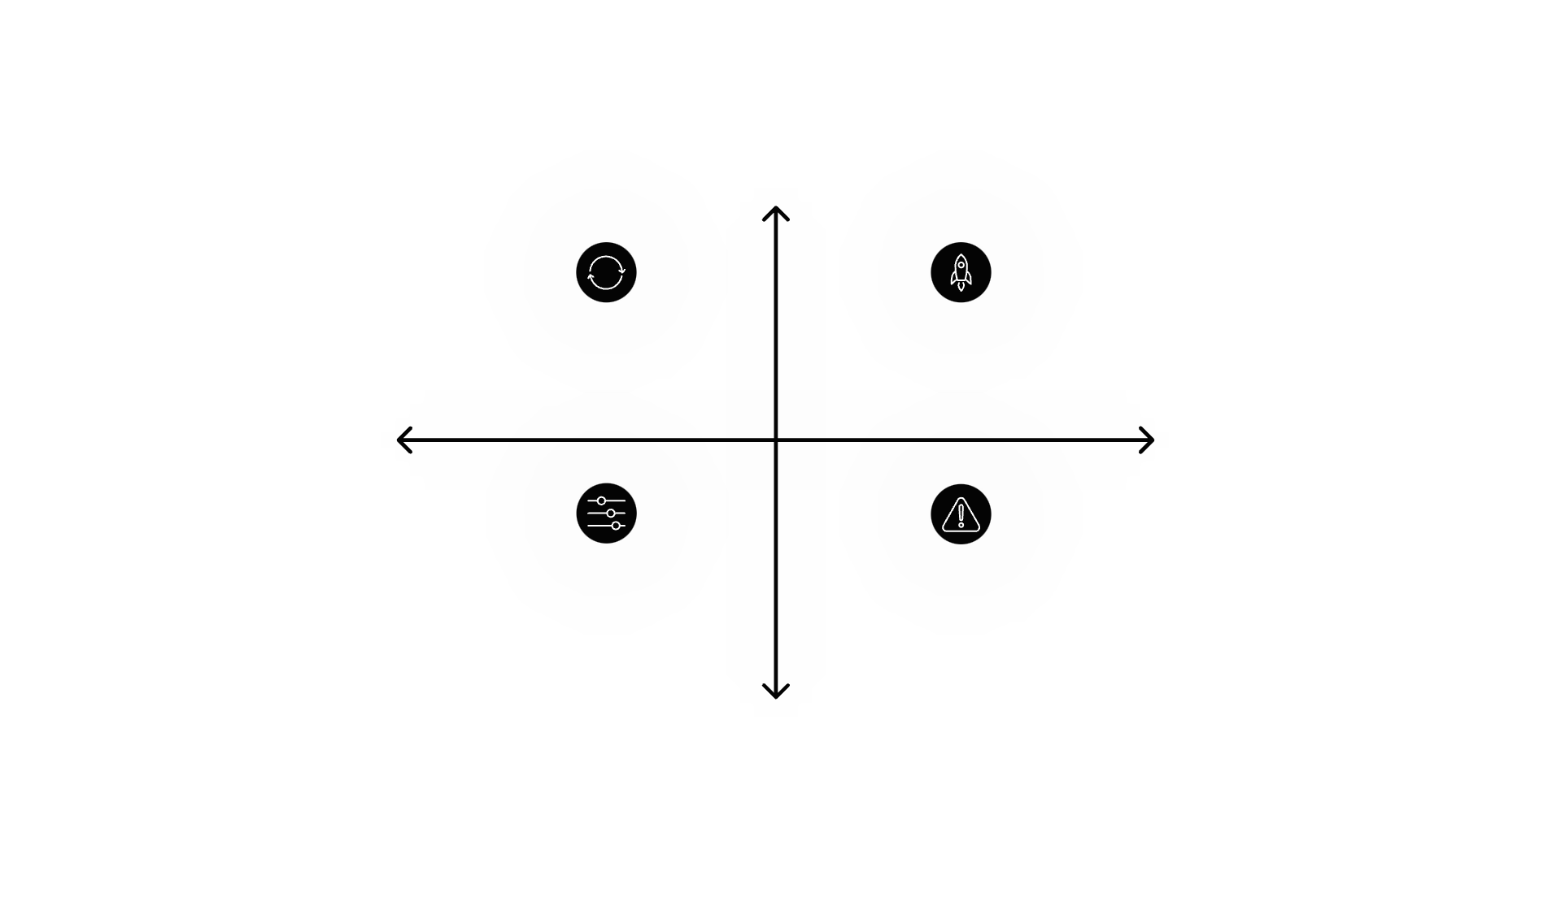
DEEP DIVE
useEffect — Dependency Array
Runs More Often
Why Dependencies Matter
The dependency array is the second argument to useEffect. It tells React when to re-run the effect. Getting this right is the most important skill when using useEffect — wrong dependencies cause infinite loops or stale data bugs.
No Array — runs after every render
Empty Array [] — runs once on mount
Predictability
Runs On Change
Array [count,id] — runs on value change
Common Pitfalls — missing or stale deps
Syntax: useEffect(fn, [deps])
Runs Less Often
No Array — Effect runs after every render. Use carefully — can cause infinite re-renders if you set state inside.
Empty

Slide 5





USEEFFECT PATTERN
Cleanup & Common Patterns
The cleanup function returned from useEffect prevents memory leaks and ensures your component behaves correctly when it unmounts or re-renders.
Most Common useEffect Patterns
Fetch on Mount — Call an API once when the component loads using an empty dependency array []
Update
1
Cleanup runs then effect re-runs if deps change.
Reactive Fetch — Re-fetch data when a prop like userId changes by listing it in dependencies
2
Mount
Unmount
Effect runs once when component mounts.
Cleanup runs to prevent memory leaks.
Event Listener — Add an event listener on mount and remove it in the cleanup function to avoid leaks
3
Abort Controller — Cancel in-flight fetch requests in cleanup to prevent setting state after unmount
4

Slide 6








APIS
What is an API?
An API (Application Programming Interface) is a contract that defines how two pieces of software communicate. It specifies what requests you can make, what format to use, and what responses you'll get back.
Interface
Request & Response
An API is a defined interface — a set of rules and endpoints both sides agree to. The client doesn't need to know the server's internal implementation.
A client sends a request (what it wants) and the server returns a response (the result or data), usually in JSON format on the web.
Abstraction Layer
Universal Language
APIs hide complexity. You don't need to know how a database stores users — you just call GET /users/1 and get the data.
APIs let different systems talk — a React frontend, a Python backend, and a mobile app can all communicate through the same API.

Slide 7
REST APIS
What is a REST API?
REST Principles
HTTP Methods (CRUD)
Stateless
GET
Every request contains all the information needed. The server stores no session state between requests — each call is independent.
Read Data
Fetch a resource. GET /users/1 returns user with id 1.
Resource-Based URLs
POST
REST organizes everything around resources (nouns), not actions. URLs like /users, /posts/5, /comments represent things, not verbs.
Create Data
Create a new resource. POST /users with a body creates a user.
Uses HTTP Methods
PUT
REST uses standard HTTP verbs — GET, POST, PUT, PATCH, DELETE — to describe what action to perform on a resource.
Update (Full)
Replace an entire resource. PUT /users/1 replaces user 1.
DELETE
Delete Data
Remove a resource. DELETE /users/1 deletes user 1.

Slide 8
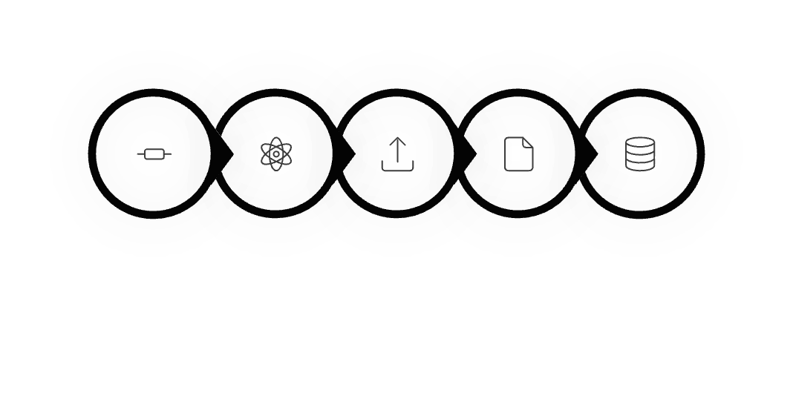
PUTTING IT TOGETHER
Fetching APIs with useEffect
Combining useEffect with the Fetch API (or Axios) is the standard pattern for loading server data in a React component. Here's how the pieces connect:
useEffect(() => {
// 1. Create an AbortController for cleanup
const controller = new AbortController();
// 2. Define and call the async fetch function
async function fetchUser() {
const res = await fetch(
'https://api.example.com/users/1',
{ signal: controller.signal }
);
const data = await res.json();
setUser(data); // 3. Store in state
}
fetchUser();
// 4. Cleanup: cancel request on unmount
return () => controller.abort();
}, [userId]); // 5. Re-run when userId changes
The Full Data Flow
Mount
useEffect
Send Request
Receive JSON
Update State
The component renders first (possibly with a loading state), then useEffect fires, the REST API call goes out, data comes back as JSON, and setState triggers a final re-render with real data.

Slide 9

What We Covered
Key
Takeaways
useEffect runs after render and is the right place for any side effect — including API calls, timers, and subscriptions.
You now have a solid mental model connecting React's rendering lifecycle to the outside world through useEffect and REST APIs.
The Three Pillars
1
Side Effects — Any operation outside React's render: fetching data, DOM access, timers, and event listeners.
2
useEffect — Controls when side effects run using a callback and a dependency array. Always clean up after yourself.
3
REST APIs — Stateless, resource-based HTTP interfaces. Use GET, POST, PUT & DELETE to read and modify data.

