Slide 1

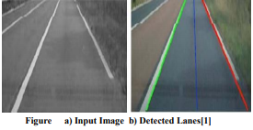
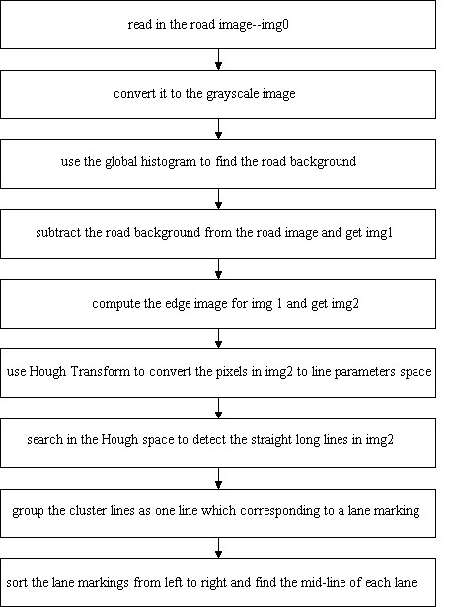
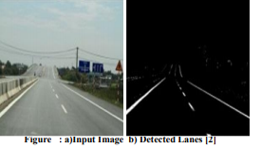
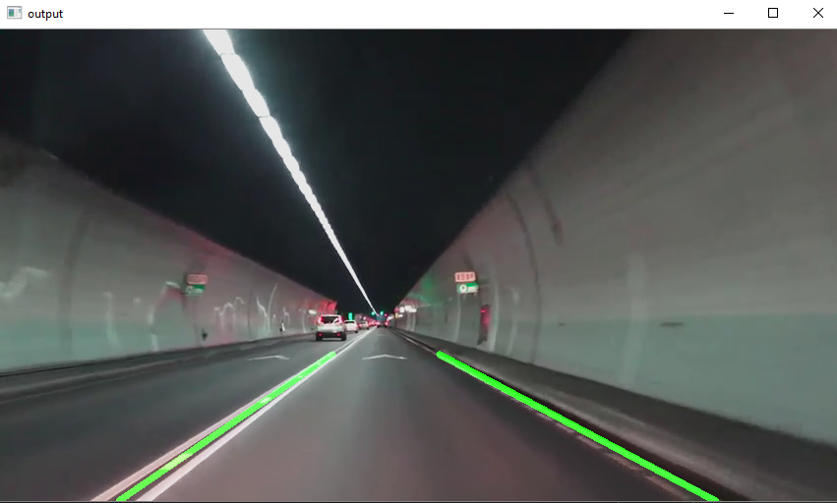
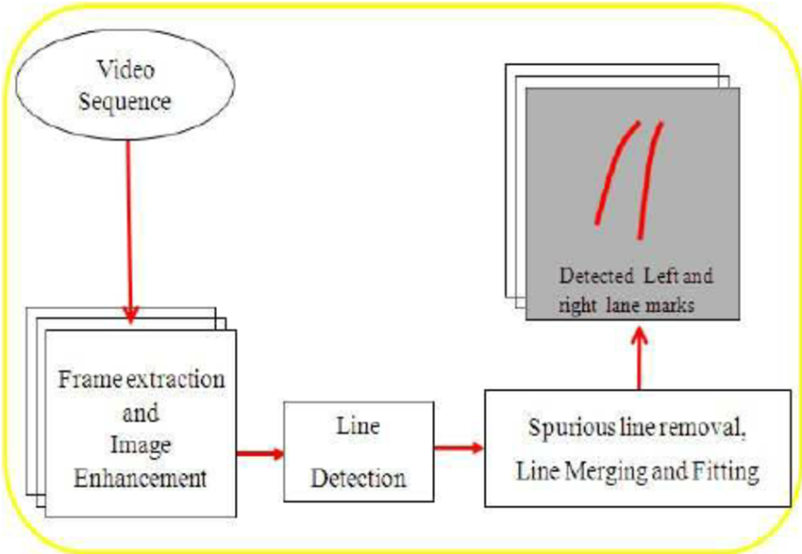
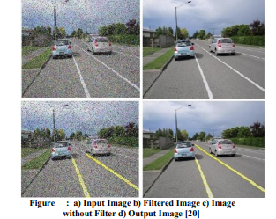
Automated Lane Simulation
Raksha Sankhala, Saiel Wadwekar, Saquib Qureshi, Yashasvi Sharma, Yashraj Sharma, Yuvraj S Panwar
Acropolis Institute of Technology and Research, Indore, Madhya Pradesh
ABSTRACT
PROPOSAL
RESULTS
CONCLUSION
Lane detection is a challenging problem. It has attracted the attention of the computer vision community for several decades. Essentially, lane detection is a multi feature detection problem that has become a real challenge for computer vision and machine learning techniques. Although many machine learning methods are used for lane detection, they are mainly used for classification rather than feature design. But modern machine learning methods can be used to identify the features that are rich in recognition and have achieved success in feature detection tests. However, these methods have not been fully implemented in the efficiency and accuracy of lane detection. In this project, we propose a new method to solve it. We introduce a new method of preprocessing and ROI selection. The main goal is to use the HSV color transformation to extract the white features and add preliminary edge feature detection in the preprocessing stage and then select ROI on the basis of the proposed preprocessing. This new preprocessing method is used to detect the lane.
Our main contribution in this project is to do a lot of work in the preprocessing stage. We proposed to perform color transform of HSV in the preprocessing stage, then extract white, and then perform conventional preprocessing operations in sequence. Moreover, we selected an improved method proposed in the area of interest (ROI). In this project, based on the proposed preprocessing method (after HSV color transform, white feature extraction, and basic preprocessing), one-half part of the processed image is selected as the area of interest (ROI). In addition, we performed twice edge detection. The first is in the preprocessing stage, and the second is in the lane detection stage after the ROI is selected. The purpose of performing twice edge detection is to enhance the lane recognition rate.
We detected that the lane marks, lane mark’s characteristics and had the ability to determine the travelling direction. It used the well known Hough transform to detect the potential lines in the images. To ensure the right detection of the lane mark, they had developed a technique that extracts the inner margin of the lane. The margins are highlighted by generating the magnitude image.
In this project, we proposed a new lane detection preprocessing and ROI selection methods to design a lane detection system. The main idea is to add white extraction before the conventional basic preprocessing. Edge extraction has also been added during the preprocessing stage to improve lane detection accuracy. We also placed the ROI selection after the proposed preprocessing. Compared with selecting the ROI in the original image, it reduced the non lane parameters and improved the accuracy of lane detection. Currently, we only use the Hough transform to detect straight lane and track lane and do not develop advanced lane detection methods. In the future, we will exploit a more advanced lane detection approach to improve the performance.
REFERENCES
[1] J. Navarro, J. Deniel, E. Yousfi, C. Jallais, M. Bueno, and A. Fort, “Influence of lane departure warnings onset and reliability on car drivers' behaviors,” Applied Ergonomics, vol. 59, pp. 123–131, 2017.
[2] P. N. Bhujbal and S. P. Narote, “Lane departure warning system based on Hough transform and Euclidean distance,” in Proceedings of the 3rd International Conference on Image Information Processing, ICIIP 2015, pp. 370–373, India, December 2015. V. Gaikwad and S. Lokhande, “Lane Departure Identification for Advanced Driver Assistance,” IEEE Transactions on Intelligent Transportation Systems, vol. 16, no. 2, pp. 910–918, 2015.
[3] H. Zhu, K.-V. Yuen, L. Mihaylova, and H. Leung, “Overview of Environment Perception for Intelligent Vehicles,” IEEE Transactions on Intelligent Transportation Systems, vol. 18, no. 10, pp. 2584–2601, 2017.
[4 ]F. Yuan, Z. Fang, S. Wu, Y. Yang, and Y. Fang, “Real-time image smoke detection using staircase searching-based dual threshold AdaBoost and dynamic analysis,” IET Image Processing, vol. 9, no. 10, pp. 849–856, 2015.
[5]P.-C. Wu, C.-Y. Chang, and C. H. Lin, “Lane-mark extraction for automobiles under complex conditions,” Pattern Recognition, vol. 47, no. 8, pp. 2756–2767, 2014.
[6] M.-C. Chuang, J.-N. Hwang, and K. Williams, “A feature learning and object recognition framework for underwater fish images,” IEEE Transactions on Image Processing, vol. 25, no. 4, pp. 1862–1872, 2016.
[7] Y. Saito, M. Itoh, and T. Inagaki, “Driver Assistance System with a Dual Control Scheme: Effectiveness of Identifying Driver Drowsiness and Preventing Lane Departure Accidents,” IEEE Transactions on Human-Machine Systems, vol. 46, no. 5, pp. 660–671, 2016.
[8]Q. Lin, Y. Han, and H. Hahn, “Real-Time Lane Departure Detection Based on Extended Edge-Linking Algorithm,” in Proceedings of the 2010 Second International Conference on Computer Research and Development, pp. 725–730, Kuala Lumpur, Malaysia, May 2010.
[9]C. Mu and X. Ma, “Lane detection based on object segmentation and piecewise fitting,” TELKOMNIKA Indonesian Journal of Electrical Engineering, vol. 12, no. 5, pp. 3491–3500, 2014
OBJECTIVES
Our adaptive method based on HSI color model to detect lane marking. First, they converted RGB-based image to its HSI-based image. However, HSI color model was improved by the change in the way to calculate the intensity (I) component from RGB color images. From observing the color images of the road scene in HIS color space, they utilized the limited range of color. Hence, H, S and I component were used in this method. The proposed method can label the location of lane marking accurately.
The objective of this project is to use traditional Computer Vision techniques to develop an advanced and robust algorithm that can detect and track lane boundaries in a video. The pipeline was designed to operate under the following scenarios:
To detect exactly two lane lines, i.e. the left and right lane boundaries of the lane the vehicle is currently driving in.
To carry load and transfer load between two divisions of any Industry/Factory.
To use radium tapes to make lane which will be detected by machine as it will reduce the electricity cost of the factory with manual labour as well.
To detect both the lanes because if only one of two lane lines have been successfully detected, then the detection is considered invalid and will be discarded. In this case, the pipeline will instead output a lane line fit (for both left and right) based on the moving average of the previous detections. This is due to the lack of an implementation of the lane approximation function (which is considered as future
work).
We proposed an efficient ways of noise reduction in the images by using different filtering techniques in this paper. The main objective was to design, develop, implement and subsequently simulate an efficient lane detection algorithm which will provide high quality results in the case when noise is present in the signal. Various filters used for comparison were median, wiener, and hybrid median filters.
ACKNOWLEDGEMENT
We would like to thanks to our Professors, Mr. Pawan K Gupta and Mr. Prraveen Bhanodia under their support and guidance we were able to make our project “Automated Lane Simulation”. We hope that we have been able to fulfill the instructions expected from us and also special thanks for the group members

