Slide 1

Automated Lane Simulation
Project Report on:
Submitted to:
Prof. Pawan K Gupta

Slide 2
PROJECT PRESENTATION OUTLINE

Slide 3
Abstract
Introduction
Objective
Survey of Existing Systems
Requirement Analysis
Solution Proposed
Models and Diagrams
Limitations and Conclusion

Slide 4
ABSTRACT

Slide 5
Lane detection is a challenging problem. It has attracted the attention of the computer vision community for several decades. Essentially, lane detection is a multi feature detection problem that has become a real challenge for computer vision and machine learning techniques. Although many machine learning methods are used for lane detection, they are mainly used for classification rather than feature design. But modern machine learning methods can be used to identify the features that are rich in recognition and have achieved success in feature detection tests. However, these methods have not been fully implemented in the efficiency and accuracy of lane detection. In this project, we propose a new method to solve it. We introduce a new method of preprocessing and ROI selection. The main goal is to use the HSV color transformation to extract the white features and add preliminary edge feature detection in the preprocessing stage and then select ROI on the basis of the proposed preprocessing. This new preprocessing method is used to detect the lane.

Slide 6
INTRODUCTION

Slide 7
Lane detection is a well-researched area of computer vision with applications in autonomous vehicles and driver support systems.
This is in part because, despite the perceived simplicity of finding white markings on a dark road, it can be very difficult to determine lane markings on various types of road.
These difficulties arrive from shadows, occlusion by other vehicles, changes in the road surfaces itself, and differing types of lane markings.
A lane detection system must be able to pick out all manner of markings from cluttered roadways and filter them to produce a reliable estimate of the vehicle position and trajectory relative to the lane.
By integrating the lane marking detector with the lane tracking system, we have developed a robust lane detection system that works well in a variety of different conditions.
The detection is performed using steerable filters which are suitable for detecting bots dots, solid lines, and dashed lines.
For solid and dashed lines, the filters can be tuned to respond to a specific lane angle, thereby removing extraneous road features.

Slide 8
OBJECTIVE

Slide 9
The objective of this project is to use traditional Computer Vision techniques to develop an advanced and robust algorithm that can detect and track lane boundaries in a video.
The pipeline highlighted below was designed to operate under the following scenarios:
    It can detect exactly two lane lines, i.e. the left and right lane boundaries of the lane the vehicle is currently driving in.
It cannot detect adjacent lane lines.
The vehicle must be within a lane and must be aligned along the direction of the lane.
If only one of two lane lines have been successfully detected, then the detection is considered invalid and will be discarded. In this case, the pipeline will instead output a lane line fit (for both left and right) based on the moving average of the previous detections.
This is due to the lack of an implementation of the lane approximation function (which is considered as future work).

Slide 10
Survey of Existing Systems

Slide 11
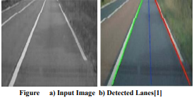
Results using Hough Transform
Mariut et al in his research paper proposed a simple algorithm that detected the lane marks, lane mark’s characteristics and had the ability to determine the travelling direction.
It used the well known Hough transform to detect the potential lines in the images.
To ensure the right detection of the lane mark, they had developed a technique that extracts the inner margin of the lane.
The margins are highlighted by generating the magnitude image.

Slide 12
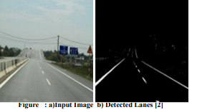
Results using Hough Transformation and Filters
T.T Tran et al in his research paper proposed an adaptive method based on HSI color model to detect lane marking. First, they converted RGB-based image to its HSI-based image.
However, HSI color model was improved by the change in the way to calculate the intensity (I) component from RGB color images.
From observing the color images of the road scene in HIS color space, they utilized the limited range of color. Hence, H, S and I component were used in this method.
The proposed method can label the location of lane marking accurately.

Slide 13
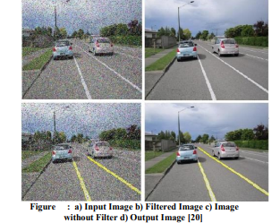
Results of Lane Detection based on HSI model
S. Srivastava et al in his research paper proposed an efficient ways of noise reduction in the images by using different filtering techniques in this paper.
The main objective was to design, develop, implement and subsequently simulate an efficient lane detection algorithm which will provide high quality results in the case when noise is present in the signal.
Various filters used for comparison were median, wiener, and hybrid median filters.

Slide 14
REQUIREMENT
ANALYSIS

Slide 15
Functional Requirements
The lane lines are mapped from the road which are a result of determination of pixels which would be a part of the right and left lines of the lane.
A way which would help to reduce traffic problems as lesser changing of lanes would take place.
A method which would combine for the concept of self-driving cars.
Software Requirements
Jetbrains by Pycharm community edition 2019.2.1
Python 3.7.4
OpenCV
Important packages such as Matplotlib
Pillow
Pip
Numpy
Opencv-python
PyBundle
Kiwisolver and many more library packages.

Slide 16
Hardware Requirements
Intel Core i3 or above
Windows 10
RAM 4 GB or above
Memory 500 GB or above

Slide 17
SOLUTION PROPOSED

Slide 18
In any driving scenario, lane lines are an essential component of indicating traffic flow and where a vehicle should drive.
It's also a good starting point when developing a self-driving car! In this project, I'll be showing you how to build your own lane detection system in OpenCV using Python. Here's the structure of our lane detection pipeline:
-Reading Images
-Color Filtering in HLS
-Region of Interest
-Canny Edge Detection
-Hough Line Detection
-Line Filtering & Averaging
-Overlay detected lane
-Applying to Image/ video.
In this project, we propose a lane detection method that is suitable for all kinds of vehicles. First, we preprocessed each frame image and then selected the area of interest (ROI) of the processed images.
We introduced a new preprocessing method and ROI selection method. First, in the preprocessing stage, we converted the RGB color model to the HSV color space model.
At the same time, the preliminary edge feature detection is added in the preprocessing stage, and then the part below the image is selected.

Slide 19
MODELS
&
DIAGRAMS

Slide 20
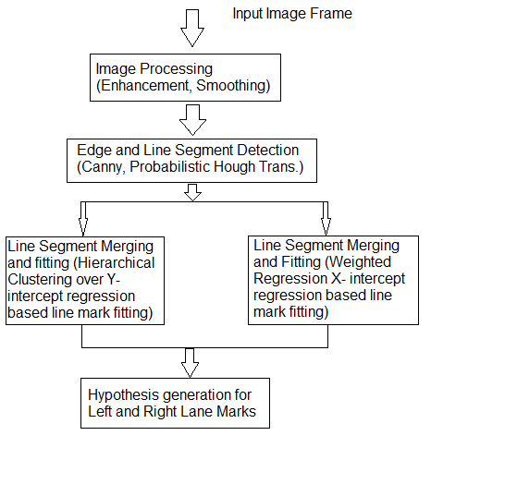
Flow Diagram

Slide 21
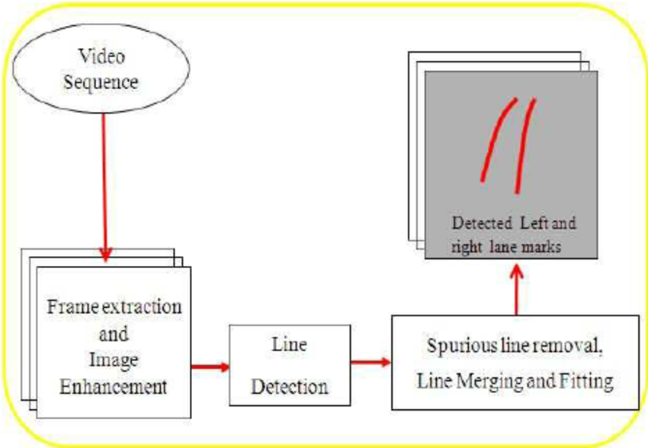
Block Diagram

Slide 22
LIMITATIONS
&
Conclusion

Slide 23
Limitations
A recorder system to check the utility of the software on road and along with physical conditions is unavailable.
A running concept of research which is not accepted widely in the current world scenario.
Conclusion
In this project, we proposed a new lane detection preprocessing and ROI selection methods to design a lane detection system.
The main idea is to add white extraction before the conventional basic preprocessing. Edge extraction has also been added during the preprocessing stage to improve lane detection accuracy.
We also placed the ROI selection after the proposed preprocessing.
Compared with selecting the ROI in the original image, it reduced the nonlane parameters and improved the accuracy of lane detection. Currently, we only use the Hough transform to detect straight lane and track lane and do not develop advanced lane detection methods. In the future, we will exploit a more advanced lane detection approach to improve the performance.

Slide 24
ACKNOWLEDGEMENT

Slide 25
We would like to thanks to our Professor, Mr. Pawan K Gupta under his support and guidance we are able to make our project “Automated Lane Simulation”
We hope that we have been able to fulfill the instructions expected from us and also special thanks for the group members

Slide 26
BIBLIOGRAPHY

Slide 27
D. Pomerleau, “RALPH: rapidly adapting lateral position handler,” in Proceedings of the Intelligent Vehicles '95. Symposium, pp. 506–511, Detroit, MI, USA, 2003.
J. Navarro, J. Deniel, E. Yousfi, C. Jallais, M. Bueno, and A. Fort, “Influence of lane departure warnings onset and reliability on car drivers' behaviors,” Applied Ergonomics, vol. 59, pp. 123–131, 2017.
P. N. Bhujbal and S. P. Narote, “Lane departure warning system based on Hough transform and Euclidean distance,” in Proceedings of the 3rd International Conference on Image Information Processing, ICIIP 2015, pp. 370–373, India, December 2015. V. Gaikwad and S. Lokhande, “Lane Departure Identification for Advanced Driver Assistance,” IEEE Transactions on Intelligent Transportation Systems, vol. 16, no. 2, pp. 910–918, 2015.
H. Zhu, K.-V. Yuen, L. Mihaylova, and H. Leung, “Overview of Environment Perception for Intelligent Vehicles,” IEEE Transactions on Intelligent Transportation Systems, vol. 18, no. 10, pp. 2584–2601, 2017.
F. Yuan, Z. Fang, S. Wu, Y. Yang, and Y. Fang, “Real-time image smoke detection using staircase searching-based dual threshold AdaBoost and dynamic analysis,” IET Image Processing, vol. 9, no. 10, pp. 849–856, 2015.
J. W. Lee, C. D. Kee, and U. K. Yi, “A new approach for lane departure identification,” in Proceedings of the IEEE IV2003 Intelligent Vehicles Symposium, pp. 100–105, 2003.

Slide 28
PRESENTATION BY
Raksha Sankhala (0827IT161086)
Saquib Qureshi (0827IT161098)
Saiel Wadwekar (0827IT161094)
Yashasvi Sharma (0827IT161121)
Yashraj Sharma (0827IT161122)
Yuvraj Singh Panwar (0827IT161123)

Slide 29
Thanks!

