Slide 1

Mental Health for Rural Women
Team: Binary Beast

Slide 2
Introduction
Mental health
Integral to living a healthy and balanced life
Emotional, psychological, and social well-being
Statistics
56 million Indians are suffering from depression.
38 million from anxiety disorders (WHO)
Crisis
Indian’s Mental health crisis is at an inflection point. (2017 study from Lancet estimates)
Progress
Progress in breaking awareness observed in urban areas
RURAL mental health is less explored !

Slide 3
Motivation
About 10% Indians suffer from stress, depression or substance use disorders.
Around 70–80% of the population in India currently live in rural settings.
Results show that the levels of Anxiety and Depression is greater in women than men!

Slide 4

Solution
Availability : WHO recommends that there should be one mental health personnel available per 100,000 people in a country.
Accessibility : Local Volunteers and Health professionals’ help to target accessibility challenges like Distance, Financial
Acceptability : Awareness efforts to teach people that it is normal for the mind to be unwell from time to time.

Slide 5
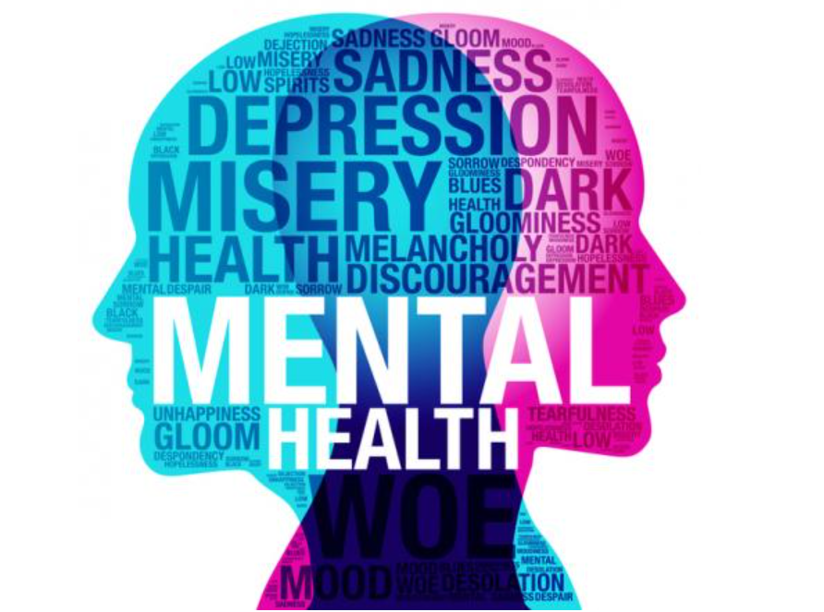
Platform
A platform made accessible to the people through local health centers.
AI driven Initial diagnosis using rightly sourced questionnaire that can be localized to regional language to judge the level of mental illness.
DASS (Depression Anxiety Stress Scales) as one of the scales.
Connect people with the right health professional (such as Psychiatrists) through e-consultations supported by the clinics through voice and video calls.
Incentivization through social certificates issued to health professionals volunteering for this cause.
Eliminate the stigma with the help of local NGOs, Volunteers, campaigns to create awareness on Mental health

Slide 6
Conclusion
Effort starts with Rural Women to bring this change
Break the stigma around mental illness and well being
Right help to each individual privileged or under-privileged

Slide 7
References
https://www.forbesindia.com/blog/health/how-do-you-take-mental-health-conversations-to-rural-india/)
https://www.ncbi.nlm.nih.gov/pmc/articles/PMC6034434/
https://link.springer.com/article/10.1007/s11126-022-09973-8
https://www.thehindu.com/sci-tech/health/addressing-mental-health-in-rural-india/article25352154.ece
https://hbr.org/2018/10/ais-potential-to-diagnose-and-treat-mental-illness
http://www2.psy.unsw.edu.au/dass/

