Slide 1

PHONEPE TRANSACTION INSIGHTS
Analysing Transaction Dynamics, Engagement, and Growth Potential
BY SHARMILA

Slide 2


Introduction
Phone Pe is one of India’s leading digital payment platforms, enabling users to make secure and convenient financial transactions .
This project aims to explore and analyse transaction data from Phone Pe across various states and categories, providing insights into usage patterns, transaction volumes, and regional trends.
Through this project, we seek to highlight key trends, visualize data, and draw meaningful conclusions from Phone Pe transaction records.

Slide 3
Agenda
Introduction
Business Use Case 1: Decoding Transaction Dynamics
Business Use Case 2: Device Dominance & Engagement
Business Use Case 3: Insurance Penetration & Growth
Business Use Case 4: Market Expansion Strategy
Business Use Case 5: User Engagement and Growth Strategy
Insights and recommendations

Slide 4
Tools and technologies used
S.NO. | Tool/Technology | Purpose
1 | GitHub | Source of PhonePe JSON data
2 | Python | Data processing, transformation, analysis
3 | Pandas, Matplotlib, Seaborn | Data analysis and visualizations
4 | MySQL | Structured storage and querying of transformed data
5 | Streamlit | Web-based interactive dashboard
6 | Power BI | Business-oriented dashboard and advanced visualizations
7 | SQLAlchemy + PyMySQL | Connection between Python and MySQL database

Slide 5
Approach and workflow
Step 1: Data Extraction from GitHub
Step 2: SQL Database Setup (MySQL)
Step 3: Table Creation – Aggregated, Map, and Top tables
Step 4: Data Analysis using SQL Queries
Step 5: Visualization using Python (Matplotlib, Seaborn), Streamlit, and Power BI
Step 6: Insight Generation and Recommendations

Slide 6
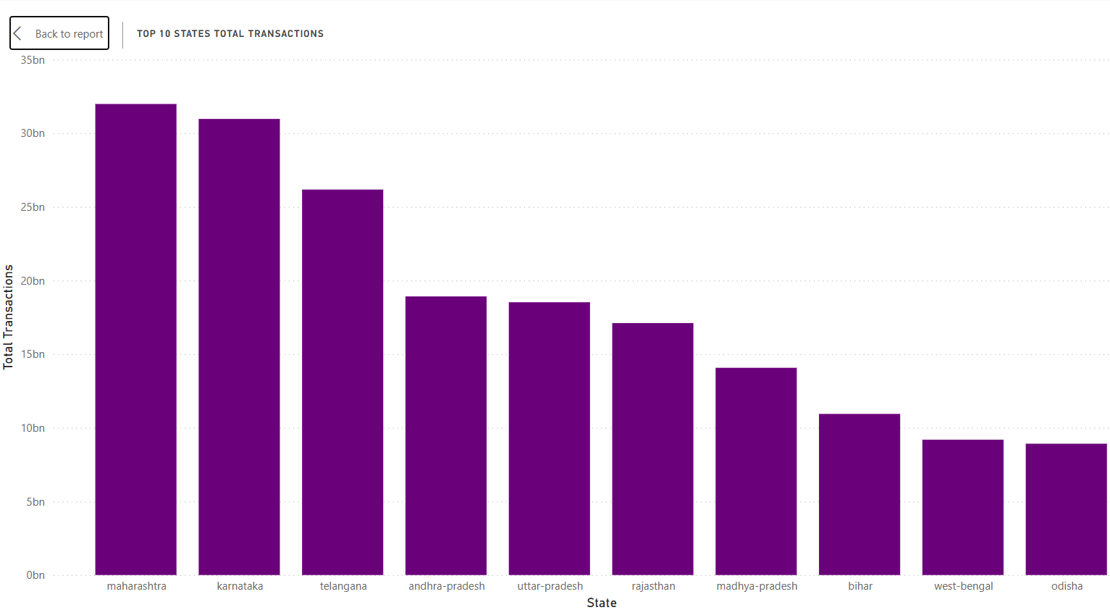
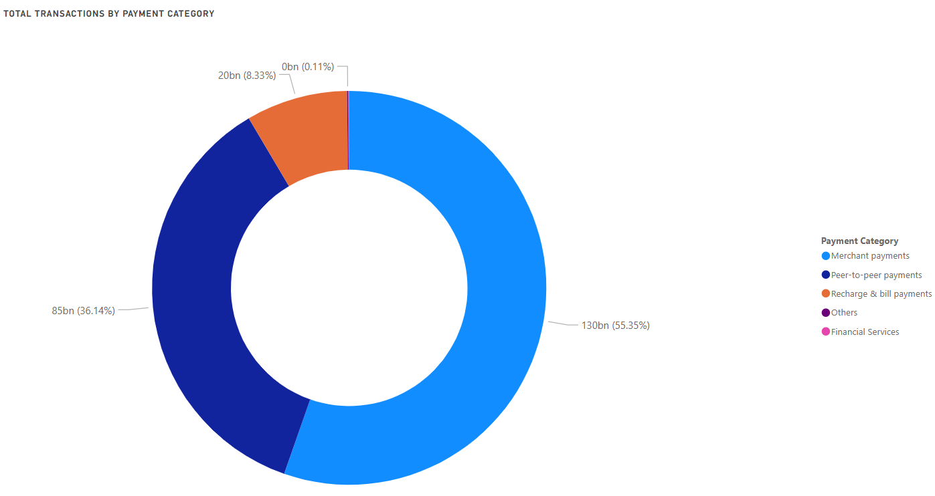
Visualisation:
Case Study 1: Decoding Transaction Dynamics on PhonePe
Total Transaction Amount Trend by State
Total Transaction Amount Trend by Transaction type

Slide 7
Insights:
Top 10 States by Total Transactions (Left Bar Chart)
Maharashtra and Karnataka dominate with over 30 billion transactions each, indicating highly digitized economies.
Telangana follows with ~26B, then a steep drop to Andhra Pradesh, Uttar Pradesh, Rajasthan, each around 17–19B.
Remaining states: Madhya Pradesh, Bihar, West Bengal, Odisha show moderate transaction volumes (~9–14B).
📌 Key Takeaway: The digital transaction ecosystem is heavily centered in developed and urbanized states, but Tier-2 states are showing considerable activity.
Total Transactions by Payment Category (Right Donut Chart)
Merchant Payments account for the largest share (55.35%) – 130B transactions.
Peer-to-Peer (P2P) Payments follow with 36.14% – 85B transactions.
Recharge & Bill Payments contribute 8.33% – 20B transactions.
Others and Financial Services are negligible (combined <0.2%).
📌 Key Takeaway: The bulk of digital activity revolves around consumer-to-merchant and peer-to-peer transactions. Other services have minimal adoption.

Slide 8
Recommendations:
a. Focus on High-Transaction States
Prioritize expansion and partnerships in Maharashtra, Karnataka, and Telangana, which:
Are leaders in digital adoption
Offer economies of scale for payment platforms
Should be target zones for value-added services (insurance, credit, savings)
b. Boost Penetration in Mid-Tier States
Andhra Pradesh, Uttar Pradesh, Bihar, and West Bengal show strong volumes despite socio-economic challenges.
Leverage government schemes, local agents, and multilingual support to push further adoption.
c. Diversify Beyond Merchant and P2P Payments
Recharge & bill payments have decent engagement but are under-tapped.
Promote automated bill pay, reminders, and cashback offers to boost user retention and frequency.
Explore growth of financial services (lending, micro-savings) especially in Tier-2/3 regions.
d. Cross-Sell to Existing High-Usage Users
Users already engaging in merchant and P2P payments should be cross-sold:
Insurance (micro or bundled)
Investment services
Subscription-based payments
e. Monitor Payment Category Trends
Regularly track if merchant vs. P2P shares shift — e.g., festive seasons may favor merchant spends, while economic downturns may push P2P activity.
Adjust marketing campaigns accordingly.

Slide 9
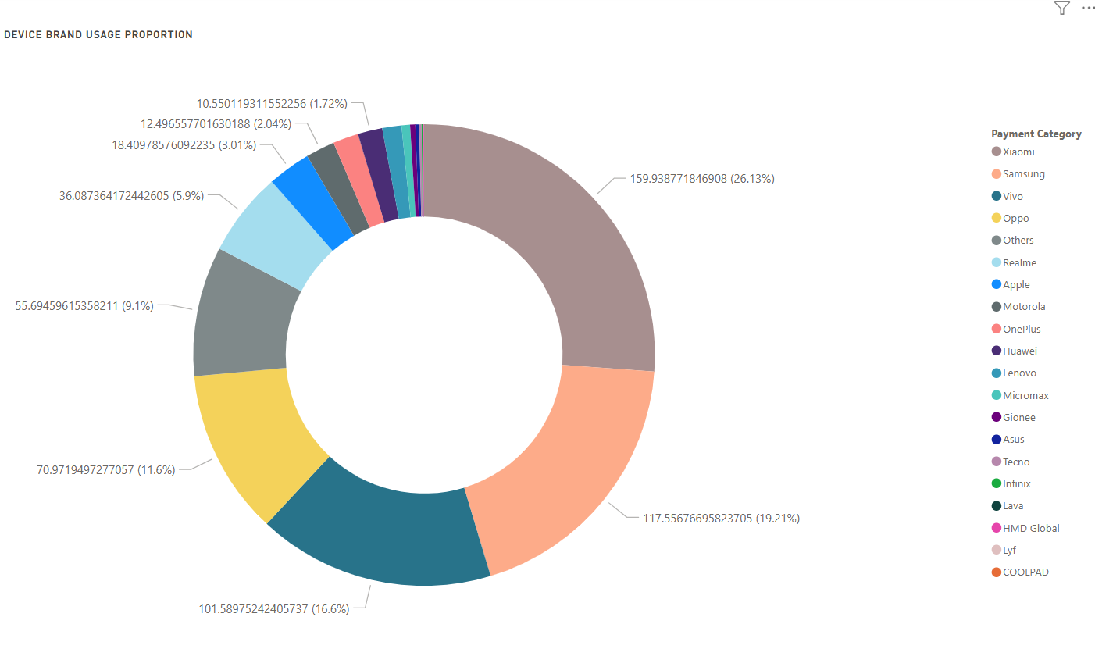
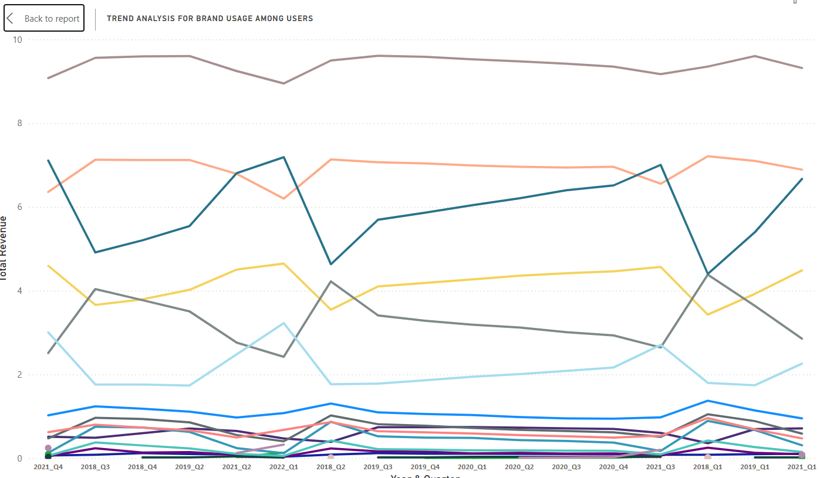
Visualisation:
Case Study 2: Device dominance and user engagement analysis
Top 5 Device Brands by Total Users
Brand Engagement % Across States

Slide 10
Insights:
Device Brand Usage Proportion (Left Donut Chart)
a. Xiaomi dominates the market with 26.13% of users, followed by:
Samsung (19.21%)
Vivo (16.6%)
Oppo (11.6%)
Others (9.1%) – represents various small brands
b. Brands like Realme (5.9%), Apple (3.01%), and Motorola (2.04%) trail behind.
📌 Key Takeaway: The majority of users are using budget to mid-range Android phones, indicating a price-sensitive user base.
Trend Analysis for Brand Usage Among Users (Right Line Graph)
a. Xiaomi maintains the highest total revenue consistently over multiple quarters, showing strong user loyalty and purchase behavior.
b. Samsung shows stable revenue trends, but not growing significantly.
c. Vivo shows an upward trend and occasionally surpasses Samsung, indicating its rising popularity.
d. Oppo and Others maintain moderate trends with small fluctuations.
e. Realme shows steady growth, signaling a brand on the rise.
f. Brands like Apple, OnePlus, and Motorola remain at the bottom in terms of revenue, showing minimal change over time.
📌 Key Takeaway: While Xiaomi leads, Realme and Vivo are growing players that could soon capture more market share.

Slide 11
Recommendations:
1. Strategic Brand Partnerships
Prioritize alliances with Xiaomi, Samsung, and Vivo for bundled offerings, promotions, or co-marketing since they dominate user share and revenue.
Collaborate with emerging brands like Realme to tap into fast-growing segments.
2. Targeted Marketing
Focus campaigns on budget-conscious consumers, highlighting value-for-money, since most users prefer affordable Android brands.
Use customized offers for mid-range phones (e.g., Vivo, Oppo), especially in regions showing growth.
3. Product Optimization
Optimize app and services for Xiaomi and Vivo devices, as these are dominant among your users.
Ensure feature compatibility and performance testing on the top 5 brands before others.
4. Monitor Shifting Trends
Keep an eye on Realme's upward trend—they may become a key player.
Consider periodic brand usage trend analysis (quarterly) to adapt to changing device preferences.
5. Deprioritize Low-Impact Brands
Brands like Apple, Motorola, and OnePlus have minimal impact in this user segment, so resource allocation to support or promote these brands can be minimized unless targeting a niche premium market.

Slide 12
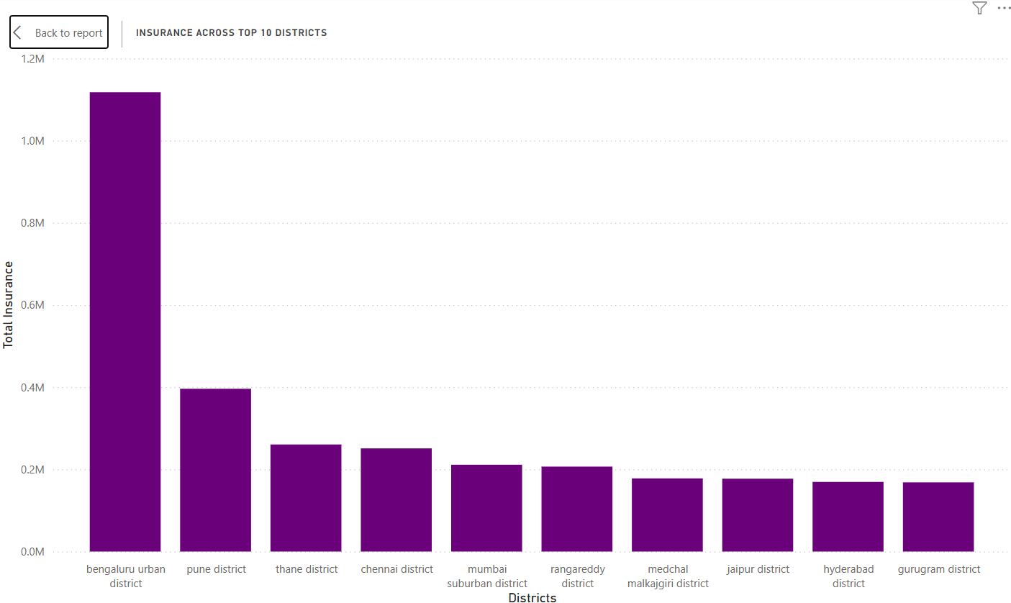
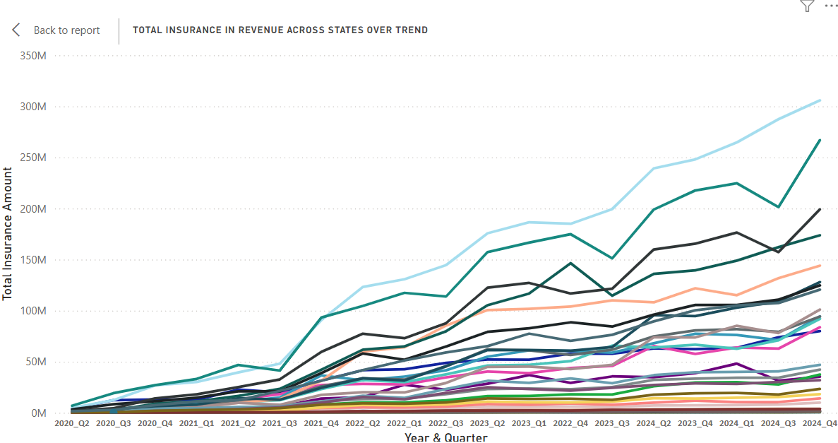
Visualisation:
Case Study 3: Insurance penetration and growth potential analysis
Total Insurance in Revenue Across States Over Time
Insurance Across Top 10 Districts

Slide 13
Insights:
Total Insurance in Revenue Across States Over Time (Left Line Chart)
a. Steady Growth: There is a clear upward trend in total insurance revenue across almost all states from Q2 2020 to Q2 2024.
b. Top-Performing States:
Two states (light blue and dark teal lines) are leading significantly, reaching over 300M and 250M respectively by 2024 Q2.
A third cluster of states shows moderate growth (100M–200M range).
c. Post-2021 Surge: A significant uptick begins around 2021 Q2, possibly due to policy changes, increased digital adoption, or post-pandemic recovery.
d. Low-Tier States: Several states still contribute minimally and show slower growth, indicating untapped markets.
📌 Key Takeaway: Insurance uptake is expanding rapidly, with a few states leading the charge. There’s strong momentum post-2021.
Insurance Across Top 10 Districts (Right Bar Chart)
Bengaluru Urban District is the clear leader, with over 1.1M in total insurance—nearly 3× more than the second-highest.
b. Other Key Districts:
Pune, Thane, Chennai, Mumbai Suburban – moderate contributors (200K–400K range).
Rangareddy, Medchal-Malkajgiri, Jaipur, Hyderabad, Gurugram – relatively lower but still in the top 10.
c. Distribution shows a sharp drop-off after the first district, followed by a more gradual decline among the rest.
📌 Key Takeaway: Insurance concentration is heavily skewed toward Bengaluru Urban, suggesting high market maturity or digital penetration.

Slide 14
Recommendations:
1. Expand in Underperforming States
Target states with slower growth for insurance awareness campaigns, local partnerships, and onboarding incentives.
Customize offerings based on regional socio-economic factors.
2. Double Down on High-Growth States
Focus product innovation, cross-selling, and premium plans in the top 2–3 performing states.
Use these as reference markets for testing new digital insurance features.
3. Replicate Success in Similar Districts
Analyze Bengaluru Urban’s model (digital penetration, partnerships, urban demographics) and replicate strategies in other metro hubs.
Consider hyperlocal marketing in mid-performing districts like Pune and Chennai.
4. Unlock Rural Potential
Several districts and states remain far below the growth curve. Use micro-insurance products, vernacular support, and agent networks to boost inclusion.
5. Monitor Growth Trends
Continue tracking quarterly changes to detect early signs of saturation or new surges.
Use trend data for forecasting and resource planning by region.

Slide 15
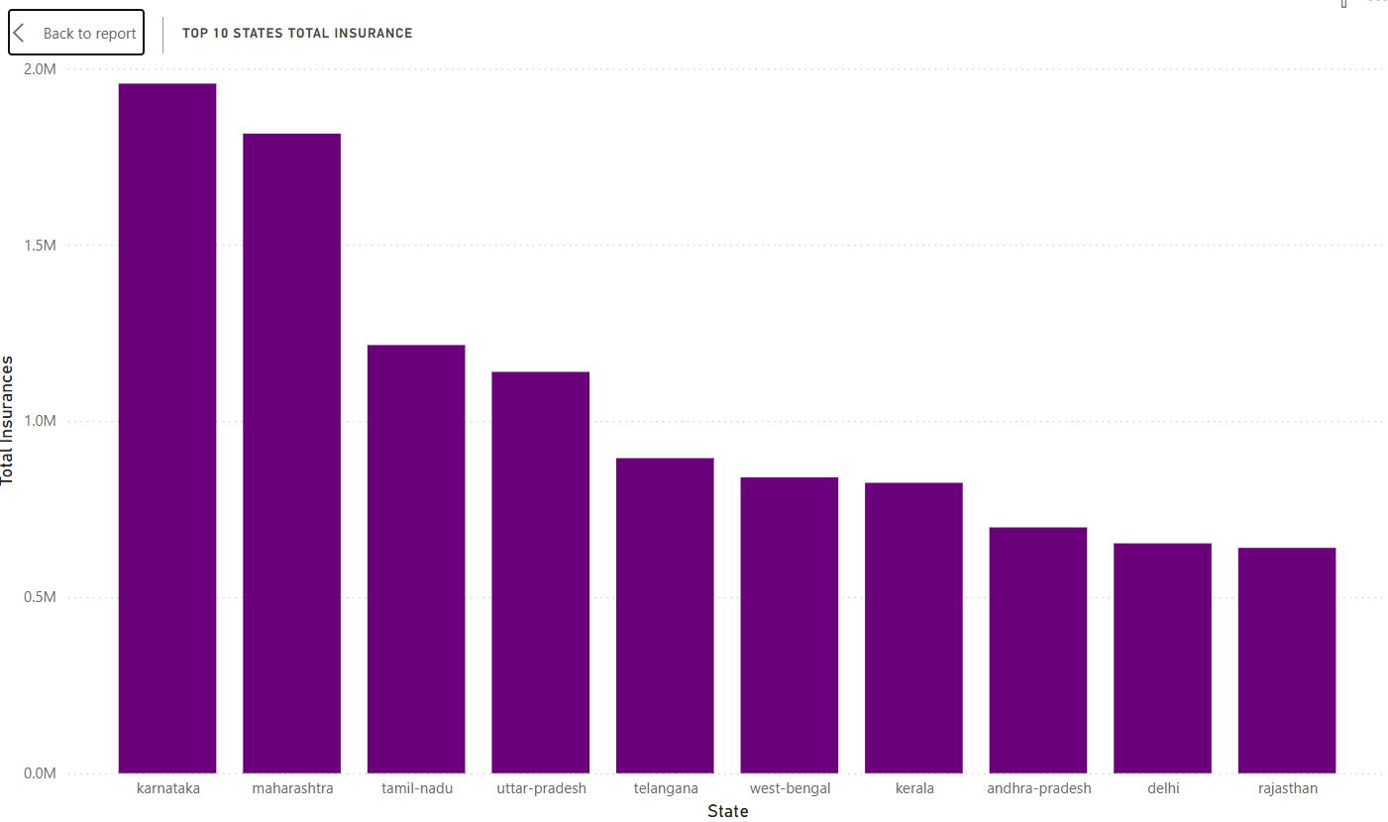
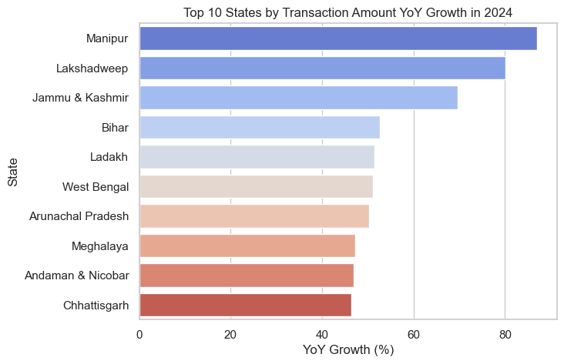
Visualisation:
Case Study 4: Transaction Analysis for Market Expansion
Top 10 States by Total Insurance
Top 10 States by Transaction Amount YoY Growth in 2024

Slide 16
Insights:
Top 10 States by Total Insurance (Left Bar Chart)
a. Top Contributors:
Karnataka leads with the highest total insurance count (~2M), followed closely by Maharashtra.
Other major states: Tamil Nadu, Uttar Pradesh, Telangana, West Bengal, Kerala, Andhra Pradesh, Delhi, Rajasthan.
b. These states show a significantly higher volume of total insurance, indicating strong market penetration, population base, or urban development.
📌 Key Takeaway: The insurance market is concentrated in large, populous, and more urbanized states.
Top 10 States by YoY Growth in Transaction Amount – 2024 (Right Horizontal Bar Chart)
a. High Growth, Low Base States:
Manipur, Lakshadweep, and Jammu & Kashmir top the list with YoY growth above 60–80%.
Other fast growers: Bihar, Ladakh, West Bengal, Arunachal Pradesh, Meghalaya, Andaman & Nicobar, Chhattisgarh.
b. These regions likely had lower starting volumes but are now growing quickly.
📌 Key Takeaway: Emerging or previously underserved states are experiencing rapid growth in insurance adoption, though they may still lag in total volume.

Slide 17
Recommendations:
a. Strengthen Presence in High-Volume States
Maintain and enhance services in top states like Karnataka and Maharashtra through:
Loyalty programs
Enhanced product portfolios (e.g., premium or bundled insurance)
Faster claims processing
b. Invest in Emerging High-Growth States
Manipur, Lakshadweep, Jammu & Kashmir, and other high-growth states should be prioritized for expansion, as they:
Offer lower competition
Represent new user segments
Indicate rising awareness and adoption
Use localized marketing, vernacular language support, and flexible plans to improve traction.
3. Tailor Products to Regional Needs
For low-volume, high-growth states, introduce micro-insurance, health and agriculture insurance, or short-term policies that appeal to semi-urban and rural populations.
4. Track Growth Sustainability
Regularly monitor whether YoY growth in emerging states sustains or tapers off.
Focus efforts on states with both rising growth and improving retention.
5. Focus on West Bengal
Appears in both charts — significant in volume and showing healthy YoY growth.
Opportunity to turn it into a core market with the right engagement strategies.

Slide 18
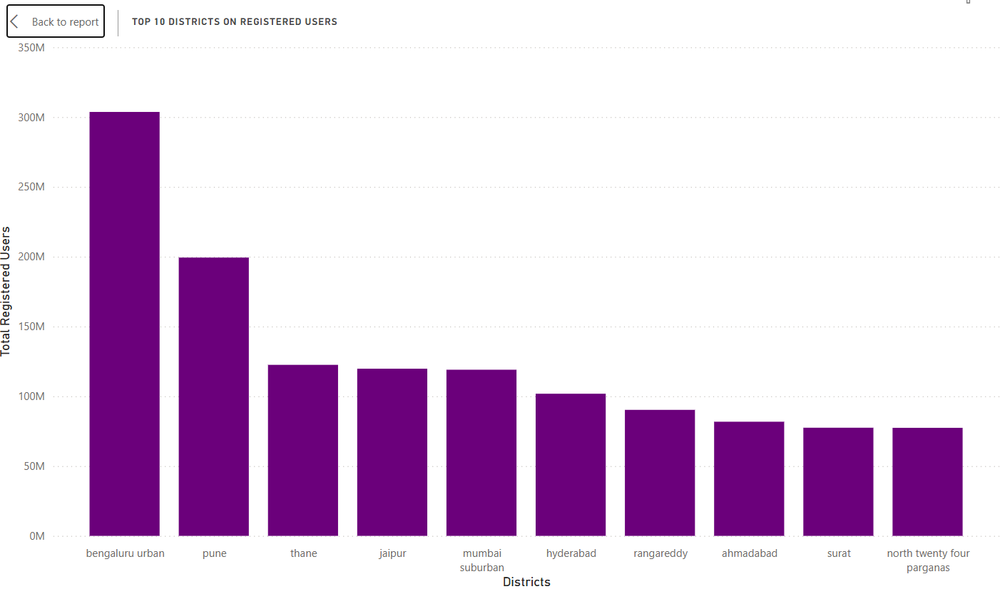
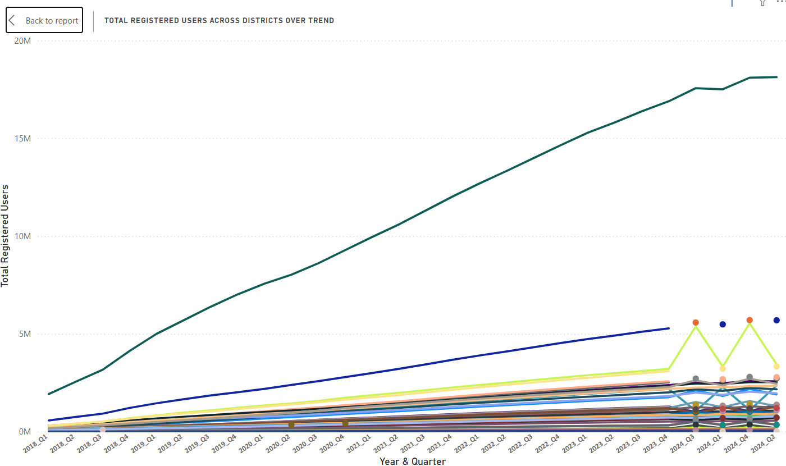
Visualisation:
Case Study 5: Transaction Analysis Across States and Districts
Total Registered Users by State
Quarterly Registered Users Trend - Top 5 States

Slide 19
Insights:
Top 10 Districts by Registered Users (Left Bar Chart)
a. Bengaluru Urban leads significantly with over 300 million registered users, far ahead of all others.
b. Other key districts include:
Pune (~200M)
Thane, Jaipur, Mumbai Suburban, Hyderabad (100M–130M range)
Smaller but notable contributions from Rangareddy, Ahmedabad, Surat, and North 24 Parganas.
📌 Key Takeaway: Urban and metro districts dominate in user registrations, highlighting their tech adoption, population size, and economic activity.
Total Registered Users Over Time by District (Right Line Chart)
a. Bengaluru Urban shows a steep and continuous upward trajectory from 2018 to 2024, hitting nearly 20M users by 2024.
b. Other districts have steady but much slower growth curves, remaining well below the 5M mark.
c. Some volatility is visible in a few districts (likely seasonal campaigns or data updates), but no consistent breakout trends apart from Bengaluru.
📌 Key Takeaway: Growth is highly skewed toward Bengaluru Urban, which has maintained dominance over multiple years, while other districts are growing at a moderate pace.

Slide 20
Recommendations:
Double Down on Bengaluru Urban
With consistently high user growth and the largest base, this district should be:
A primary testing ground for new product features and services.
Targeted with premium offerings, loyalty rewards, and personalized outreach.
b. Replicate the Bengaluru Playbook
Study what’s working in Bengaluru (e.g., digital penetration, partnerships, outreach channels), and apply similar strategies in:
Pune, Thane, Hyderabad, Mumbai Suburban, where registration is already strong and can scale further.
3. Drive Campaigns in Mid-Tier Districts
Districts like Rangareddy, Ahmedabad, Surat, and North 24 Parganas show decent traction and are ripe for localized campaigns, awareness drives, and onboarding incentives.
4. Address Growth Disparity
Create special engagement models for slower-growth districts, such as:
Vernacular content
Agent-led outreach
Bundled services for rural or Tier-2/3 areas
5. Monitor Quarterly Patterns
The spikes and dips seen in the time series (right chart) indicate seasonal behavior or promotional impacts.
Use this insight to time campaigns for maximum impact, especially in low-performing districts.

Slide 21
THANK YOU

