Slide 1


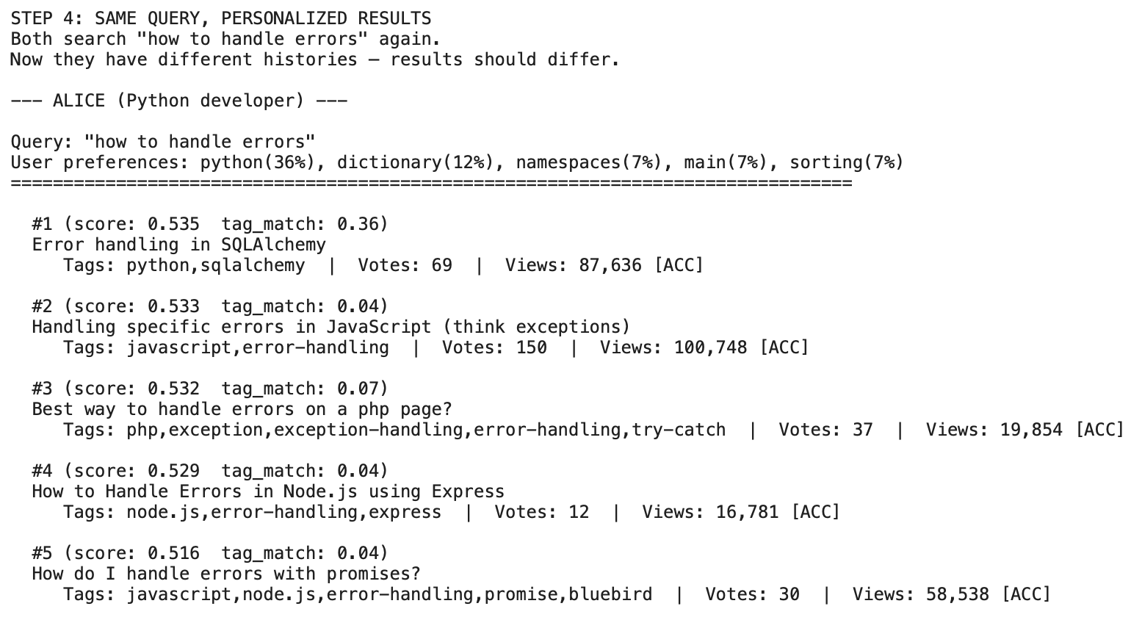
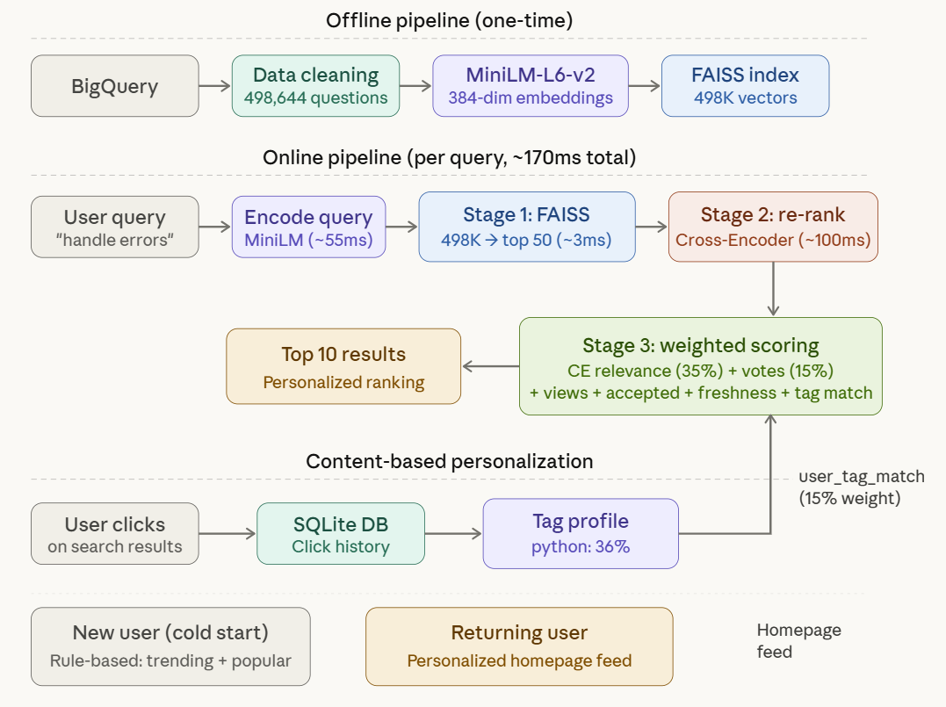
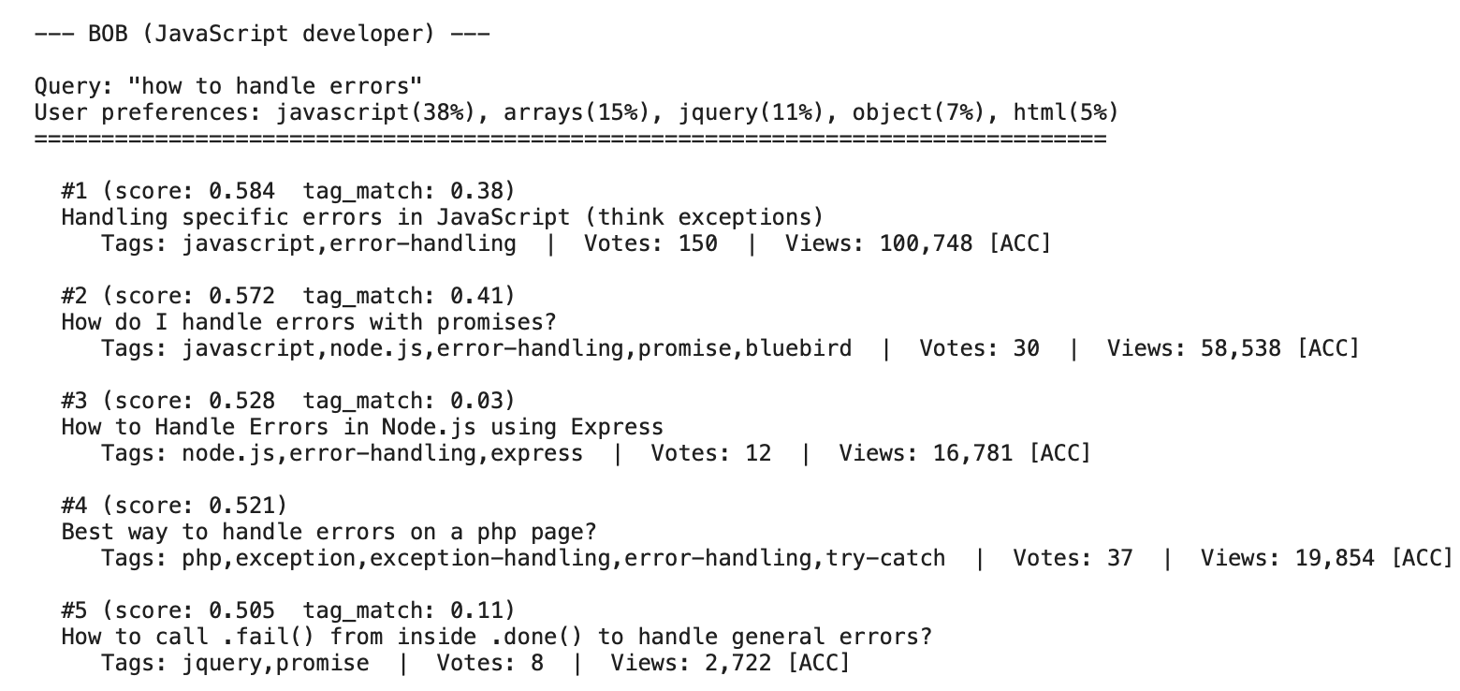
SEMANTIC SEARCH AND CONTENT-BASED PERSONALIZATION FOR STACK OVERFLOW QUESTION RECOMMENDATION
Sharmendra Desiboyina, Tarun Kumar Jasti and Satyaki Mitra
Data Analytics Program, School of Professional Studies
Clark University, Worcester, MA
23rd Annual
Graduate Multidisciplinary
Conference (MDC)
Abstract
Methodology & Procedure
Results
Stack Overflow hosts over 24 million questions, yet developers frequently struggle to find relevant, high-quality answers. Traditional keyword-based search fails when different words describe the same concept—“sort array” misses results titled “order elements in list” despite identical intent. This project introduces a semantic search and content-based personalized recommendation system for Stack Overflow questions. We extract 498,644 questions and 1.2 million answers from Google BigQuery, clean HTML while preserving inline code keywords critical for embeddings, and generate 384-dimensional sentence embeddings using all-MiniLM-L6-v2. Our 3-stage pipeline employs FAISS vector similarity search for candidate retrieval (~3ms), a Cross-Encoder re-ranker trained on 8.8 million Bing query-passage pairs for relevance refinement, and a 6-signal weighted scoring formula incorporating community votes, view counts, and answer quality. Content-based personalization tracks user click history in SQLite and builds tag-preference profiles, enabling different developers to receive tailored results for identical queries. Evaluation across 15 test queries demonstrates a 16.4% improvement in NDCG@5 over TF-IDF keyword baseline, with the full pipeline achieving NDCG@5 of 0.885 and winning 10 of 15 queries.
Evaluation Setup:
Evaluated 15 queries across multiple programming topics, comparing TF-IDF, FAISS, FAISS + Cross-Encoder, and a full personalized pipeline, using NDCG@5 with graded relevance.
3-Stage Retrieval & Ranking Pipeline:
Stage 1
FAISS Retrieval (~3ms)
The user query is encoded into a 384-dim vector and searched against all 498,644 question vectors using FAISS IndexFlatIP (brute-force cosine similarity via normalized inner product). Returns top 50 candidates.
Approach | NDCG@5 | Avg Grade | P@5 | Wins | Speed | Improvement
TF-IDF (baseline) | 0.760 | 2.84 / 5 | 1.000 | 1 / 15 | 591 ms | —
FAISS Only | 0.848 | 3.55 / 5 | 1.000 | 4 / 15 | 95 ms | +11.6%
FAISS + CrossEncoder | 0.792 | 3.25 / 5 | 1.000 | 0 / 15 | 176 ms | +4.2%
Full Pipeline | 0.885 | 3.89 / 5 | 1.000 | 10 / 15 | 169 ms | +16.4%
Content-Based Personalization:
User clicks are tracked in SQLite. A tag-preference profile is built with recency weighting (recent clicks weighted 1.0, oldest decays to 0.3). The user_tag_match signal boosts results matching the user’s preferred tags. New users receive rule-based cold start recommendations (trending questions across diverse tags).
Stage 2
Cross-Encoder Re-ranking (~100ms)
A cross-encoder (ms-marco-MiniLM-L-6-v2, trained on 8.8M Bing query-passage pairs) reads each (query, candidate) pair simultaneously—unlike the bi-encoder which encodes them independently. This captures word-level relationships, producing more accurate relevance scores. Narrows to top 20.
Key Findings:
Embeddings beat keywords: Embeddings outperformed keywords—TF-IDF returned irrelevant results due to shared terms, while FAISS captured context and returned correct Python results.
Quality ranking matters: FAISS misranked a low-vote result above a high-vote answer, while the full pipeline corrected it, ranking the best answer first and achieving perfect NDCG@5 = 1.000.
Personalization works: For “how to handle errors,” personalization adapted results by user context—ranking Python error handling first for a Python user and JavaScript for a JavaScript user.
Introduction & Background
Stage 3
Weighted Quality Scoring (~1ms)
Final ranking combines six signals: Cross-Encoder relevance (35%), community votes (15%, log-scaled), view count (15%), accepted answer (10%), answer score (5%), freshness (5%), and user personalization tag match (15%). Log-scaling prevents viral questions (score 26,621) from dominating over moderate-quality results.
Stack Overflow is the largest programming Q&A platform with 24 million+ questions spanning every technology domain. Developers rely on it daily, yet finding the right answer remains challenging for two fundamental reasons:
1. Keyword Mismatch: Traditional search engines match exact words. A search for “sort a list in Python” returns results containing those keywords—including R language questions about sort() and list() functions. The search cannot understand that “order elements” means the same as “sort array.”
2. Quality Ranking Gap: Even when relevant results appear, a 35-vote question often ranks above a 419-vote canonical answer because conventional search ranks by text similarity, not content quality. The best answers remain buried.
3. No Personalization: A Python developer and a JavaScript developer searching “how to handle errors” receive identical results, despite having fundamentally different needs.
Our system:
Key Technologies: Google BigQuery, Sentence-Transformers (BERT family), FAISS (Facebook AI Similarity Search), Cross-Encoder (MS MARCO), SQLite, FastAPI.
Personalization Demo
"Same query ‘how to handle errors’ produces different results for different users. Alice (Python developer, tag profile: python 36%) sees Python error handling at position #1. Bob (JavaScript developer, tag profile: javascript 38%) sees JavaScript error handling at position #1. Content-based personalization uses click history to build tag-preference profiles, boosting results that match the user’s technology interests."
Architectural Diagram
Semantic Understanding (Not Keywords)
Quality-Aware Ranking
~3 ms Retrieval Time
Personalized Results
End-to-End ML System
Methodology & Procedure
Future Work and Conclusion
Data Extraction & Cleaning:
We extracted 500,000 questions and 1.23 million answers (top 3 per question by community votes) from Google BigQuery’s public Stack Overflow dataset using a single optimized SQL query with stratified sampling across 30 technology tags. This ensured balanced coverage, with each tag receiving a minimum number of samples while preserving natural popularity distributions. HTML bodies were cleaned using BeautifulSoup, preserving inline code (e.g., pandas, float) as semantic keywords while separating multi-line code blocks to reduce embedding noise. Seven additional features were engineered, including text length metrics and structural indicators. The final dataset contains 498,644 clean questions and 1,199,383 answers.
Embedding Generation:
Each question is encoded into a 384-dimensional dense vector using all-MiniLM-L6-v2, a distilled BERT-based model developed by Microsoft and fine-tuned for semantic similarity tasks. The input structure follows “{title} [SEP] {tags} [SEP] {body first 200 words},” where the separator token enables the model to differentiate between semantic components. Body text is truncated to 200 words to align with the model’s token limit and ensure efficient processing. To maintain consistency between embeddings and source data, an explicit ID mapping (question_ids.npy) is stored, preventing misalignment during FAISS retrieval. The final output is a 730.4 MB embedding matrix of shape (498,644 × 384).
This project demonstrates that a 3-stage retrieve-and-rank pipeline with content-based personalization significantly outperforms keyword search for technical Q&A recommendation. The system achieves NDCG@5 of 0.885 with real-time response (~170ms) across 498,644 questions.
Planned enhancements:
Collaborative Filtering: BigQuery’s Stack Overflow dataset contains user answering behavior (owner_user_id in posts_answers) that could power collaborative “users who answered similar questions” recommendations with sufficient user scale.
Live Data Pipeline: Integrate Stack Overflow API for continuous ingestion of new questions, with scheduled embedding generation and index updates.
Figure 1: System Architecture. The offline pipeline extracts, cleans, embeds, and indexes 498,644 questions. The online pipeline processes each query through three stages: FAISS retrieval (498K → top 50, ~3ms), Cross-Encoder re-ranking (top 50 → 20, ~100ms), and weighted scoring combining relevance, quality signals, and user tag preferences (top 20 → 10, ~1ms). Content-based personalization tracks clicks in SQLite, builds tag profiles, and feeds a user_tag_match signal (15% weight) into the scoring stage. Total latency: ~170ms per query.
References
P. Gaba, S. Singh, P. Passi, and K. Saxena, “A BERT-Based Approach for Predicting Stack Overflow Question Quality,”in Proc. Int. Conf. Multidisciplinary Research and Innovations in Engineering (MRIE), 2025, pp. 797–801.
S. O. Olatinwo and C. Demmans Epp, “Predicting Tags for Learner Questions on Stack Overflow,” International Journal of Artificial Intelligence in Education, vol. 35, pp. 1346–1387, 2025, doi: 10.1007/s40593-024-00441-x.

