Slide 1

AI-Powered Student Project Tracking & Management System
SOA Project Review-1
18-08-2026 / 2:00
Team Members
 | Under the Guidance of Dr. Neelima Gogineni Professor, Department of Computer Science and Engineering, KLH CSE Bowrampet Campus
Name | Roll Number
Kommineni Rahul | 2420030011
Pathi Sharmila | 2420030042
Ivaturi Vennela | 2420030185

Slide 2
Outline of Project Work
Focus
Introduction
Literature Survey
Challenges
Research Objectives
Conclusion & Future Work
References
Publications Details

Slide 3
Problem Statement
Students often struggle to effectively track project tasks, deadlines, and overall progress. Existing project management systems mainly provide basic task tracking and require users to manually monitor their work. They do not intelligently identify delayed or at-risk tasks or suggest what should be done next. Therefore, there is a need for an AI-powered Student Project Tracking System that automatically monitors project progress, detects potential delays, prioritizes tasks, and provides intelligent recommendations using a SOA/Microservices architecture.

Slide 4
Objectives
To develop an AI-powered system for tracking student projects, tasks, deadlines, and progress.
To automate project monitoring using an AI Agent that analyzes task status and identifies pending, overdue, and at-risk tasks.
To prioritize tasks and recommend the next best action based on project progress and deadlines.
To implement the system using SOA/Microservices architecture for modular and scalable service integration.
To improve project management efficiency by providing timely and intelligent insights to students and faculty.

Slide 5
Literature Survey
Authors | Title of the Paper | Methodology | Inferences | Limitation/Future work
Ianire Taboada, Abouzar Daneshpajouh, Nerea Toledo, Tharaka deVass | Artificial Intelligence Enabled Project Management: A Systematic Literature Review (2023) | Systematic Literature Review (SLR) analyzing AI applications in project-management performance domains. | AI, particularly ML, can support planning, forecasting, decision-making, and project performance, making it highly relevant to automated project monitoring. | More empirical studies and practical implementations are needed to validate AI-based project-management solutions in real-world environments.
Maciej Koszykowski, Witold Orzeszko | Machine Learning in Project Schedule Creation: A Systematic Literature Review (2026) | Systematic review of ML techniques used for project schedule creation and management. | ML has strong potential for automated scheduling, which supports your project's deadline monitoring, task prioritization, and prediction features. | ML adoption in project scheduling is still limited; further research is needed to demonstrate its effectiveness with real project data.
Mohamad Abou Ali, Fadi Dornaika, Jinan Charafeddine | Agentic AI: A Comprehensive Survey of Architectures, Applications, and Future Directions (2026) | Comprehensive survey of Agentic AI architectures, applications, capabilities, and future directions. | Provides a foundation for developing an AI Agent capable of reasoning, planning, and taking actions, which directly supports the intelligent-agent component of your system. | Agentic AI is rapidly evolving, so issues such as reliability, evaluation, safety, and real-world deployment require further research.
Mehmet Söylemez, Bedir Tekinerdogan, Ayça Kolukısa Tarhan | Challenges and Solution Directions of Microservice Architectures: A Systematic Literature Review (2022) | SLR analyzing 3,842 studies, with 85 selected primary studies on Microservice Architecture. | Microservices provide modularity, flexibility, independent development, maintainability, and scalability, supporting your SOA/Microservices-based design. | Microservices introduce challenges in service identification, management, communication, and maintenance; future work should develop better solutions for these challenges.
Gunnar Auth, Oliver Jokisch, Christian Dürk | Revisiting Automated Project Management in the Digital Age – A Survey of AI Approaches (2019) | Literature review combined with real-world examples to examine AI approaches for automating project-management activities. | Shows that AI can automate project-management tasks and provide cognitive assistance, automation, and decision support, supporting the automation goal of your project. | Further development is needed to handle the complexity and uniqueness of individual projects and to improve practical AI-based automation.

Slide 6
Problem Gap Identification
Existing project management systems mainly provide basic task, deadline, and progress tracking with limited intelligent automation.
Current AI-based approaches often focus on individual functions such as scheduling, prediction, or decision support rather than an integrated solution.
There is limited use of Agentic AI to continuously analyze project status and recommend the next best action.
Existing systems rarely detect at-risk tasks and predict potential project delays proactively.
Hence, there is a need for an AI-powered Student Project Tracking System that integrates automated monitoring, risk detection, task prioritization, and intelligent recommendations using SOA/Microservices architecture.

Slide 7
Innovation, Creativity, and Novelty
Innovation
Our project innovatively combines Agentic AI with SOA/Microservices architecture to automate student project tracking, monitoring, and decision-making instead of relying only on manual updates.
Creativity
The AI Agent creatively analyzes project progress, pending tasks, deadlines, and risks to prioritize tasks and recommend the next best action for the student.
Novelty
The novelty lies in integrating risk detection, task prioritization, deadline awareness, and intelligent next-action recommendations into a single AI-powered system specifically designed for student project management.

Slide 8
Feasibility and Project Plan
Technical Feasibility:
The system can be developed using Python, AI/LLM tools, REST APIs, and SOA/Microservices, which support modular and scalable implementation.
Operational Feasibility:
Students and faculty can easily manage projects, tasks, deadlines, and progress, while the AI Agent provides automated insights.
Economic Feasibility:
The project can rely mainly on open-source frameworks and tools, requiring minimal development cost.
Implementation Feasibility:
The system can be developed incrementally, starting with basic project tracking and then integrating risk detection, task prioritization, and next-action recommendation.

Slide 9
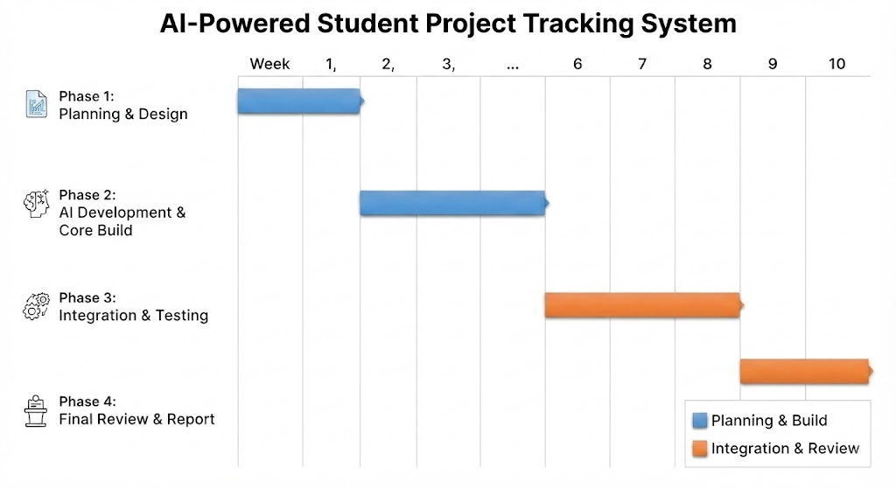
Project Plan Chart

