Slide 1


AirAware
Smart Air Quality Monitoring & Prediction System
Precision in Every Prediction
Team 3

Slide 2

Addressing the Silent Threat: Air Pollution
Air pollution poses a significant global challenge, impacting both public health and the environment. Many individuals struggle to comprehend its complexities, leading to a lack of awareness and proactive measures.
User Understanding Gap
Users often find AQI values confusing and lack understanding of pollution causes and necessary safety guidance.
Limitations of Existing Systems
Current monitoring systems typically present raw AQI numbers without explaining trends, future impacts, or offering actionable advice.
Our mission is to bridge this gap by designing a system that not only monitors and analyses air quality but also predicts and explains it in a simple, user-friendly manner.

Slide 3
Our Vision: Empowering Informed Decisions
AirAware is designed with clear objectives to deliver comprehensive and actionable air quality insights.
Real-time Monitoring
1
To provide live air quality data for various Indian states, ensuring up-to-date information.
Trend Analysis
2
To analyse AQI trends on hourly, daily, and monthly bases to identify patterns and changes.
Predictive Modelling
3
To forecast future AQI levels, offering a proactive approach to air quality management.
AI-driven Recommendations
4
To deliver AI-based insights and personalised health recommendations.
User Engagement
5
To facilitate user interaction through query submission, feedback mechanisms, and an AI chatbot.

Slide 4




AirAware's Robust Architecture
Our system is built on a scalable and intelligent architecture, integrating various components to ensure seamless operation.
Frontend: Engaging User Experience
Developed with HTML, CSS, and JavaScript, featuring interactive charts, dashboards, and responsive UI for seamless navigation, including dedicated login and signup pages.
Backend: Powerful Data Processing
Powered by Python (Flask), handling REST APIs, user authentication, session management, and efficient AQI data processing.
External Services: Real-time & Intelligence
Leveraging OpenWeatherMap API for real-time AQI data, an email service for query and feedback, and OpenAI/GPT-OSS-20B for an intelligent AI chatbot.

Slide 5
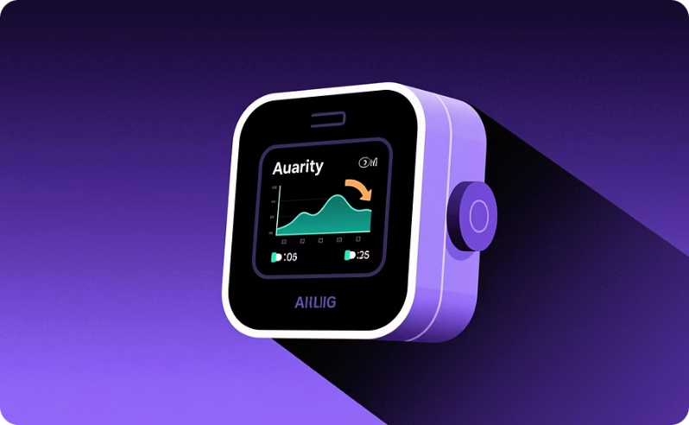
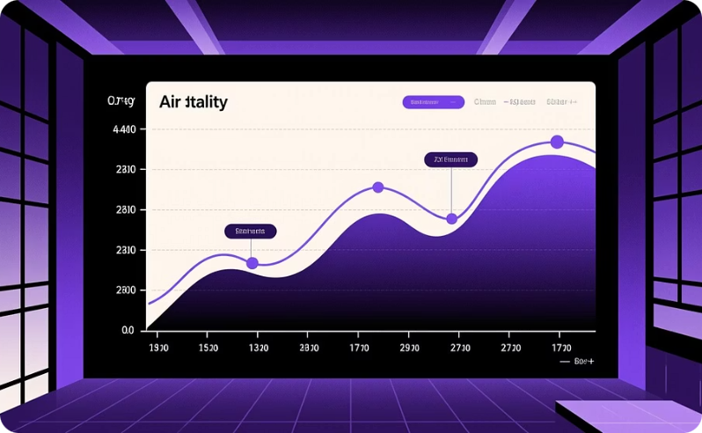


Key Features: Comprehensive Air Quality Insights
AirAware offers a suite of features designed to provide users with in-depth and actionable information about air quality.
Real-Time AQI Monitoring
Advanced Visualization
Intelligent Prediction Module
Seamless User Interaction
Visualisations for hourly (last 24 hours), daily (last 7 days), and monthly (last 6 months) AQI trends to easily identify patterns.
Live AQI data for selected states, including a detailed breakdown of pollutants such as PM2.5, PM10, NO₂, and SO₂.
Year-based AQI forecasting and trend-based projections to anticipate future air quality conditions.
An integrated query and feedback system, complemented by email notifications for personalised updates.

Slide 6



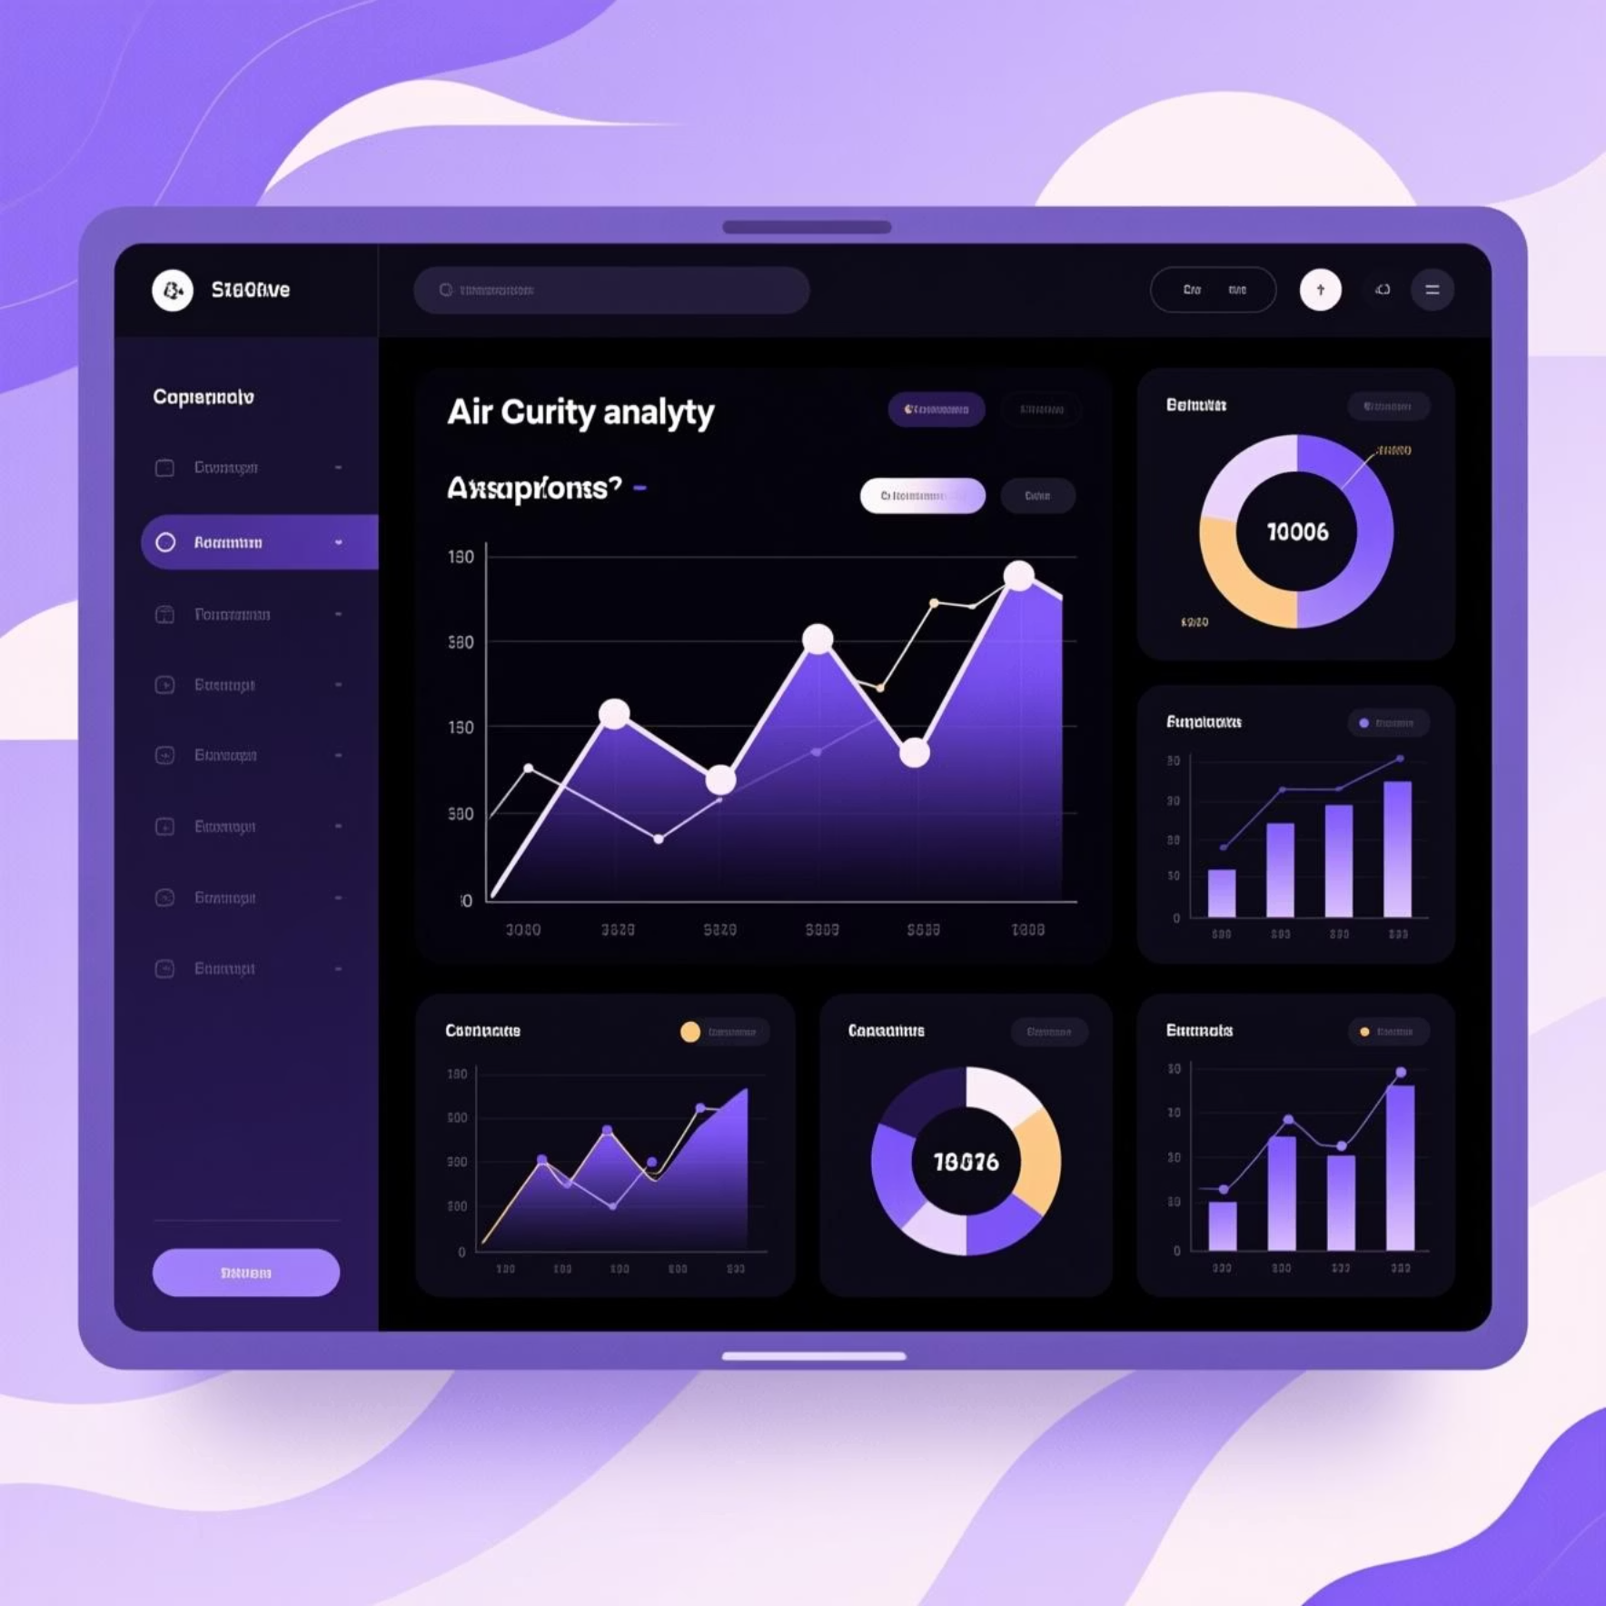
AI-Powered Analysis and Actionable Analytics
AirAware goes beyond mere data display, offering intelligent analysis and practical insights to safeguard user health.
AI Analysis
Analytics Section
AI logic analyses AQI trends and variations.
Our robust analytics engine provides critical insights into air quality dynamics:
Generates clear explanations for pollution causes.
Predicts safe outdoor times and recommends mask usage.
Provides a comprehensive health safety rating.
Trend Analyzer
Detailed 24-hour and 7-day AQI change analysis.
Analytics Snapshot
Displays volatility index and forecast confidence levels for better understanding.

Slide 7





The Minds Behind AirAware
Our dedicated team brought AirAware to life through collaborative effort and expertise.
Sharmika Gangadharan
Designed the complete UI, implemented dashboard layout, and integrated charts and user interaction features.
Machika Kapil
Added AQI history and Health Advisory cards, and contributed to both frontend and backend technologies, including UI enhancements.
Joseph Alvis Sajith
Developed data processing pipelines, implemented the analytics engine, and integrated the AI chatbot.
Varshini Reddy & Mehar
Conducted thorough functional testing and UI validation to ensure system reliability and user satisfaction.

Slide 8
Conclusion: Towards a Healthier Tomorrow
AirAware stands as a testament to intelligent environmental monitoring, seamlessly integrating real-time data with AI-driven insights.
Smart Monitoring
1
Provides intelligent AQI monitoring, offering real-time data and comprehensive insights.
Integrated Intelligence
2
Combines real-time data with AI-based analysis and predictive capabilities for a holistic view.
Empowering Users
3
Helps users understand air quality, take necessary health precautions, and make informed decisions about their well-being.
Future Applications
4
Ideal for smart city initiatives and advanced environmental monitoring applications, promoting healthier urban living.

Slide 9

Thank You
For more information or to provide feedback, please contact us.
Together, we can build a future with cleaner air.

