Slide 1
NAME: SHARMI.S
REGISTER NO AND NMID:2413121210500122042 and asanm121anm12124213041
DEPARTMENT:BCA
COLLEGE NAME: IMMACULATE COLLEGE FOR WOMEN/ANNAMALAI UNIVERSITY

Slide 2
DIGITAL PORTFOLIO

Slide 3
AGENDA
Problem statement
Project overview
End user
Tools and technologies
Portfolio design and layout
Features and functions
Result and screenshot
Conclusion
GitHub

Slide 4
PROBLEM STATEMENT
1.Be Specific:
A vague problem statement will lead to unclear solutions. Focus on a concrete issue.
2. Show, Don't Just Tell:
Provide data, user research, or examples to support your claims about the problem.
3. Focus on the User:
Frame the problem from the user's perspective to show you understand their needs.
4. Keep it Concise:
A problem statement should be short, clear, and to the point.
5. Avoid Premature Solutions:
Don't describe your proposed solution within the problem statement itself; focus solely on the problem.

Slide 5
PROJECT OVERVIEW
Be Specific:
A vague problem statement will lead to unclear solutions. Focus on a concrete issue.
2. Show, Don't Just Tell:
Provide data, user research, or examples to support your claims about the problem.
3. Focus on the User:
Frame the problem from the user's perspective to show you understand their needs.
4. Keep it Concise:
A problem statement should be short, clear, and to the point.
5. Avoid Premature Solutions:
Don't describe your proposed solution within the problem statement itself; focus solely on the problem.

Slide 6
END USER
Potential Employers/Recruiters:
They use the portfolio to assess a candidate's abilities for a job or project.
Clients:
They may view a freelancer's portfolio to decide if they want to hire them for a specific service.
Academic Institutions:
Students may use a portfolio to apply to schools or programs.
End User:
The investor who owns and manages the portfolio, and for whom the portfolio is designed to meet financial goals, balance risk, and generate returns.

Slide 7
Tools and technologies
Website Builders
For a more customized and creative approach, students can use these drag-and-drop website editors to build their own portfolio site.
Google Sites:
A customizable and easy-to-use tool for creating media-rich websites by importing various types of content.
WordPress:
A popular and user-friendly platform that allows students to customize web pages using themes and plugins.
Squarespace:
Uses templates to simplify website design, allowing students to customize their pages to showcase their skills.
Wix:
A drag-and-drop website builder that simplifies the process of creating and housing a portfolio.

Slide 8
PORTFOLIO DESIGN AND LAYOUT
Use high-quality visuals:
Ensure all images are clear and present your work in the best possible light.
Show your process:
Briefly highlight the stages of your work, like early sketches or mood boards, to demonstrate your thought process.
Start and end strong:
Place your most impressive work at the beginning and end of your portfolio to make a powerful first and lasting impression.
Quality over quantity: Choose your strongest projects, and only a few complete sketchbooks, rather than trying to include everything. Show diversity: Select projects that demonstrate different skills and illustrate your ability to design across various content problems.

Slide 9
FEATURES AND FUNCTIONS
Assessment:
Serves as a tool for teachers to evaluate student mastery of content and skills.
Communication:
Facilitates communication of student progress to parents, teachers, and other stakeholders.
College & Career Readiness:
Showcases achievements and skills to college admissions and potential employers.
Personal Responsibility:
Fosters a sense of personal responsibility and self-direction in learning.
Metacognitive Tool:
Helps students understand their own learning process (metacognition).
Skill Development:
Develops critical thinking, decision-making, and technology skills in students.
Showcasing Strengths:
Highlights student strengths and areas of interest.
Transition Support:
Aids in transitions to new grades or higher education by presenting a comprehensive view of a student's abilities.

Slide 10
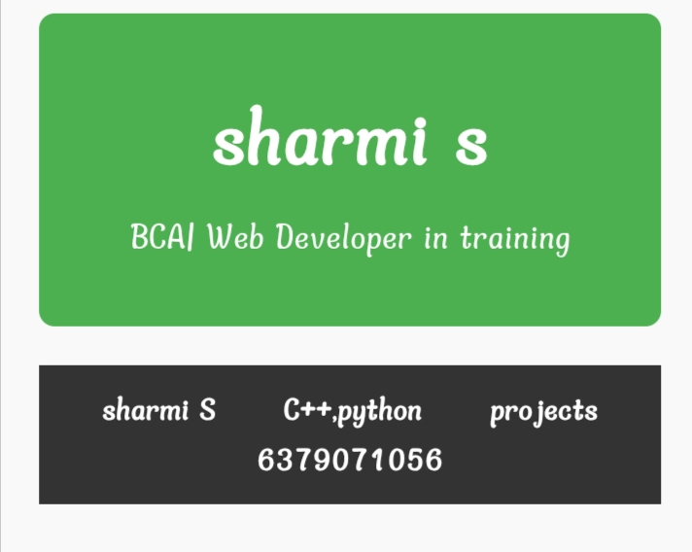
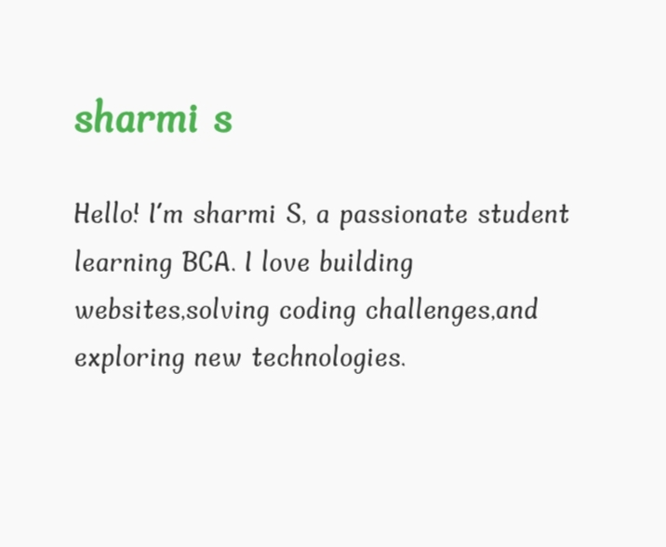
RESULT AND SCREENSHOT

Slide 11
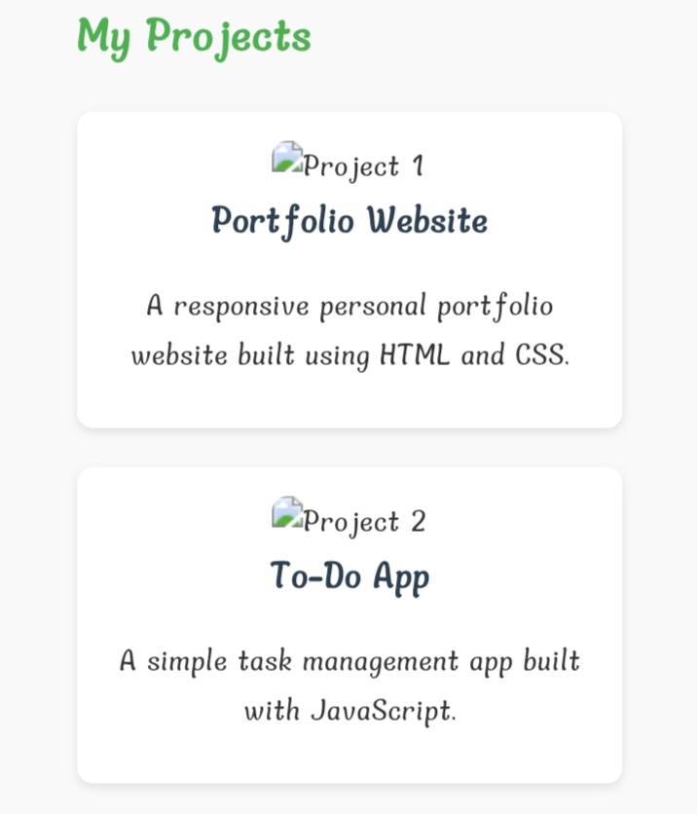
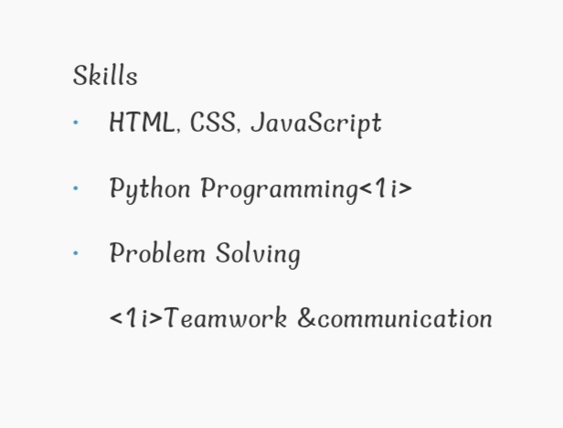
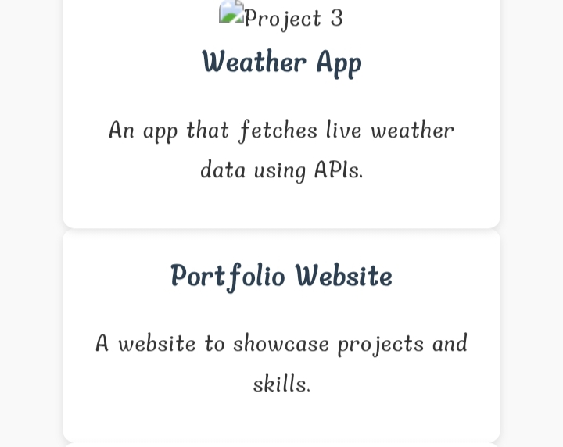
RESULT AND SCREENSHOT

Slide 12
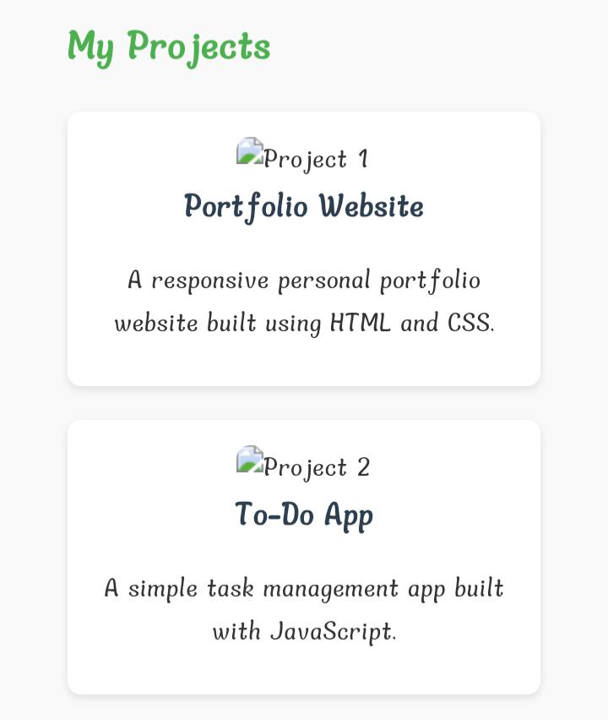
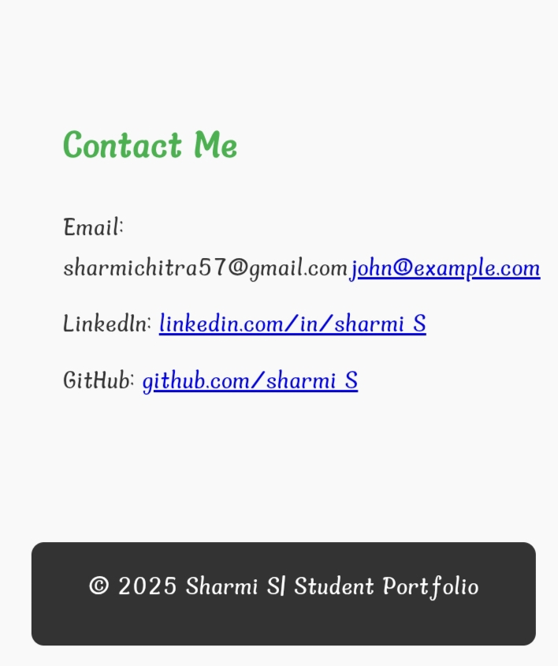
RESULT AND SCREENSHOT

Slide 13
CONCLUSION
Reflect on Growth:
Discuss how you've developed as a student, writer, and thinker throughout the course or program.
Highlight Key Learnings:
Mention specific skills, concepts, and activities that were most impactful or helpful in your development.
Acknowledge Challenges and Successes:
Discuss any obstacles you faced, the reasons behind them, and how you overcame them or what you could do differently next time.
Showcase Metacognition:
Explain what you've learned about your own learning processes, study habits, and how to approach complex information.

Slide 14
GITHUB LINK

