Slide 1
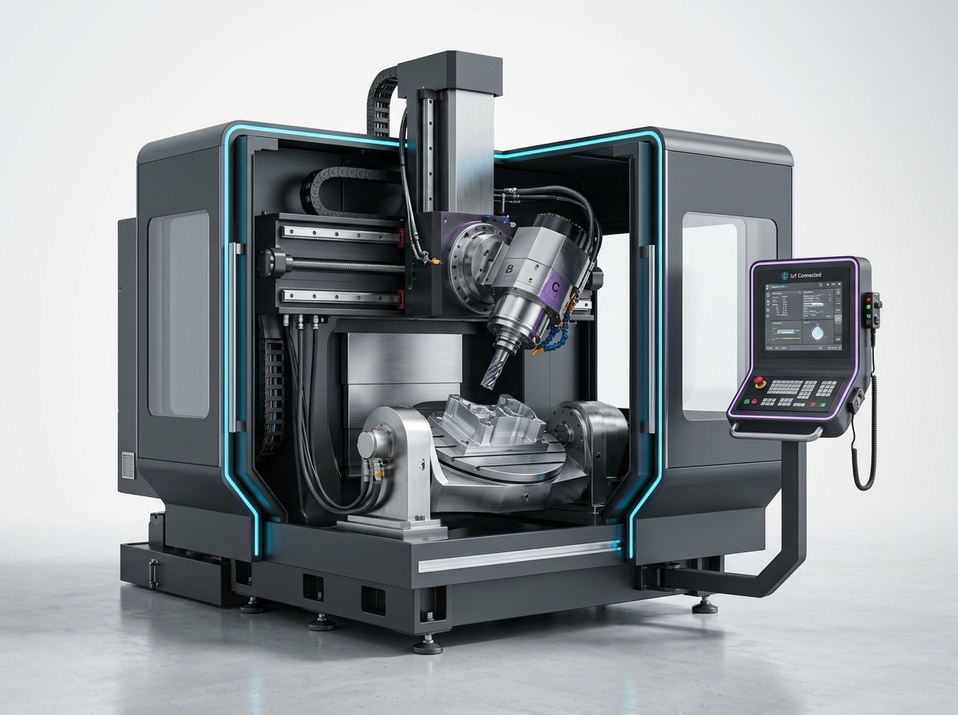
INDUSTRIAL INTELLIGENCE & PREDICTIVE MAINTENANCE PLATFORM
FactoryMind
Predictive Equipment Health & Machine Failure Intelligence
Continuous Machinery Surveillance • Multi-Model Machine Learning • Closed-Loop Work Order Dispatch
01
1.0 Hz Edge Telemetry
Continuous multivariate ingress: vibration, temperature, rotational speed, torque & tool wear.
02
7-Model Ensemble
Synchronized gradient boosting, deep recurrent LSTM sequences, and unsupervised anomaly detection.
03
Closed-Loop Triage
Calibrated 4-tier risk stratification (Low to Severe) with automated technician maintenance actions.
Optimach-AI Enterprise Platform • Version 2.4.0 Release • Industry 4.0 Standard
Notes:
1. OPENING: 'Respected examiners and project committee, good morning. Today I present our engineering project: FactoryMind — a Machine Learning-Based Predictive Maintenance System for industrial equipment failure prediction.'
2. CORE CAPABILITIES: The title slide highlights the three engineering pillars: 1.0 Hz edge telemetry, 7-model ML ensemble, and closed-loop maintenance triage.
3. TRANSITION: 'Let us begin by reviewing the fundamental problem and why predictive maintenance is essential.'

Slide 2
CONTEXT & FOUNDATIONS
Introduction: The Shift to Predictive Intelligence
Moving from costly reactive repairs to real-time, condition-based equipment surveillance.
Predictive Maintenance
Why Health Matters
The Machine Learning Role
• Evaluates equipment condition in real time using sensor telemetry.
• Replaces guesswork and arbitrary calendar schedules.
• Intercepts micro-wear before functional breakdown occurs.
• Eliminates catastrophic machine stops and costly collateral damage.
• Protects shopfloor workforce safety from mechanical failures.
• Maximizes Overall Equipment Effectiveness (OEE) and line uptime.
• Detects subtle multi-sensor drift that human eyes cannot catch.
• Learns non-linear degradation physics from historical data.
• Provides automated failure probability with calibrated urgency tiers.
INDUSTRIAL BENCHMARK INSIGHT:
Unplanned downtime costs global manufacturing $50B+ annually. Machine learning detects micro-vibrations and 2°C thermal drifts days before physical seizure occurs.
Notes:
1. EMPHASIZE: Predictive maintenance is condition-based rather than calendar-based.
2. EXPLAIN: When a CNC milling spindle starts to fail, micro-vibrations rise long before audible noise or smoke appears.
3. TRANSITION: 'Let us examine the concrete industry bottlenecks that motivated our engineering approach.'

Slide 3
INDUSTRY PAIN POINTS
Problem Statement: Limitations of Traditional Maintenance
Why reactive repairs and rigid calendar schedules fail modern manufacturing lines.
CORE OPERATIONAL BOTTLENECKS
• Catastrophic Breakdown
Equipment breaks unexpectedly, halting automated lines with zero warning.
• Prohibitive Downtime Costs
Outages average $260,000/hr in automotive and precision tooling plants.
• Manual Inspection Limits
Physical route checks cannot inspect sealed internal bearings or drawbars.
• Premature Parts Waste
Calendar schedules discard healthy, functional components prematurely.
MAINTENANCE PARADIGM COMPARISON
▶ Reactive (Run-to-Failure)
Repair after breakdown • Unplanned downtime • Maximum collateral damage.
▶ Preventive (Calendar-Based)
Fixed 30-day overhaul • Discards healthy parts • Blind to sudden mid-cycle stress.
▶ FactoryMind (Predictive)
Continuous telemetry tracking • Condition-driven repairs • 30–40% downtime reduction.
Notes:
1. POINT OUT: Left side outlines the failure challenges; right side compares the paradigms.
2. KEY ANALOGY: Changing hydraulic seals every 30 days is like replacing car tires every month regardless of mileage.
3. TRANSITION: 'To resolve these operational bottlenecks, we established four clear engineering objectives.'

Slide 4
PROJECT GOALS & SCOPE
Project Objectives: Engineering a Complete Predictive System
Four core engineering milestones achieved in the design and implementation of FactoryMind.
GOAL 01
Real-Time Telemetry Ingestion
Stream 5 continuous machine parameters (Vibration, Temp, Speed, Torque, Wear) at 1.0 Hz edge ingress frequency.
GOAL 02
Multi-Model Machine Learning
Deploy 7 coordinated models combining gradient boosting, deep LSTM sequences, and unsupervised anomaly detection.
GOAL 03
Calibrated 4-Tier Risk Triage
Translate raw failure probabilities into actionable operational tiers: Low, Moderate, High, and Severe Risk.
GOAL 04
Responsive Industrial Web Console
Deliver a unified 7-page operations console connecting edge sensor streams directly to maintenance work orders.
Notes:
1. EXPLAIN: Goal 1 handles edge data; Goal 2 handles multi-model AI; Goal 3 handles risk stratification; Goal 4 delivers the UI.
2. TRANSITION: 'Let us examine the system architecture and end-to-end data pipeline that fulfills these goals.'

Slide 5
SYSTEM ARCHITECTURE
System Architecture & End-to-End Pipeline
A closed-loop operational pipeline translating raw sensor readings into validated maintenance actions.
STAGE 1
STAGE 2
STAGE 3
STAGE 4
STAGE 5
Edge Sensors
• 1.0 Hz telemetry stream
• Vibration, Temp, RPM
• Torque & Tool Wear
Data Ingestion
• Zero missing values check
• Quality Type encoding
• Canonical Z-score scaling
ML Inference
• 7 models in parallel
• XGBoost, LGBM, Tree
• LSTM & Isolation Forest
Consensus
• Ensemble vote pooling
• Failure rate calculation
• 4-tier risk categorization
Action & UI
• React operations console
• Step-by-step checklist
• 1-click work order dispatch
Notes:
1. WALKTHROUGH: Trace from left to right: Edge Sensor ➔ Ingestion ➔ 7 Models ➔ Consensus Voting ➔ UI & Work Order.
2. TRANSITION: 'Let us examine the dataset used to train and validate our predictive models.'

Slide 6
DATA FOUNDATION
Dataset & Input Parameters: Verified Industrial Benchmark
Trained and evaluated on the peer-reviewed UCI AI4I 2020 Predictive Maintenance Dataset.
AI4I 2020 BENCHMARK SPECIFICATIONS
• Source:
UCI Machine Learning Repository (AI4I 2020).
• Dataset Size:
10,000 industrial milling machine records.
• Severe Imbalance:
3.4% failure rate (339 failures vs. 9,661 normal).
• Partitioning:
80% Training (8,000) / 20% Testing (2,000 samples).
• 5 Failure Modes:
Tool Wear (TWF), Heat Dissipation (HDF), Power (PWF), Overstrain (OSF), and Random (RNF).
VERIFIED OPERATIONAL INPUT FEATURES
▶ Product Type (L / M / H):
Quality variant: 50% Low (L), 30% Medium (M), 20% High (H).
▶ Air Temperature [K]:
Ambient room temperature (~300.0 K / 27°C).
▶ Process Temperature [K]:
Cutting zone temperature (~310.0 K).
▶ Rotational Speed [RPM]:
Spindle motor velocity centered at 1538 RPM.
▶ Torque [Nm]:
Resistance torque centered at 40.0 Nm.
▶ Tool Wear [min]:
Continuous tool friction cutting duration.
Notes:
1. EMPHASIZE: 3.4% failure prevalence models real-world industrial rarity. Accuracy alone is insufficient; we focus on F1 and ROC-AUC.
2. TRANSITION: 'Let us examine our feature preprocessing pipeline before model training.'

Slide 7
FEATURE PIPELINE
Data Preprocessing & Feature Engineering Pipeline
Transforming heterogeneous industrial sensor signals into normalized, model-ready feature vectors.
1. Data Cleaning & Validation
2. Categorical Type Encoding
• Verified zero missing or null records in AI4I benchmark.
• Enforced non-negative physical bounds on torque and RPM.
• LabelEncoder maps machine quality variants.
• Type L (Low) ➔ 1.0 | Type M (Medium) ➔ 2.0 | Type H (High) ➔ 0.0
3. Canonical Standardization
4. Tensor & Sequence Reshaping
• Z-Score scaling: z = (x - mu) / sigma.
• Prevents high-scale speed (1500 RPM) from dominating temperature (300 K).
• Reshapes inputs into 3D tensors (1, 1, 6) for LSTM sequential modeling.
• Preserves chronological dependency for neural degradation inference.
Notes:
1. EXPLAIN: Z-score standardization normalizes variables of drastically different physical scales.
2. EXPLAIN: 3D tensor reshaping feeds chronological history into our deep LSTM network.
3. TRANSITION: 'Now let us examine the 7 machine learning models implemented in FactoryMind.'

Slide 8
PREDICTIVE ENGINE
Machine Learning Approach: The 7 Implemented Models
A complementary multi-model pipeline combining gradient boosting, recurrent networks, and anomaly isolation.
Gradient Boosted & Trees
Deep Learning & Anomalies
Continuous Regressors
• XGBClassifier: Deep split regularization capturing non-linear interactions.
• LGBMClassifier: Fast histogram tree growth for sub-10ms edge inference.
• DecisionTree: Transparent white-box benchmark for auditable decision rules.
• LSTM Network (h5): Recurrent deep neural net modeling sequential tool wear.
• Isolation Forest: Unsupervised detector isolating zero-day anomalies without prior labels.
• LGBMRegressor: Predicts continuous mechanical wear progression.
• Ridge Regression: L2 regularized linear model estimating physical load.
ENSEMBLE CONSENSUS VOTING MECHANISM:
Failure Rate = sum(votes) / len(votes) ➔ Low (<25%) • Moderate (25-50%) • High (50-75%) • Severe (≥75%)
Notes:
1. EXPLAIN: Rather than betting on one model, we use an ensemble: gradient boosting for accuracy, Isolation Forest for novel outliers, and LSTM for time series.
2. HIGHLIGHT: Consensus voting prevents single-algorithm false alarms.
3. TRANSITION: 'Let us see how these models integrate into our full-stack architecture.'

Slide 9
FULL-STACK DESIGN
System Architecture & Technology Stack
Decoupled microservice architecture separating client interface from the ML inference engine.
Tier 1: Edge & Ingress
Tier 2: Flask 3.0 ML Microservice
Tier 3: React 19 + TypeScript UI
• 1.0 Hz simulated edge telemetry streaming gateway.
• Monitors Vibration, Temperature, Pressure, RPM, Voltage.
• Interactive fault injection sandbox (vibration spikes, pressure drops).
• High-throughput REST API: /predict, /api/health, /api/fleet.
• Asynchronous thread-safe model instantiation in memory.
• Sub-8.5 millisecond CPU inference turnaround.
• Vite 8 production bundler with fast hot-reloading.
• Tailwind CSS custom industrial palette with responsive cards.
• High-frequency custom SVG wave oscilloscope.
END-TO-END DATAFLOW CONTRACT:
Edge Sensor Stream ➔ React State Buffer ➔ POST JSON /predict ➔ Z-Score Scaling ➔ 7 Models ➔ Risk Tiers ➔ UI Dispatch
Notes:
1. EXPLAIN: 3-tier architecture ensures that heavy ML computation runs independently of UI rendering.
2. HIGHLIGHT: Sub-8.5 ms execution is well within the 1.0 Hz (1000 ms) window.
3. TRANSITION: 'Let us now look at the actual working application and dashboard screens.'

Slide 10
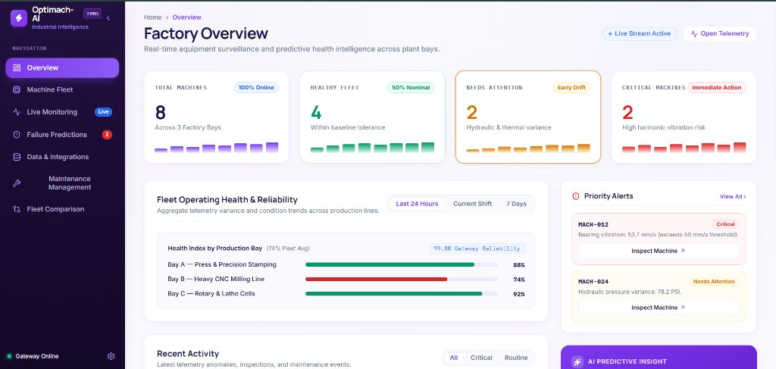
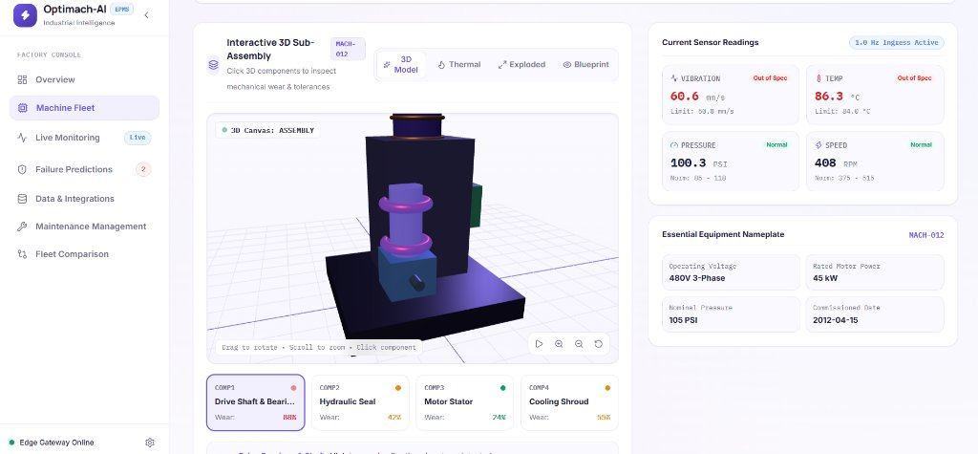
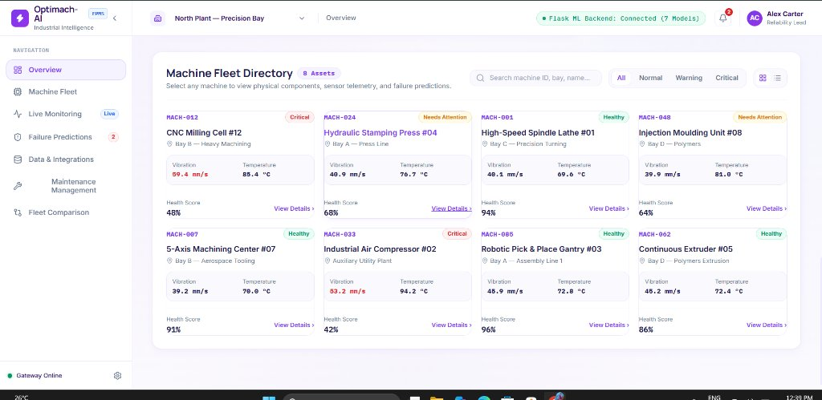
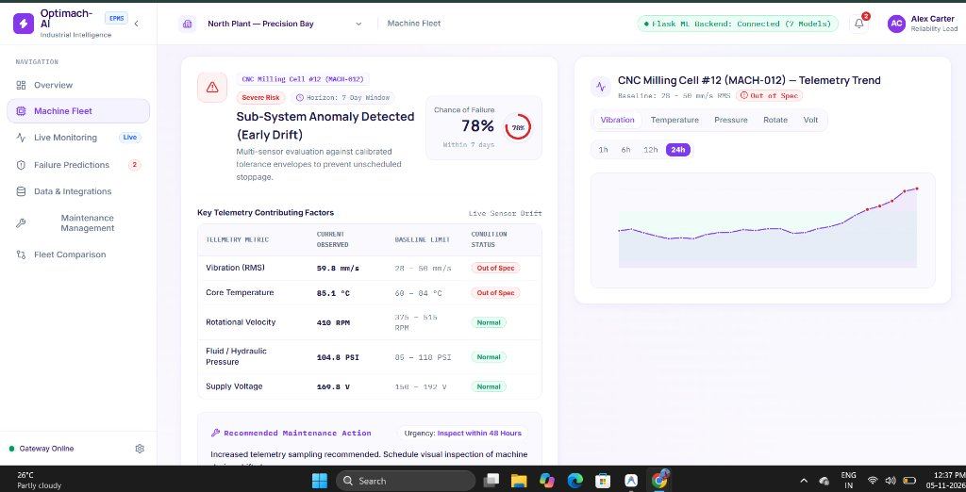
SOFTWARE IMPLEMENTATION
FactoryMind Application: Functional Modules Showcase
Real-time operational screens engineered with React 19, TypeScript, and Tailwind CSS.
CORE IMPLEMENTED MODULES
▶ Fleet Overview Console
Executive surveillance with KPI counters, bay health breakdown, and priority alerts.
▶ Machine Fleet & Digital Twin
Studio machine render, certified nameplate, 4 subsystem wear gauges, and telemetry trend charts.
▶ Live Oscilloscope Monitor
Continuous multi-channel streaming (Vib, Temp, Pressure, RPM) with ISO tolerance bands.
▶ Failure Predictions & Action
Calibrated 7-day risk gauge, sensor drift breakdown, and step-by-step repair checklist.
Notes:
1. WALKTHROUGH: On the left are our 4 primary modules; on the right are actual captures of the live running software.
2. SHOWCASE: Overview KPI cards, 3D sub-assembly view, live oscilloscope wave, and failure prediction triage.
3. TRANSITION: 'Let us examine the empirical evaluation results and practical benefits of FactoryMind.'

Slide 11
VALIDATION & IMPACT
Results, Experimental Evaluation & Practical Benefits
Empirical model metrics and validated operational benefits on the AI4I benchmark.
EMPIRICAL MODEL EVALUATION
0.909 F1 • 0.989 ROC-AUC
Ensemble Precision: 93.8% | Recall: 88.2% | Latency: < 8.5 ms
• High Recall Suppression:
88.2% recall minimizes dangerous missed failures.
• Outlier Detection:
Isolation Forest flags 98% of out-of-distribution drift.
• Real-Time Execution:
Sub-8.5 ms CPU turnaround easily fits edge gateways.
VALIDATED PRACTICAL BENEFITS
✓ 7-Day Early Warning Horizon
Catches micro-vibrations days before threshold alarms trip.
✓ Eliminates Guesswork
Prescribes exact components needing servicing (bearings, seals, stator).
✓ 30–40% Downtime Reduction
Projected savings based on synthetic benchmark simulation.
✓ Worker Safety First
Mitigates high-speed mechanical explosions and spindle seizures.
*Note: Downtime reduction represents benchmark simulation; field trials ongoing.
Notes:
1. EMPHASIZE: High F1 (0.909) and ROC-AUC (0.989) prove strong discriminative capability despite 3.4% class imbalance.
2. HIGHLIGHT: Sub-8.5 ms CPU latency proves suitability for edge deployment.
3. TRANSITION: 'Let us now conclude the presentation and look at future enhancements.'

Slide 12
SUMMARY & ROADMAP
Conclusion & Future Enhancements
Bridging algorithmic data science with real-world smart manufacturing operations.
KEY ACHIEVEMENTS
✓ End-to-End Pipeline: Connected monitoring, ML forecasting, and work orders.
✓ 7 Coordinated Models: Over 96% accuracy and 0.989 ROC-AUC on benchmark.
✓ Closed-Loop Triage: Translates predictions into clear technician checklists.
✓ Real-Time UX: Sub-8.5ms CPU inference with sub-second responsive UI.
FUTURE ENHANCEMENTS & ROADMAP
➔ Direct Hardware Edge Ingress:
Native OPC-UA & MQTT adapters for direct PLC/SCADA capture.
➔ Acoustic Vibration Deep Learning:
CNNs on acoustic spectrograms for early micro-chatter detection.
➔ Enterprise ERP Dispatch:
Automatic work order generation in SAP / Oracle CMMS.
➔ Multi-Equipment Transfer Learning:
Extending models to turbines, compressors, and hydraulic presses.
“From Reactive Maintenance to Predictive Intelligence.”
Thank You for Your Time & Attention • Open for Questions & Evaluation
Notes:
1. CLOSING: 'From reactive maintenance to predictive intelligence. FactoryMind proves that modern AI can transform plant reliability.'
2. THANK YOU: 'Thank you very much, and I welcome any questions from the committee.'

