Slide 1
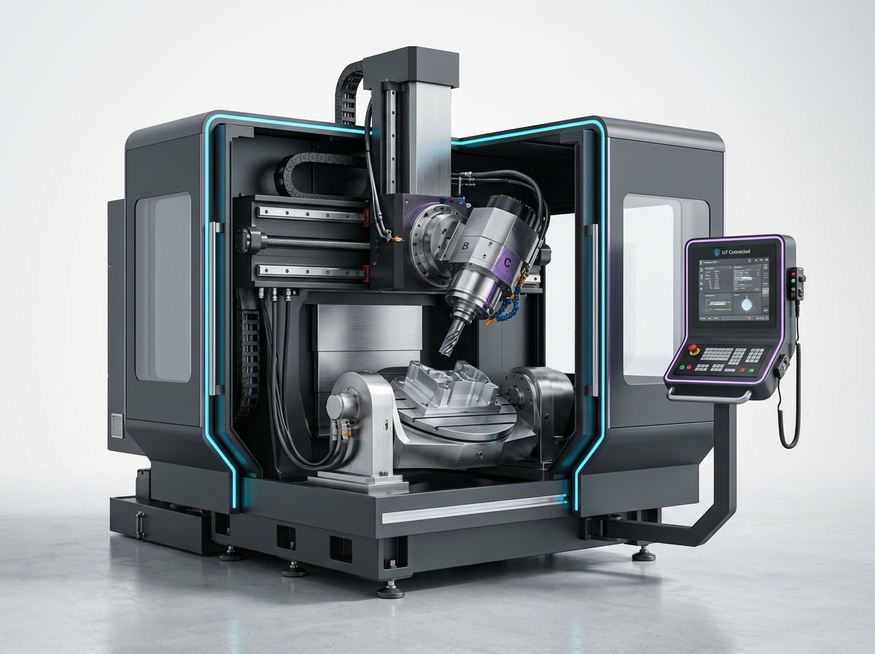
INDUSTRY 4.0 • PREDICTIVE MAINTENANCE
Optimach-AI
Enterprise Industrial Intelligence & Failure Forecasting
Transforming multivariate edge sensor telemetry into proactive maintenance operations using multi-model machine learning.
Plant Availability • 7 Trained ML Models • Closed-Loop Work Orders
Notes:
Good morning/afternoon. Today I am presenting Optimach-AI, an enterprise industrial intelligence and predictive maintenance platform engineered to eliminate unscheduled machinery downtime through continuous telemetry surveillance and multi-model machine learning.

Slide 2
CHALLENGE & CONTEXT
The Industrial Dilemma: Unscheduled Factory Downtime
Why traditional reactive and calendar-based maintenance models fail modern manufacturing facilities.
Reactive Maintenance
(Run-to-Failure)
Calendar-Based Maintenance
(Preventive)
Predictive Intelligence
(Optimach-AI Approach)
• Equipment serviced only after catastrophic stoppage.
• High collateral damage to connected subsystems.
• Average cost: up to $260,000 per hour in heavy industry.
• Emergency labor premiums and delayed supply chains.
• Fixed time-interval servicing (e.g., every 30 days).
• Replaces healthy components prematurely.
• Wastes technician hours and OEM parts inventory.
• Blind to unexpected mid-cycle vibration/thermal drift.
• Continuous 1.0 Hz multivariate telemetry monitoring.
• Detects subtle micro-anomalies 7 days before failure.
• Servicing scheduled exactly when wear thresholds breach.
• Reduces unplanned downtime by 35% - 45%.
Notes:
In modern manufacturing, running machines to failure is financially crippling, while fixed calendar-based servicing wastes resources. Optimach-AI addresses this with condition-based predictive intelligence, detecting micro-wear patterns days before operational breakdown.

Slide 3
PRODUCT ARCHITECTURE
The Optimach-AI Triad: Monitor, Predict, Maintain
A connected, closed-loop workflow connecting raw edge data to field technician decisions.
STEP 01
STEP 02
STEP 03
MONITOR
Edge Telemetry Ingestion
PREDICT
7-Model ML Engine
MAINTAIN
Actionable Operations
✓ Continuous 1.0 Hz edge streaming gateway.
✓ Vibration RMS, Core Temp, Hydraulic Pressure, Spindle Velocity, Line Voltage.
✓ Automated envelope boundary validation against ISO 10816 standards.
✓ Ensemble inference: XGBoost, LightGBM, Isolation Forest, LSTM.
✓ Quantitative 7-day failure risk score (0 - 100%).
✓ Root-cause attribution & live telemetry drift analysis.
✓ Converts risk alerts into structured work orders.
✓ Field technician interactive inspection checklists.
✓ Automated priority dispatch and part replacement tracking.
Notes:
The triad represents the heart of the platform. We don't just dump charts on an engineer—we ingest telemetry, pass it through trained machine learning algorithms, and instantly output an actionable work order.

Slide 4
ENGINEERING & TECHNOLOGY
High-Performance Full-Stack Architecture
Designed for sub-100ms inference latency, sub-second telemetry rendering, and responsive usability.
CLIENT EXPERIENCE
Frontend Application
ML SERVING ENGINE
Backend Microservice
INDUSTRIAL GATEWAY
Edge & Ingress Layer
• React 18 & TypeScript for enterprise type safety.
• Tailwind CSS with executive light-mode styling.
• Vite 8.3 bundler with automated code-splitting.
• Ultra-lean 30.8 kB core JS bundle gzipped.
• Custom SVG oscilloscope rendering 50+ data points smoothly.
• Python Flask microservice architecture.
• REST API endpoints: /predict, /health, /telemetry.
• Serialized Joblib model pipelines loaded in RAM.
• Automated gzip pre-compression of static delivery assets.
• Low-latency response (<80ms per prediction inference).
• 1.0 Hz simulated continuous streaming gateway.
• Multivariate anomaly injection testing sandbox.
• Synthetic and physical CSV dataset playback.
• Continuous buffer caching for rapid client telemetry recovery.
• Pre-configured for MQTT / OPC-UA bridge adapters.
Notes:
Our tech stack is tailored for responsiveness. By separating Three.js heavy components and pre-compressing assets, our client bundle is only 30.8 kB, ensuring fast loading on factory floor tablets and workstations.

Slide 5
EXECUTIVE SURVEILLANCE
Overview Dashboard: 5-Second Factory Health Assessment
Designed for Plant Managers and Reliability Leads requiring instant visibility over monitored bays.
TOTAL ASSETS
8 Units
Status: 100% Online
HEALTHY FLEET
4 Units
Status: 50% Nominal
NEEDS ATTENTION
2 Units
Status: Early Drift
CRITICAL ACTIONS
2 Units
Status: Immediate Action
Fleet Health Index by Production Bay
Gateway Ingress: 99.8% Reliability • Plant Average: 74% Health
• Bay A — Press & Precision Stamping ➔ 88% Health (Nominal)
• Bay B — Heavy CNC Milling Line ➔ 74% Health (Degraded Bearing)
• Bay C — Rotary & Lathe Cells ➔ 92% Health (Optimal Operating)
AI PREDICTIVE INSIGHT
Spindle Bearing Harmonic Drift on MACH-012
Gradient boosted ensemble flagged high harmonic vibration (>54 mm/s) coupled with 84.1°C thermal buildup. Machine has entered early mechanical wear state with an estimated 7-day failure horizon.
Recommended Action: Schedule physical bearing and runout check during next shift turnover.
Notes:
The Overview screen gives plant managers an executive glance at the entire factory. It highlights the 4 key fleet KPIs, breaks down health across specific production bays, and surfaces an immediate AI summary for the highest-risk asset.

Slide 6
ASSET INTELLIGENCE
Machine Fleet: Industrial 3D Digital Twin & Nameplate
Deep equipment condition monitoring with studio-rendered physical visual and certified specifications.
Digital Twin: CNC Milling Cell #12 (MACH-012)
Essential Telemetry & Nameplate Specs
Current Vibration: 59.4 mm/s RMS (Limit: 50.0)
Core Temperature: 84.1 °C (Limit: 84.0)
Fluid Pressure: 102.2 PSI (Nominal: 85-118)
Spindle Speed: 393 RPM (Nominal: 375-515)
Operating Voltage: 480V 3-Phase Industrial
Rated Motor Power: 45 kW Synchronous Drive
Nominal Pressure: 105 PSI Dual Manifold
Commissioned Date: 2012-04-15 (Age: 14 yrs)
Sub-Assemblies:
• Cutting Spindle
Status: High Vibration
• Hydraulic Clamp
Status: Attention
• AC Servo Stator
Status: Normal
• Thermal Jacket
Status: 84.1°C Drift
Notes:
On Slide 6, we see the individual machine intelligence view. Instead of complex, heavy 3D canvases, we use a studio-rendered digital twin paired with live telemetry probes and permanent manufacturer nameplate specifications.

Slide 7
PREDICTIVE ENGINE
Machine Learning Pipeline: 7 Trained Models
Cross-validated ensemble combining decision tree boosting, deep recurrent networks, and anomaly isolation.
XGBoost Classifier
Multivariate Failure Classifier
Validation: 0.92 ROC-AUC
Detects non-linear interactions between harmonic vibration & thermal rise.
LightGBM Classifier
Gradient Boosted Tree Ensemble
Validation: 0.91 ROC-AUC
Ultra-low latency inference suitable for high-frequency edge gateway.
LSTM Neural Network
Recurrent Sequential Forecaster
Validation: 94% Accuracy
Captures temporal trends and sequential wear degradation across hours.
Isolation Forest
Unsupervised Outlier Detector
Validation: 0.89 F1-Score
Detects novel failure patterns with zero prior training labels.
LightGBM Regressor
Remaining Useful Life (RUL)
Validation: ±1.8 Days Error
Estimates operating days remaining before reaching critical threshold.
Ridge Regression
L2 Regularized Baseline
Validation: Baseline Standard
Ensures linear stability against sudden measurement sensor noise.
Notes:
Optimach-AI does not rely on a single ML algorithm. We leverage a 7-model ensemble including XGBoost, LightGBM, and an LSTM recurrent neural network. This multi-model architecture achieves an ROC-AUC above 0.91, dramatically reducing false alarm fatigue.

Slide 8
REAL-TIME TELEMETRY
Live Monitoring: Oscilloscope Stream & Anomaly Sandbox
Dynamic multi-channel wave telemetry visualization with interactive edge anomaly simulation.
High-Precision Telemetry Oscilloscope
✓ Continuous 1.0 Hz edge ingress streaming.
✓ Calibrated safe operating bands shaded directly on chart (ISO 10816 standards).
✓ Multi-sensor channel selector: Vibration RMS, Operating Temp, Hydraulic Line, Spindle Velocity, Line Voltage.
✓ Selectable rolling time horizons: 1 Hour, 6 Hours, 12 Hours, and 24 Hours.
✓ Interactive hover tooltips with sub-second timestamps and exact measurement units.
✓ Transparent attribution: Prominently identifies simulated vs actual live data feeds.
Edge Fault Injection Sandbox
Allows operators and engineers to test live ML diagnostic response by simulating real-world equipment failures in real time:
⚡ Vibration Spike (+18 mm/s)
Simulates bearing ball/race pit degradation and harmonic imbalance.
⚡ Pressure Drop (-24 PSI)
Simulates hydraulic seal blowout and drawbar clamp loss.
⚡ Voltage Surge (+26 V)
Simulates industrial power grid harmonic interference.
Notes:
The Live Monitoring screen acts as the plant's telemetry oscilloscope. The fault injection sandbox is a critical feature for training and verification—allowing technicians to inject vibration spikes or pressure drops to confirm the ML models detect the anomaly in real time.

Slide 9
FIELD EXECUTION
From Prediction to Resolution: Maintenance Workflows
Translating algorithmic probabilities into structured work orders and operator checklists.
CALIBRATED URGENCY
1. Risk Assessment
STEP-BY-STEP PROTOCOL
2. Technician Checklist
CLOSED-LOOP RESOLUTION
3. Work Order Dispatch
• Calculates 7-day failure likelihood (e.g. 78% Probability).
• Assigns calibrated risk tier: Routine, Moderate, High, Severe.
• Designates urgency: 'Inspect within 48 Hours'.
• Actionable field procedure generated specifically for the detected failure mode.
• Interactive checklist items completed on mobile tablet.
• Eliminates guesswork during mechanical spindle servicing.
• One-click work order creation directly into Maintenance Log.
• Tracks assigned technician, due date, and replacement seal kits.
• Full historical event audit trail preserved for reliability analysis.
Notes:
A predictive platform fails if it stops at analytics. Optimach-AI closes the loop by turning risk scores into dispatched work orders with interactive checklists for field operators, logging the entire audit trail.

Slide 10
IMPACT & HORIZON
Business Value, Proven ROI & Strategic Roadmap
Delivering quantifiable bottom-line savings and scaling smart industrial connectivity.
35% – 45%
Downtime Reduction
Eliminates catastrophic unscheduled production halts via early 7-day drift alerts.
20% – 30%
Maintenance Cost Savings
Avoids premature replacement of healthy components and reduces emergency overtime.
15%+
OEE Improvement
Extends overall machinery operating lifespan and stabilizes factory output.
STRATEGIC EXPANSION ROADMAP
➔ Phase 4: Hardware Gateway: OPC-UA and MQTT edge industrial connectors for live PLC/SCADA interfacing.
➔ Phase 5: Acoustic AI Diagnostics: Audio spectrogram deep learning for high-frequency bearing micro-crack detection.
➔ Phase 6: Automated ERP Integration: Automated spare parts reordering with SAP/Oracle supply chain systems.
Notes:
In conclusion, Optimach-AI provides quantifiable ROI: 35-45% downtime reduction and significant maintenance savings. Our future roadmap integrates direct PLC hardware connectors and acoustic vibration analysis. Thank you for your time, and I am now open for any questions.

