Slide 1
Introduction to Probability Theory
March 7, 2017
Credits for slides: Allan, Arms, Schutze.

Slide 2
Required Reading
“Information Retrieval” Textbook
  Chapter 11: Probabilistic IR
Today: Probability Review

Slide 3

Probability & Statistics References
Statistical Inference (Hardcover)
  George Casella, Roger L. Berger

Slide 4
Definition of Probability
The probability of an event is the proportion of the time that events of the same kind will occur in the long run.
Examples:
  – the probability my flight to Chicago will be on time
  – the probability my ticket will win the lottery
  – the probability it will rain tomorrow
Always a number in the interval [0,1]
  0 means “never occurs”
  1 means “always occurs”

Slide 5
Sample Spaces
Sample space: a set of possible outcomes for some event
Examples:
– flight to Chicago: {on time, late}
– lottery: {ticket 1 wins, ticket 2 wins,…,ticket n wins}
– weather tomorrow:
{rain, not rain} or
{sun, rain, snow} or
{sun, clouds, rain, snow, sleet} or…

Slide 6
Random Variables
Random variable: a variable representing the outcome of an experiment
Example:
  X represents the outcome of my flight to Chicago
  We write the probability of my flight being on time as
  When it is clear which variable we are referring to, we may use the shorthand

Slide 7

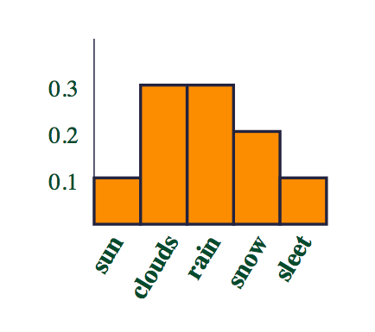
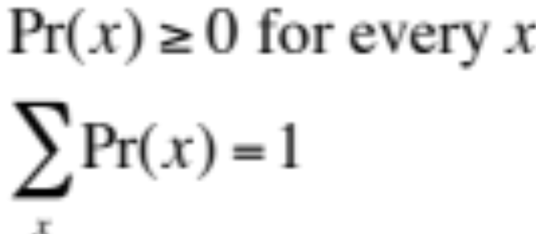
Probability Distributions
If X is a random variable, the function given by
for each x is the probability distribution of X
Requirements:
A histogram plots the number of times or the frequency with which each value of a given variable is observed.
Probability Distribution = Frequency Histogram

Slide 8

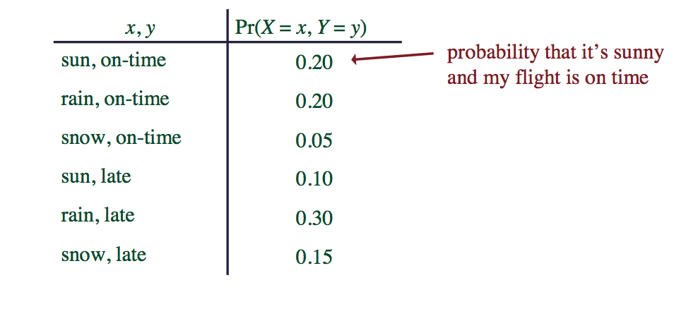
Joint Distributions
Joint probability distribution: the function given by
Read “X equals x and Y equals y”
Example

Slide 9
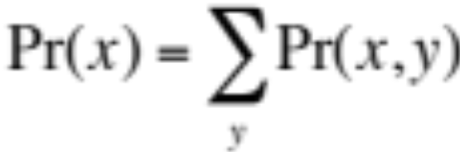
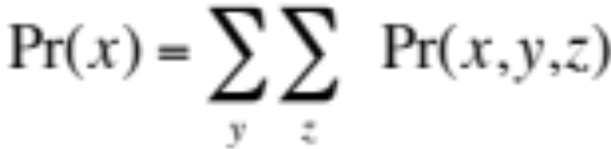
Marginal Distributions
The marginal distribution of X is defined by
“The distribution of X ignoring other variables”
This definition generalizes to more than two variables, e.g.

Slide 10
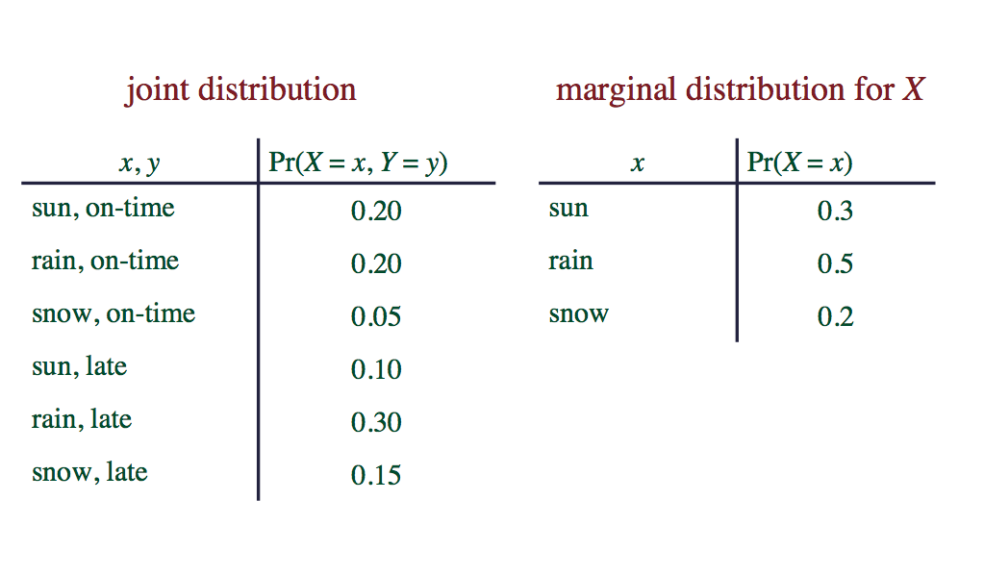
Marginal Distribution Example

Slide 11
Marginal Distribution Example

Slide 12
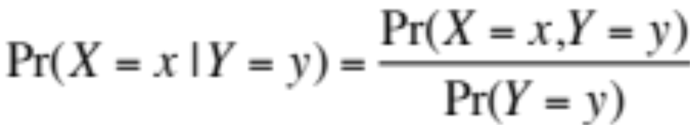
Conditional Distributions
The conditional distribution of X given Y is defined as:
“the distribution of X given that we know Y ”

Slide 13
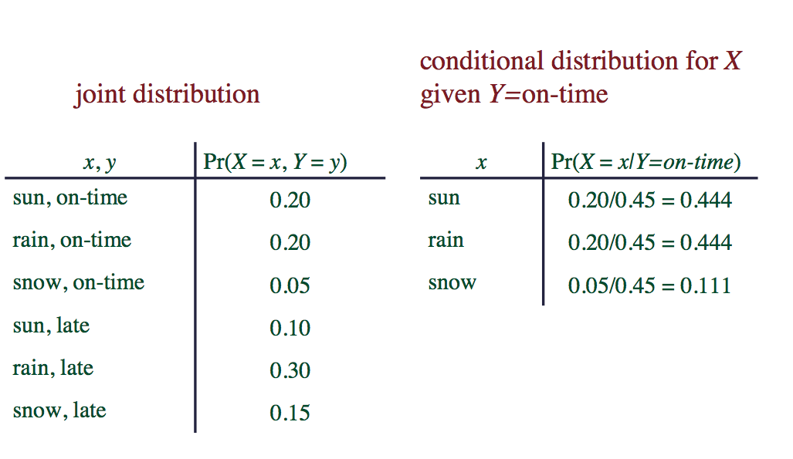
Conditional Distribution Example

Slide 14
Conditional Distribution Example

Slide 15
Independence
Two random variables, X and Y, are independent if

Slide 16
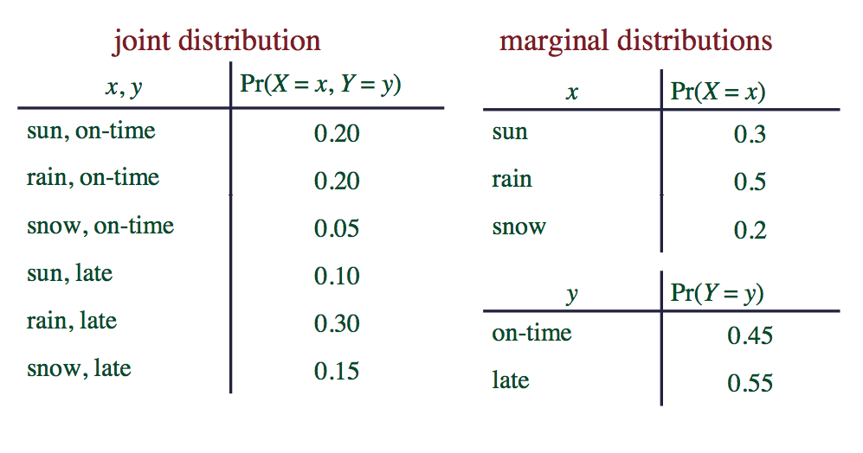
Independence Example #1
Are X and Y independent here?

Slide 17
Independence Example #1
Are X and Y independent here? NO.

Slide 18
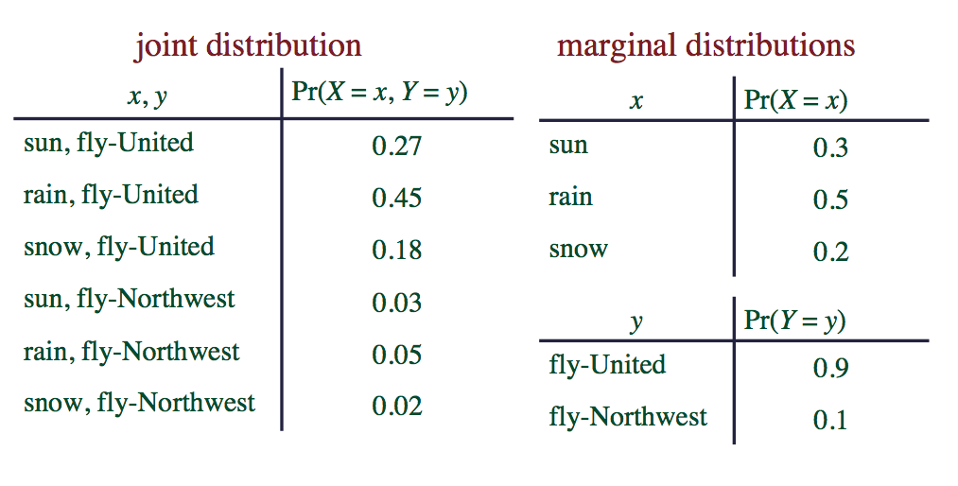
Independence Example #2
Are X and Y independent here?

Slide 19
Independence Example #2
Are X and Y independent here? YES.

Slide 20

Conditional Independence
Two random variables X and Y are conditionally independent given Z if
“once you know the value of Z, knowing Y doesn’t tell you anything about X ”
Alternatively

Slide 21
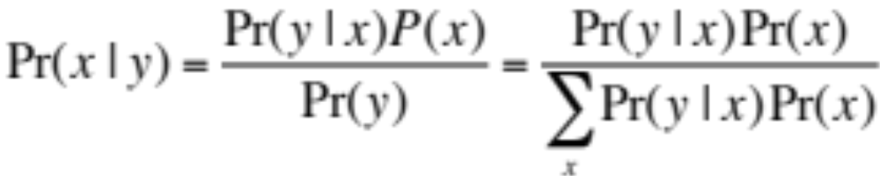



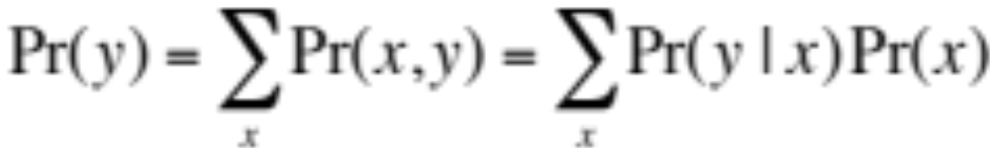
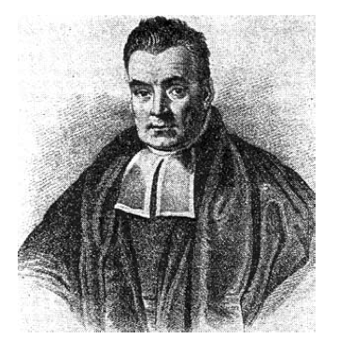
Bayes Rule
This theorem is extremely useful
There are many cases when it is hard to estimate directly, but it’s not too hard to estimate and
Bayes, Thomas (1763) An essay towards solving a problem in the doctrine of chances. Philosophical Transactions of the Royal Society of London, 53:370-418

Slide 22
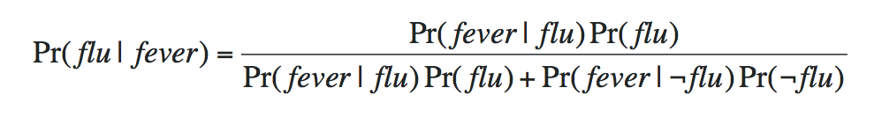
Bayes Theorem Example
MDs usually aren’t good at estimating Pr(Disorder | Symptom)
They’re usually better at estimating
Pr(Symptom | Disorder)
If we can estimate Pr(Fever | Flu) and Pr(Flu) we can use Bayes’ Theorem to do diagnosis

