Slide 1
ARTIFICIAL INTELLIGENCE AND MACHINE LEARNING Employee Attrition Prediction

Slide 2
Objective & Dataset
Objective: The project's goal is to build predictive models that can determine whether an employee is likely to leave an organization. By identifying the key factors that lead to attrition, companies can work to improve employee retention and decrease turnover costs.
Dataset Used:
Source: Employee-Attrition
Size: 1470 records
Target Variable: Attrition (Yes/No)

Slide 3
Feature Categories:
Demographics: Age, Gender, MaritalStatus
Job-Related: Department, JobRole, JobLevel, JobSatisfaction, YearsAtCompany
Compensation: MonthlyIncome, DailyRate, PercentSalary Hike
Work-Life: WorkLifeBalance, OverTime, Business Travel
Tenure Metrics: YearsSinceLastPromotion, YearsWith CurrManager

Slide 4
Models & Performance Metrics
Models Implemented and Compared:
Logistic Regression
Decision Tree
Random Forest
K-Nearest Neighbors (KNN)
Gradient Boosting
Support Vector Classifier (SVC)

Slide 5
Performance Metrics Used for Evaluation:
Accuracy
Precision
Recall
F1-Score
Confusion Matrix

Slide 6
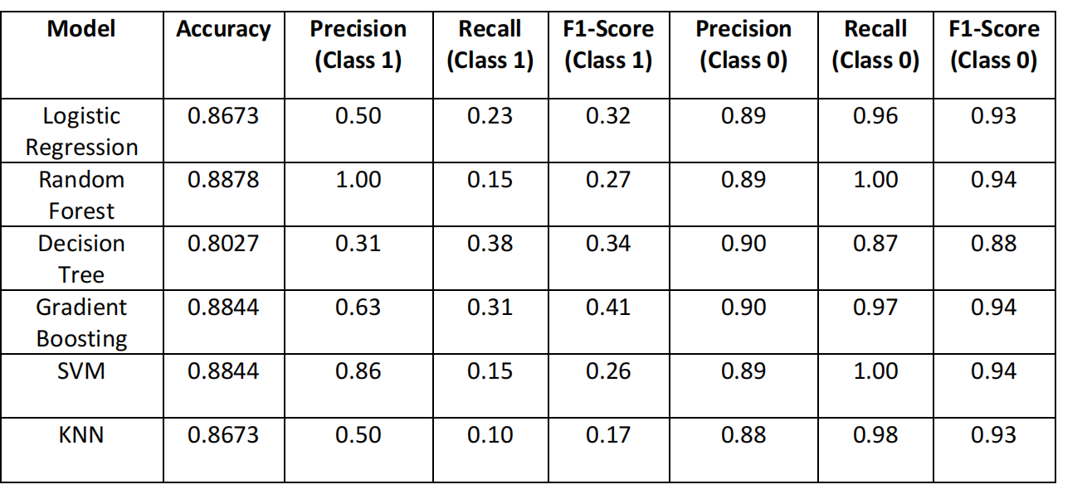

Slide 7
Model Accuracy Comparison
Key Findings:
Best Accuracy: Random Forest (88.78%) and Gradient Boosting (88.44%) are the top performers.
Lowest Accuracy: The Decision Tree model had the lowest accuracy at 80.27%.
The random forest model was concluded to be the best model based on its 88.78% accuracy.

Slide 8
Random Forest Confusion Matrix & Feature Importance
Random Forest Confusion Matrix:
The model predicted
No Attrition for 1233 cases and Attrition for 233 cases.
(Note: The source text for these numbers is not explicitly clear, but can be inferred from the image provided. I'm providing a cautious interpretation.)

Slide 9
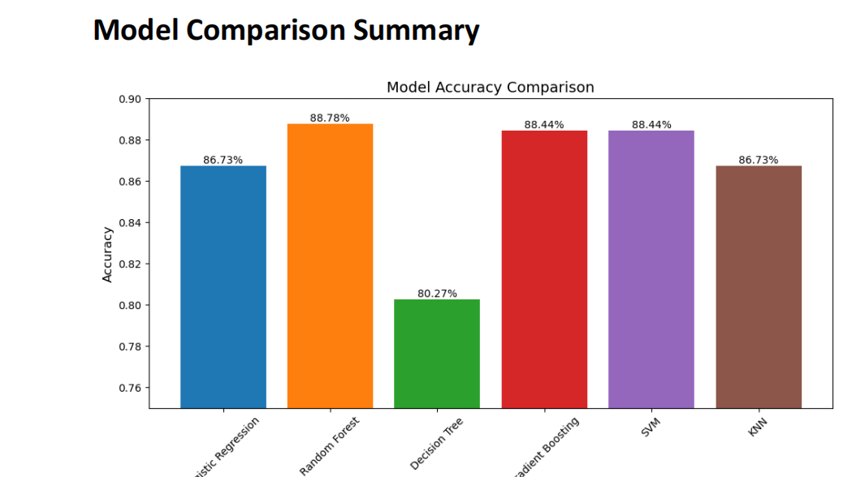

Slide 10
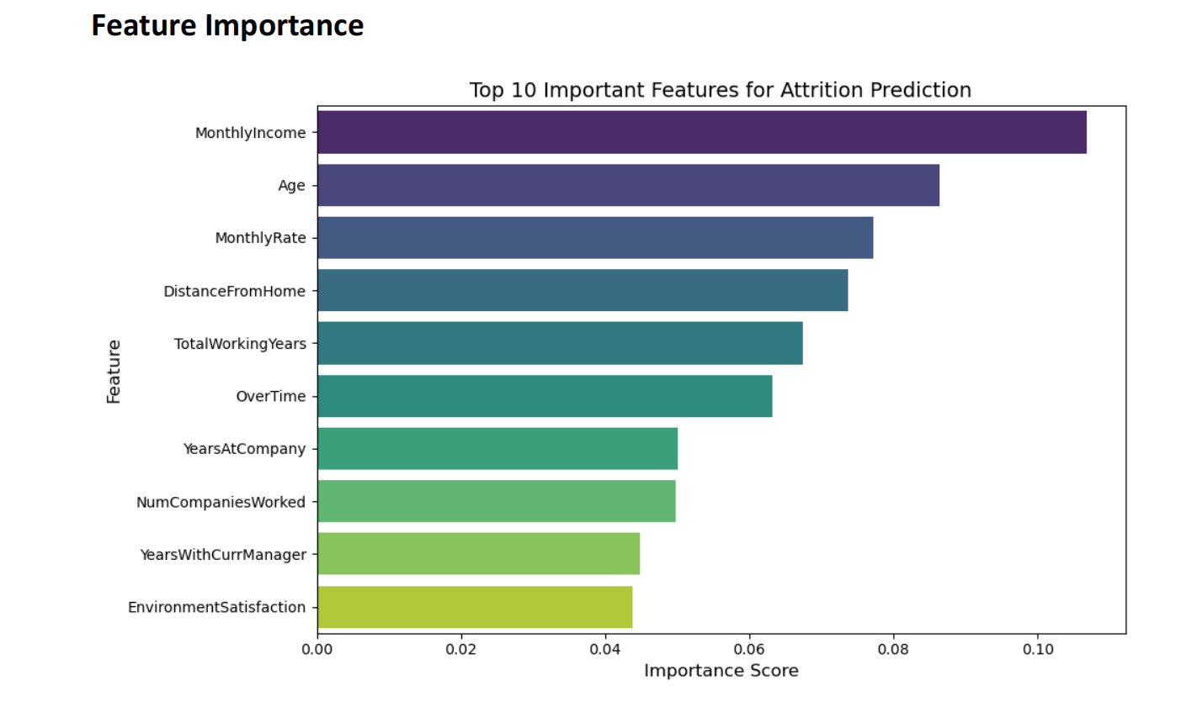
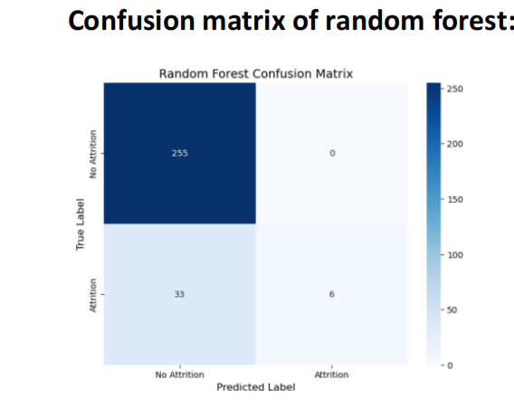
After this performace matrix we can conclude that best model is random forest with accuracy 88.78%.

Slide 11
Top 10 Important Features for Attrition Prediction:
MonthlyIncome
Age
MonthlyRate
DistanceFromHome
Total Working Years
OverTime
YearsAtCompany
NumCompaniesWorked
YearsWithCurrManager
EnvironmentSatisfaction

Slide 12
Challenges & Learnings
Challenges:
Class Imbalance: The target variable (Attrition) was imbalanced, which made it difficult for some models to detect the minority class.
Model Selection: Choosing the best model required careful cross-validation and metric evaluation.
Hyperparameter Tuning: Experimentation was needed to optimize each model's performance.

Slide 13
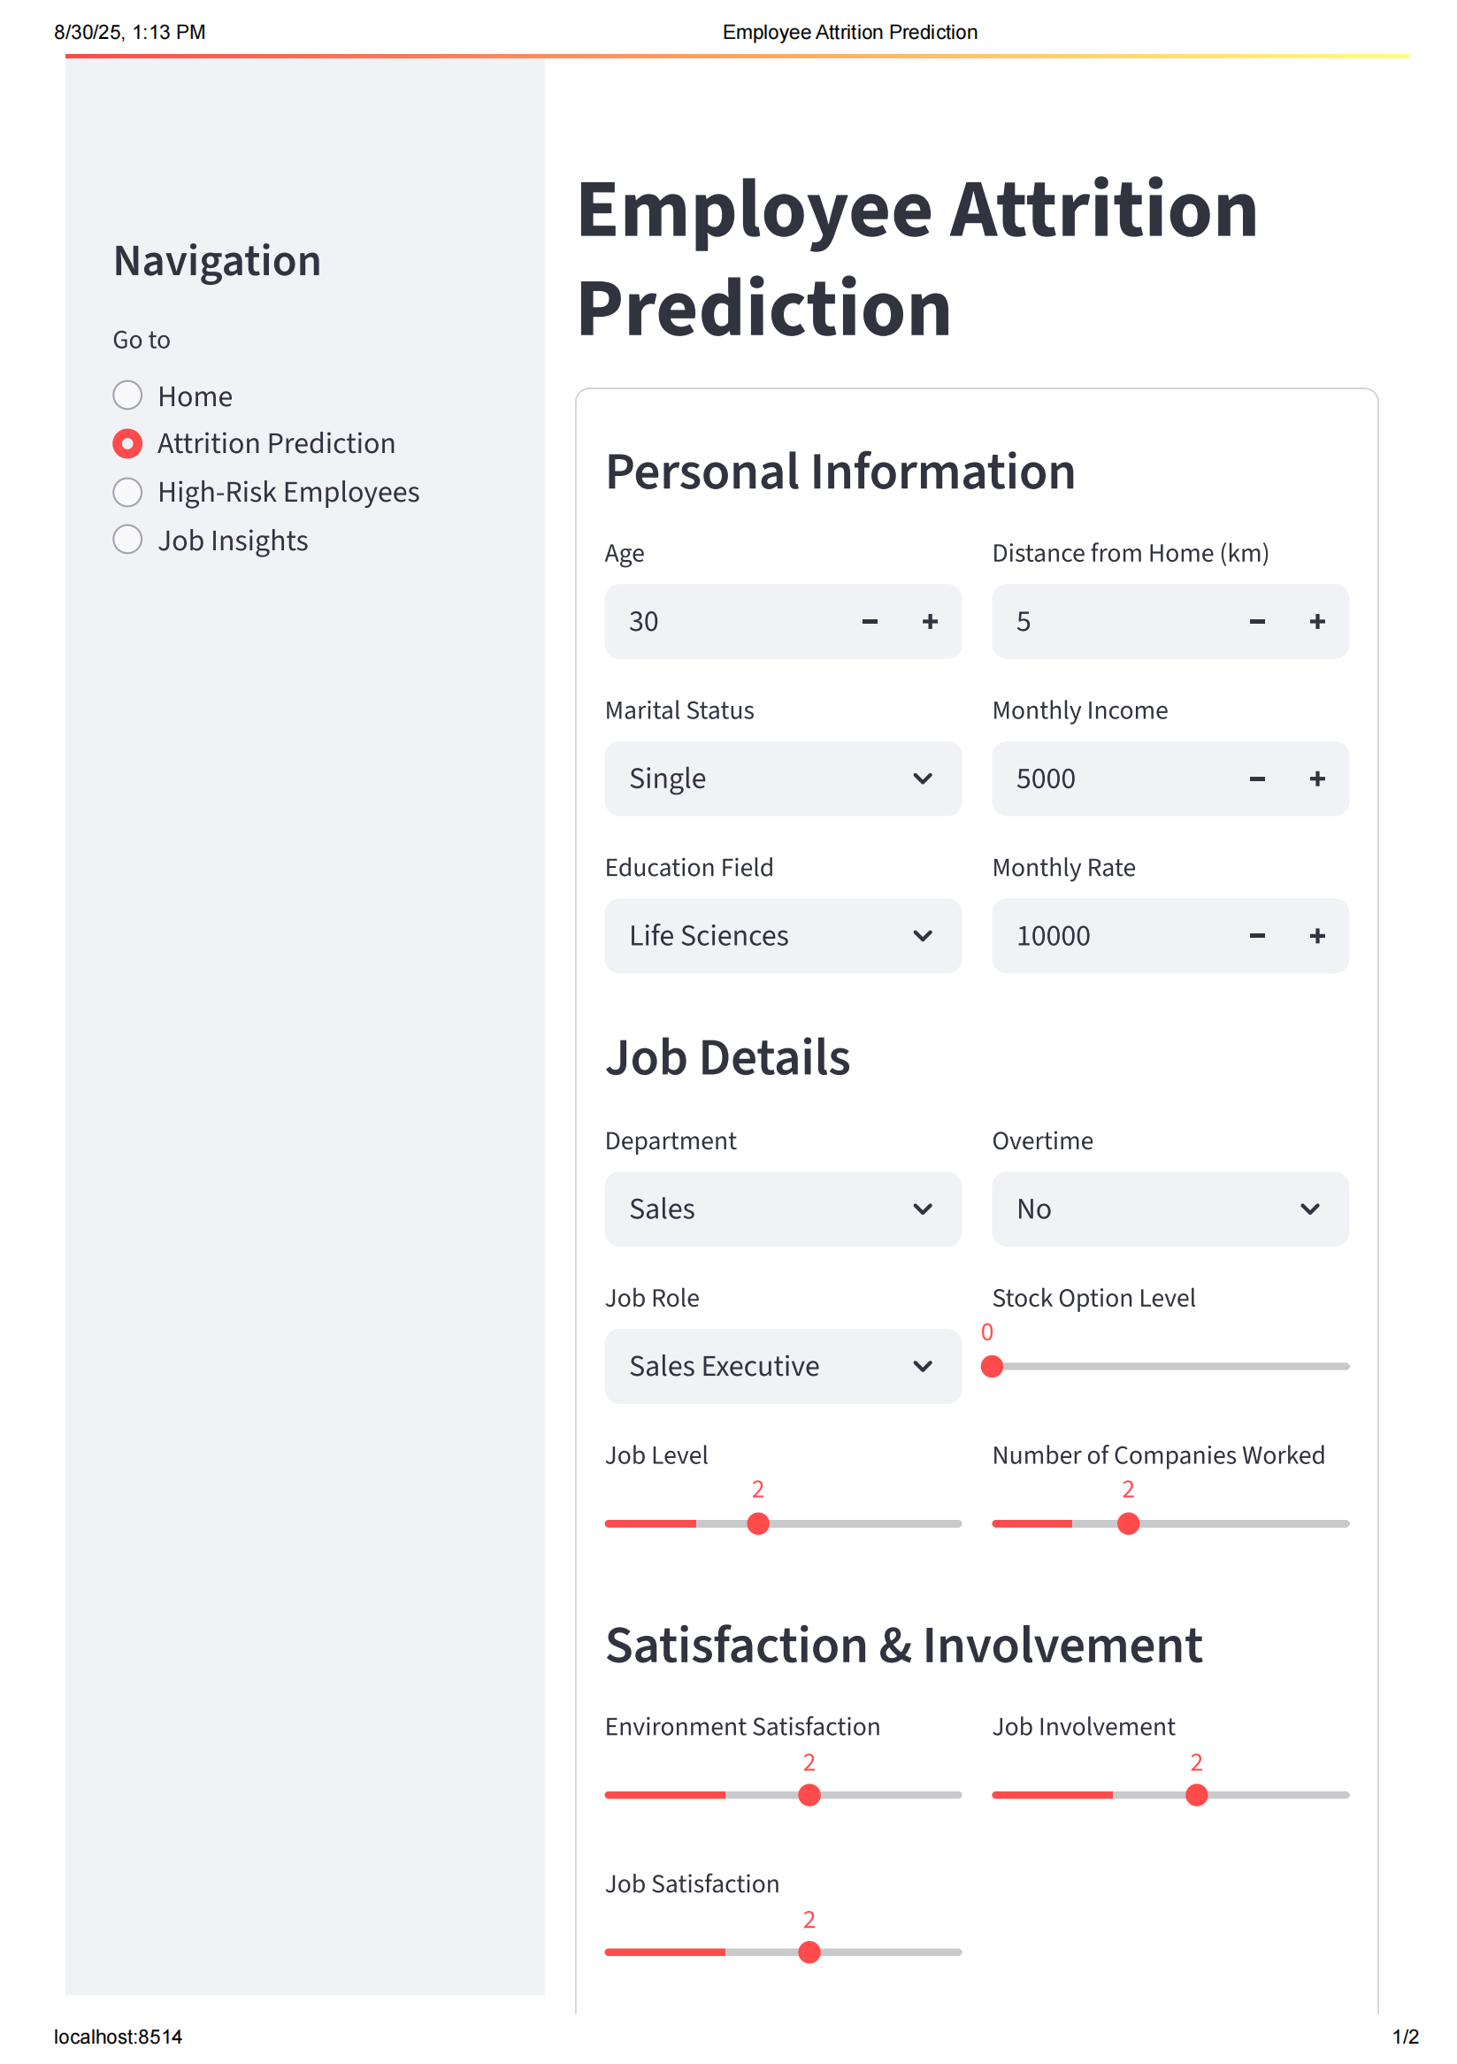

Slide 14
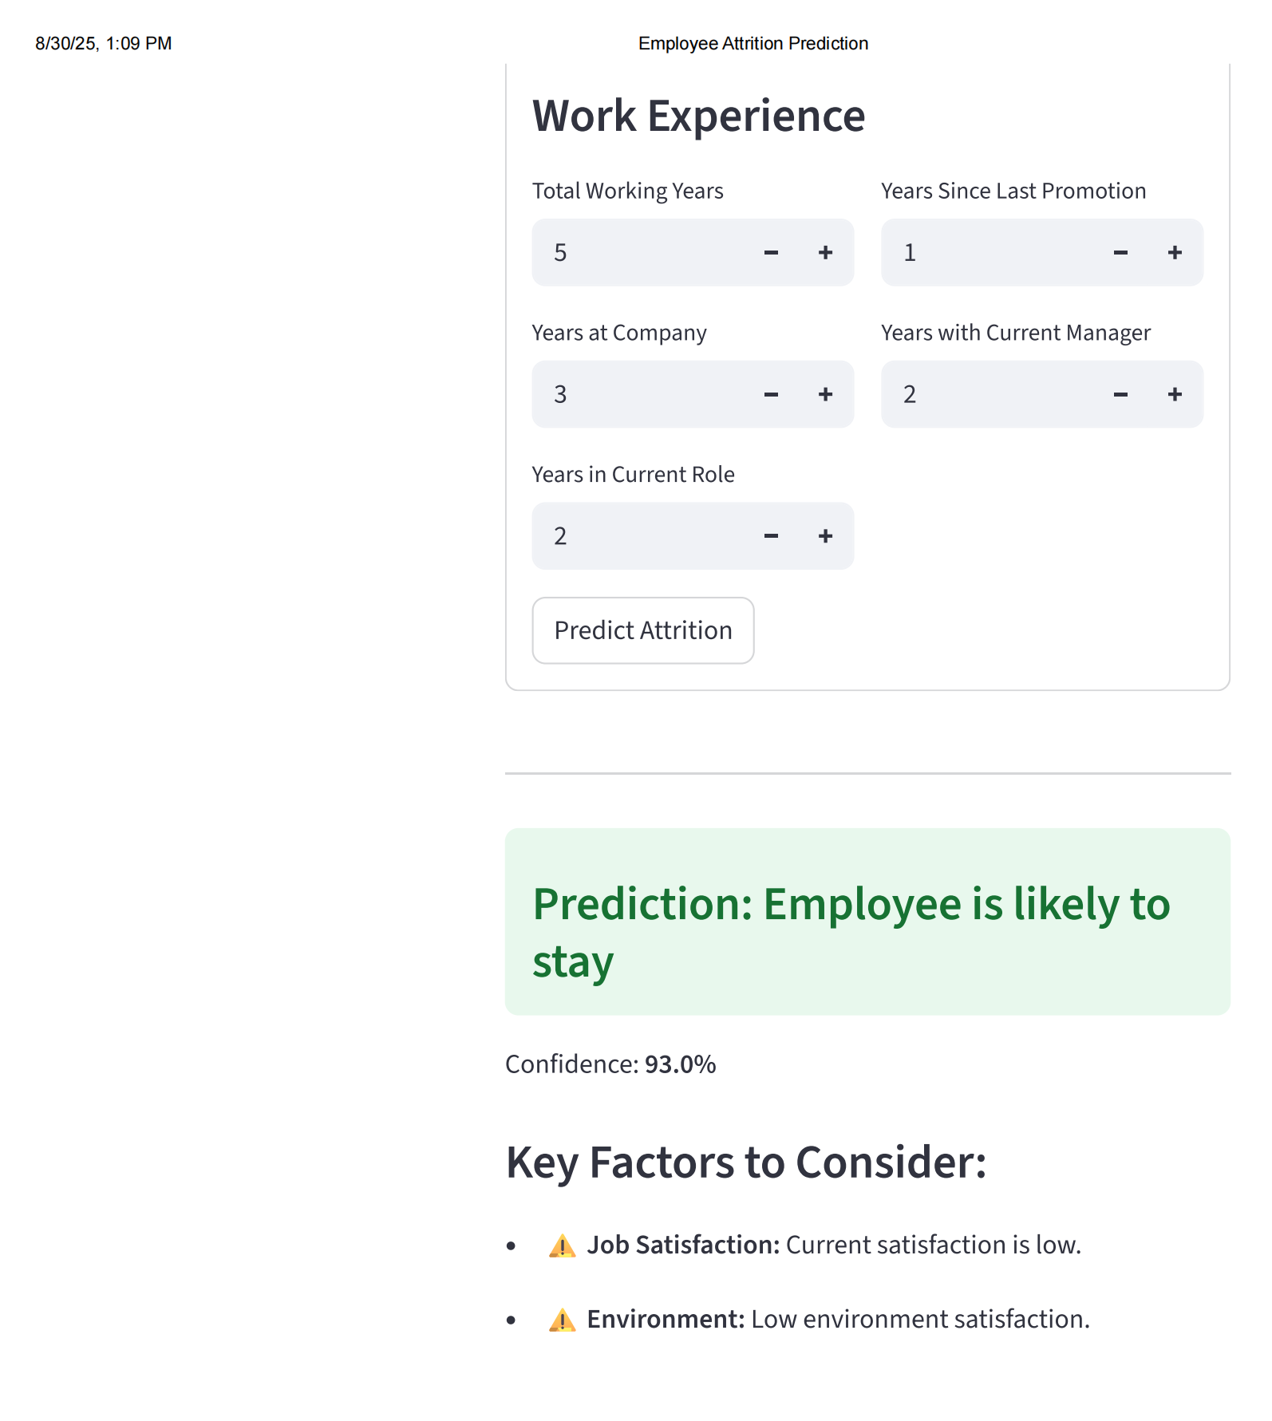

Slide 15
Learnings:
Tree-based models, such as Random Forest and Gradient Boosting, were more effective at identifying attrition patterns.
Feature scaling and encoding significantly impacted model performance.
Visualizations were helpful for understanding the underlying data distribution and model behavior.
Using multiple models provided insight into which algorithms were best suited for the data characteristics.

