Slide 1
L-MIST – Learn musical INSTRUMENT THROUGH EMG SENSOR
-Sharmila Mani

Slide 2
EMG Data Collection1
EMG Data Collection 2
Feature Extraction and Experiment
Benchmark
With CMU Data
Additional Features
Benchmark

Slide 3
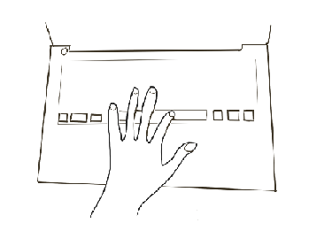
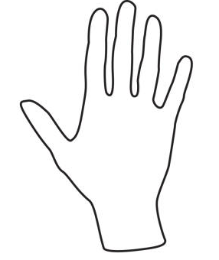
EMG Data Collection 1
5 secs
+
+
5 secs
5 secs
Using Forearm Electromyograms to Classify Hand Gestures
Gene Shuman et al

Slide 4
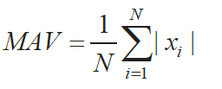
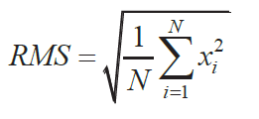
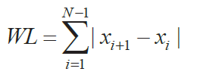

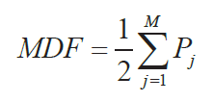
Feature Extraction
Classification of EMG signal based on Time and Frequency Domain Features - J.Too et al
The features mentioned for Time Domain is
(1) Root Mean Square
(2) Mean Average Value
(3) Wave length
The features mentioned for Frequency Domain Signal is
(1) Mean Frequency
(2) Median Frequency
(3) Frequency Ratio
Time Domain features help in pattern recognition and Frequency domain features helps in Power Spectrum estimation , muscle fatigue and muscle force estimation

Slide 5
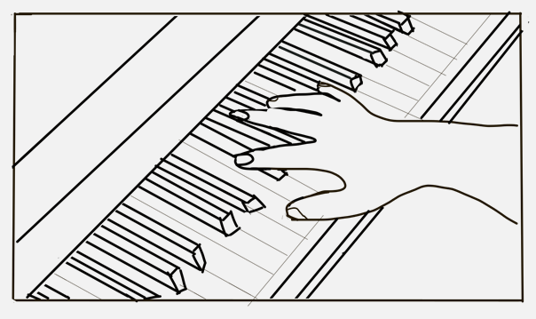
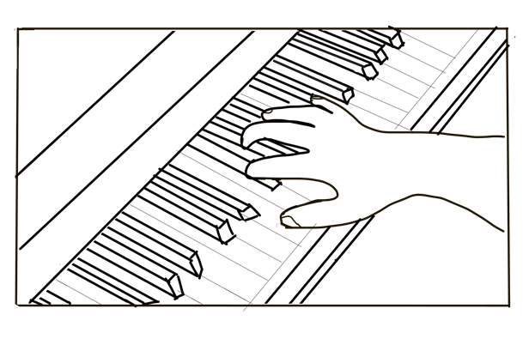
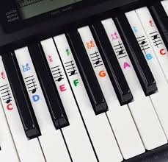
EMG Data Collection 2
+
+
2 secs
10 secs
2 secs
3 4
2
5
#Electrodes = 2
#Experiments = 10
1
Fingers | Keys |  |  |  | CMajorChord
1 | C |  |  |  | C (1) + E (3) + A (5)
2 | D |  | CS | FS
3 | E |  | DS | GS
4 | F | A |  | AS
5 | G | B

Slide 6
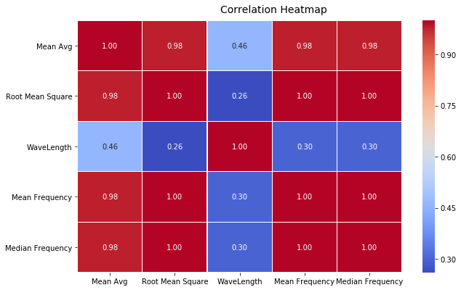
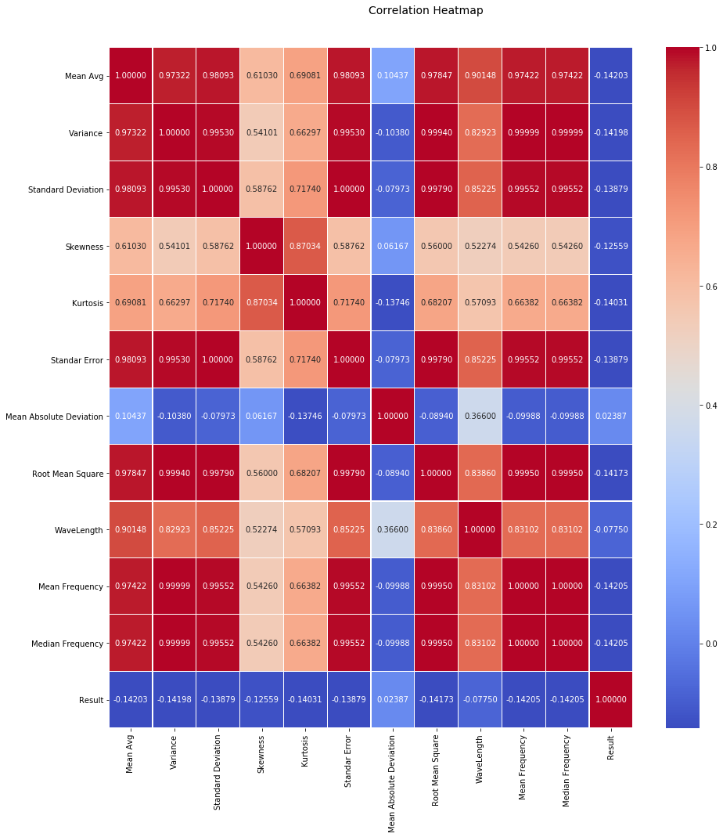
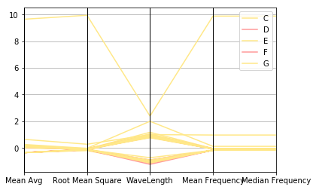
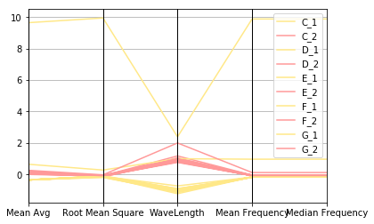
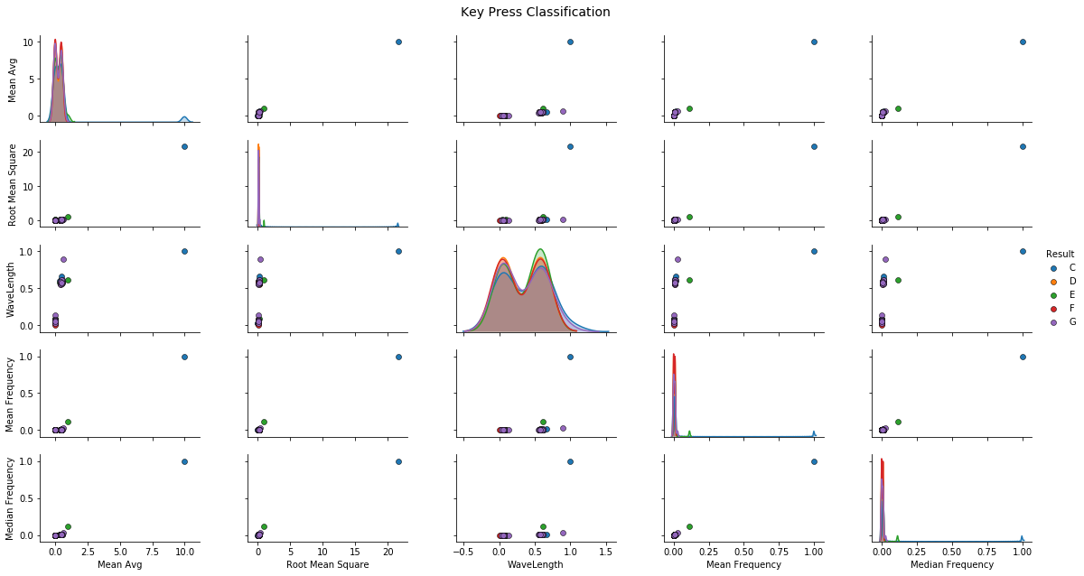
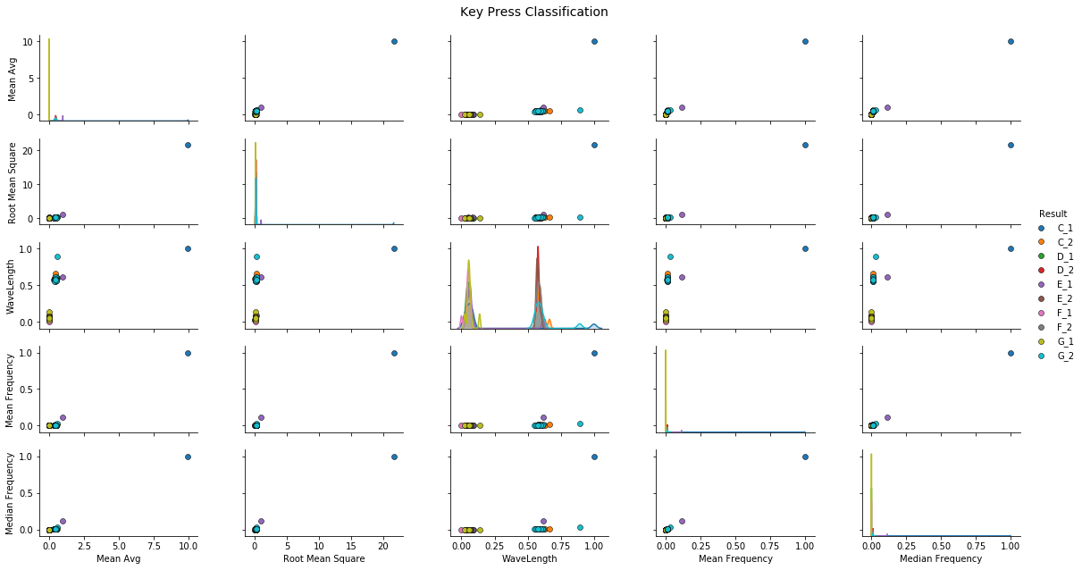
Feature Extraction and Experiment
Correlation Heat map for C1, C2 vs C
Parallel Coordinate Plot
Scatter Plot
Kmeans and LDA

Slide 7
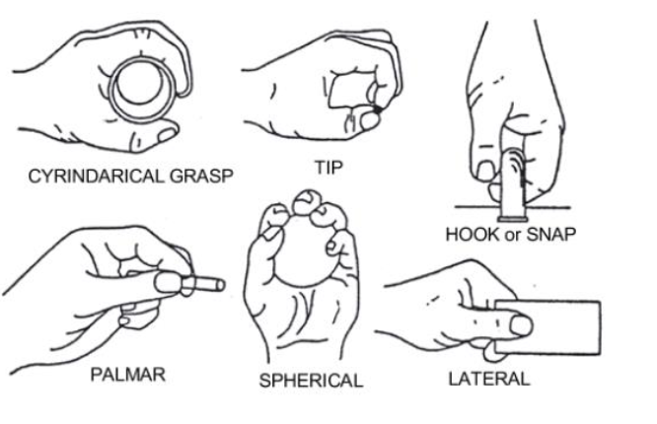
CMU EMG Data
UCI Machine Learning Repository: sEMG for Basic Hand movements Data Set
sEMG for Basic Hand movements Data Set Download: Data Folder, Data Set Description. Abstract: The EMG for Basic Hand movements includes 2 databases of surface electromyographic signals of 6 hand movements using Delsys' EMG System. Healthy subjects conducted six daily life grasps.
https://archive.ics.uci.edu/ml/datasets/sEMG+for+Basic+Hand+movements
Data Set | People / Subjects | #Times | Time / Experiment
1 | 5 ( 2 M / 3 F) | 30 | 6 sec
2 | 1 | 300 ( 100 / day) | 5 sec

Slide 8
BenchMark with CMU - 1
 | EMG | CMU Data 1– Test 1 | CMU Data 1 – Test 2
Data Collection Time | 12 sec | 6 sec | 6 sec
Sample Data Per Electrode (1 Exp Data) | 238 | 3000 | 3000
Number of trials per movement | 10 | 10 | 30
Mean Avg | Standard Normalization | NA | NA
 | Min – 669.33 Max – 944.14 | Min – 0.1346 Max – 0.1458 | Min -0.13456 Max -0.1496
Root Mean Square | Standard Normalization | NA | NA
 | Min –669.61 Max -1 -843.41 Max – 4642.55 | Min – 0.1615 Max – 1.2877 | Min-0.1615 Max-1.3655
Wavelength | LOG and Standard Normalization
 | Min -192 Max -70236 | Min – 208.68 Max – 3483.29 | Min-189.80 Max-3531.10
Mean Frequency | LOG and Standard Normalization
 | Min –106176719 Max -164579502 Max – 5100073033 | Min-78.25 Max – 4975.26 | Min-78.25 Max-5593.93
Median Frequency | LOG and Standard Normalization
 | Min- 12589141202 Max-19502670987 Max – 6.04359E11 | Min –117379.79 Max – 7462895.85 | Min-117379.79 Max-8390896.03
Accuracy Score of KMeans Plot LDA | 20 % | 22% | 9%
Different users
Matters??

Slide 9
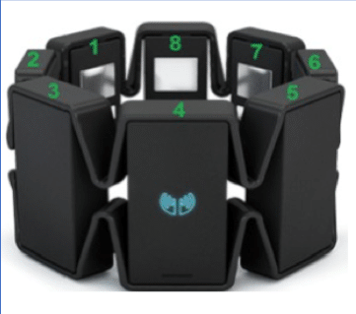
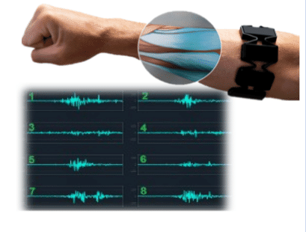
Additional Features
Comparative Analysis of EMG Signal Features in Time-domain and Frequency-domain using MYO Gesture Control
# Subjects / Person | Features | #Gestures | #Channel
4 | 13 | 4 | 8
KNN – 90%
WEKA – 93.8%
Time Features |  | Frequency Features
Mean Absolute Value | ✓ | Mean Frequency | ✓
Variance | ✓ | Median Frequency | ✓
Standard Deviation | ✓ | Power Bandwidth
Skewness | ✓ | Total Harmonic Distortion
Kurtosis | ✓ | Signal To Noise Ratio
Standarad Error | ✓ | Power Spectral Density
Mean Absolute Deviation | ✓
 | Root Mean Square
 | WaveLength
#Experiments??

Slide 10
Benchmark
Data Set | Features | Time | #Trials * # Person | Electrodes | #Actions | Data | Experiment | Result
CMU 1 | 'Mean Avg', 'Root Mean Square', 'WaveLength’, 'Mean Frequency', 'Median Frequency' | 6 | 30 * 5 | 2 | 6 | 360* 3000 (360 – 30 * 5 * 2 * 6) | LDA for 6 components | 69.44
CMU 1 | 'Mean Avg', 'Variance', 'Standard Deviation', 'Skewness', 'Kurtosis', 'Standar Error’, 'Mean Absolute Deviation', 'Root Mean Square', 'WaveLength’, 'Mean Frequency', 'Median Frequency' | 6 | 30 * 5 | 2 | 6 | 360* 3000 (360 – 30 * 5 * 2 * 6) | LDA for 6 components | 80.56
CMU 2 | 'Mean Avg', 'Root Mean Square', 'WaveLength’, 'Mean Frequency', 'Median Frequency' | 5 | 300 * 1 | 2 | 6 | 3600 * 2500 (3600 – 300 * 1 * 2 * 6) | LDA for 6 components | 75.97
CMU 2 | 'Mean Avg', 'Variance', 'Standard Deviation’, 'Skewness', 'Kurtosis', 'Standar Error’, 'Mean Absolute Deviation', 'Root Mean Square', 'WaveLength', 'Mean Frequency', 'Median Frequency' | 5 | 300 * 1 | 2 | 6 | 3600 * 2500 (3600 – 300 * 1 * 2 * 6) | LDA for 6 components | 79.17
Keyboard Dataset | 'Mean Avg', 'Root Mean Square', 'WaveLength’, 'Mean Frequency', 'Median Frequency' | 12 | 10 * 1 | 2 | 5 | 100 * 238 (100 – 10 * 1 * 2 * 5) | LDA for 5 components | 10
Keyboard Dataset | 'Mean Avg', 'Variance', 'Standard Deviation', 'Skewness', 'Kurtosis', 'Standar Error’, 'Mean Absolute Deviation', 'Root Mean Square', 'WaveLength’, 'Mean Frequency', 'Median Frequency', | 12 | 10 * 1 | 2 | 5 | 100 * 238 100 – 10 * 1 * 2 * 5) | LDA for 5 components | 25

Slide 11
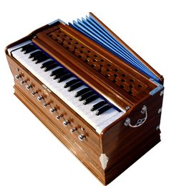

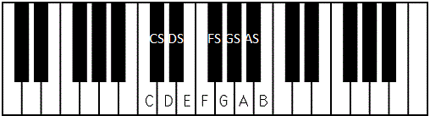
Future Work
CMU Data Other Classifiers on Feature Extracted Data/ EMG Data – Kmeans / Ensemble etc
EMG Data Collection and Reclassify
Single Finger with High Accuracy
EMG Perspective
Single Finger Pressing Key
Multiple Finger Pressing Keys (chords)
Key Press + Hand Movement (leads)
Keyboard Perspective
Recognizing Leads and Chords
Major / Minor on C/D/E/F/G/A/B
Recognizing Left and Right Hand Finger
Identifying Particular Music Notes among other notes
4
3
3
4
5
2
2
5
1
1
Chords (2 or 3 keys)
Leads ( Key sequence)
For Sequence
Major Leads (Flat Straight) C Major - C D E F G A B C
Minor Leads (Ups & Downs)
C Minor - C D D# F G G# A# C
Left Hand / Right Hand
C Major – C D E F G A B C
Left - 5 4 3 2 1 3 2 1
Right - 1 2 3 1 2 3 4 5

Slide 12
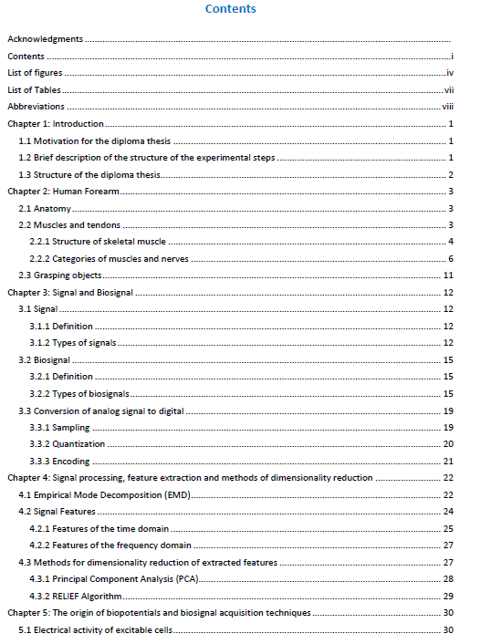
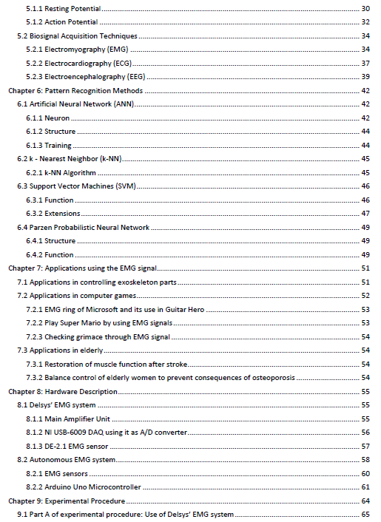
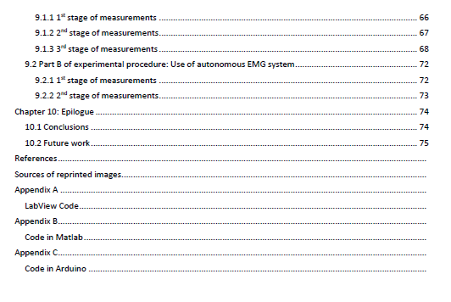
Future Work
Reading Diploma Thesis : “ Recognition of basic hand movements using Electromyography” – 120 Pages

Slide 13


