Slide 1



🪄Digital Portfolio🦋
STUDENT NAME: SHARMILA.M
REGISTER NO:24131210500122043
NMID:asanm121anm12124213042
DEPARTMENT:BCA
COLLEGE: IMMACULATE COLLEGE FOR WOMEN
UNIVERSITY: ANNAMALAI UNIVERSITY

Slide 2

PROJECT TITLE:
👉code has a clear structure with sections for contact and footer.
👉implemented a simple contact form with required fields for name, email, and message.
👉external JavaScript file (script.js) which suggests you'll be handling form submission or other interactive functionality.

Slide 3



:
AGENDA:
Problem Statement
Project Overview
End Users
Tools and Technologies
Portfolio design and Layout
Features and Functionality
Results and Screenshots
Conclusion
Github Link
3/21/2024 Annual Review

Slide 4

PROBLECT STATEMNT:
📝Learn to create dynamic and interactive web applications using HTML for structure, CSS for styling, and JavaScript for functionality. This presentation will cover and the fundamentals and best practices for building robust web application

Slide 5

PROJECT OVERIEW: 👉Dynamic User Interface:The HTML, CSS, and JavaScript to create a dynamic and interactive user interface that responds to user input and actions. 👉Responsive Design:The project incorporates responsive design principles using CSS media.

Slide 6


WHO ARE THE END USERS? 💫General Public: Websites, web applications, or online platforms accessible to anyone with an internet connection. 💫Targeted Audience: Specific groups, such as customers, students, or professionals, who will interact with the project for a particular purpose.

Slide 7

TOOLS AND TECHNIQUES: 👉Code Editors: Tools like Visual Studio Code, Sublime Text, or Atom that provide features like syntax highlighting, auto-completion. 👉Front-end Frameworks: Libraries like Bootstrap (CSS) or React, Angular, or Vue.js thatt simplify development and provide pre-built components.

Slide 8

POTFOLIO DESIGN AND LAYOUT:
🍁Responsive Grid Layout: Use CSS Grid or Flexbox to create a responsive layout that showcases projects in a visually appealing way. 🍁Interactive Animations: Utilize JavaScript libraries like GSAP or AnimeJS to add interactive animations and micro-interactions that enhance user experience.
8

Slide 9

FEATURES AND FUNCTIONALITY: 🫴User Interface (UI) Components: Creating reusable UI components, such as buttons, forms, and navigation menus, using HTML, CSS, and JavaScript. 🫴Interactive Functionality: Adding interactive elements, such as animations, transitions, and dynamic updates, using JavaScript and CSS. 🫴Responsive Design: Ensuring that web pages adapt to different screen sizes, devices, and orientations using CSS media queries and responsive design techniques.

Slide 10
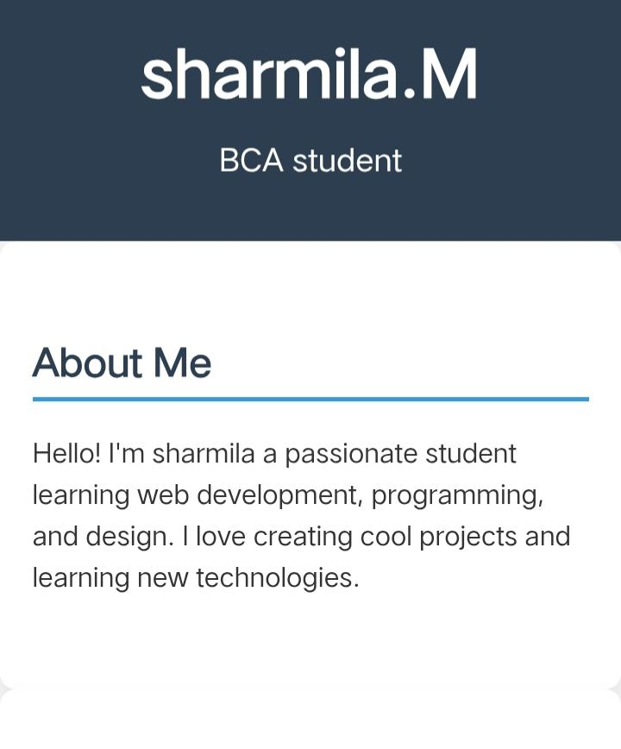
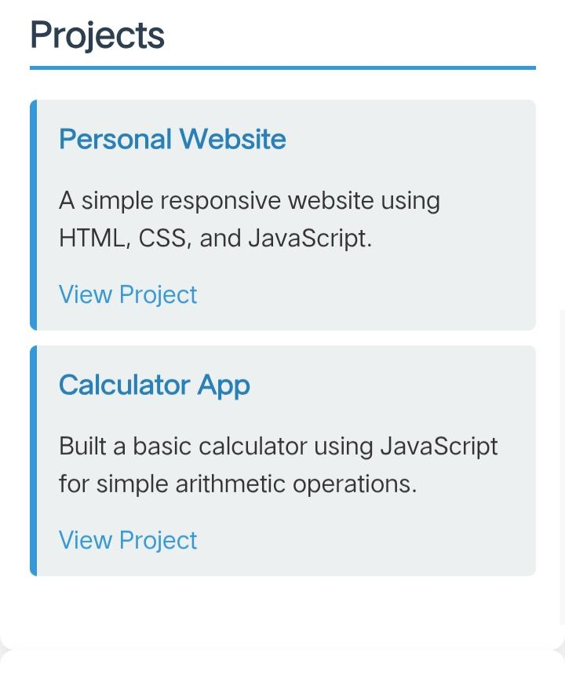
STUDENT PORTFOLIO:
3/21/2024 Annual Review
10

Slide 11
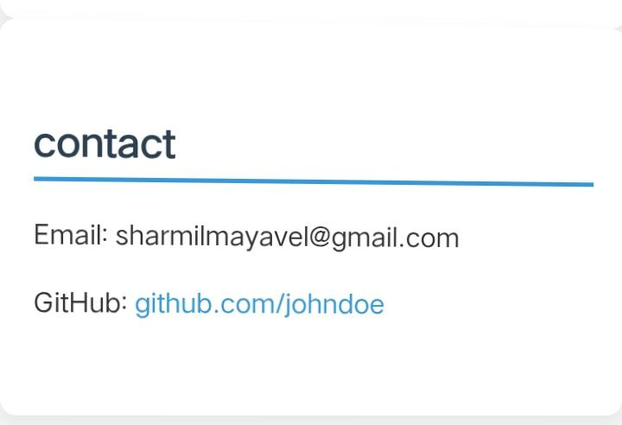
RESULTS AND SCREENSHOTS:

Slide 12
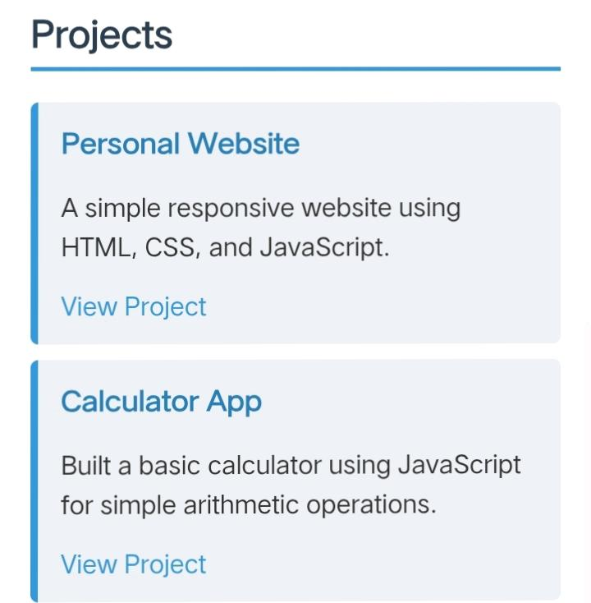
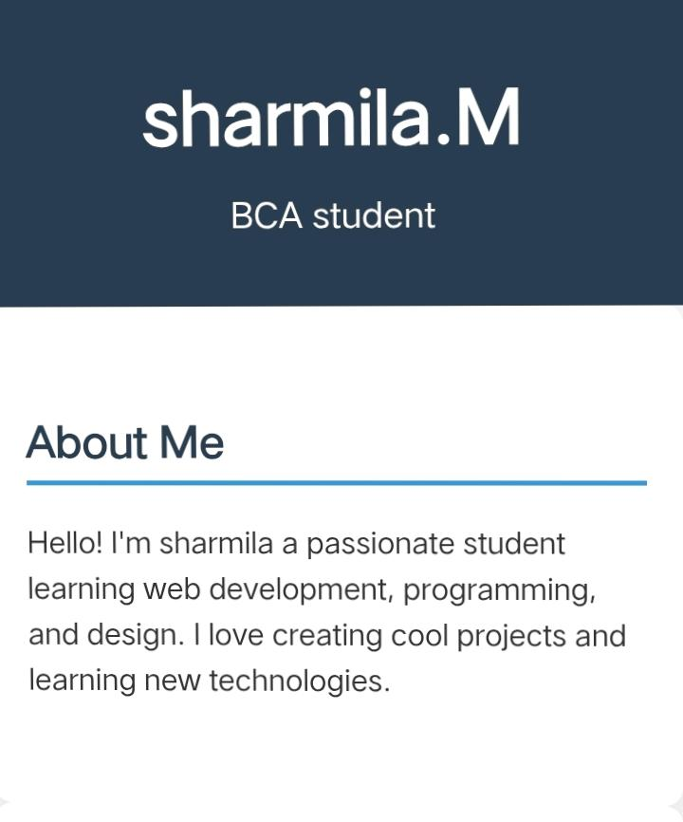
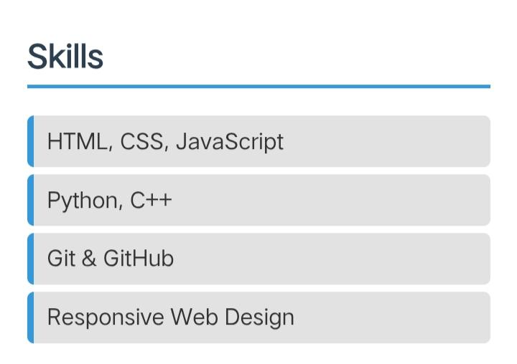
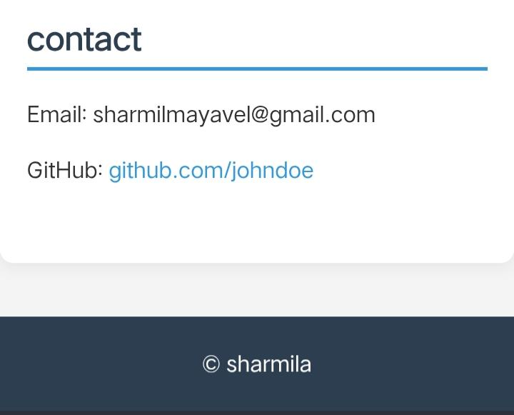
RESULT AND SCREENSHOT

Slide 13

CONCLUSION: 👉In conclusion, this portfolio represents my growth, achievements, and learning throughout this academic journey. Each piece included reflects the effort, creativity, and knowledge I have developed over time. As I look back, I can see how my skills have improved and how my thinking has Evolved.
13

Slide 14
GITHUB: https://GitHub.com/

Slide 15


