Slide 1
Matrices & Vectors <-> ML
Sharmili Srinivasan

Slide 2
Understanding Language of Maths

Slide 3
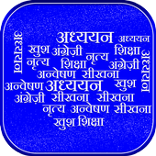
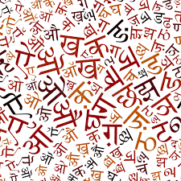

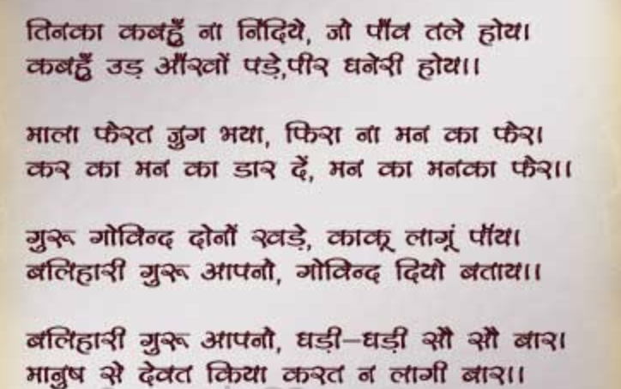
Journey with a Language

Slide 4
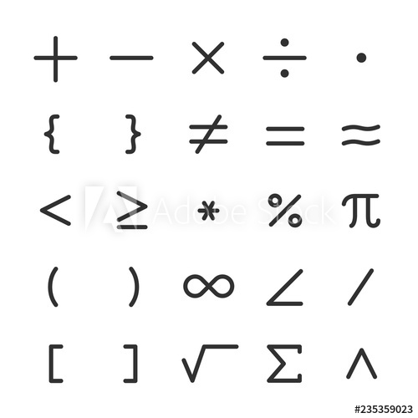
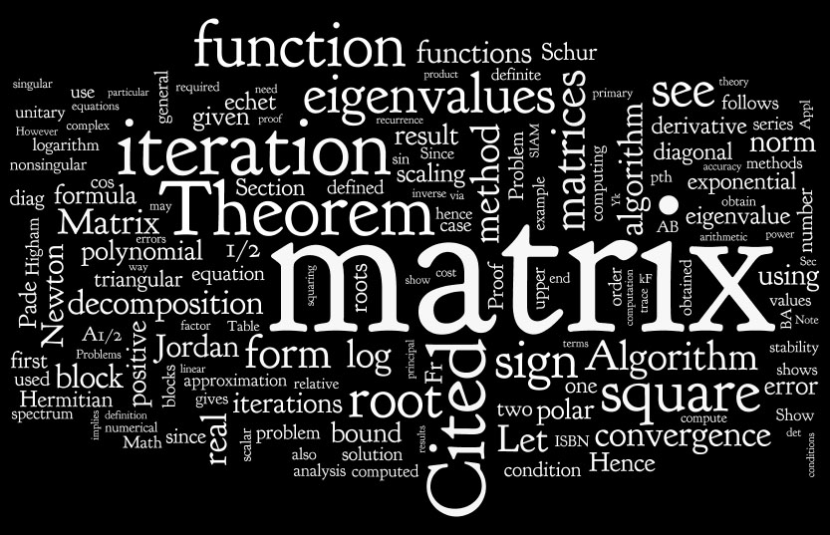
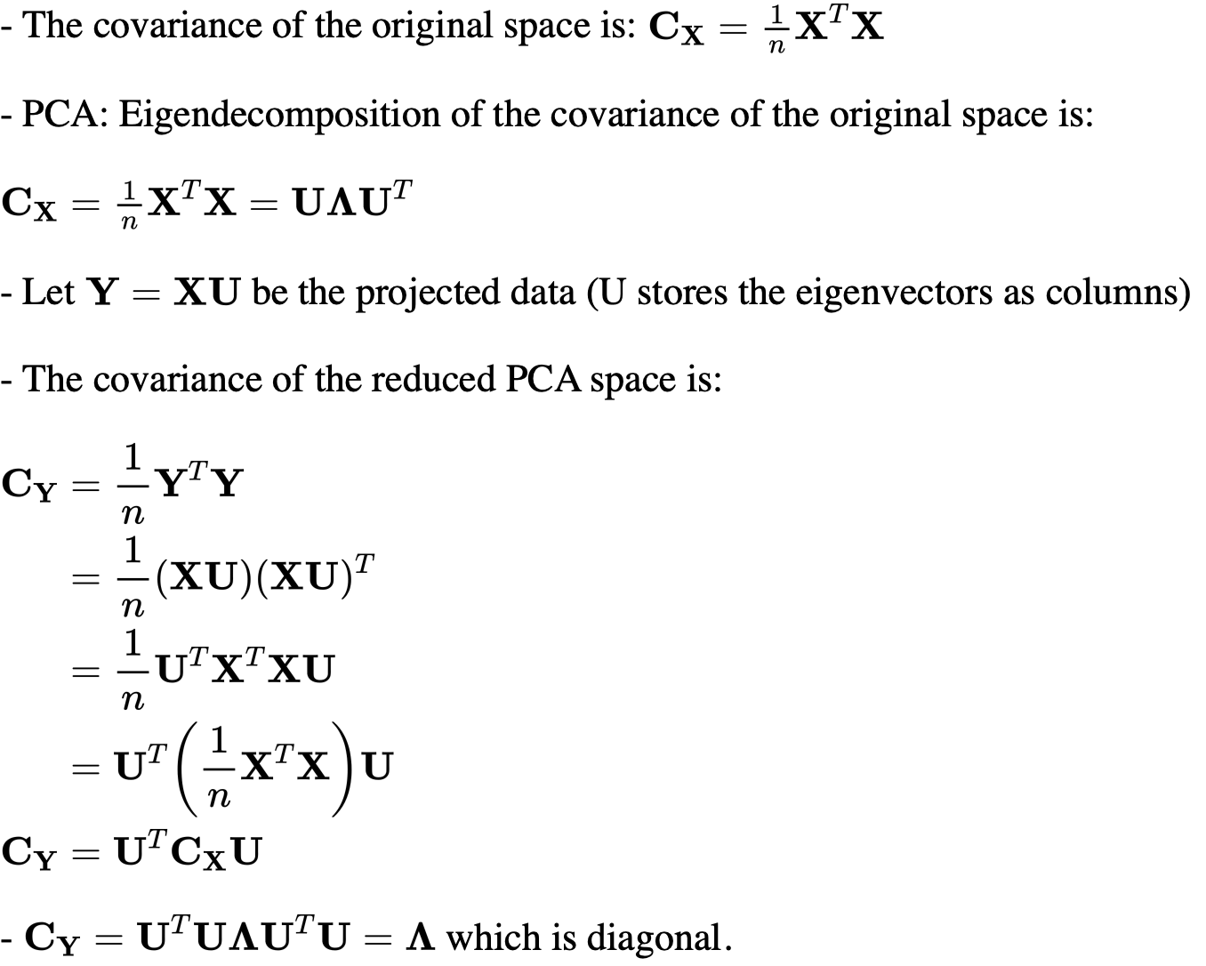
Journey with Maths

Slide 5
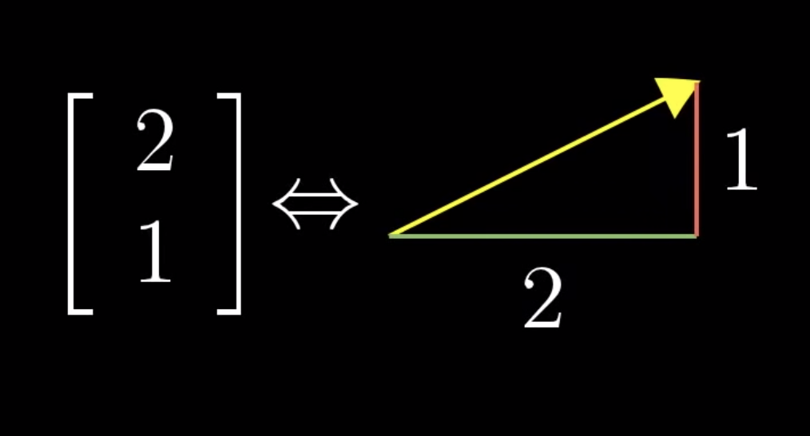
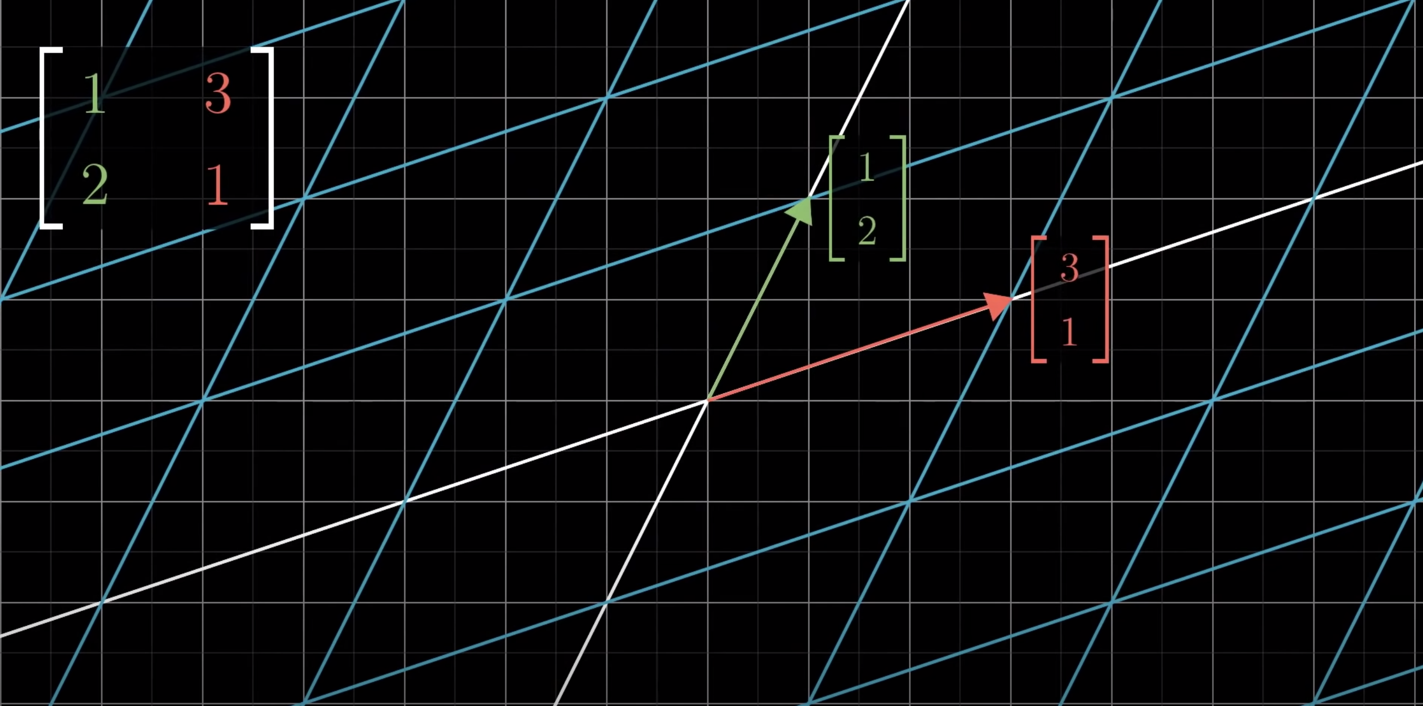

Slide 6
Relearning Matrices and Vectors (for ML)

Slide 7
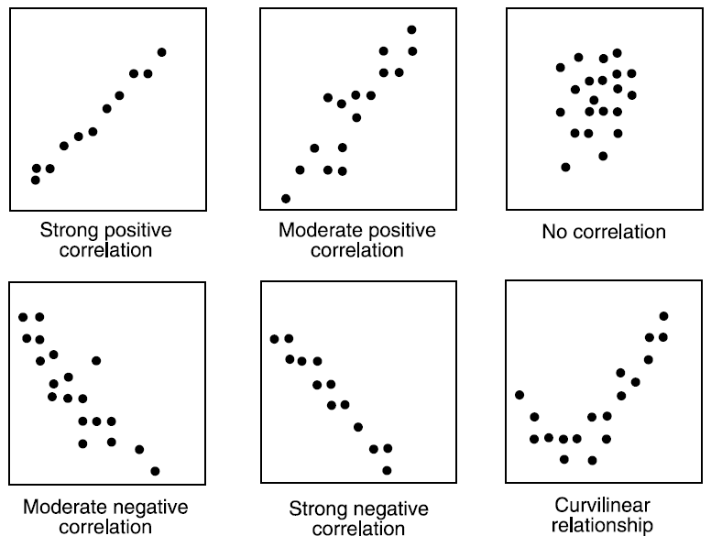

Concept – Covariance/ Correlation
Property value
Avg age per house

Slide 8
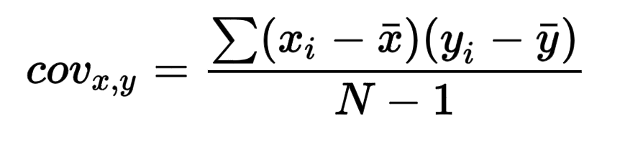
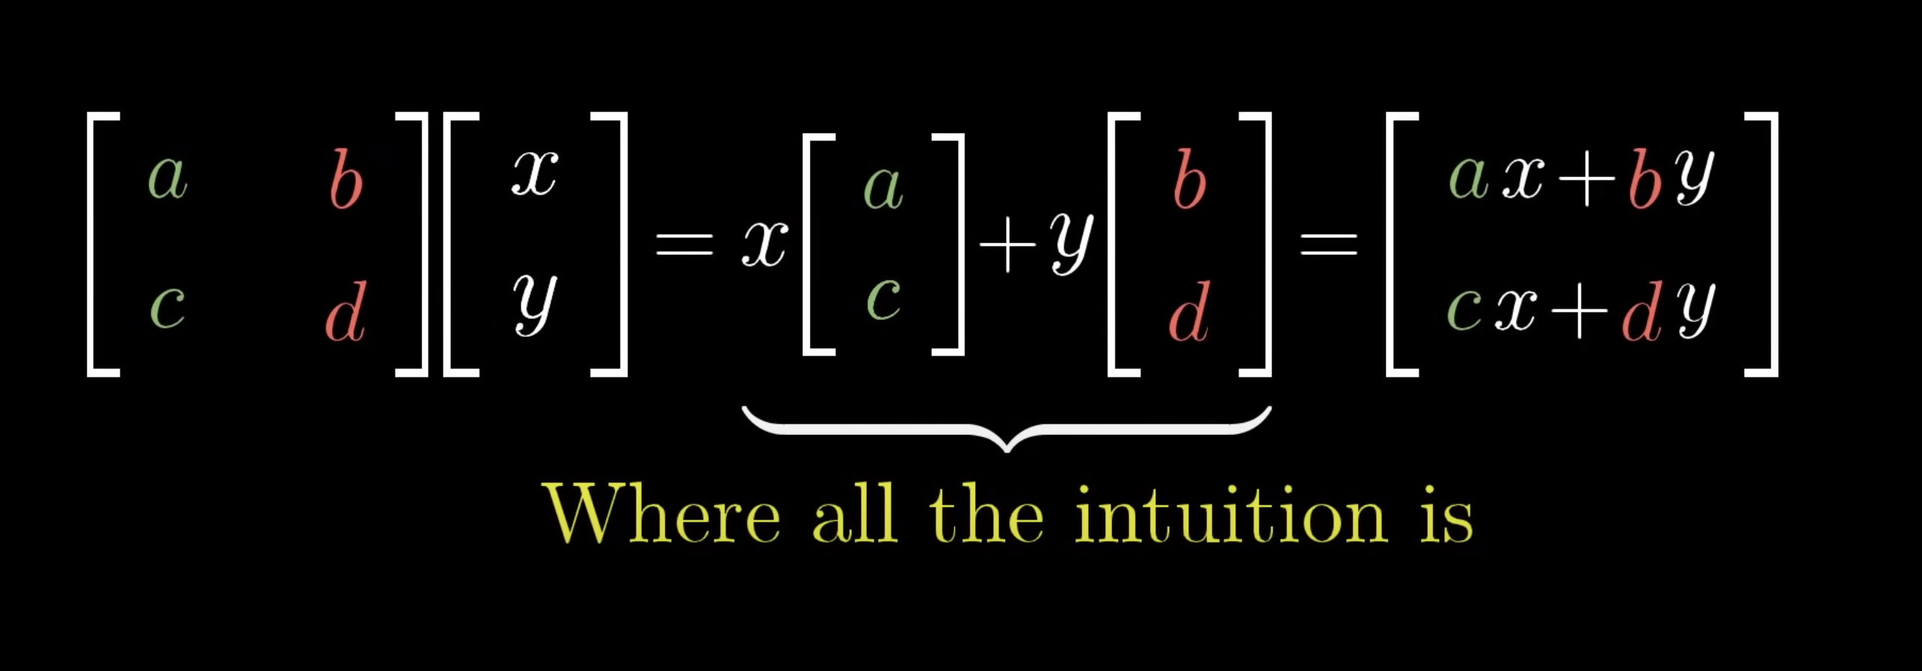
Why Matrices, why not basic statistics and for loop?
Fundamental Nature of Matrix operations

Slide 9
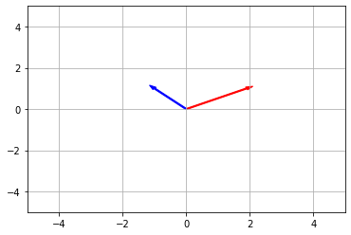
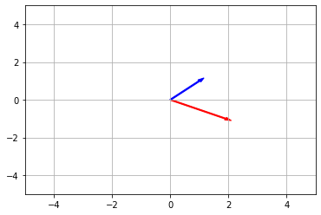
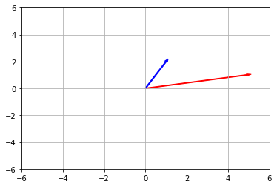
Concepts to relearn
Matrices
Matrix Multiplication
Transpose of Matrix
=> Numerical representation on linear transformations
=> Composition of linear transformations
=> Scale as A and Rotate as A⁻¹
Cov=
A^{T}
A
A^{T}
A
2 -1
1 1
2 1
-1 1
5 1
1 2

Slide 10
Major Areas of Matrix usage
Dimensionality Reduction
PCA and SVD
Image
Image Compression
Eigen Faces
Text Analysis
LSA
Word Embeddings

Slide 11
Thank you!

