Slide 1
Tech Talk
Principal Component Analysis Intuition
Sharmili S
2021-02-24

Slide 2
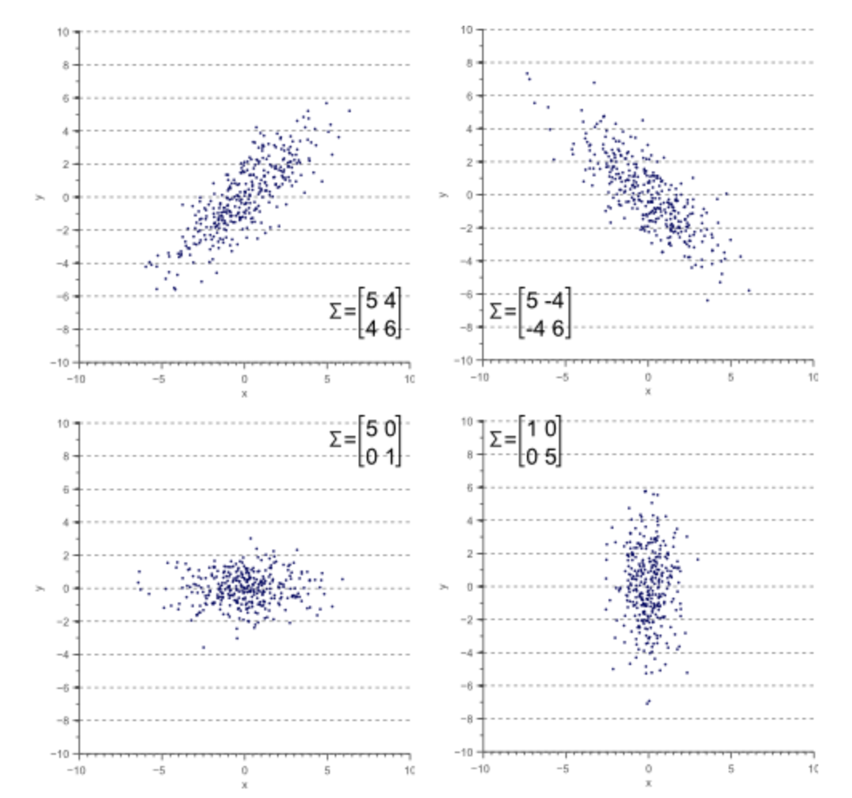
Why PCA?
Dimensionality reduction technique
Objective: Reduce dimensions – Retain as much information as possible
Use of lesser features
Faster training
Generalized models
Easy visualization
How?: Combine highly correlated variables to “principal components”

Slide 3




Story Time
Teapot
???

Slide 4
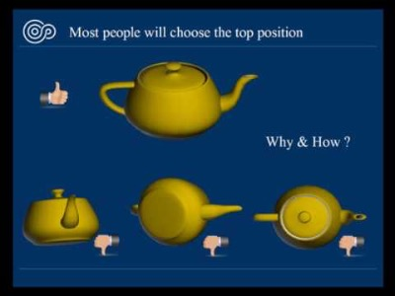
What's the intuition?

Slide 5
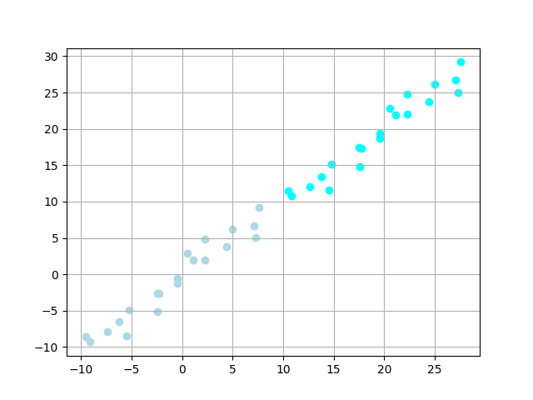
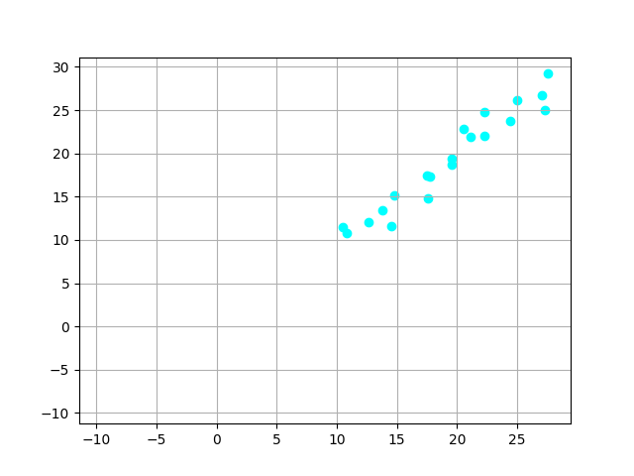
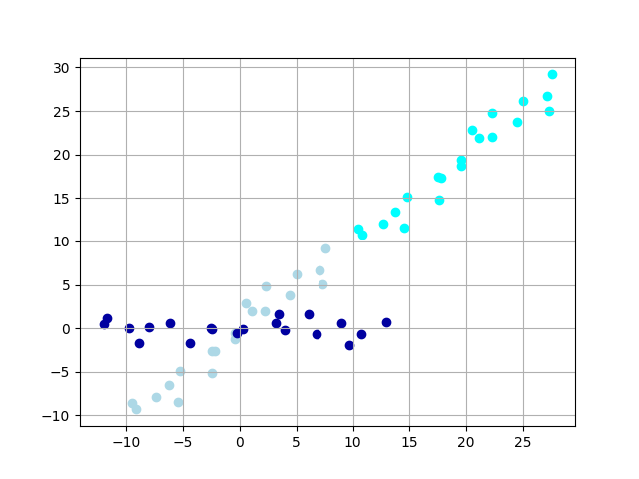
One step deeper

Slide 6
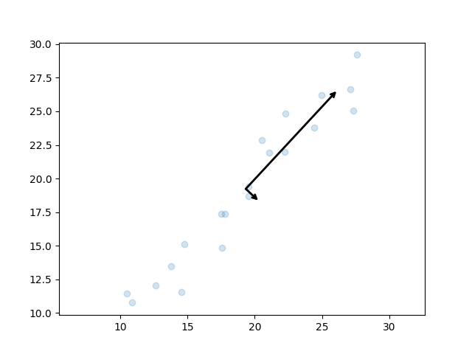
Principal Components

Slide 7
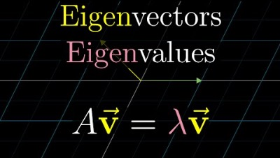
Eigen Vectors and Values

Slide 8
Back to Teapot
Demo

Slide 9
References
Blogs
https://jakevdp.github.io/PythonDataScienceHandbook/05.09-principal-component-analysis.html
https://scikit-learn.org/stable/modules/generated/sklearn.decomposition.PCA.html
https://www.visiondummy.com/2014/04/geometric-interpretation-covariance-matrix/
https://www.linkedin.com/pulse/understanding-pca-part-1-intuition-karan-rajwanshi/
Videos
https://www.youtube.com/watch?v=PFDu9oVAE-g&list=PLZHQObOWTQDPD3MizzM2xVFitgF8hE_ab&index=14
https://www.youtube.com/watch?v=BfTMmoDFXyE

