Slide 1


LANDMARK RECOGNITION
GROUP 6
Gayatri Chandrasekaran • Sharmin Kantharia • Saurav Mainali

Slide 2
INTRODUCTION
Computer Vision Tasks/Image Mining – Latest interest among Data Engineers
Issues - Lack of large annotated dataset to train Models
Landmark Recognition :
Challenge :
Geometry of each image
Illumination and different aspect ratio of image
Collection of image is used – typical Appearance of image is captured
Aim:
To Build a model that recognizes given popular landmark using Google landmark dataset
Applications:
Photo Organizations in smartphones
Crime Solving cases
Field – Aviation, Maps

Slide 3
DATASET DESCRIPTION
DATA SOURCE:
Google-Landmarks-v2 (September 2019) – Published by Google
Dataset: 5 Million Images with 2 Millions classes
Project Scope: Top 10 Sampled Classes
Total Records - 34960
Number of classes - 10
Landmark_id | Category
192931 | York_River_State_Park
177870 | Lviv
126637 | Corktown,_Toronto
62798 | Enchanted_Floral_Gardens_of_Kula
171772 | University_of_Chicago_Library
83144 | Museum_of_Folk_Architecture_and_Ethnography_in_Pyrohiv
151942 | Naturschutzgebiet_Mittleres_Innerstetal_mit_Kanstein
176528 | Haleakal National_Park
20409 | Noraduz_Cemetery
138982 | Media_contributed_by_the_ETH-Bibliothek

Slide 4
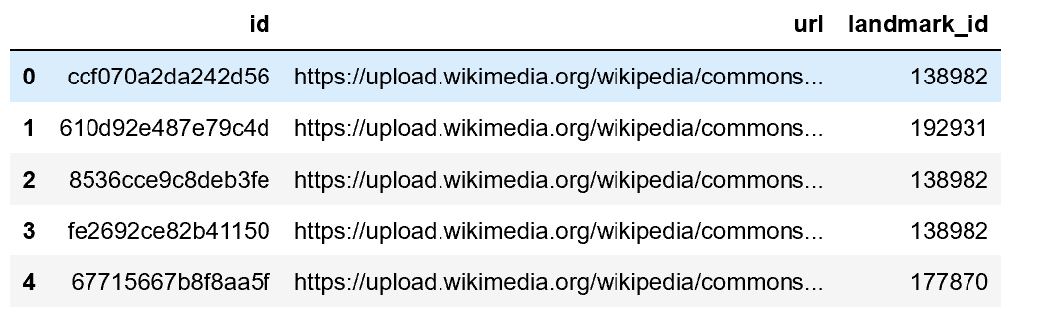
DATASET DESCRIPTION
DATA SPLIT:
Ratio : 70:30
Train Set – 24472
Test Set – 10488
DATA STRUCTURE:
Three Features –
Id – String - unique Id associated with each datapoint
URL - Describes the image link – mostly from wiki commons
Landmark_id – Unique Id to identify each image class – Label class

Slide 5
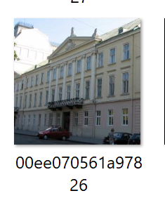
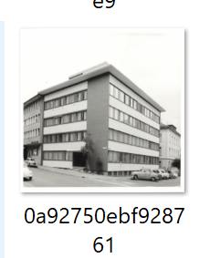
PREPROCESSING
Read Image from URL
Check for URL - Broken URL, Website issues
Save the Image
Resize the image – aspect Ratio – to maintain uniformity
Save Images to Train & Test Folders separately
Errored Images details are saved for reference

Slide 6
FEATURE EXTRACTION
Feature descriptor captures and represents important information of the images
POPULAR FEATURE DESCRIPTOR:
HOG – Histogram of Oriented Gradients
SIFT – Scale Invariant Feature Transform
SURF – Speeded-up Robust Feature
HOG Descriptor:
Counts the occurrence of gradient orientation in localized portions of the image.
Important Aspects – Focus on structure/shape of image along with their direction

Slide 7
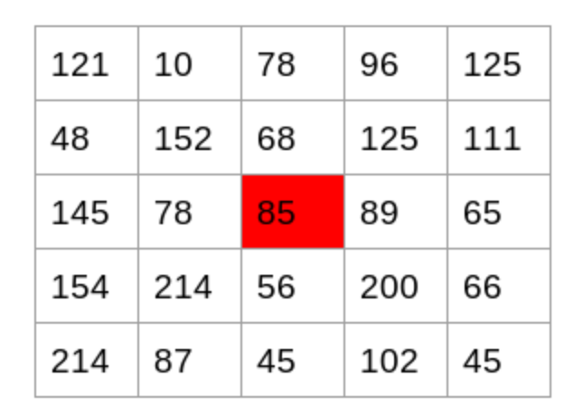
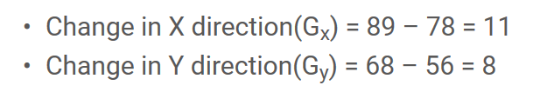


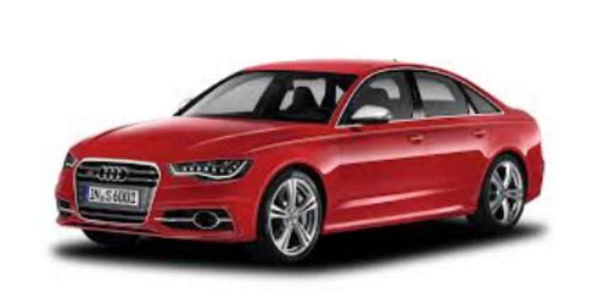
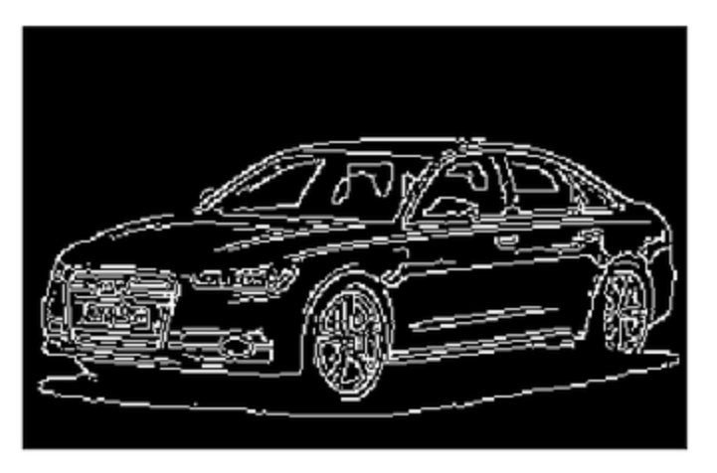
FEATURE EXTRACTION
HOG Feature Descriptor Process:
Calculate Gradients [Both x and Y direction ] for each pixel in image.
Example : Matric represent pixel values
2. Compute the Magnitude and orientation for each pixel value
3. Histograms are plotted using this gradient and orientation

Slide 8
FEATURE EXTRACTION
Implementation of HOG Classifier:
Packages : skimage.feature – hog
Open CV2 – hog function - Used in this project
Train and Test images are given as input and important feature of the image is computed using HOG classifier
These feature values are stored as numpy arrays and later used as input variables to our model
Labels associated with each feature is also converted to numpy array – Target variables to model

Slide 9
DATA MINING ALGORITHM - MODELLING

Slide 10
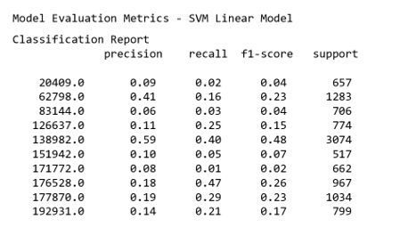
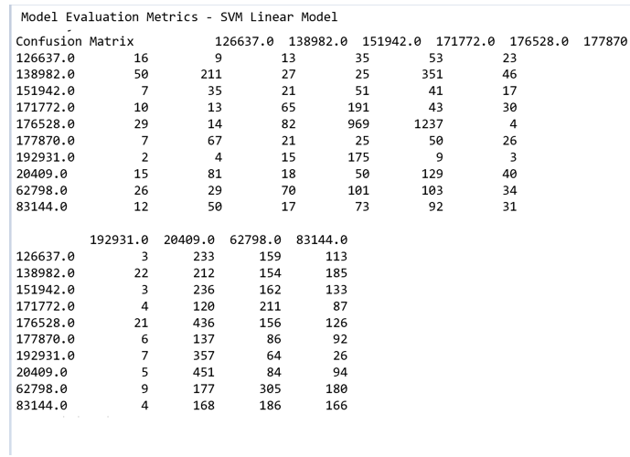
SVM – Support Vector Machine
Supervised learning Algorithm
Suited for both Classification and regression Problems
Linear Kernel:
Apart from landmark id – 138982, no other class is classified properly. Even 138982 haven’t had any great classification report.

Slide 11
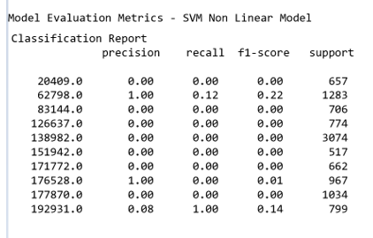
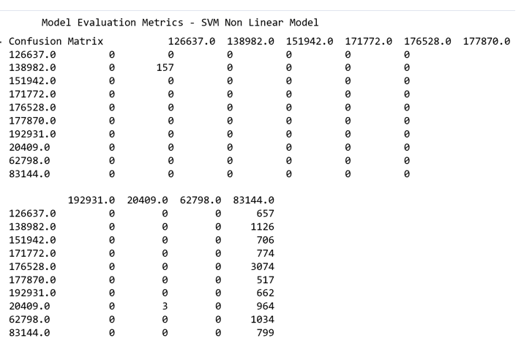
SVM – Support Vector Machine
Non-Linear Kernel:
Kernel – rbf – radial basis function – Gaussian Kernel
Parameters – “c” – cost/penalty trade off for misclassifying the datapoint. C- low – high bias and low variance – misclassification is high
“gamma” – spread of kernel around the data point[decision region] – low – boundary Is board , high –overfitting
Grid Search - GridSearchCV(estimator=svm, param_grid=params_dict)
Best parameters are obtained – used for training the model – c= 0.1 and gamma = 0.001
SVM Performs least for our dataset.

Slide 12
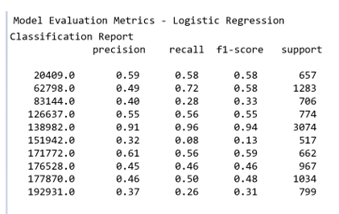
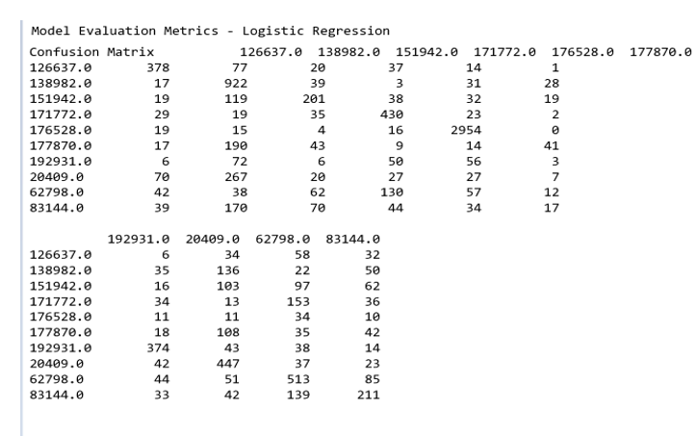
Logistic Regression
Multinomial Logistic Classification
Softmax function instead of sigmoid function, output values are between the range [0,1], input are fed function – ratio of exponentials of input to sum of exponentials of all input values.
Solver – finds the parameters weights that minimize cost function – mostly used in regression scenario. In our project, we used lbfgs – default – fast for larger dataset.
Landmark id – 138982,171772

Slide 13
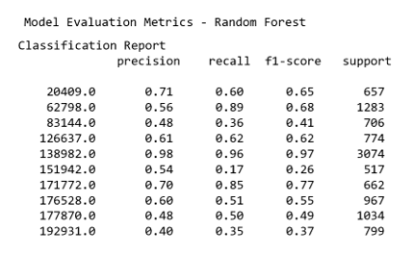
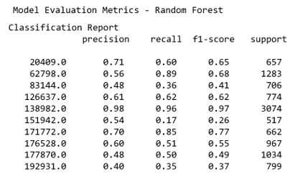
Random Forest
Supervised learning Algorithm – most flexible and easy to use algorithm
Ensemble method – uses various sample output which increases prediction
Number of trees – 500
Landmark id – 138982,171772 , 62798
Better results than other algorithms used.

Slide 14
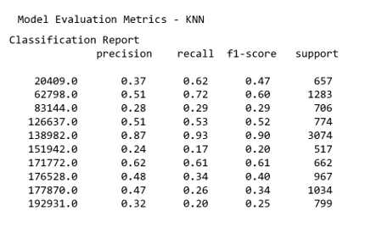
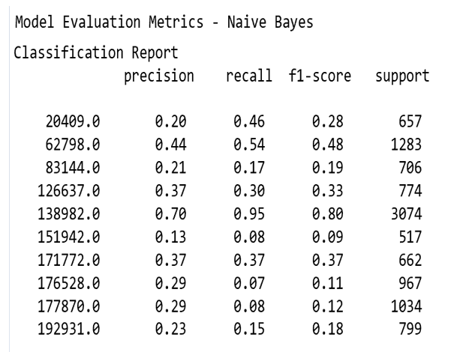
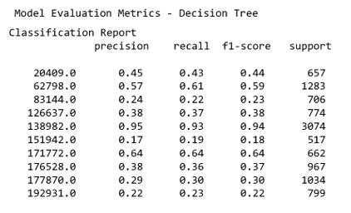
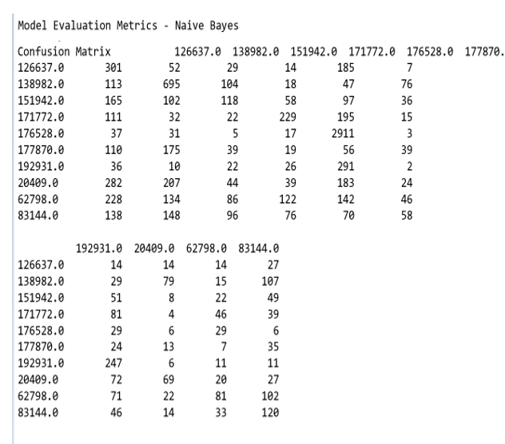
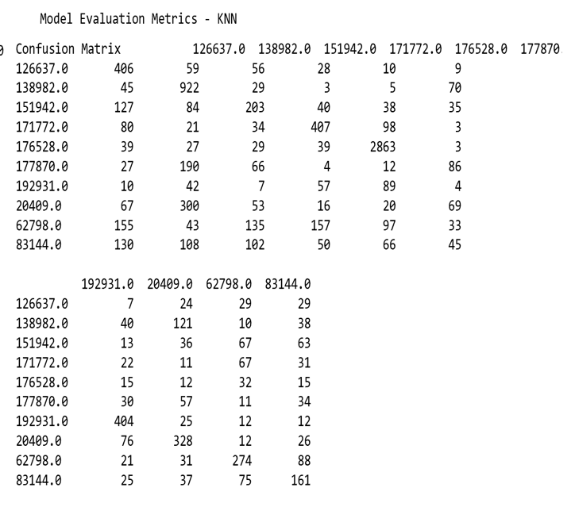
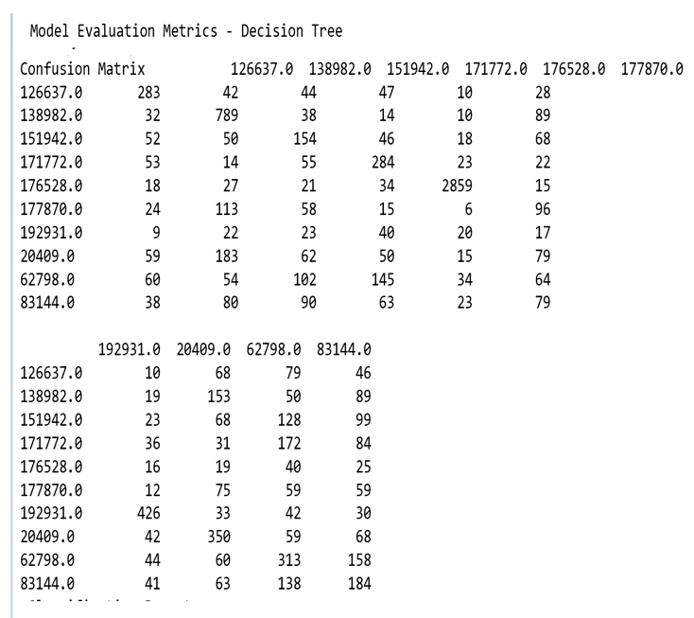
Decision Tree KNN Naïve Bayes

Slide 15
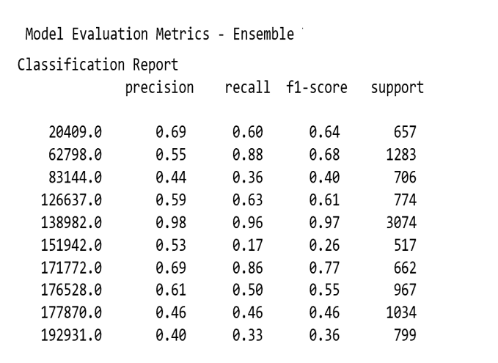
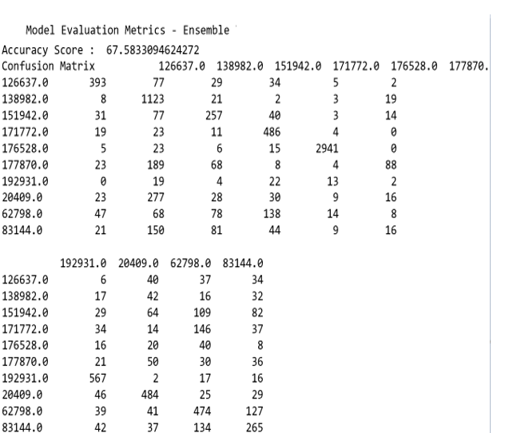
Ensemble Method
Stacking the Results of various Model output as input and maximized voting classes is used as final prediction
Stacking may or may not increases the final output
Method – Ensemble method – VotingClassifier is used
Best voting – Various combination of Model output is stacked together, and accuracy is measured to get best combination of Models
Best Combinations – Random Forest & SVM-Nonlinear
Random Forest, LR, KNN, SVM-linear & SVM – Nonlinear

Slide 16
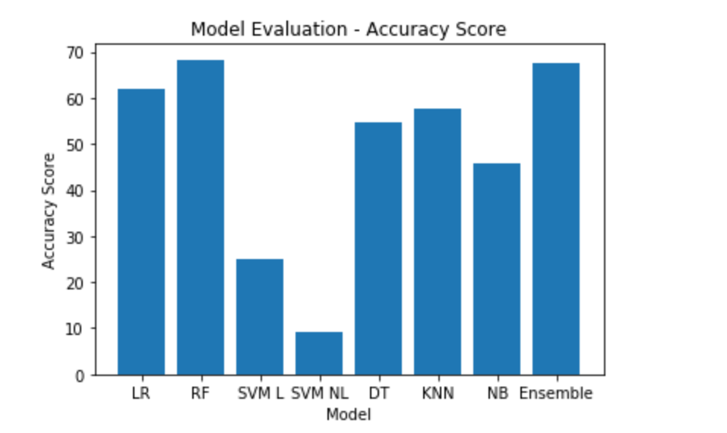
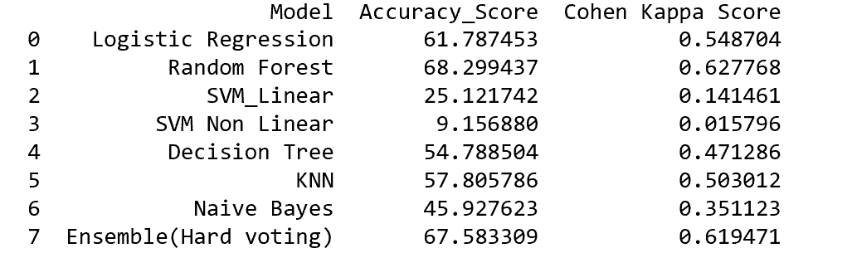
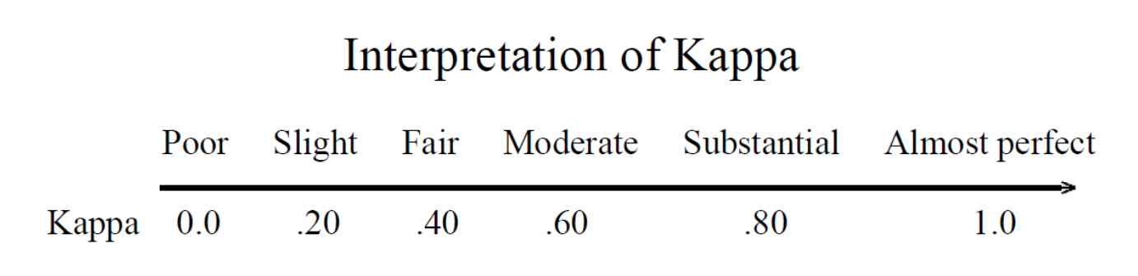
Model Evaluation
Cohen Kappa – Measure of inter-rater reliability.
Useful for Multiclass & highly imbalance data problems

Slide 17
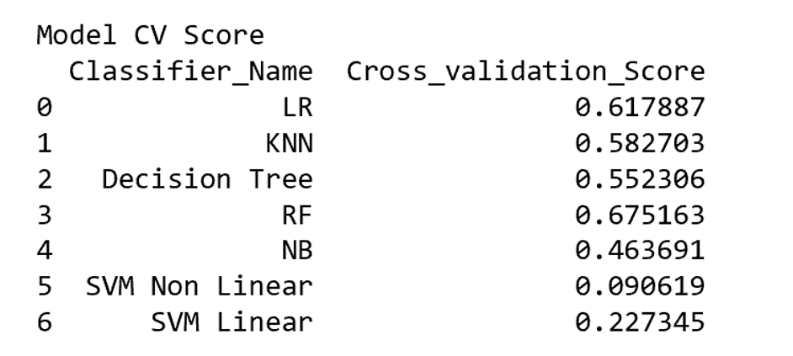
Cross Validation Score
How Model react to different datasets
10-Fold Cross Validation is performed on train set
Results are comparatively similar to test results

Slide 18
Summary & Conclusion
Random Forest works better for given dataset, followed by logistic Regression and ensemble models
SVM model is not suited for our dataset and model is slow , takes more time for classification
From results, we could observe more the data samples for a class, better the classification[Prediction Rate].
class scalability prediction performance
For larger dataset, Neural Networks may work better
Larger annotated image samples will help in prediction rate, as original dataset has more classes with single digit data sample.

Slide 19
References
https://ai.googleblog.com/2019/05/announcing-google-landmarks-v2-improved.html
https://www.kaggle.com/c/landmark-recognition-2019
https://www.cs.cornell.edu/~yuli/papers/landmark.pdf
http://cs229.stanford.edu/proj2014/Andrew%20Crudge,%20Will%20Thomas,%20Kaiyuan%20Zhu,%20Landmark%20Recognition%20Using%20Machine%20Learning.pdf
https://www.cs.cmu.edu/~takeuchi/iuw97/iuw97.html
https://www.analyticsvidhya.com/blog/2019/09/feature-engineering-images-introduction-hog-feature-descriptor/

