Slide 1

Time Series Analysis and Forecasting of Reliance Stock Market Data
By – Sharmin Kantharia
December 16, 2020

Slide 2
Introduction
Stock market prediction aims to determine the future movement of the stock value of a financial exchange.
Many factors - interest rates, politics, and economic growth.
It provides business firms and trade agencies the opportunity to improve investments.

Slide 3
Dataset
The Reliance Stock Market Data of the Nifty-50 consists of the price history and trading volumes from the National Stock Exchange – India (NSE).
The data is taken from Kaggle.
The data spans from January 1, 2000 to July 31, 2020.
The data is collected daily.

Slide 4
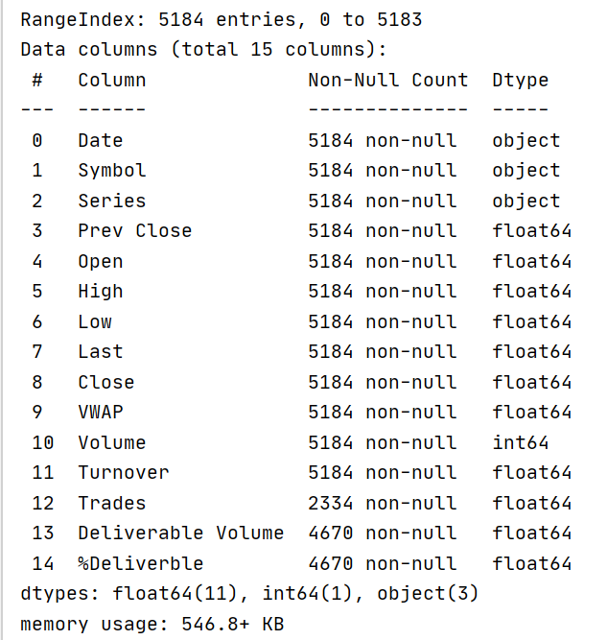
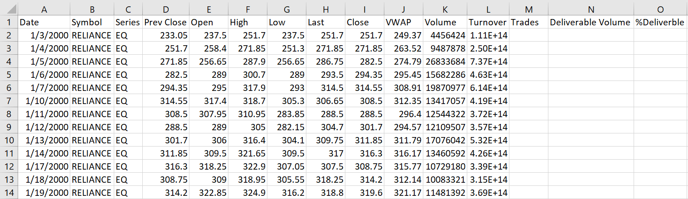

Slide 5
Project Overview
Data Pre-processing
Time Series Decomposition
Base Models
Holt-Winter’s Method
Multiple Linear Regression
ARMA Model
Final Model
ARIMA Model

Slide 6
Data Pre-processing

Slide 7
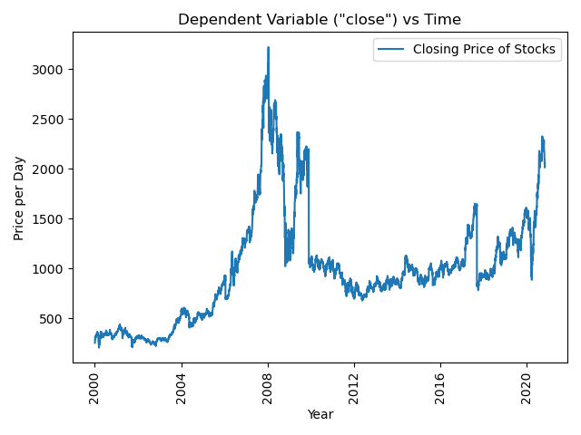
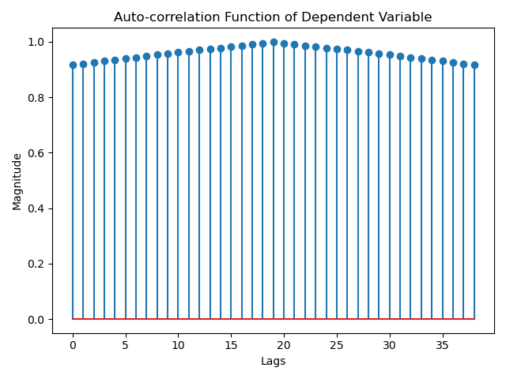
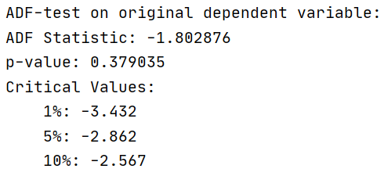

Slide 8
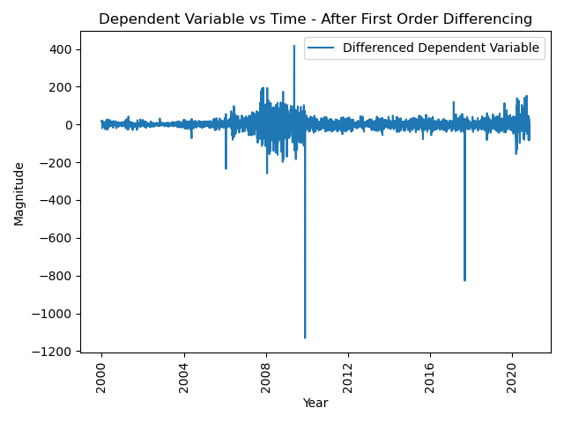
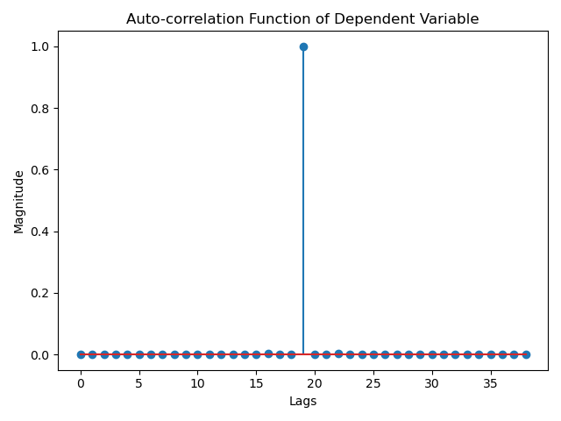
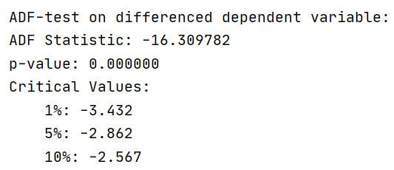

Slide 9
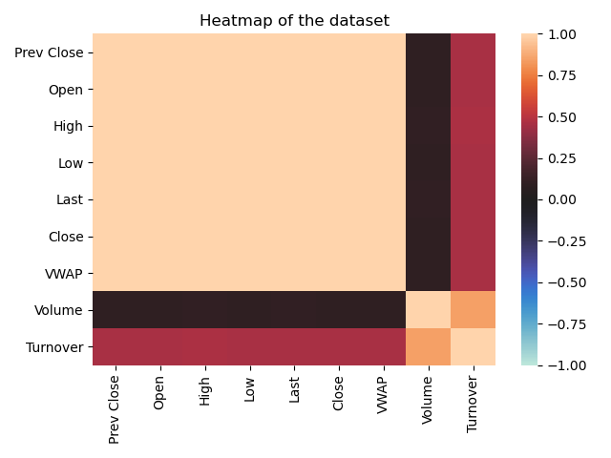

Slide 10
Time Series Decomposition

Slide 11
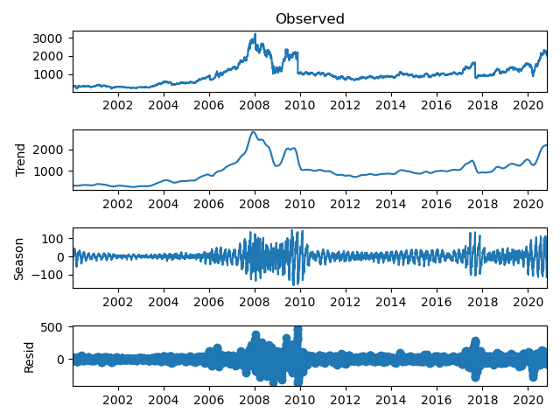
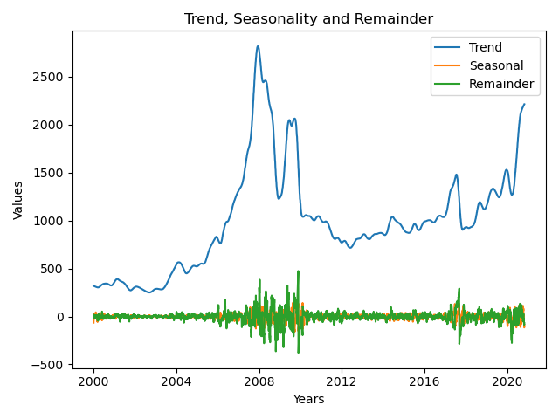

Slide 12
Base Models

Slide 13
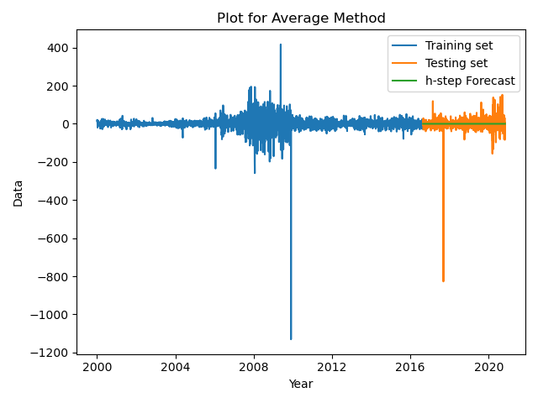
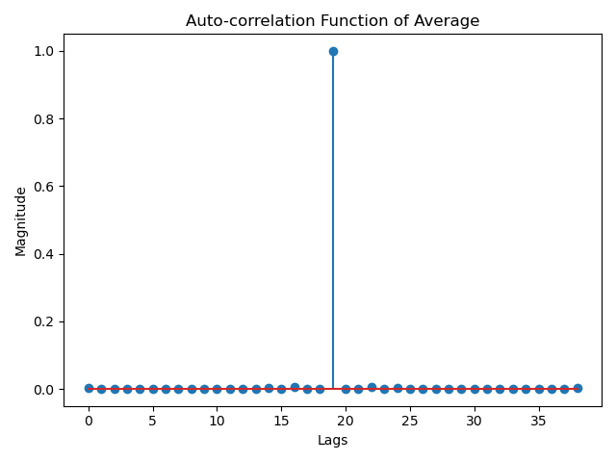
Average Method

Slide 14
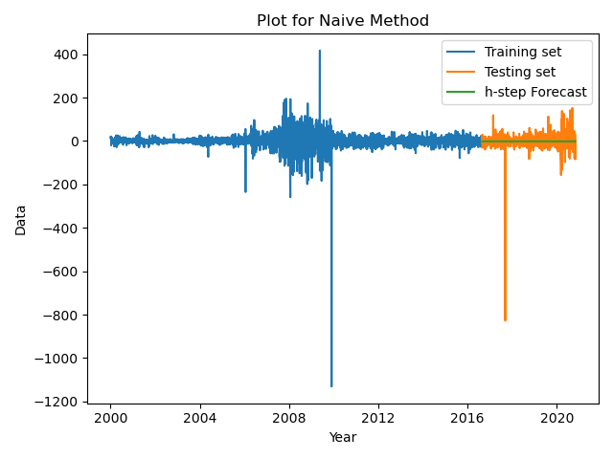
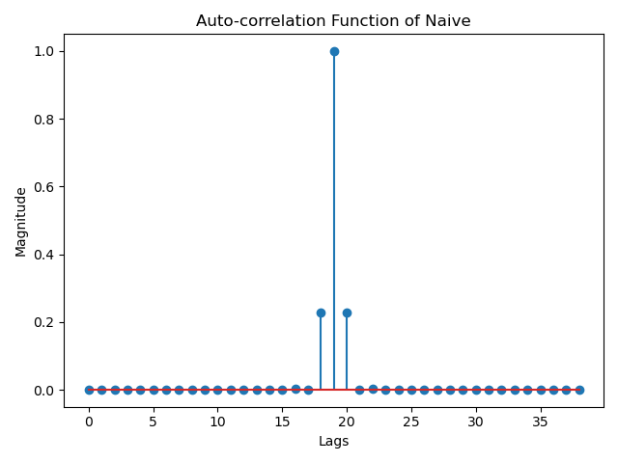
Naive Method

Slide 15

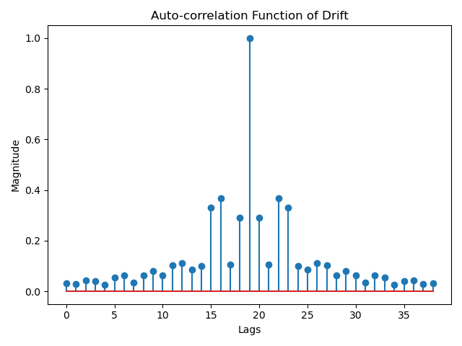
Drift Method

Slide 16
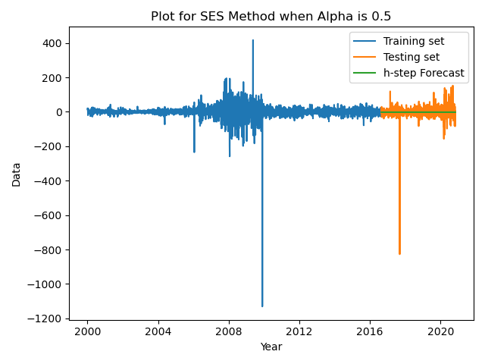
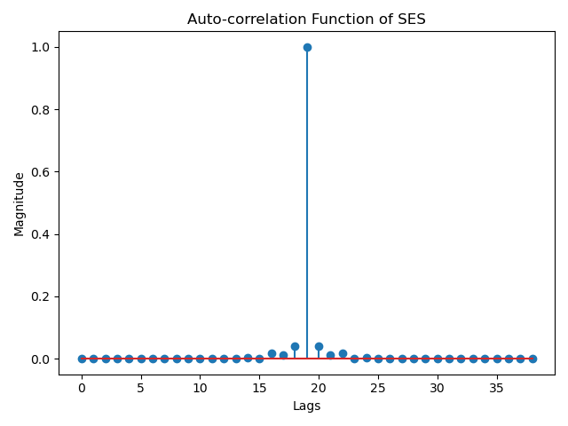
SES Method

Slide 17
Holt-Winter’s Method

Slide 18
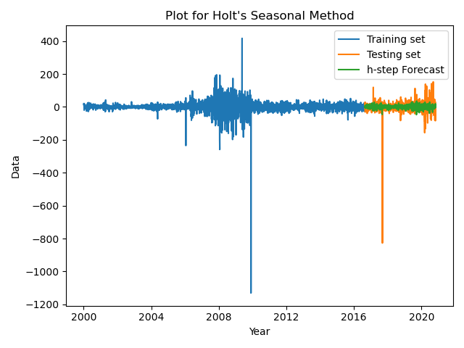
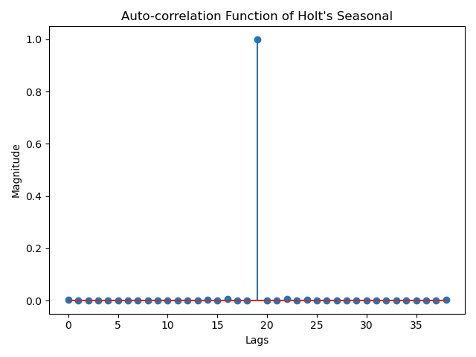
Seasonal Method

Slide 19
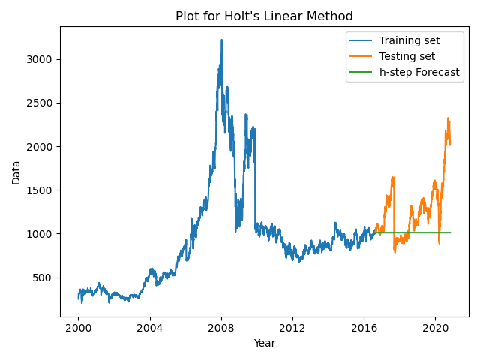
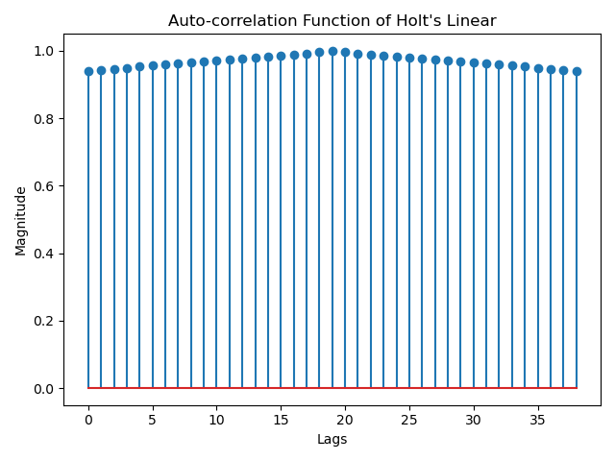
Linear Method – Non-Differenced Data

Slide 20
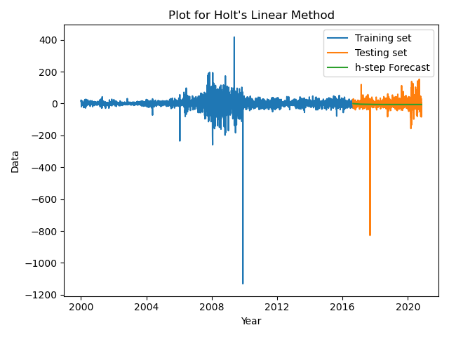
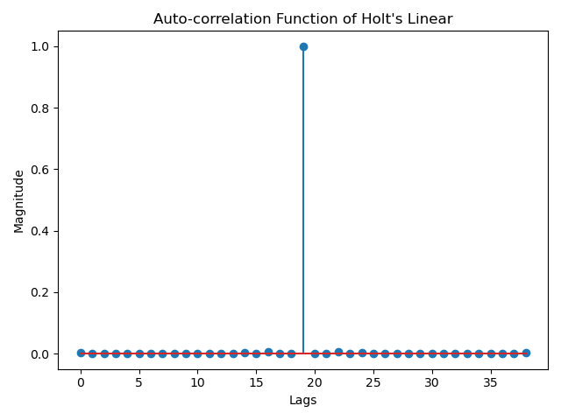
Linear Method – Differenced Data

Slide 21
Feature Selection – Backward Regression

Slide 22
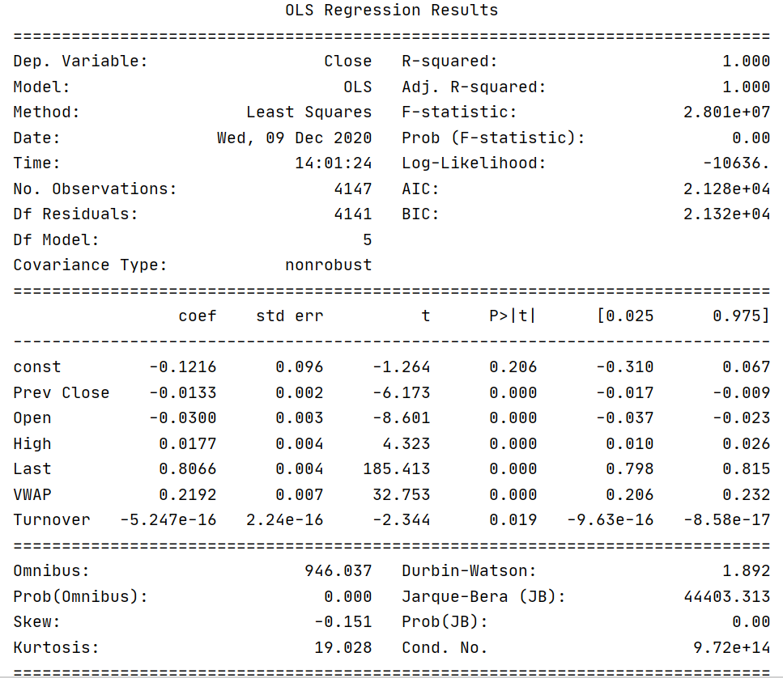
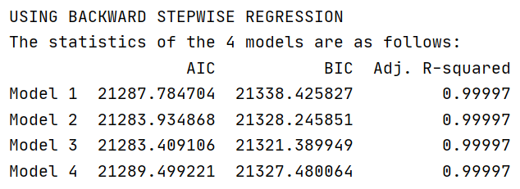


Slide 23
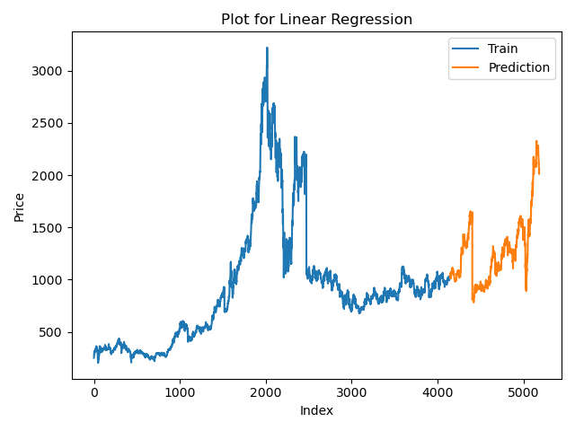
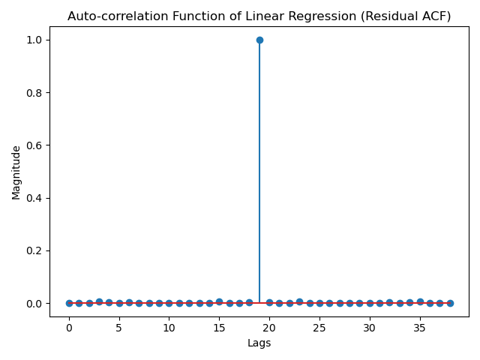

Slide 24
Feature Selection – Forward Regression

Slide 25
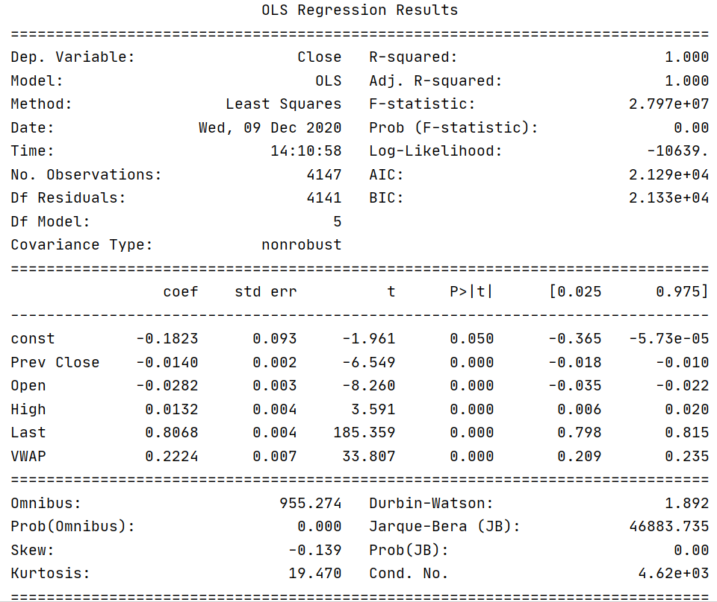
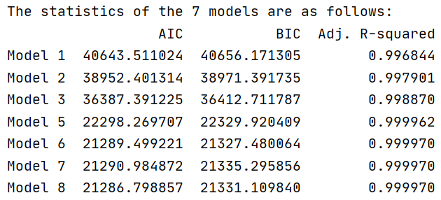


Slide 26


Slide 27
ARMA Models

Slide 28
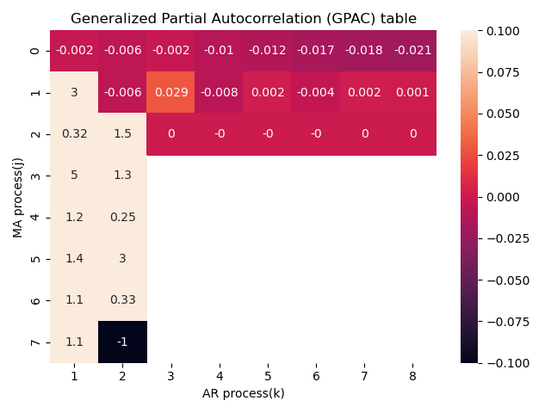
GPAC Table
Possible Orders (Initially):
ARMA(2,2)
ARMA(2,0)

Slide 29
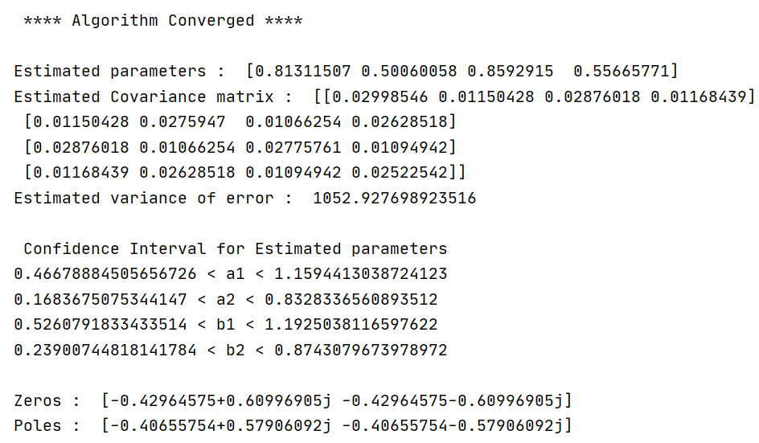
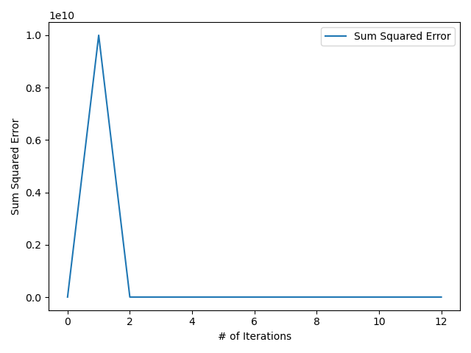

Slide 30
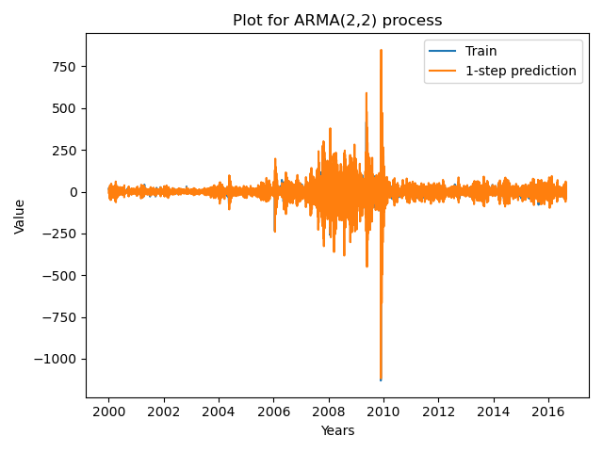
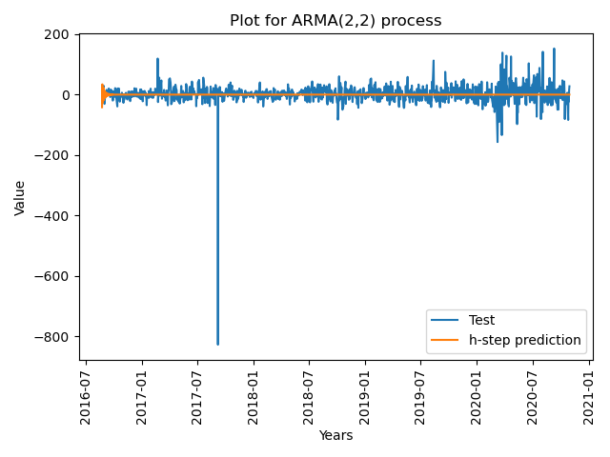
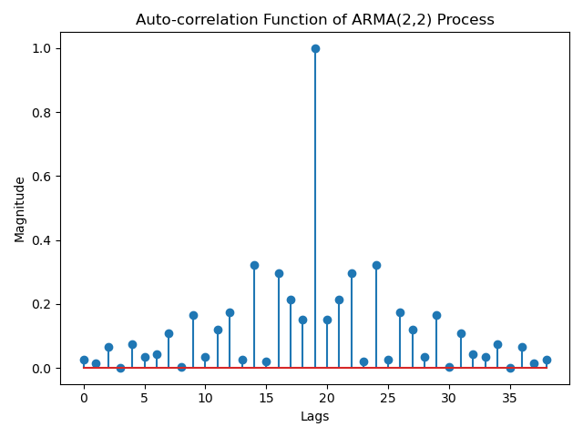

Slide 31
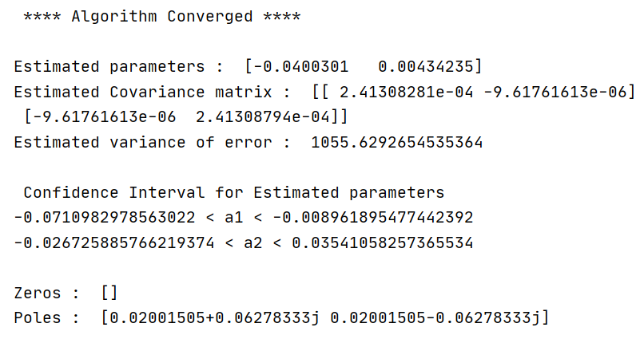
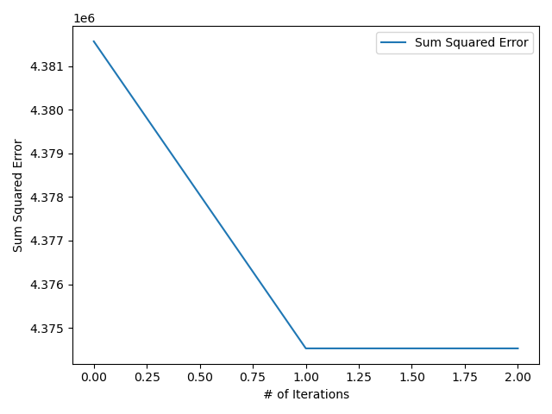

Slide 32
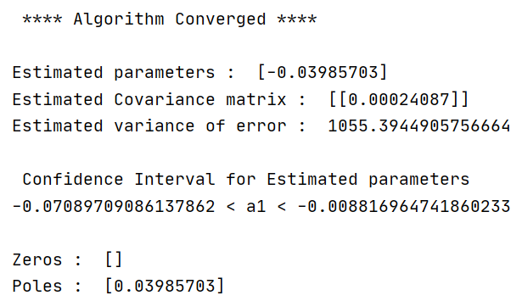
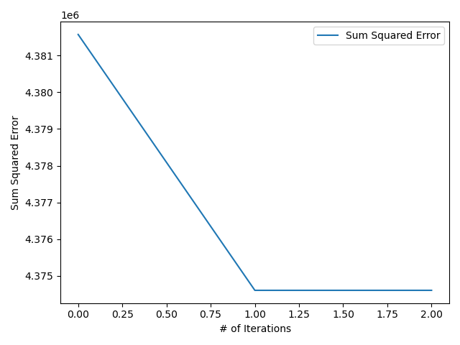

Slide 33




Slide 34
ARIMA Models

Slide 35
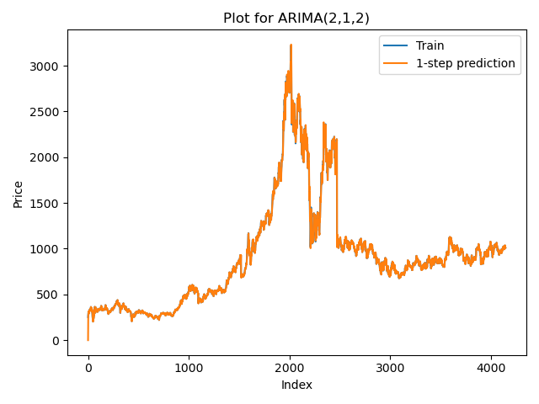
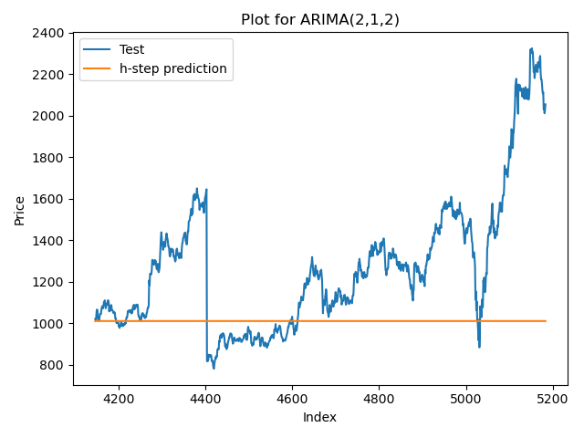


Slide 36




Slide 37
Final Model Selection

Slide 38
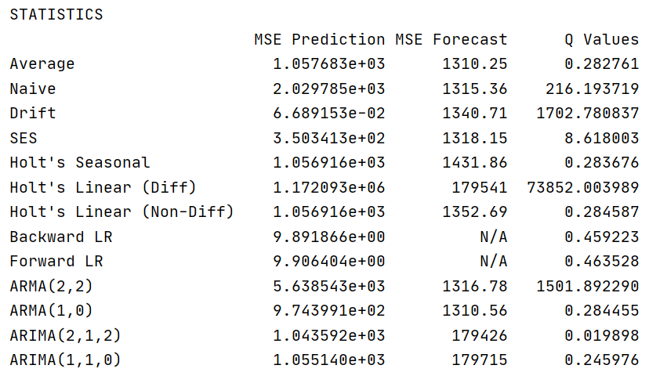
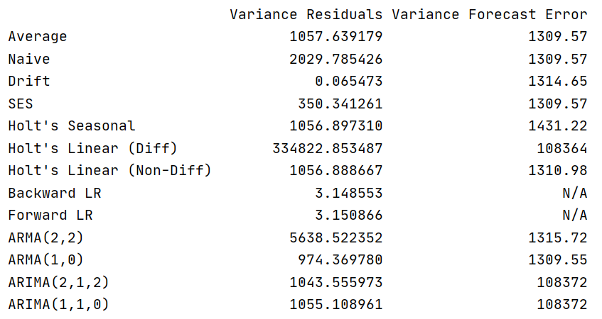

Slide 39
Summary & Conclusion
The ARIMA model with the order (2,1,2) was seen to be the best performing model.
The SARIMA model was not implemented in this project, mainly because the decomposition of the components suggested highly trended data.
More advanced models including neural networks such as the LSTM models and even Prophet and Auto-ARIMA models can be used.

