Slide 1
Sentiment Analysis Using Neural Networks
Machine Learning Lab
Course No: CSE 476
Course Teacher: Dr. Md Forhad Rabbi
Submitted by: Sharmin Ahmed
Registration No. : 2016331091

Slide 2
Sentiment Analysis
Sentiment analysis is a machine learning technique that analyzes texts for detecting emotion of a text.
By training, machines automatically learn how to detect sentiment without human input.
In this project, the analysis is done on positive and negative sentiment of the input examples.

Slide 3
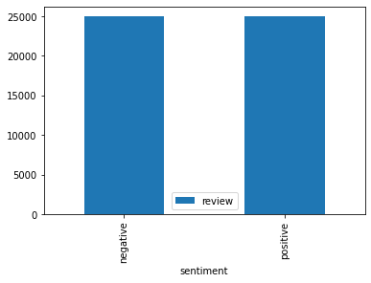
Sentiment Analysis Dataset Overview
Large Movie Review Dataset [1]
IMDB Dataset of 50k Movie Reviews
For binary sentiment classification – positive, negative
Figure 1. Dataset

Slide 4
Overview
Data preprocessing
Model Architecture
Result Analysis

Slide 5
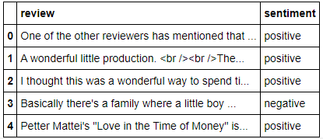
Data Cleaning
The data needed some cleaning. Some basic cleaning steps were –
Converting to lower case
Removing all special characters
Removing punctuations
Removing html tags
Removing extra white spaces
Lemmatizing
Figure 2. Unprocessed Dataset

Slide 6
Label Encoding
Labels (sentiments – positive, negative) were encoded as numeric form -
As it is more machine-readable form
Machine learning algorithms performs well in deciding in operating with the data

Slide 7
Data Tokenization
Tokenization is used to-
Create vocabulary (taken 10000 most common) from the raw texts
It basically breaks the raw text into words called tokens
These tokens helped in understanding the context

Slide 8
Using Glove Embedding
For obtaining vector representations for words glove embedding is used
Vectorization is the process of converting text into numerical representation
It turns text into a numerical form that deep neural networks can understand

Slide 9
Splitting Dataset
The dataset (50k) were split into 3 classes -
Train set 36000 data
Validation set 4000 data (during training)
Test set 1000 data

Slide 10
Models Chosen For Sentiment Analysis
Recurrent Neural Network
Convolution Nueral Network

Slide 11
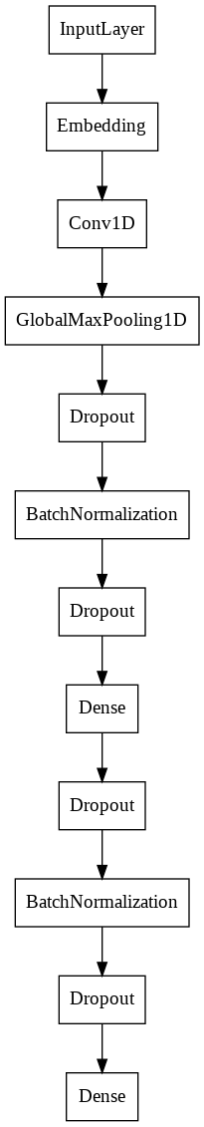
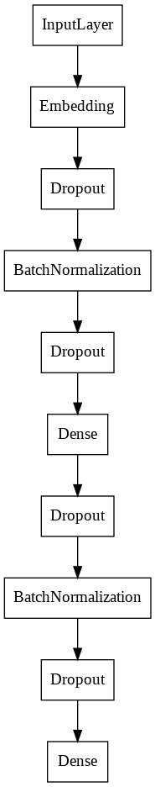
RNN Model Architecture
Figure 3. Model Architecture

Slide 12
CNN Model Architecture
Figure 4. Model Architecture

Slide 13
ModeLs Optimizers
Optimizer = “nadam”
Loss function = “'binary_crossentropy”
Metrics = “accuracy”

Slide 14
RESULT Analysis

Slide 15
RNN Model RESULT
From the result –
Train Accuracy: 0.52
Train loss: 0.69
Test Accuracy : 0.53
Test Loss : 0.69

Slide 16
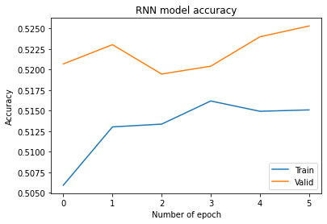
RNN Model Accuracy
From model accuracy plot, we can see both Train and validation accuracy was inconsistent over time
Figure 5. RNN Model Accuracy

Slide 17
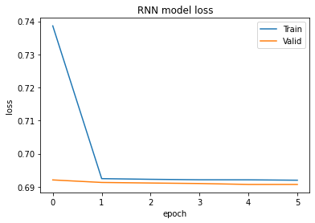
RNN Model Loss
From model loss plot, we can see both Train and validation loss decreased after each epoch. Further epoch was not proceeded to avoid overfitting
Figure 5. RNN Model Loss

Slide 18
CNN Model RESULT
From the result –
Train Accuracy: 0.89
Train loss: 0.26
Test Accuracy : 0.87
Test Loss : 0.300

Slide 19
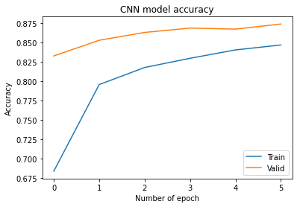
CNN Model Accuracy
From model accuracy plot, we can see both Train and validation accuracy increased
Figure 6. CNN Model Accuracy

Slide 20
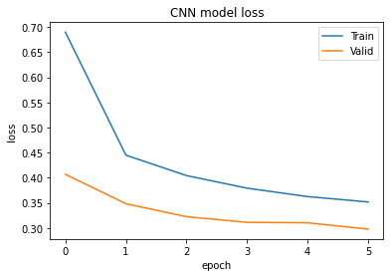
CNN Model Loss
From model loss plot, we can see both Train and validation loss decreased after each epoch. Further epoch was not proceeded to avoid overfitting
Figure 7. CNN Model Loss

Slide 21
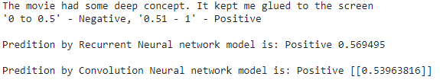
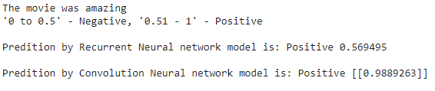
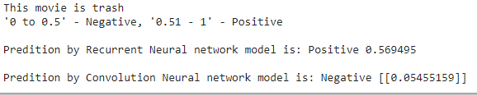
Prediction RESULT on User Input
1.
2.
3.
CNN was very accurate while RNN failed for some. RNN did not perform well as training set were very long

Slide 22
Thank You

