Slide 1

Habit
Sharmin Gaziani, Abdurrehman Zulfiqar, Jaggan Jestine, Sam Williford,
John Bui, Peter Shen, Winifred Ojo.

Slide 2

Introduction
Habit is a productivity-focused mobile app that allows the user to create new habits within a 60-day time frame.
With features like the ability to add a new habit, track your progress for each new activity, and score trophies on skills you’ve completed, Habit offers a convenient way to enhance an individual’s discipline and grit.
Our motivation:
As students ourselves, it can be difficult to commit to so many different things at once and stick with them - this tool is inspired by our willingness to learn and be organized in our goals.

Slide 3
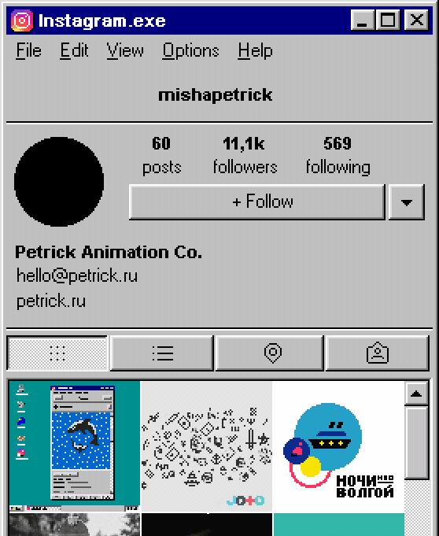
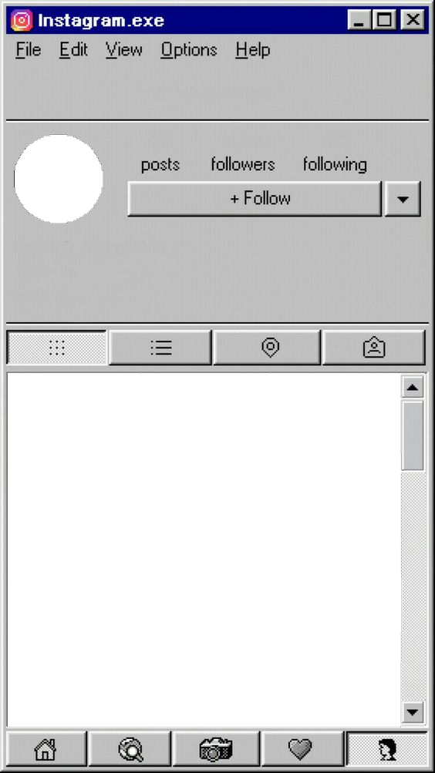
Functional and Non-functional requirements
Non-functional Requirements
Space requirements: The space needed for the software shall be within 100MB, any update size should be under 30MB.
Regulatory requirements: The software must be consistent with the regulation under all circumstances, such as Telephone Consumer Protection Act (TCPA), and General Data Protection Regulation (GDPR).
…
Functional Requirements:
The system must be able to authenticate the user's login credentials.
The system must be able to let the user set multiple habits at the same time.
The system must be able to reward the user for maintaining progress shown on a progress bar.
…

Slide 4
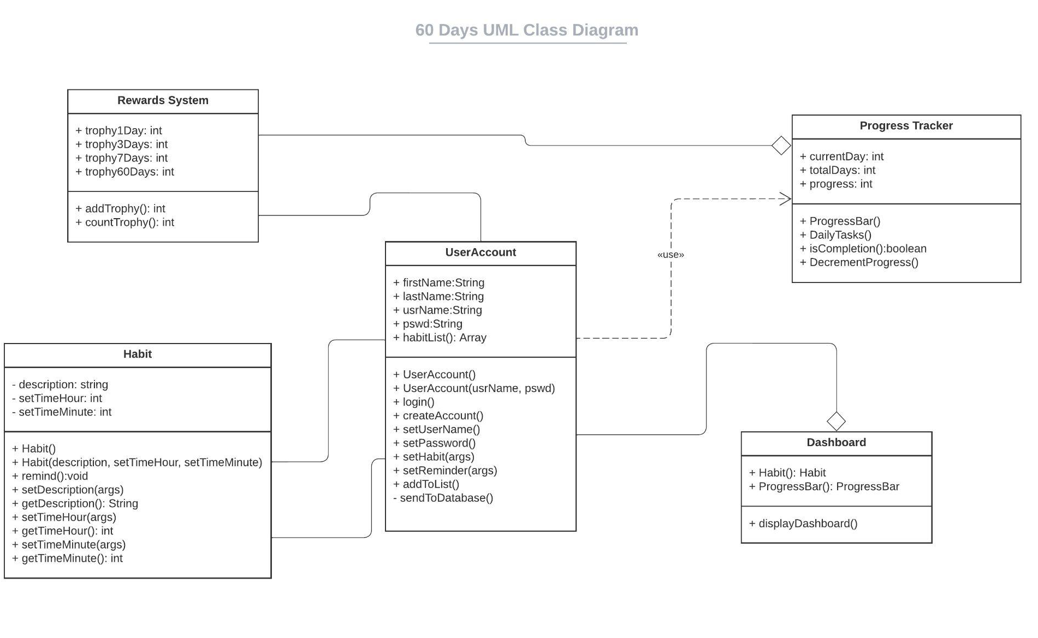

UML Class Diagram
User Account
Habit
Progress Tracker
Dashboard
Rewards System

Slide 5
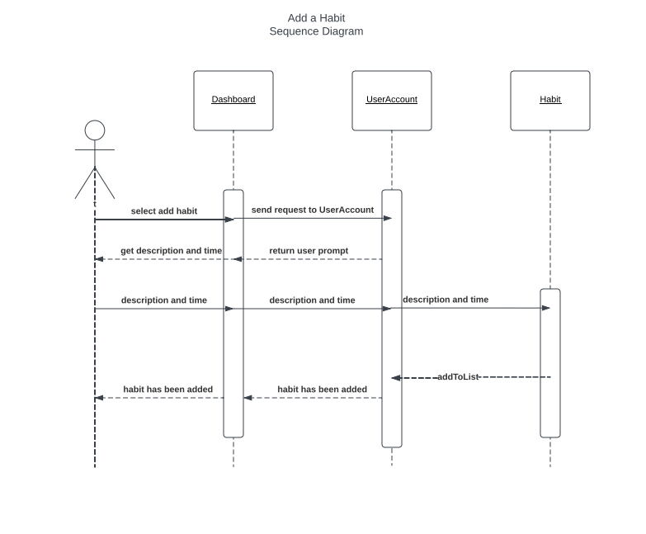
Sequence Diagrams

Slide 6
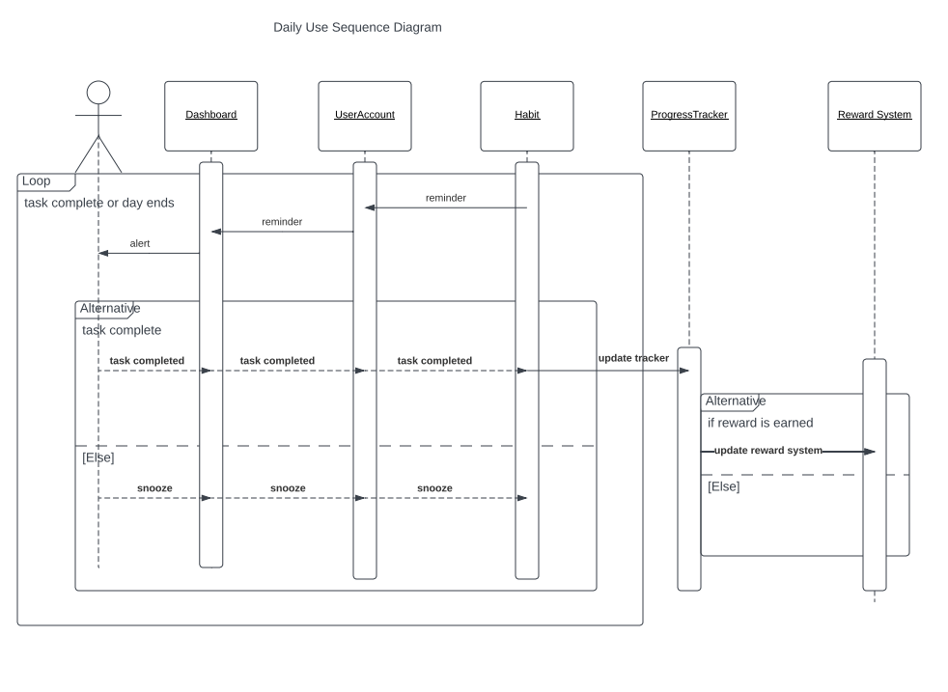

Slide 7
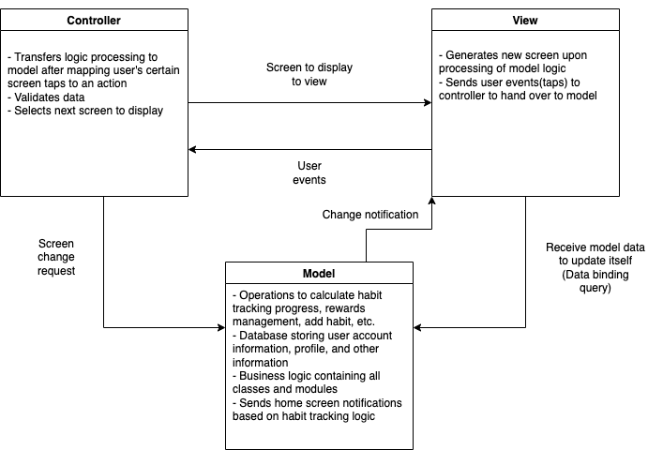
Architectural pattern - MVC

Slide 8
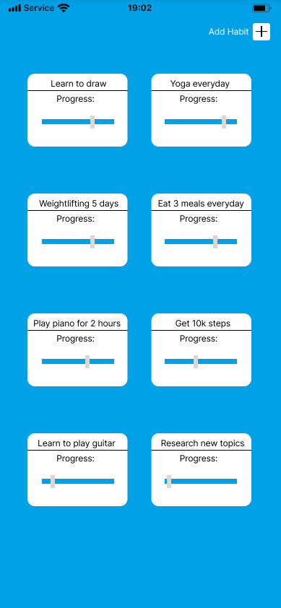
Implementation

Slide 9
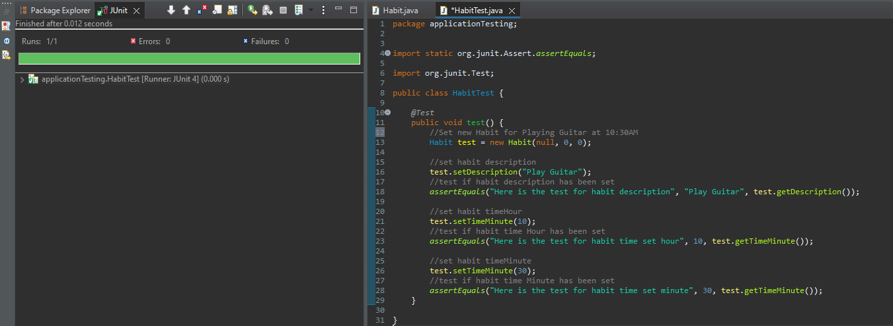
Software Test Plan
JUnit Test Cases
Test Functional Requirements
Test Non-Functional Requirements
Set Habit Test Output:

Slide 10
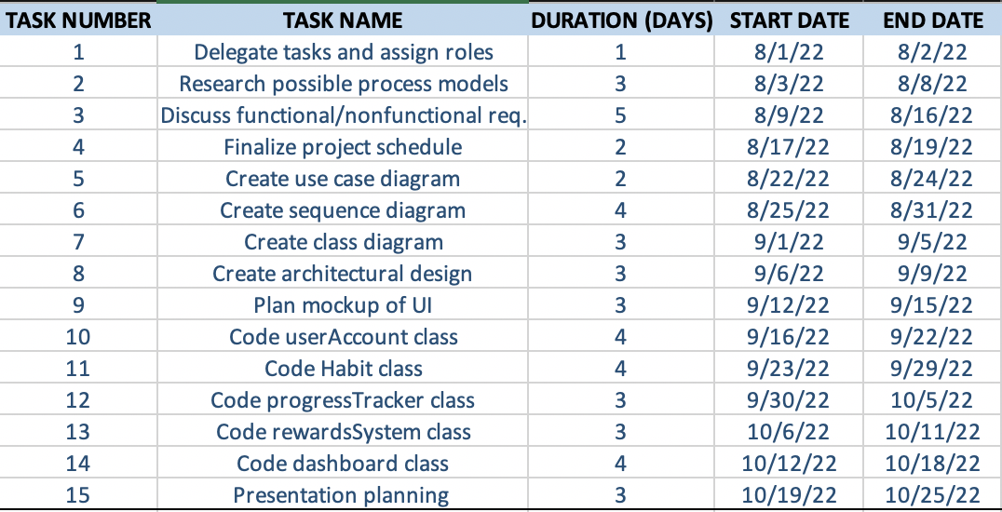

Project Scheduling
Duration: ~ 3 months
Reflects 30-40 hour work weeks
Monday through Friday

Slide 11
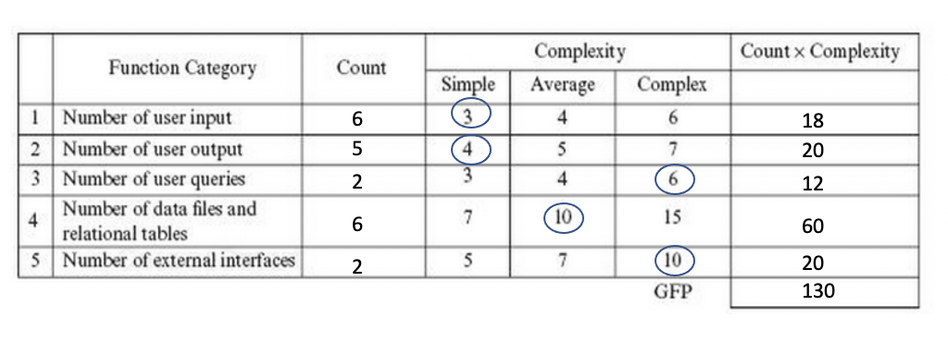
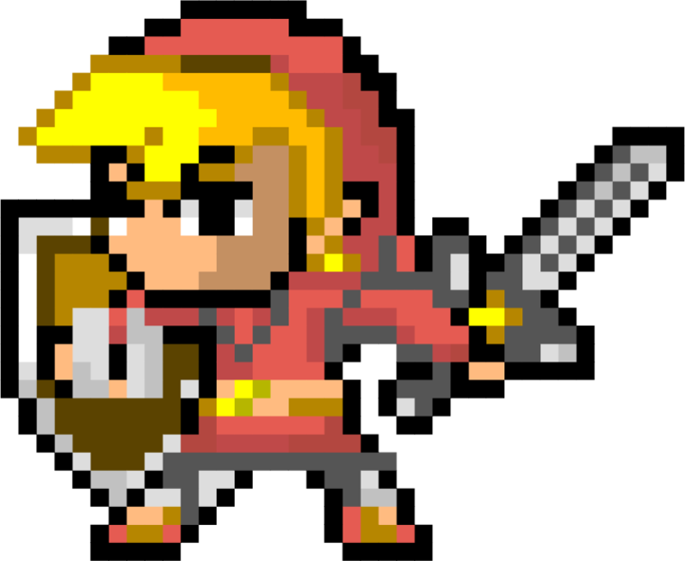
Cost Estimation
Function Point (FP)
Estimated Cost of Hardware
Estimated Cost of Software
Estimated Cost of Personnel

Slide 12
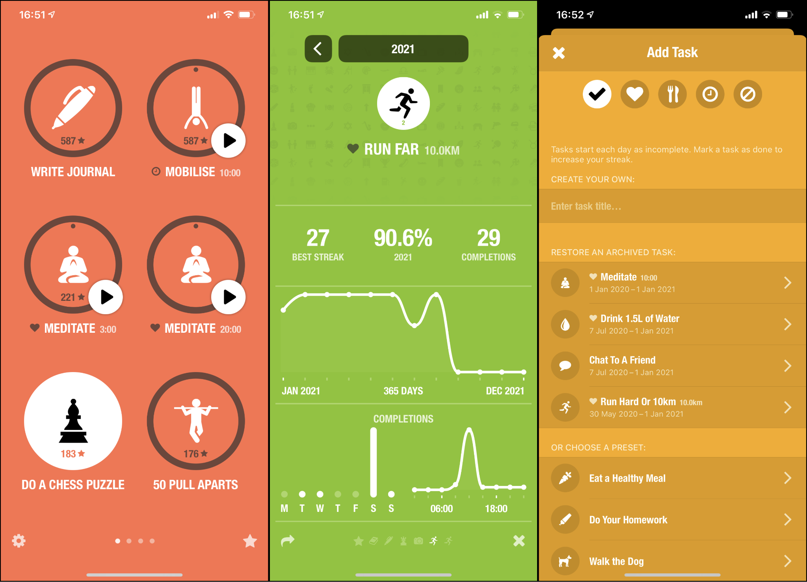
Comparison of Work
Habitshare
Social network habit tracking app
Habitica
RDG video game inspired app with customized avatar.
StickK
Commitment contract with penalty fine.

Slide 13
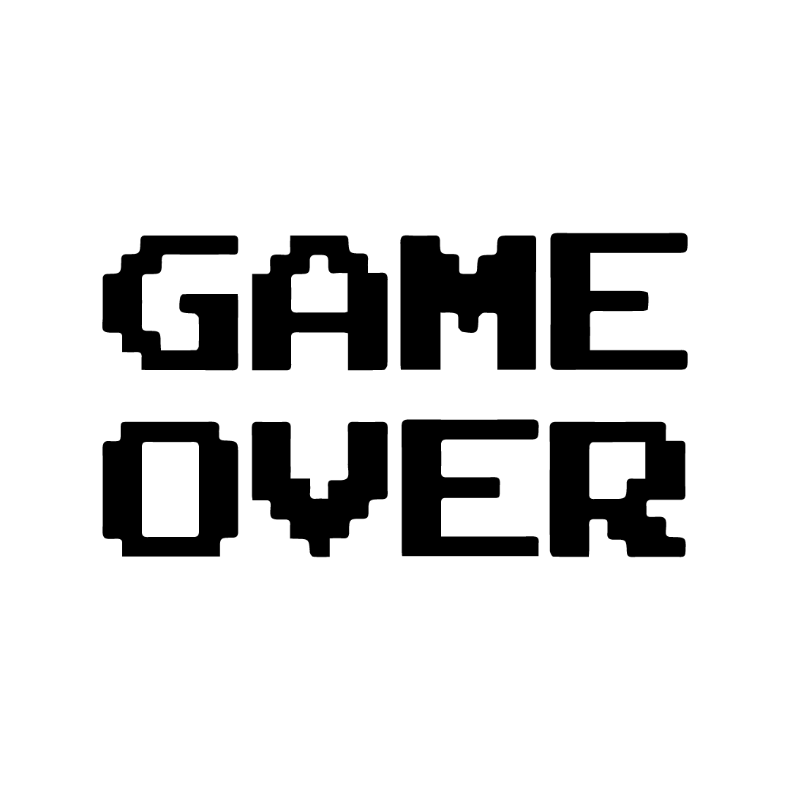
Conclusion
Our project started out with a brainstorming session where each team member suggested ideas and then voted on which idea he or she liked the best. We ultimately decided to design an application that would help people build good habits and track their progress. As our team worked throughout the semester, we realized that we had slightly different ideas about the design and details of how the end product would function. Throughout the semester, as we studied and learned about different aspects of software engineering, we created detailed requirements and diagrams, and our project transformed from a vague idea into something concrete that could actually be implemented. Overall, it was a valuable experience as we all were able to increase our understanding of the software development process.

Slide 14
References
[1] M. J. Basavaraj and K. C. Shet, “Software estimation using Function Point Analysis:
Difficulties and research challenges,” Innovations and Advanced Techniques in Computer
and Information Sciences and Engineering, pp. 111–116, 2007.
[2] K. Petersen, C. Wohlin, and D. Baca, “The waterfall model in large-scale development,”
Lecture Notes in Business Information Processing, pp. 386–400, 2009.
[3] A. Majeed, “MVC Architecture: A Detailed Insight to the Modern Web Applications
Development,” pp. 1–10, Sep. 2018.
[4] “Software development price guide & hourly rate comparison,” RSS. [Online]. Available:
https://www.fullstacklabs.co/blog/software-development-price-guide-hourly-rate-comparison. [Accessed: 18-Nov-2022].

