Slide 1


Earthquakes
Created by Sharmin Siddique

Slide 2
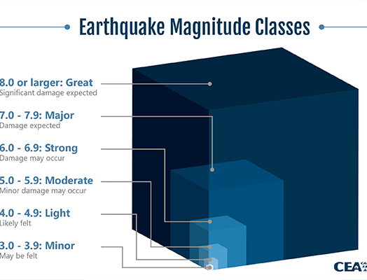

earthquakes?
Movement in the outer crust of the Earth at faults = experience shaking
Where an earthquake begins = epicenter
To better measure the shaking, size of the earthquake and damage caused = we use magnitude
How deep in the Earth an earthquake occurs = depth (km)
Notes:
Movement = stress to build up
Stress released = earthquake happens
Magnitude is a log scale – from seismic waves
All data we talk abou tis from the last 30 days

Slide 3
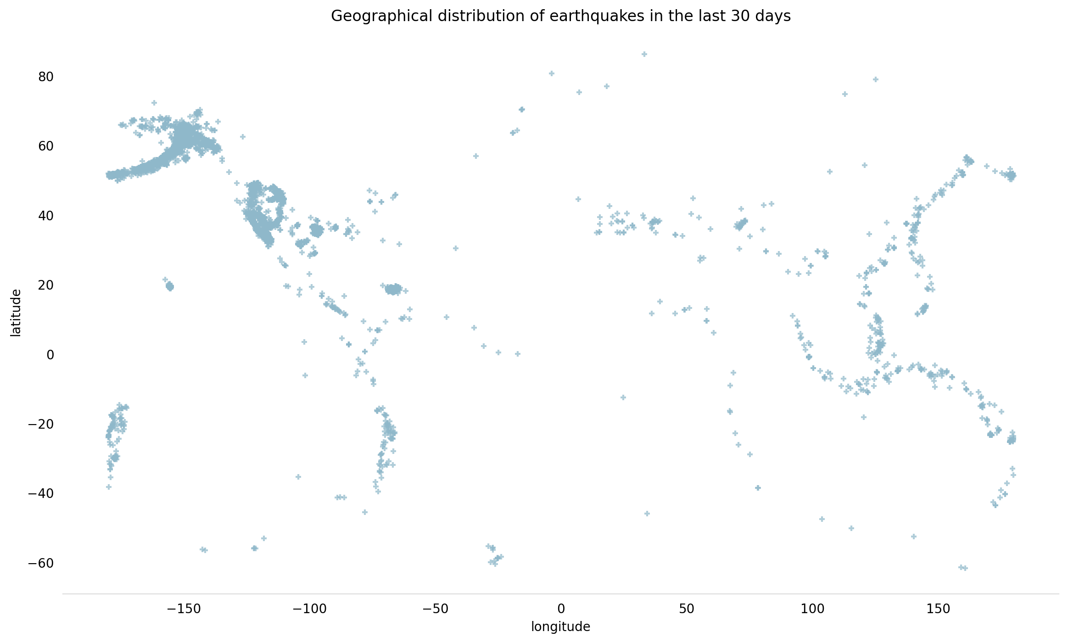
Data provided by USGS (United States Geological Survey) for all earthquakes that have occurred in the last 30 days
Imported numpy, pandas and matplotlib
Worked through understanding the data set and trying to clean
Grouped by place, magnitude
The missing values all in columns not useful for data analysis
Notes:
Grouped by to try and understand where the earthquakes had occurred in the last few days and how powerful they were
To see any patterns/correlation

Slide 4
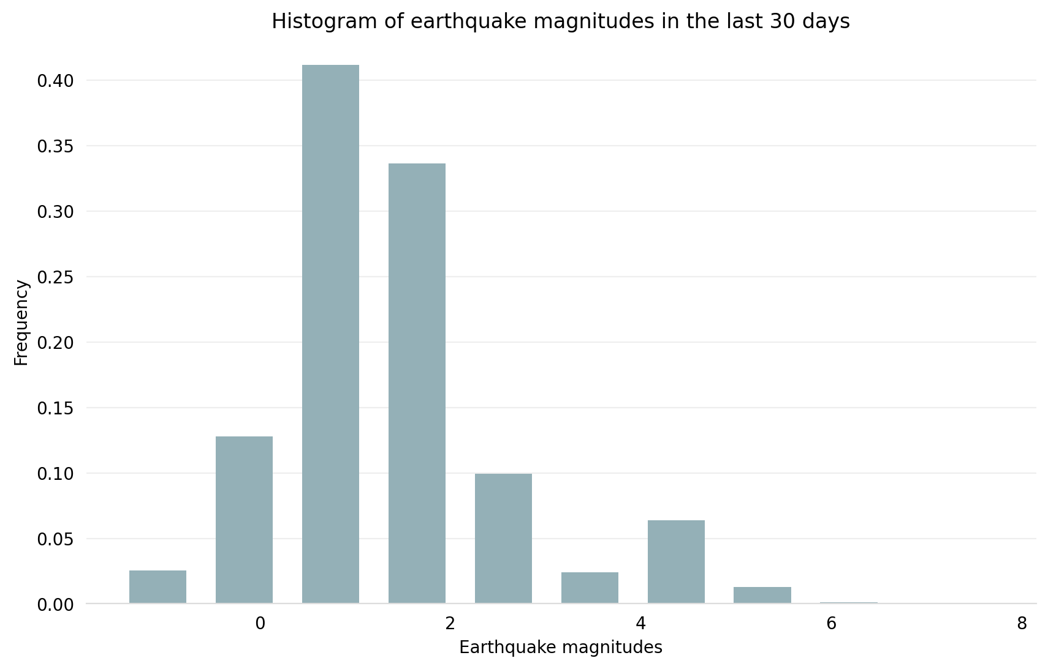
Understanding the earthquake magnitude distribution for the last 30 days.
Has there been a frequency of higher magnitude earthquakes?
Lower magnitude earthquakes?
Notes:
Orginally going to do >= 4

Slide 5
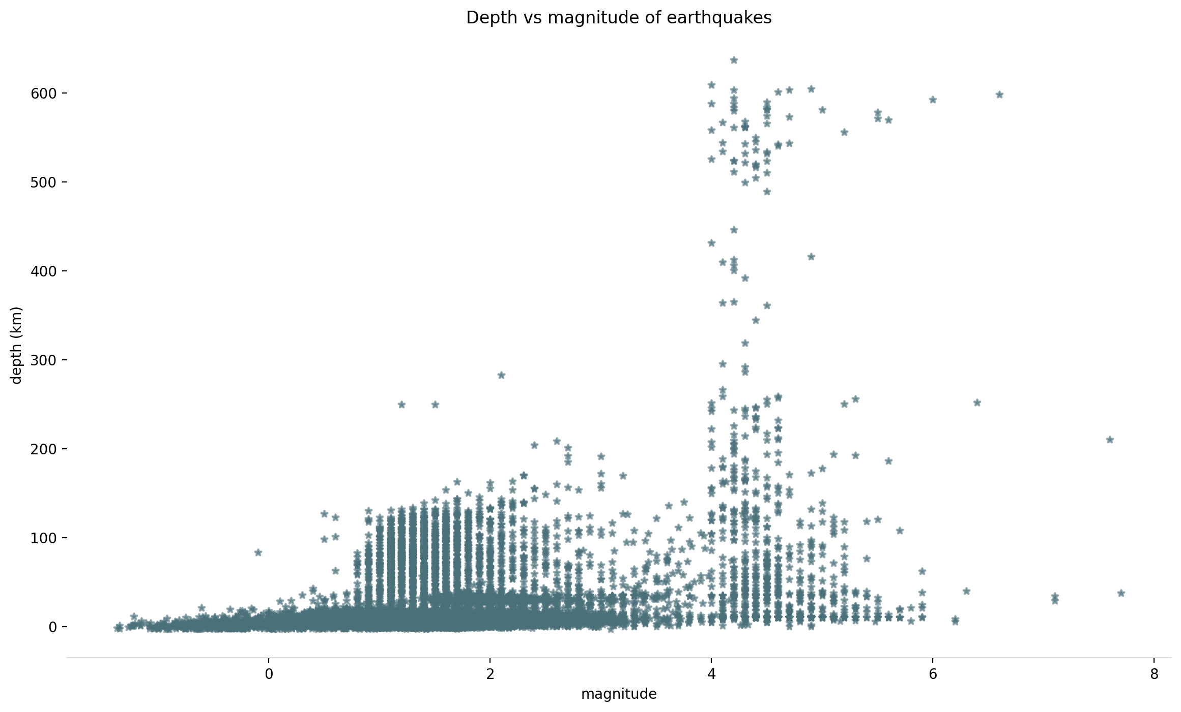
The depth and magnitude of the earthquakes
Higher depth of the earthquakes with mag >=4
Shallower earthquakes tend to be more damaging
However, deep earthquakes are more widely felt

Slide 6
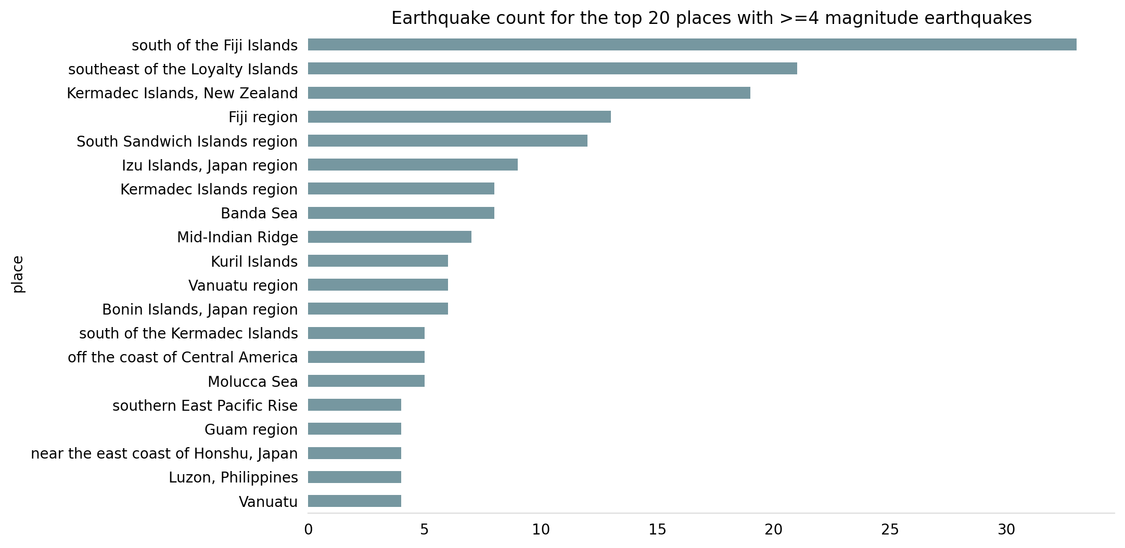
Where do earthquakes of a magnitude of >= 4 occur?
Notes:
mag_data = where_4_mag["place"].value_counts()[:20].sort_values().plot(kind="barh",
title = "Earthquake count for the top 20 places with >=4 magnitude earthquakes",
color = "#7697A0",
figsize = (10,6),
fontsize= 10)

Slide 7
conclusions
Higher magnitude earthquakes occurred south of the Fiji islands
Distribution of earthquake magnitudes for the last 30 days is more towards the lower end
Higher depth is generally achieved by higher magnitude earthquakes

Slide 8
An extra..
Could have analysed data over a year to see if more particular months where earthquakes occur
Some issues:
Would have dropped data not needed
Replace/fill missing values
Line graph for earthquake vs time (30 days)
Box plot for magnitude to see outliers

Slide 9

References
https://earthquake.usgs.gov/data/comcat/index.php#magType
https://earthquake.usgs.gov/earthquakes/feed/v1.0/summary/all_month.csv
https://www.kaggle.com/datasets/farazrahman/earthquake?resource=download&select=all_month.csv
https://www.bgs.ac.uk/discovering-geology/earth-hazards/earthquakes/
https://spaceplace.nasa.gov/earthquakes/en/

