Slide 1


Earthquakes
Created by Sharmin Siddique

Slide 2
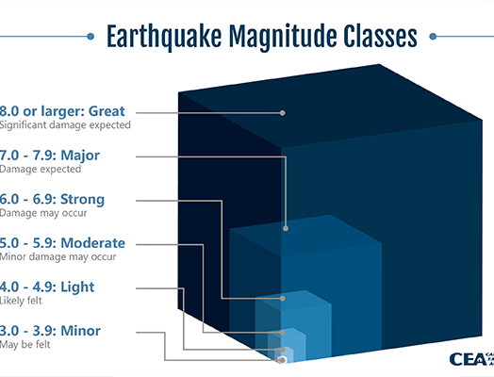

earthquakes?
Movement in the outer crust of the Earth at faults = experience shaking
Where an earthquake begins = epicenter
To better measure the shaking, size of the earthquake and damage caused = we use magnitude
How deep in the Earth an earthquake occurs = depth (km)
Notes:
Movement = stress to build up
Stress released = earthquake happens
Magnitude is a log scale – from seismic waves
All data we talk abou tis from the last 30 days

Slide 3
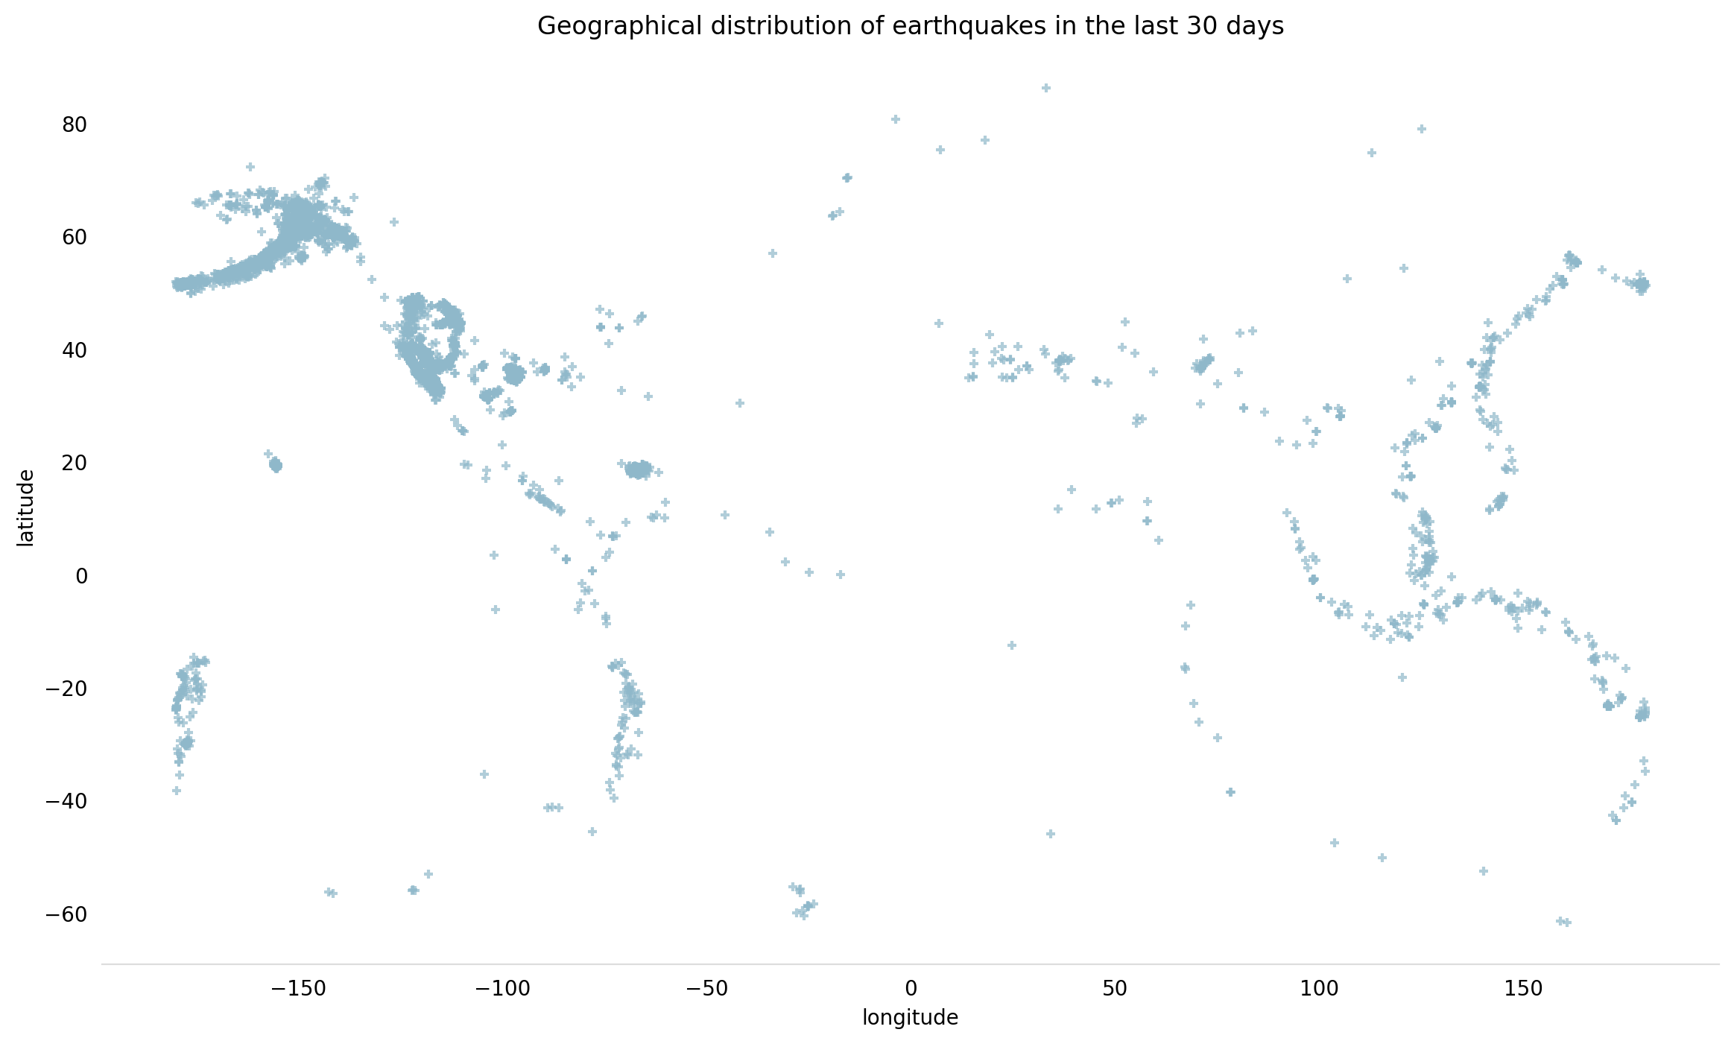
Data provided by USGS (United States Geological Survey) for all earthquakes that have occurred in the last 30 days

Slide 4

References
https://earthquake.usgs.gov/data/comcat/index.php#magType
https://earthquake.usgs.gov/earthquakes/feed/v1.0/summary/all_month.csv
https://www.kaggle.com/datasets/farazrahman/earthquake?resource=download&select=all_month.csv
https://www.bgs.ac.uk/discovering-geology/earth-hazards/earthquakes/
https://spaceplace.nasa.gov/earthquakes/en/

