Slide 1
Sharmin Yusifova AI
SVHN
PPTX

Slide 2
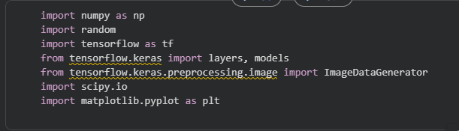
Framework , Library insertion

Slide 3
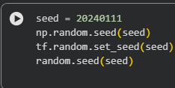
Seed configration

Slide 4
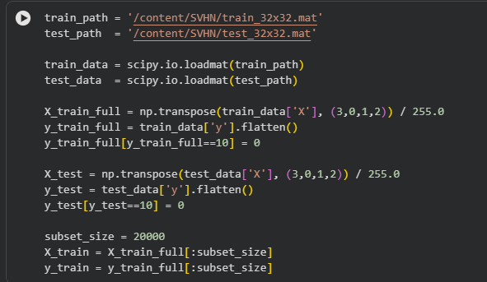
Downlaod SVHN Dataset (Manually from kaggle)

Slide 5
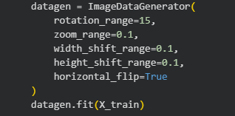
Data augmentation

Slide 6
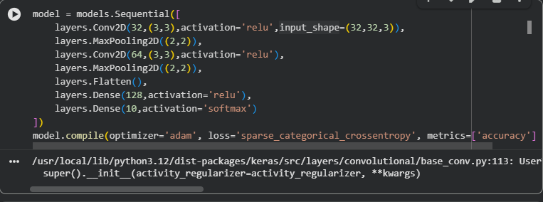
Create CNN Model

Slide 7
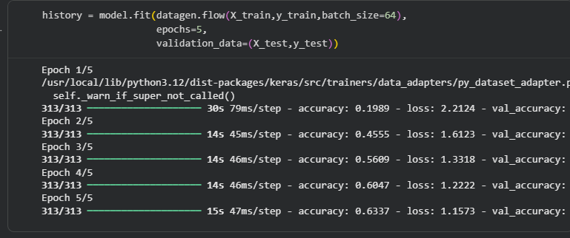
Train

Slide 8
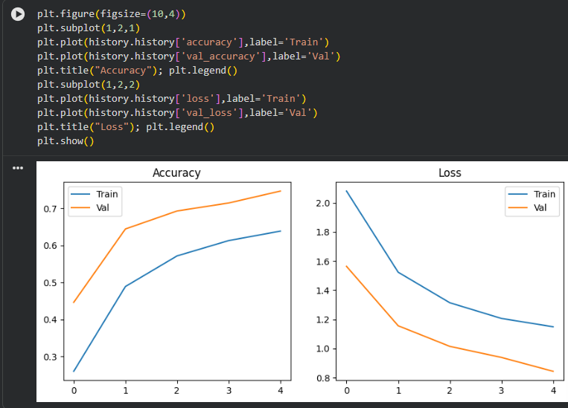
Plots with matplot

