Slide 1
SHARMITHA S 711721244050 III Btech CSBS KGiSL Institute of Technology
CAPSTONE PROJECT
Wine Quality Prediction – MACHINE LEARNING
Final Project
Presented By
3/21/2024 Annual Review

Slide 2
PROJECT TITLE
Predicting the quality of wine on the basis of given features by the use of several Machine learning models.
3/21/2024 Annual Review

Slide 3


AGENDA
1. Problem Statement
2. Project Overview
3. End Users
4. Solution and Value Proposition
5. The Wow Factor in Your Solution
6. Modelling
7. Results
3/21/2024 Annual Review

Slide 4

PROBLEM STATEMENT
The objective of this project is to develop a machine learning model capable of accurately predicting the quality of wines based on their chemical properties and sensory attributes. The prediction of wine quality is crucial for winemakers and enthusiasts alike, as it can provide valuable insights into the characteristics of a wine before it is tasted. By leveraging machine learning techniques, we aim to create a predictive model that can assist winemakers in optimizing their production processes, selecting the best grapes, and enhancing overall wine quality. Additionally, such a model can aid consumers in making informed decisions when choosing wines, ultimately improving their wine tasting experience.
3/21/2024 Annual Review

Slide 5

PROJECT OVERVIEW
- This project aims to predict wine quality using machine learning techniques.
- By analyzing chemical and sensory attributes, the model will provide insights into wine quality for both winemakers and consumers.
- The process involves data collection, preprocessing, model selection, training, evaluation, and deployment.
- Machine learning algorithms like regression and classification will be explored for accurate prediction.
- The project will emphasize interpretation of results and consider scalability for real-world applications.
3/21/2024 Annual Review

Slide 6

WHO ARE THE END USERS?
1. Winemakers: They can use the predictive model to optimize their production processes and enhance the quality of their wines.
2. Distributors and Retailers: They can employ the model to make informed decisions about which wines to distribute or sell based on their predicted quality.
3. Wine Enthusiasts and Consumers: They can benefit from the model by selecting wines that match their preferences and expectations, leading to a better overall tasting experience.
The project aims to serve these end users by providing accurate predictions of wine quality based on relevant attributes, ultimately improving decision-making processes within the wine industry.
3/21/2024 Annual Review

Slide 7

YOUR SOLUTION AND ITS VALUE PROPOSITION
Our solution utilizes machine learning to predict wine quality accurately based on chemical composition and sensory attributes, providing the following benefits:
1. Data-driven Insights: We analyze comprehensive datasets to uncover valuable insights into wine quality, empowering stakeholders with data-driven decision-making.
2. Reliable Predictions: Our predictive model delivers accurate assessments of wine quality, enabling winemakers, distributors, and consumers to make informed choices confidently.
3. Process Optimization: By identifying key factors influencing wine quality, our solution helps optimize production processes, enhancing consistency and excellence in wine production.
3/21/2024 Annual Review

Slide 8

THE WOW IN YOUR SOLUTION
Our solution offers a "wow" factor through:
1. Precision: Our model delivers highly accurate predictions, surpassing industry standards and providing confidence in decision-making.
2. Actionable Insights: We provide practical recommendations that directly impact processes, enabling users to make immediate improvements.
3. Seamless Integration: With effortless integration into existing systems, our solution minimizes disruption and maximizes efficiency.
4. Scalability: Whether you're a small vineyard or a global distributor, our solution grows with your business needs, ensuring long-term value.
3/21/2024 Annual Review
8

Slide 9
MODELLING
1. Data Preparation: Clean, preprocess, and prepare the dataset, ensuring it is ready for modeling by handling missing values, outliers, and encoding categorical variables if needed.
2. Model Selection: Explore and select appropriate machine learning algorithms such as regression or classification models tailored to the wine quality prediction task.
3. Model Training and Evaluation: Train the selected models using the prepared dataset and evaluate their performance using relevant metrics like RMSE for regression or accuracy for classification.
4. Hyperparameter Tuning: Fine-tune the model's hyperparameters to optimize performance, ensuring the model achieves the best possible results for predicting wine quality.
3/21/2024 Annual Review
9

Slide 10
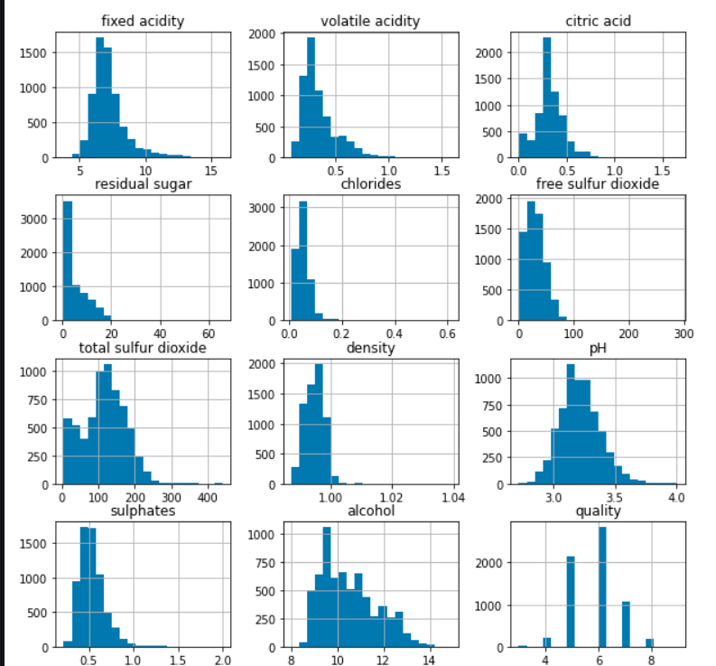
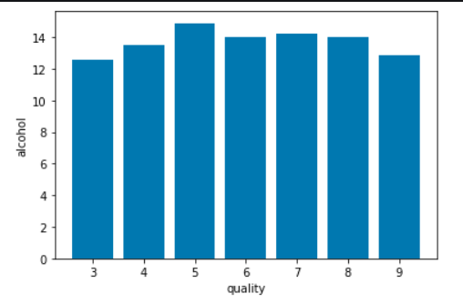
RESULTS
Demo Link
https://drive.google.com/drive/folders/1n5NoAeRAEC3C46qIPvXaVAQ9ULWq-K74?lfhs=2
3/21/2024 Annual Review
10

