Slide 1
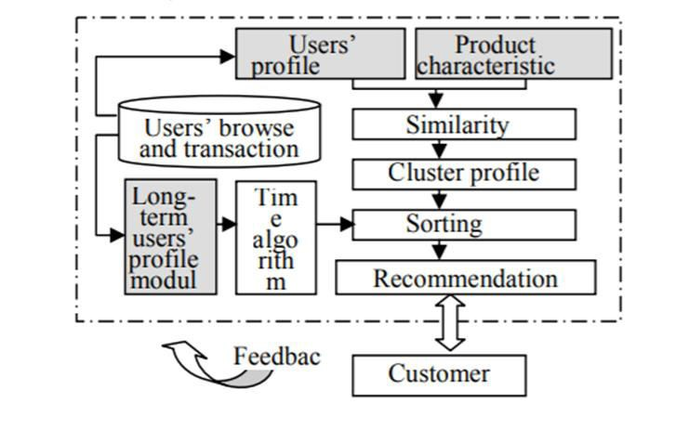
experience than before. In [4], a personalized intelligent reservation system for online reservation for proposed for reserving travel using a chatbot. This is the system that enables the user to find the cheapest and affordable hotels and rooms nearby the user’s location. In [5], interactive product manual system using chatbot was developed to stop customers from reading a long manual and rather help them to interact with a chatbot for queries. Again in [6], a real world smart chatbot for customer care was developed to help intelligent interaction between customers and management. In [7], a fully intelligent chatbot that interacts with humans and machines was developed by embedding knowledge to the bot. In 2016, an application for agricultural marketing using mobile based technologies was developed. In [1], the authors have described how brokers and middlemen are holding farmers as hostages and how they are being a major challenge in the development of agricultural industry in India. It is very unfair that farmers do not get the profit that they deserve for the effort that they put. [8] examines cellular technology which is shown to improve agricultural and delivery systems in India. But the cellular system seems to be a little complex and so this idea focuses on developing a chatbot. E- Agriculture [9] is a growing field which aims to develop the agricultural systems
products can buy directly from the farmers. However that system would be slow and not suitable for easily perishable products.
In this paper, we propose an interactive system that could be reachable to all classes of farmers and performs three main functions: receive request, recommend farmers and maintain farmers profile module. We explain our system in detail in this section and we illustrate our complete system in Fig. 1. We develop the system using Raspberry Pi 3 model using Python 2. 7. 9, R language, Java script and PostgreSQL. It is possible to implement the system in Slack using an open source software called HUBOT. Raspberry Pi is a single computer and it is used as a web application server. We
find that Raspberry Pi is sufficient for the
implementation of our system. Basically this model w ill work as following:
Getting the details of the farmers, total land area and crop that is cultivated.
Receiving request from the users, understanding of their needs and recommend farmers to the users as per their request, providing them with the contact number of the farmers.
Maintaining the farmer’s profile as per their
availability and service.
through ICT (Information and communication)
The chatbot provides a user interface and paves way to
technologies. Thus, in this system, we prevent the farmers from spending their money for inputs and also establish an online marketing for the farmers.
establish connection between the farmers and
consumers. Users just type in their question or
requirement, e.g., which farmer can cultivate
III. PROPOSED MODEL AND ANALYSIS
approximately 10kg rice for me?, what will be the estimated cost?, how long will a farmer take to produc e such a quantity for me? Etc..When a user or consumer requests the chatbot to fetch this kind of request it primarily receives the request. Also, when user types “help” on this chatbot, this system tells about the current status of farmers list and their crops. For example, if a user requests for a farmer who can cultivate 50kg of ric e at 25rs per kg, the chatbot receives the request and processes it.
This chatbot provides the user with proper recommendation of the farmers with the criteria specified by the consumer. This function actually checks the database and specifies the condition. It fetches the data and recommends it to the consumer. The consumer is provided with the contact details of the farmer so the consumer may contact the farmer and hire him. Example: when a consumer requests the chatbot for a farmer who can cultivate 50kg of rice at 25rs per kg, the chatbot recommends a list of farmers who are available for the customer at that specified price and quantity. Thus, the consumer might contact and hire him.
Fig. 1: Overall structure of the system.
We aim to develop this application to be more productive and useful to the common man. Another objective is to help the farmers avoid their dependence on middlemen. Direct communication between a farmer and the end consumers will solve the problem to a certain extent. A few large farmers [2] subscribed to famous magazines in which they advertise their products so that the readers of the magazine who may requir e the
The entire system aims at maintaining the database regarding the farmer details. The entire system provides the farmers with a contact number. The farmer
Authorized licensed use limited to: SRM University. Downloaded on March 16,2021 at 08:40:10 UTC from IEEE Xplore. Restrictions apply.

Slide 2
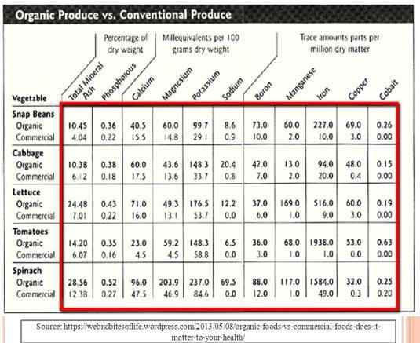
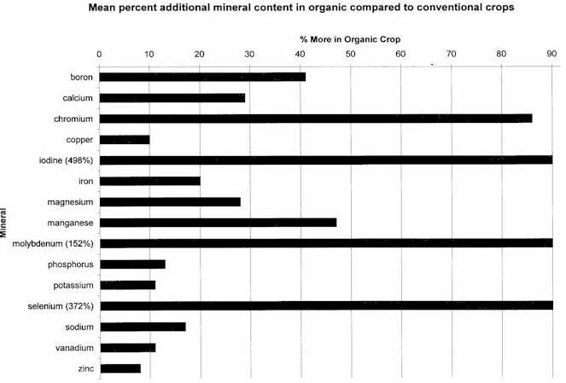
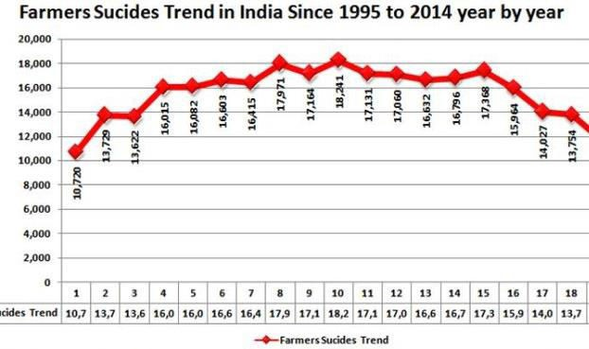
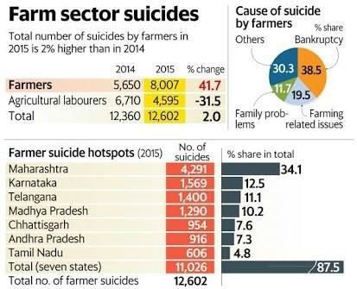
who is currently available for hiring might give a missed call to this number and an SMS will be sent to him which demands answers for three questions namely: Which crop do you produce?, What is your expected pay per kg? and How much can you approximately cultivate?. The farmers reply to this message and the database is updated with the incoming data and are made available to the consumers through the chatbot.
mentioned in Fig.2 and Fig.3. In Fig.3, there is a clear picture there is a clear picture about the amount of minerals that are used in the food crop. This can degrade the quality of the soil as well as the crop’s original quality. This system provides the farmers with all the inputs and thereby helps them in reducing the debts that they need to pay. When the input is provided, the farmer can cultivate and get his pay as well. This encourages the future generations to stay in agriculture as it provides them with all comforts financially and psychologically.
The figure 4 represents the number of deaths in India as per the report of CSO in 2016.It clearly depicts that most of the problems faced by farmers are debt and water issues which this system can overcome. The overall framework of this system provides the farmers with input thereby reducing the reasons for farmer suicide. Fig.5 also depicts the number of farmer suicides along with the reasons. Now as you can see, the difference in the profit margin when the system is used against our system not being used is huge. We achieve our objective of increasing the profit of farmers and w e also find that our system allows farmers to get the pric e that they deserve for each product that they sell.
Fig 2: Statistics of organic vs conventional food (Source: USDA report 2001)
Fig.4: Farmers suicide (Source: CSO report 2016)
Fig 3: Amount of minerals in food crops (Source: NOHA report 2011)
The performance of this system encourages organic food. The consumers can get fresh and organic crops which will encourage a healthy lifestyle. This is highly essential to fight against a variety of health problems like lung problems, skin diseases, birth defects, miscarriages, depression and neurological conditions like Parkinson's disease which are caused by conventional food. The statistics in Fig.2 represents the domination of conventional food over organic food. Since this system mainly focuses on the production of organic food, it can change the statistics that are
Fig.5: Reasons for farmers suicide (Source: National Crime Records Bureau 2015)
Authorized licensed use limited to: SRM University. Downloaded on March 16,2021 at 08:40:10 UTC from IEEE Xplore. Restrictions apply.

