Slide 1
WELCOME TO MY SLIDE SHOW
Name: Fouzia sharna
Id: 01-26-21

Slide 2
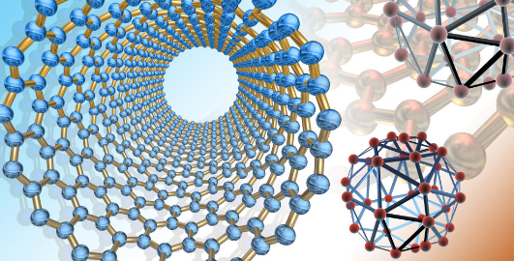
Nano materials

Slide 3
TABLE Contents
Nanomaterial name
Type
Size (nm)
Surface area (m2/g)
Band gap(eV)
Conductivity(S/m)
Magnetic properties
Applications
Maximum cost per gram($)

Slide 4
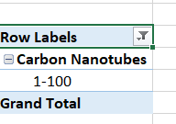
Question-1
What is the typical size range of Carbon Nanotubes?
The typical size of Carbon Nanotube is 1-10 nm.

Slide 5
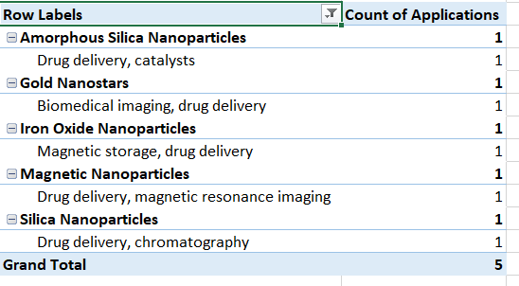
QUESTION-2
How much Nanomaterials are used in drug delivery and medical purpose?
5 Nanomaterials are used to drug delivery and for medical purpose.
Amorphous Silica Nanoparticles
Gold Nanostars
Iron Oxide Nanoparticles
Magnetic Nanoparticles
Silica Nanoparticles

Slide 6
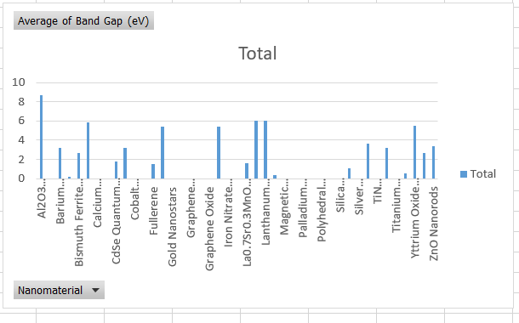
Question-3
What is the Nanomaterials having largest average band gap energies?
Aluminium Oxide have the largest band gap energy,

Slide 7
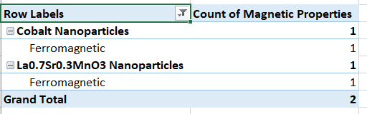
Question-4
Which number of Nanomaterials are Ferromagnetic?
2 Nanomaterials of this table show the ferromagnetic property.

Slide 8
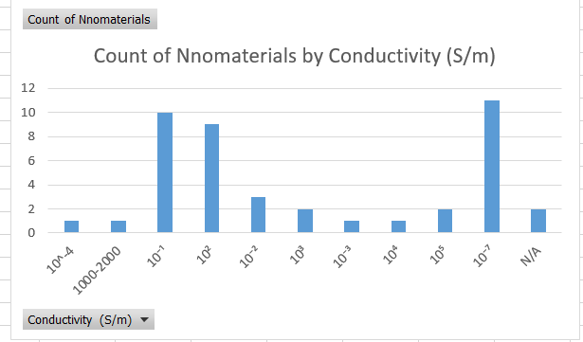
Question-5
Which conductivity is mostly showed by the Nanoparticles? Find the highest conductive Nanomaterial.
Most of the Nanomaterials of this table show the conductivity of 10^(-7).
The highest conductive Nanomaterials are:
Graphene
Carbon Nanotubes

Slide 9
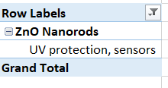
Question-6
What Nanomaterials are used for UV- protection?
ZnO Nanorods are used for UV-protection.

Slide 10
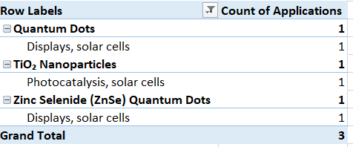
Question-7
Which number of Nanomaterials are often used in solar cell?
3 Nanomaterials are often used in solar cell:
Quantum Dots
TiO2 Nanoparticles
Zinc Selenide Quantum Dots

Slide 11
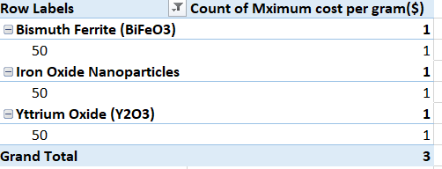
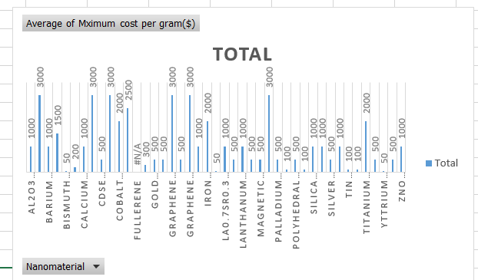
QUESTIOn-8
Which Nanoparticle is comparatively cheap to use commercially?

Slide 12
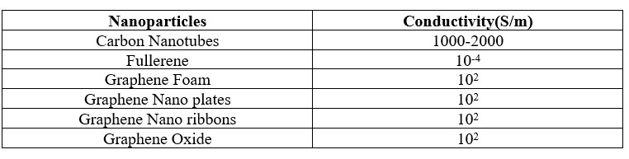
Question-9
Make a list of Carbon-based Nanoparticles and show their electric conductivity.
5 Carbon-based Nanoparticles:
Carbon Nanotubes
Fullerene
Graphene Foam
Graphene NanopLates
Graphene Nanoribbons
Graphene Oxide

Slide 13
thanks

