Slide 1
NEE
Forge
Production Software for the Workshop
Where shop-floor work gets shaped.

Slide 2
THE PAIN TODAY
The Monday-morning printout is stale by 11 a.m.
• "Where's the chassis for Job Card 0007?" → 3 phone calls + a walk to the floor.
• Variance is reconciled in arrears. The supervisor learns next Friday why something ran late, not in time to act.
• Three or more versions of "the master sheet" sit in different inboxes. None is current.
• When a tech reports a blocker, it lives in his head until end of day. Sometimes longer.
• Every printout is a snapshot of a moment that has already passed.
Show of hands — who has been on a phone call this week to find out where a job is?
NEE FORGE · Production Software for the Workshop
02 / 11

Slide 3
NEE FORGE
One system. Five personas. One source of truth.
SALES
DRAFTER
SUPERVISOR
TECH
QC
PDF intake auto-builds Job Card
Drawings · BOM · Layout upload
Schedule + 4-week capacity heatmap
Clock in / out from a phone
6-item checklist + customer email
From PDF intake to customer email — the same system the whole way through.
NEE FORGE · Production Software for the Workshop
03 / 11

Slide 4
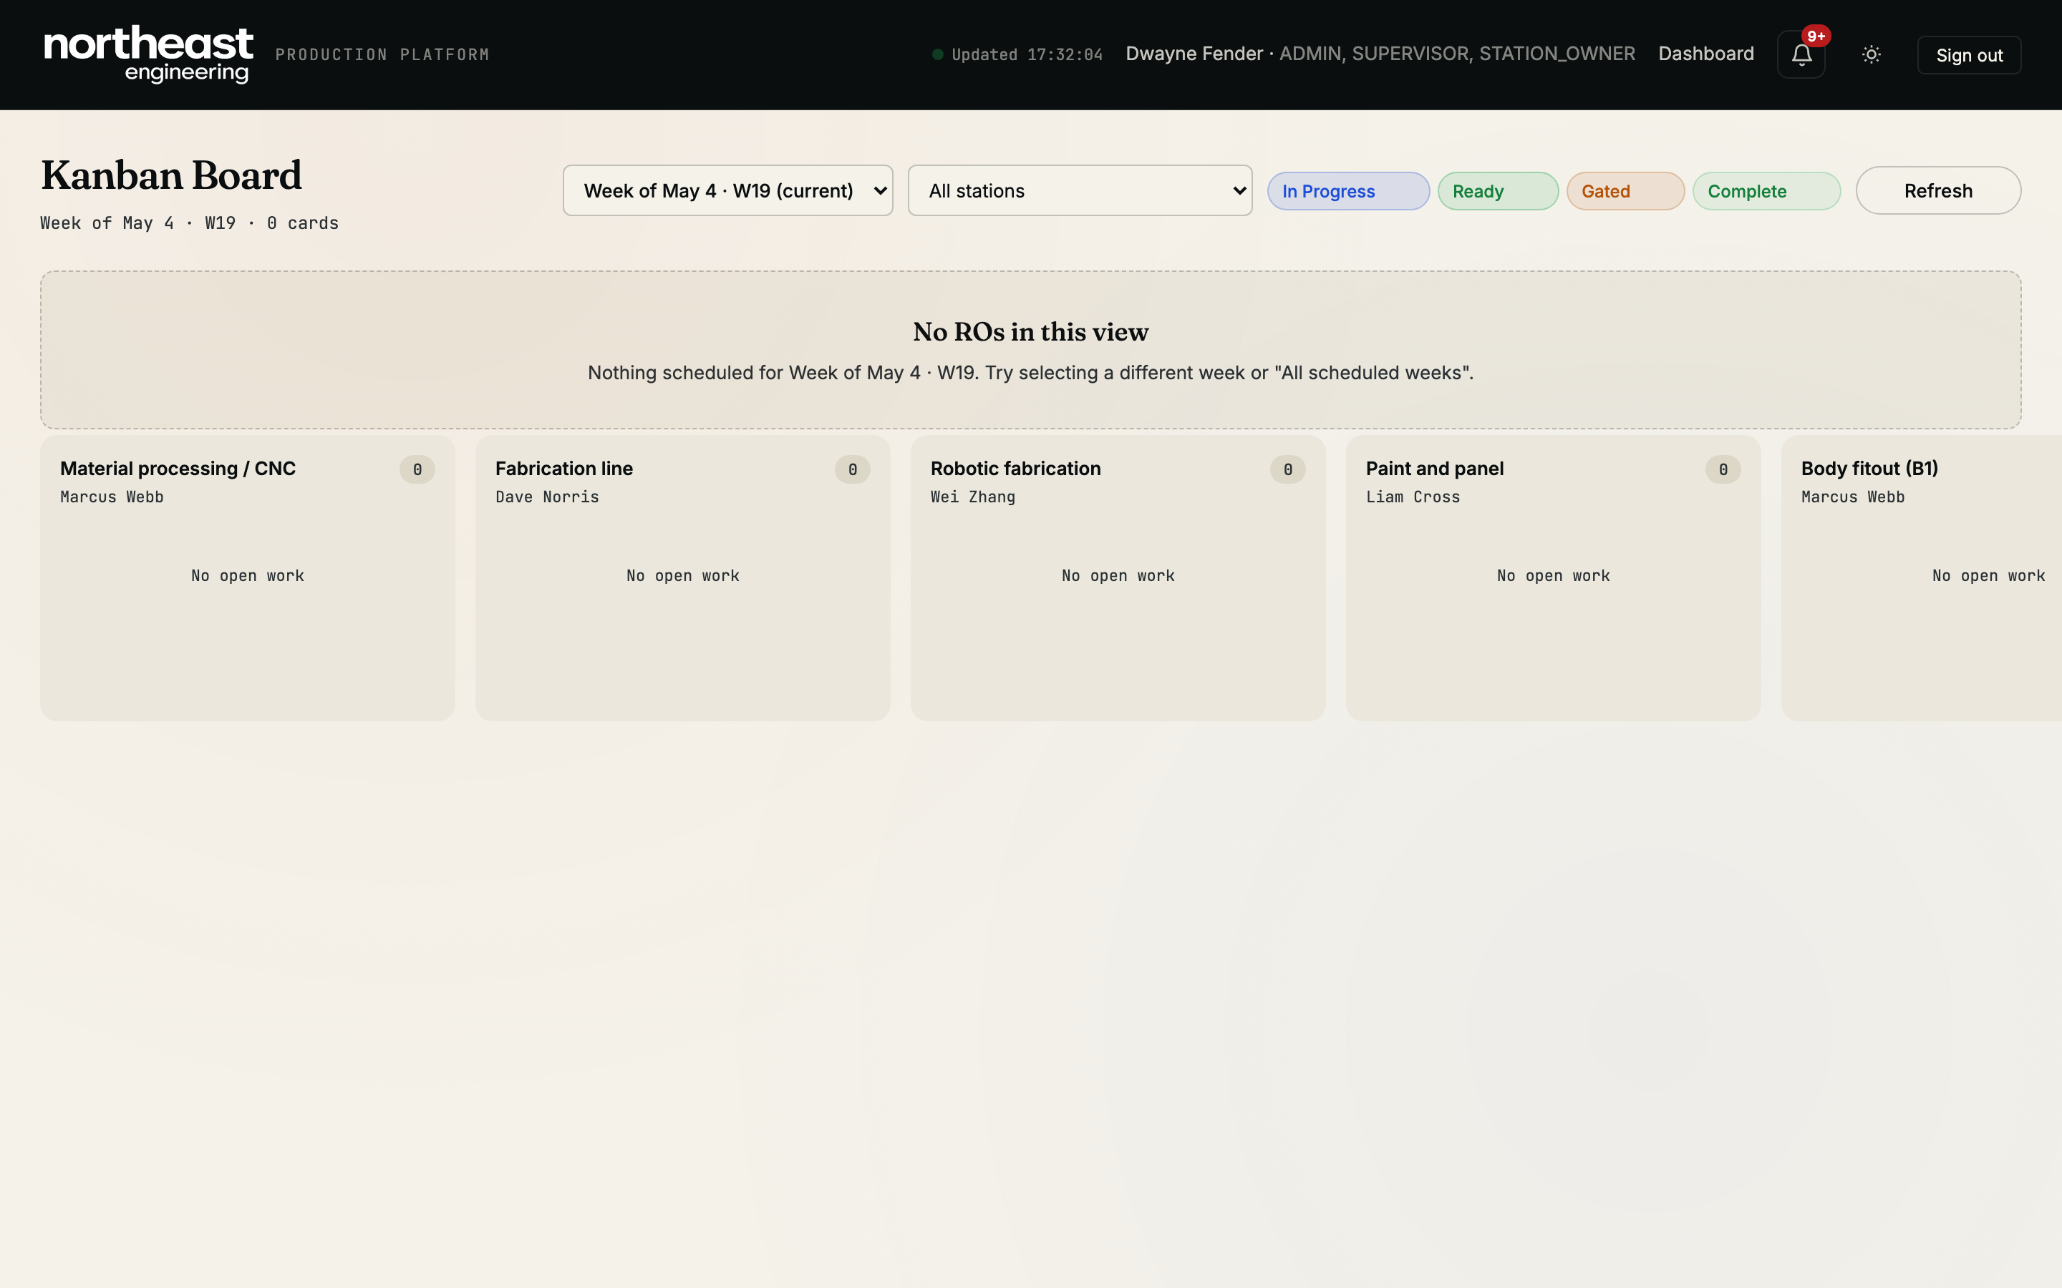
LIVE PRODUCTION FLOOR
First question of the day, answered without a phone call.
• Hospital lane — every blocked Job Card surfaces here, regardless of week.
• Week badges (W19 / W20) — Job Cards carrying over from earlier weeks are obvious.
• Force-advance — supervisor moves a Job Card past a sticking station in 2 clicks.
NEE FORGE · Production Software for the Workshop
04 / 11

Slide 5
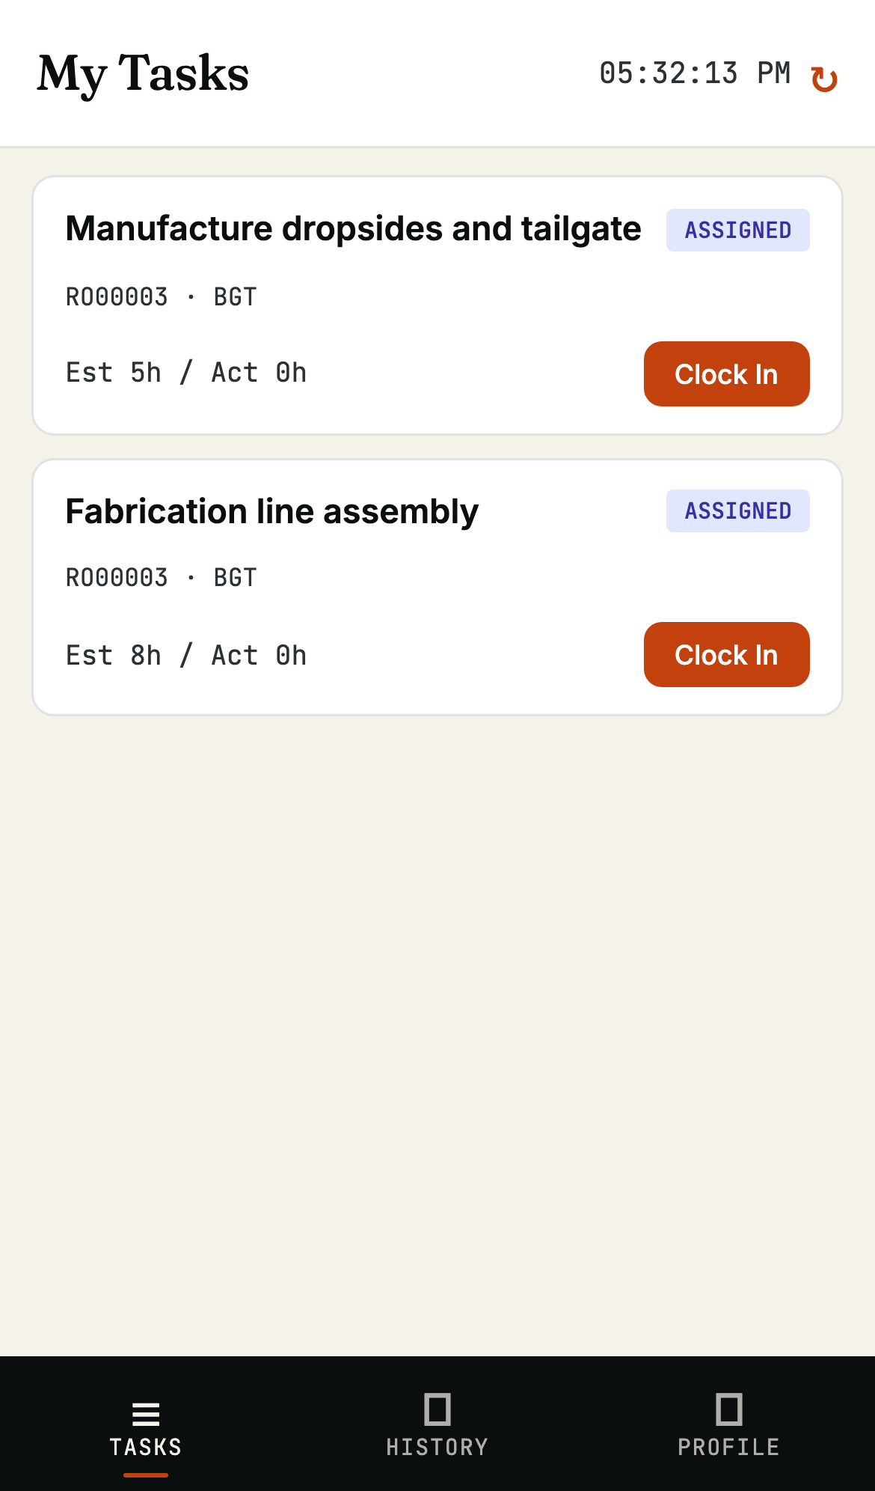
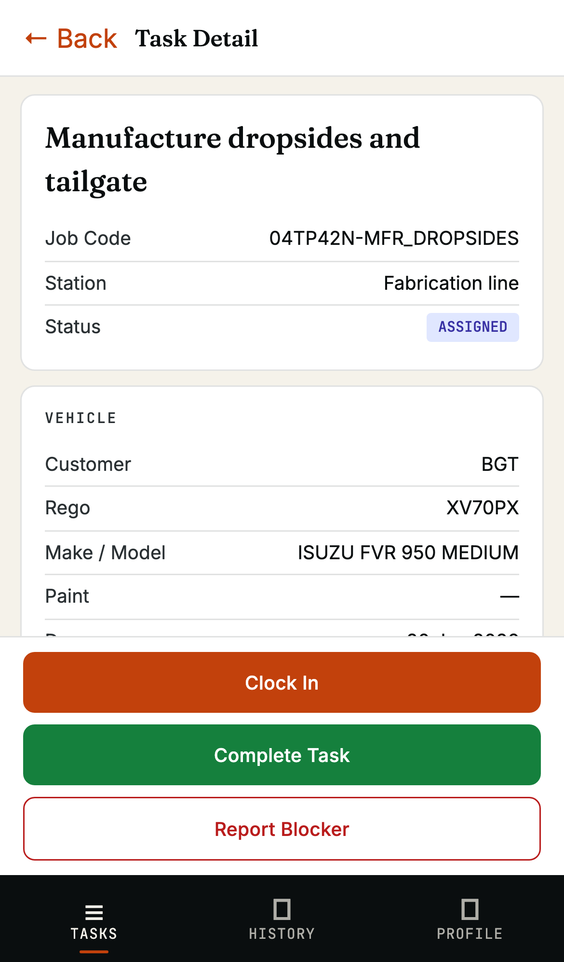
MOBILE TECH EXPERIENCE
If a tech needs more than two taps, they won't use it.
One tap to clock in.
Zero PCs on the floor.
• Median touchpoint: under 30 seconds per task event.
• Blocked Job Cards remain visible — read-only — so the tech sees the queue clearing.
• No shared logins. No end-of-day data entry.
NEE FORGE · Production Software for the Workshop
05 / 11

Slide 6
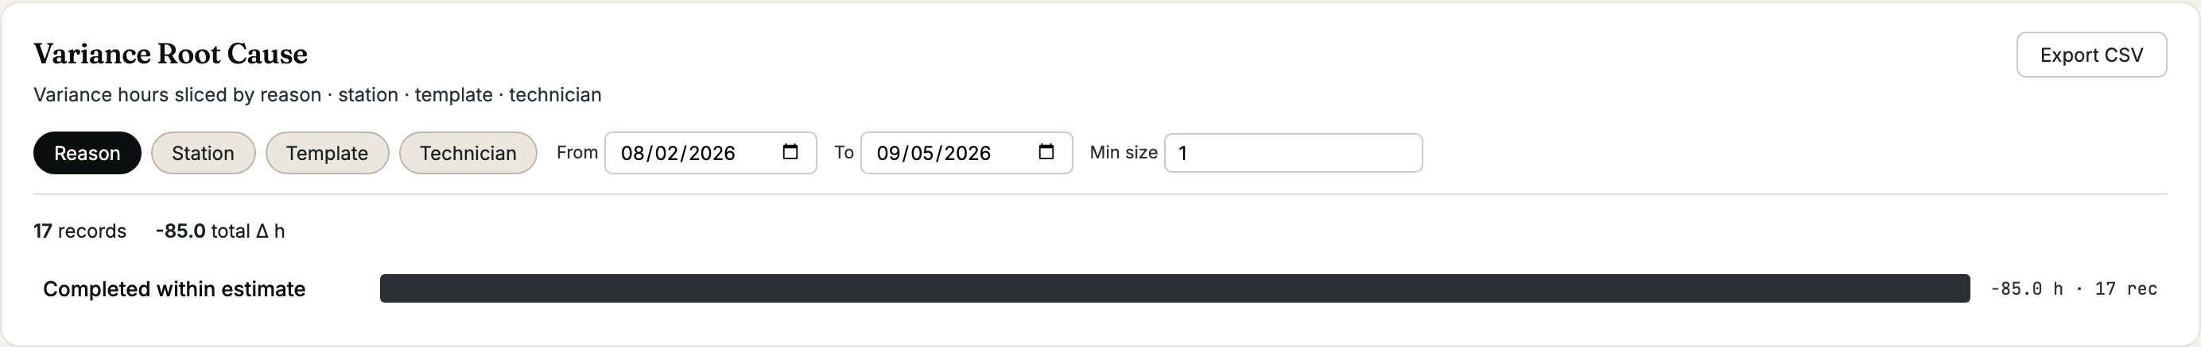
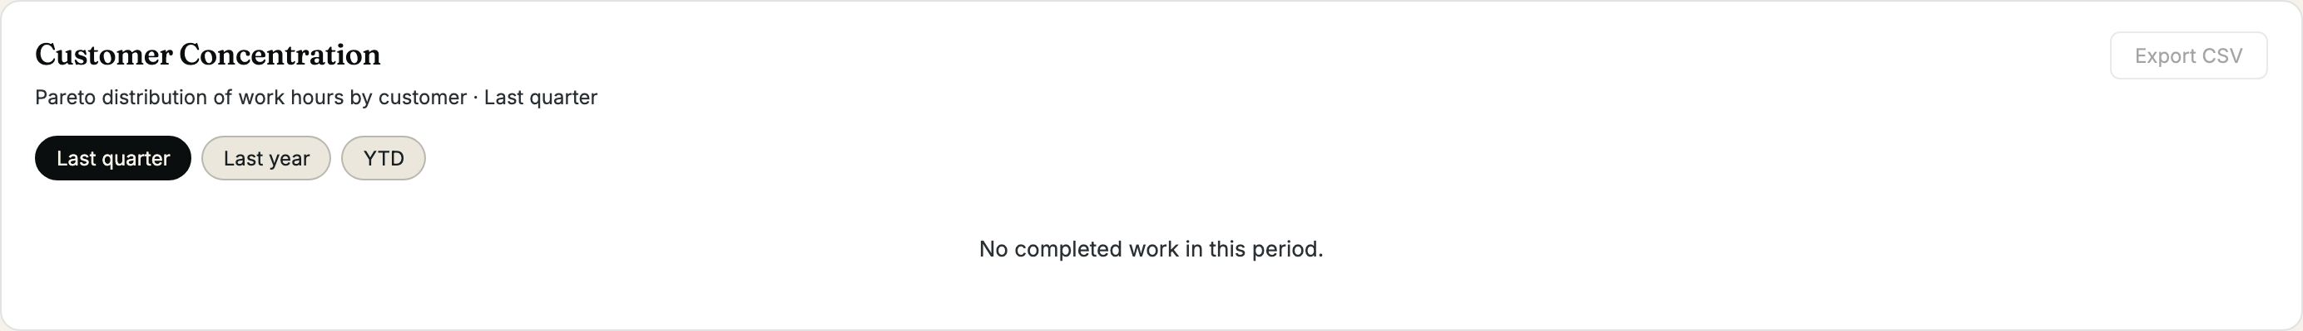
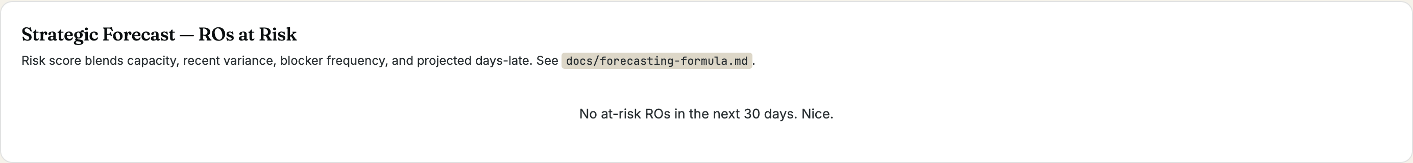
INSIGHTS WITHOUT A BI TEAM
The reports the supervisor would have asked for in three months — already there on day one.
Variance Root Cause
Customer Concentration
Strategic Forecast
Drilling jig broken accounts for
38h of overrun this quarter.
Shown automatically.
Top 3 customers = 67% of hours.
DFE alone = 42%.
Pareto and 8-quarter trend.
Job Card 0007 = HIGH risk.
Paint overcommitted W21.
18% avg overrun on TP42N.
NEE FORGE · Production Software for the Workshop
06 / 11

Slide 7
EXCEL vs NEE FORGE
Excel is free until you count the reconciliation hours.
WORKSHOP SCENARIO | EXCEL TODAY | NEE FORGE
"Where's Job Card 0007 right now?" | 5 phone calls + walk to floor | 2-second search; current station + assigned tech visible
"How many hours of overrun on TP42N last quarter?" | Pivot table + manual reconciliation, ~30 min — if the data is even there | One click on the Variance Root Cause report
"Who clocked in on Job 0042 last Tuesday?" | Not tracked | Time entries audit log per task
"How many Job Cards from DFE last quarter? Year-on-year?" | Master sheet running total — if anyone remembered to update it | Customer Concentration tab with 8-quarter trend
"Tech reports drilling jig broken at 14:30" | End-of-day note in WhatsApp | Real-time blocker on the kanban; supervisor unblocks with notes
NEE FORGE · Production Software for the Workshop
07 / 11

Slide 8
EPICOR KINETIC vs NEE FORGE
Kinetic is a kit. NEE Forge is the finished cabinet.
CAPABILITY | EPICOR KINETIC | NEE FORGE
Kanban board | Generic ERP kanban — stations and lanes configured by external implementer | Body-type tracks (BODY · CHASSIS · SUBFRAME) and Hospital lane built in. No config.
Tech clock-in | Full MES — multi-shift, indirect labour, badge readers | One tap on a phone. No badge reader, no shift configuration.
Variance tracking | Cost-variance categories with multi-level approval workflow | 13 reason codes attached at task complete. Root-cause aggregate same day.
QC | Multi-step inspection plans + sample sizes, NCR workflow | 6-item checklist that triggers a customer- facing email automatically.
Drafter handoff | Engineering Change Order subsystem (custom configuration) | Dedicated drafter persona — Layout / BOM / Drawing pack uploads.
Implementation effort | 6 – 18 months. Off-shore implementation. | Days. Shipped as a finished product.
Modules you'll never use | Multi-site · Multi-currency · MRP · EDI · HR · Payroll · Field Service | None — system is exactly the size of the problem.
Both systems can do most things. Only one is built for this workshop.
NEE FORGE · Production Software for the Workshop
08 / 11

Slide 9
IMPLEMENTATION TIMELINE
Three options. Three timelines. Same calendar.
Today
M3
M6
M9
M12
M15
M18
Excel today
Indefinite ongoing reconciliation cost.
Epicor Kinetic
Industry-standard implementation timeline.
NEE Forge
5-day UAT · 30-day evaluation · live in 2 months.
Pick a UAT start date this week, and Forge is on a public URL by Friday.
NEE FORGE · Production Software for the Workshop
09 / 11

Slide 10
THE NUMBERS THAT CLOSE THE ROOM
5
30
days to a public UAT URL
with your supervisor + 2 techs
seconds — median tech touchpoint
(clock-in / out / complete / blocker)
24
0
hours / month of supervisor's
time saved versus reconciling
three Excel sheets
per-user licence fees.
Predictable monthly hosting.
Single line on the invoice.
Every number above is verifiable. Ask for the evidence appendix.

Slide 11
DECISION
Two outcomes — your call.
DO NOTHING
ADOPT NEE FORGE
— Spreadsheets remain the master sheet
→ UAT live in 5 days on a public URL
— Variance reasons remain anecdotal
→ Every overrun has a reason code by month two
— Phone calls remain the supervisor's day-job
→ Job Card location answered in 2 seconds
— Kinetic remains an 18-month maybe
→ Decision in 30 days — roll-out or walk away
— Cost is invisible but real
→ Cost is line-item visible and capped
Pick a UAT start date this week.
NEE FORGE · Production Software for the Workshop
11 / 11

