Slide 1

Slide 1
Sales Overview
Presented By : Sharodindu Biswas

Slide 2
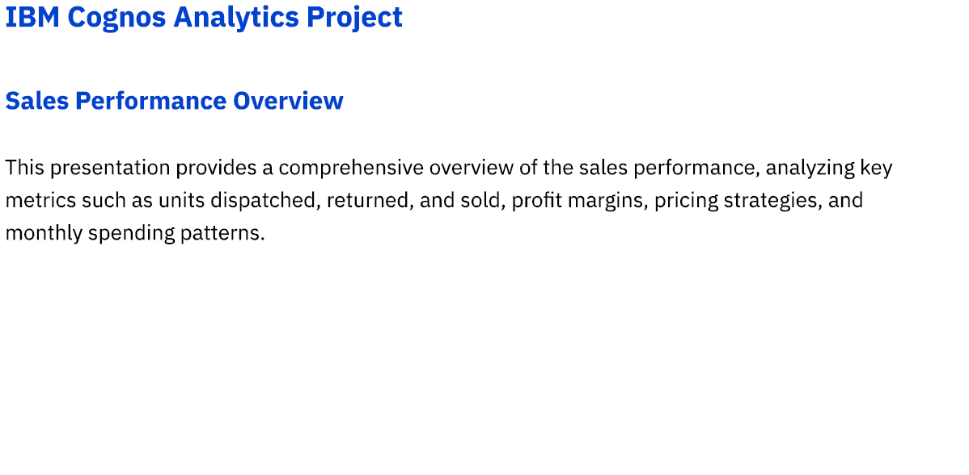
Slide 1

Slide 3
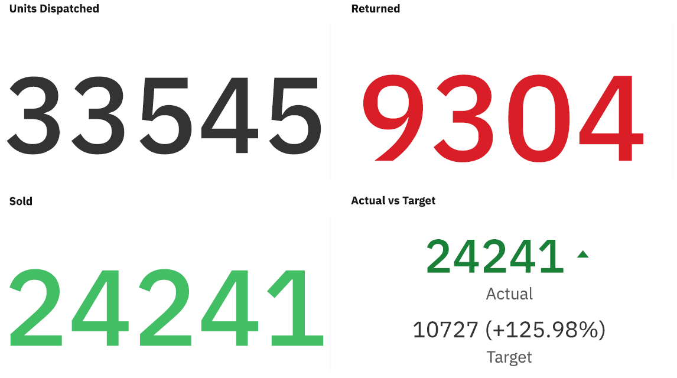
Slide 1
Actual sales is 126% higher than expected

Slide 4
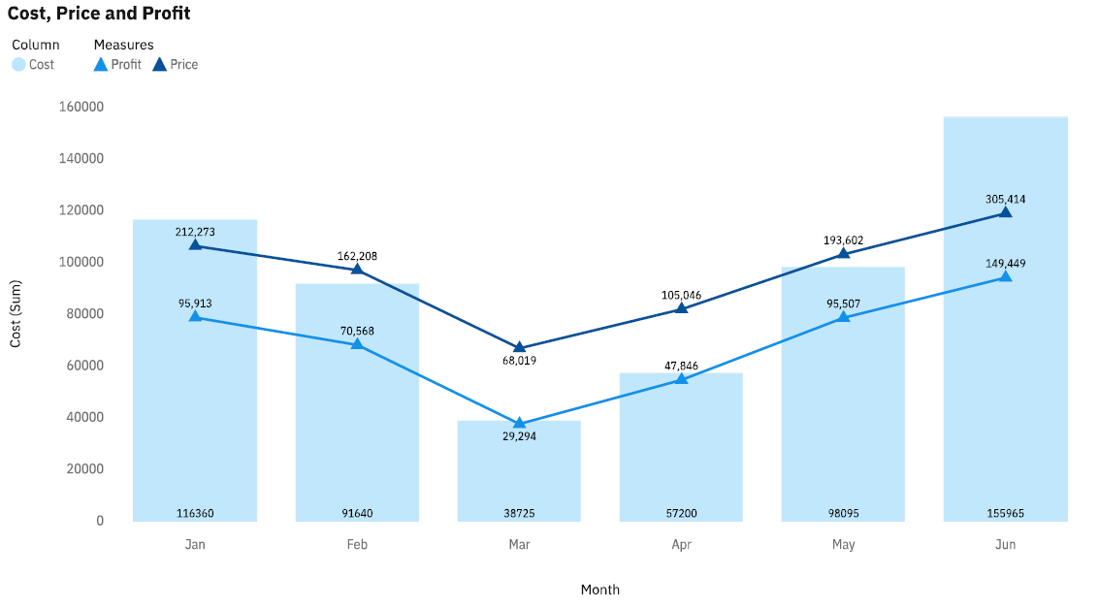
Slide 1
June has comparatively higher profits than other months.

Slide 5
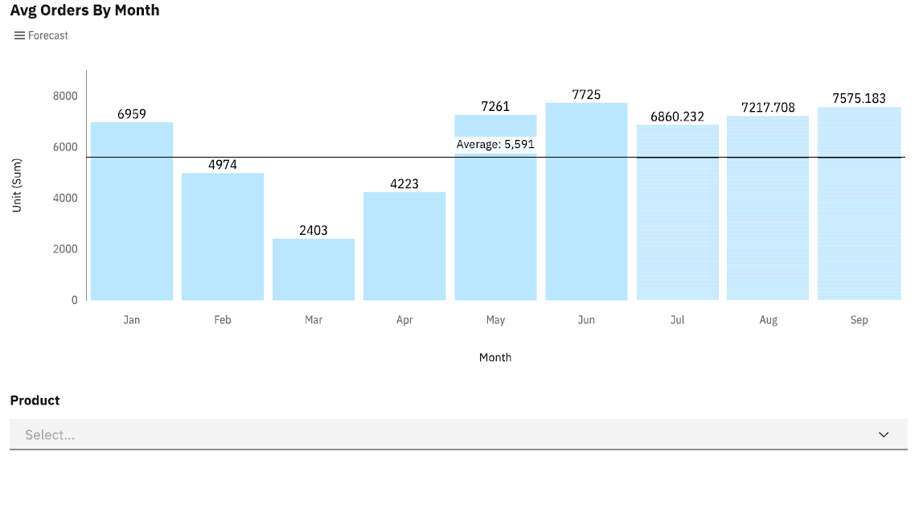
Slide 1
Average order is 5591, June month has highest orders.

Slide 6
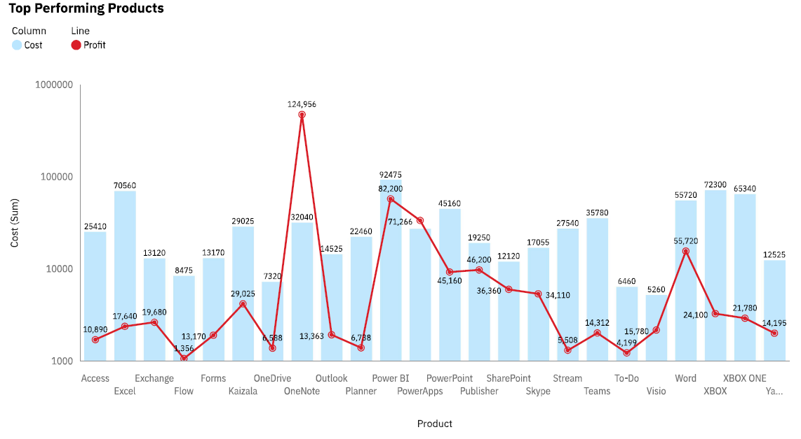
Slide 1
One note is one of the top performing products by profits and sales.

Slide 7
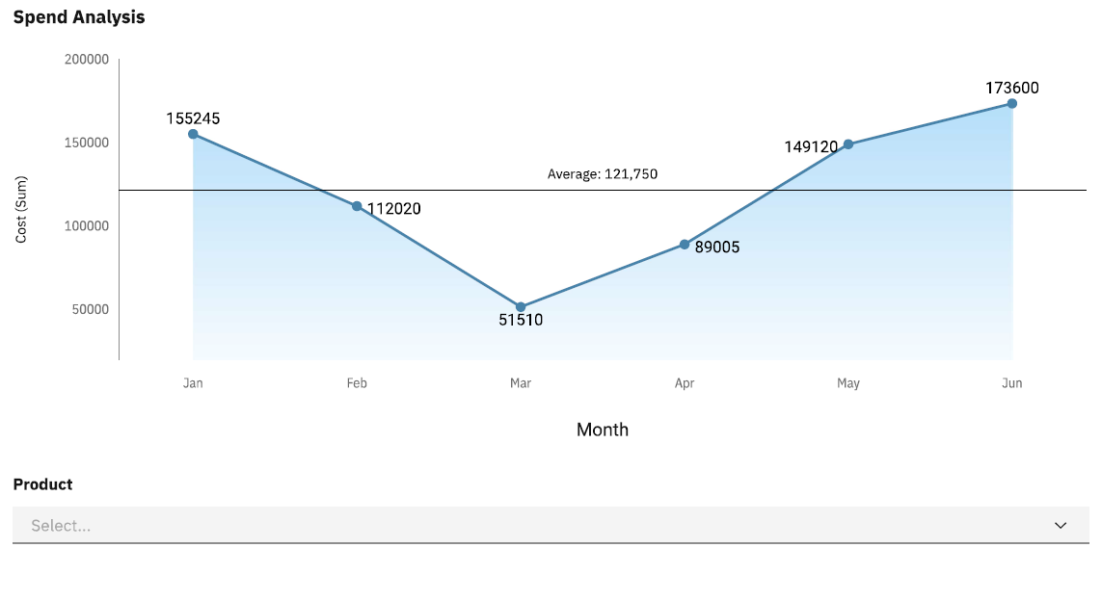
Slide 1
Average spending by month 121,750

Slide 8
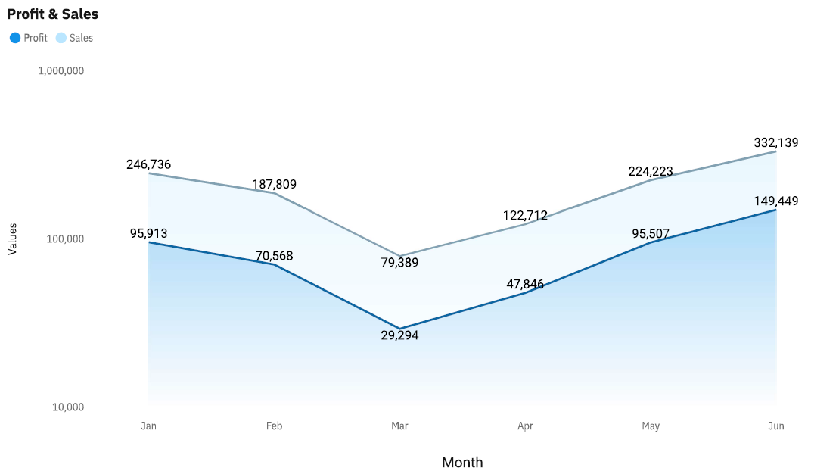
Slide 1
Profit and sales have positive relation, increases with the increase in price.

Slide 9
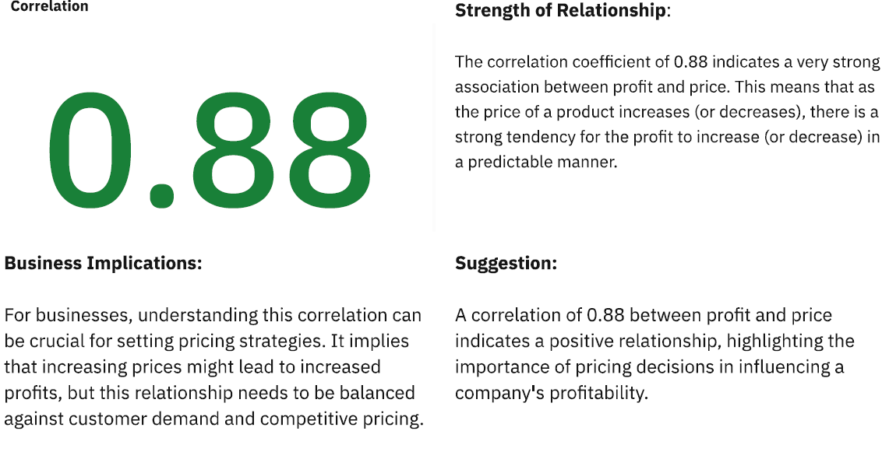
Slide 1

Slide 10
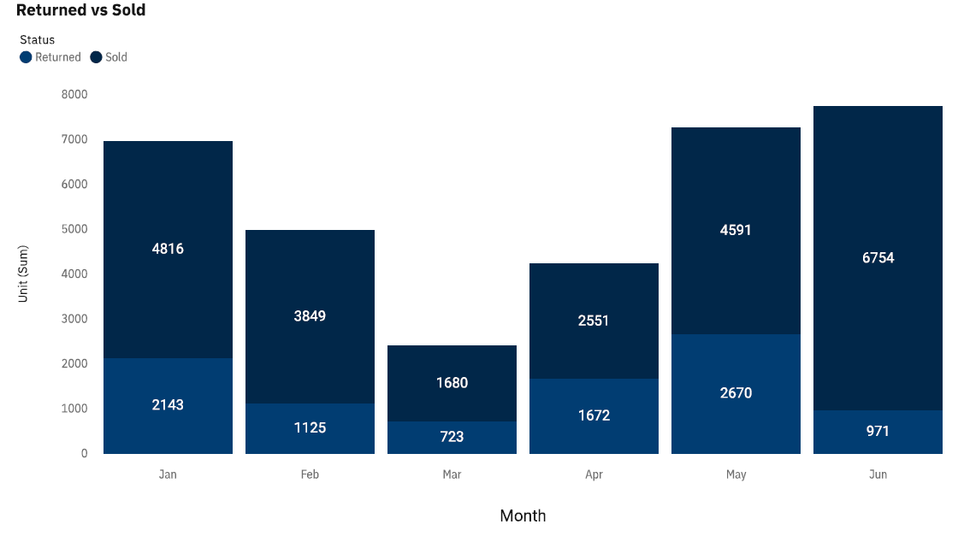
Slide 1
The order status analysis shows that the unit sold in the first two quarter is higher than units returned.
Less units returned in the month of Mar.

Slide 11
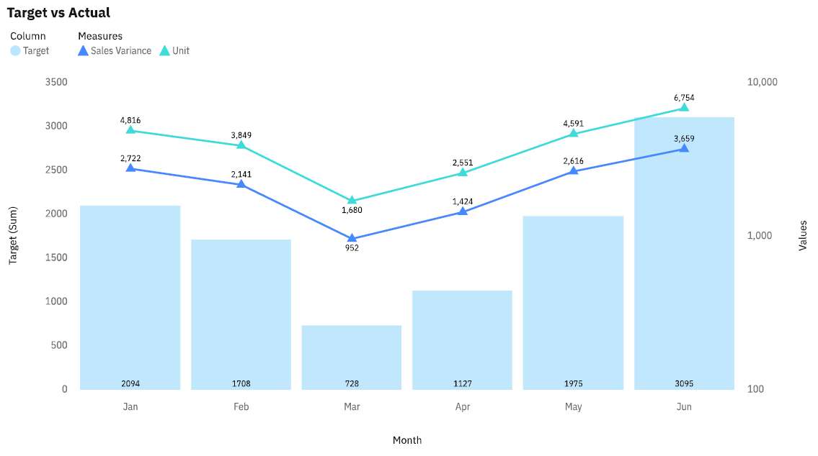
Slide 1
The blue line shows the variance between Actual units sold vs the expected digits.

Slide 12
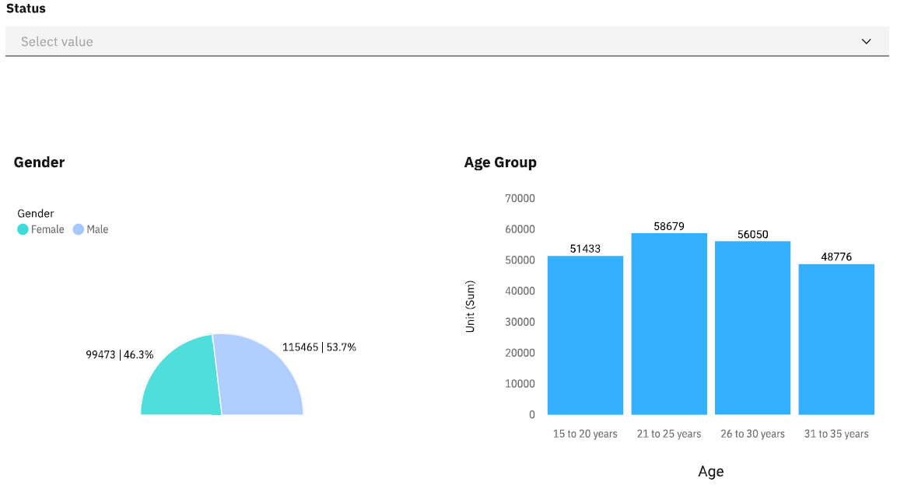
Slide 1

Slide 13
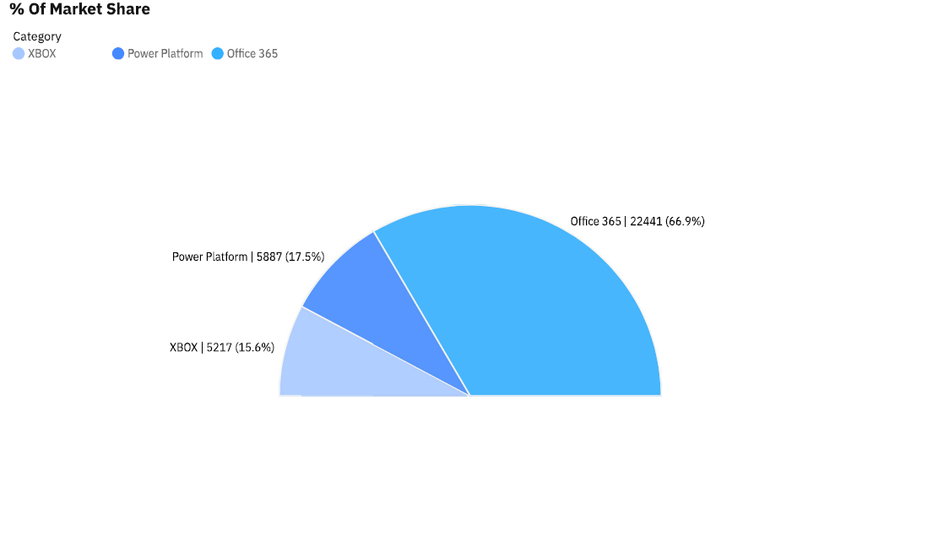
Slide 1

Slide 14

Slide 1

Slide 15
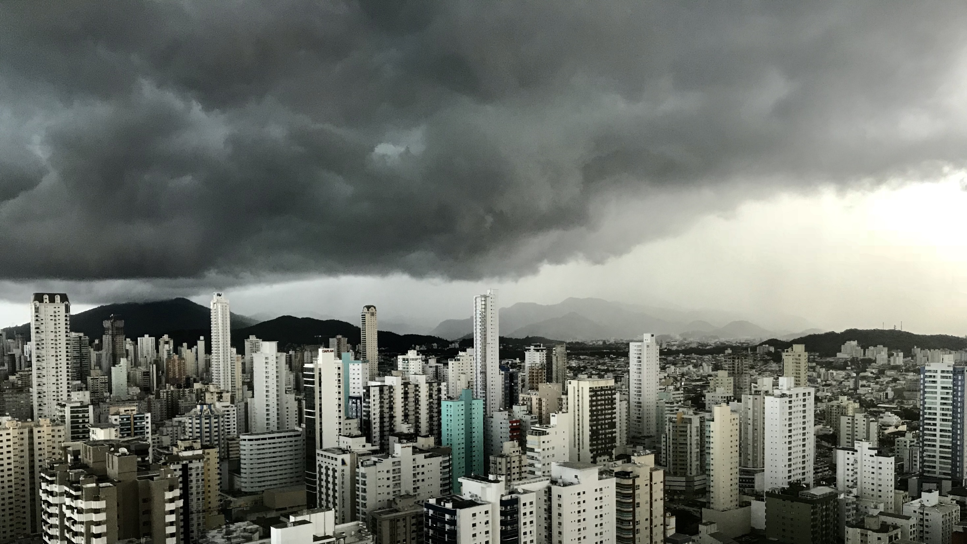
Slide 11
THANK YOU

