Slide 1

Group Project
ALY6070 - Communication and Visualization for Data Analytics
Instructor: Yoni Dvorkis
Date: February 18, 2022
By Group 3:
Tanisha Srivastava
Sharon Appoline Rosary
Vishaka Mohan Mohana
Manisha Kaila
Naveenkumar Govindasamy

Slide 2


Overview
Adolescents are between the ages of 10 and 19 as defined by the United Nations: Around 1.2 billion people in the world come into this category, accounting for 16% of the global population.
Adolescent well-being encompasses many dimensions and UNICEF monitors several indicators.
The dataset is sourced from data.unicef.org, UNICEF (United Nations Children’s Funds) it works as a non-governmental organization (NGOs) it advances and protects child’s rights and to provide health care, immunization, nutrition, access to safe water and sanitation services, education, protection, and emergency relief.
The dataset provides information about factors affecting adolescent’s life across the worldwide. From the dataset we have chosen Demographics, Health and Education. The data taken consist of approximately 3600 records.

Slide 3

Business Questions
Demographics:
1. Finding the top 10 adolescent-populated countries in the world?
2. Finding which region is more populated(overall) in proportion to the adolescent population?
Health:
1. What effect immunization percentage is having on the mortality rate and reduction rate?
2. What risk factors are affecting the adolescent population the most and how is the number of deaths?
Education:
1. Finding out the trend of completion rate vs out of school rate of top 10 countries. What is the completion rate between boys and girls?
2. How does wealth affect adolescent education completion rate?

Slide 4
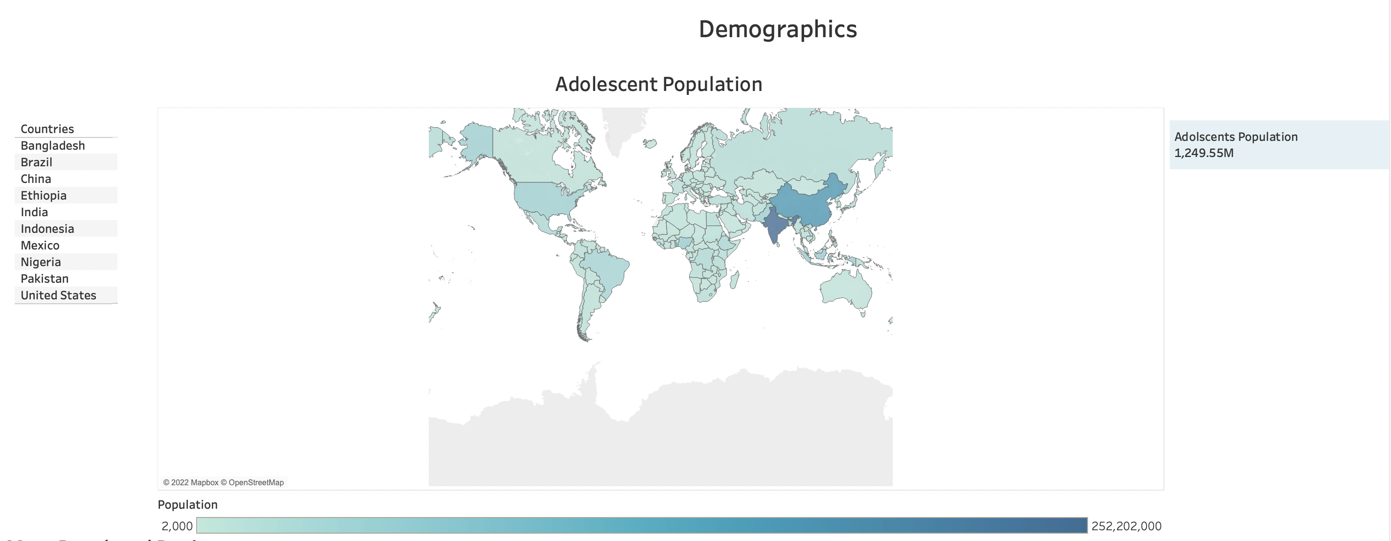
Demographics
From the demographics data, we can infer the actual population of the adolescents with respect to the total population.
From the map above, it shows the overall population of adolescents around the world is 12,49,545,000 (1.2 billion).
We have taken the 10 most adolescent populated countries like Bangladesh, Brazil, China, Ethiopia, India, Indonesia, Mexico, Nigeria, Pakistan, and the United States of America.

Slide 5
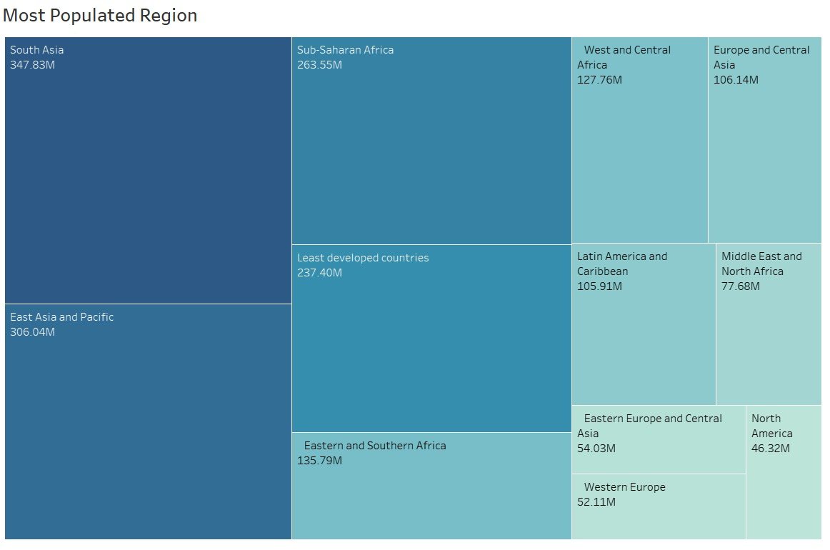
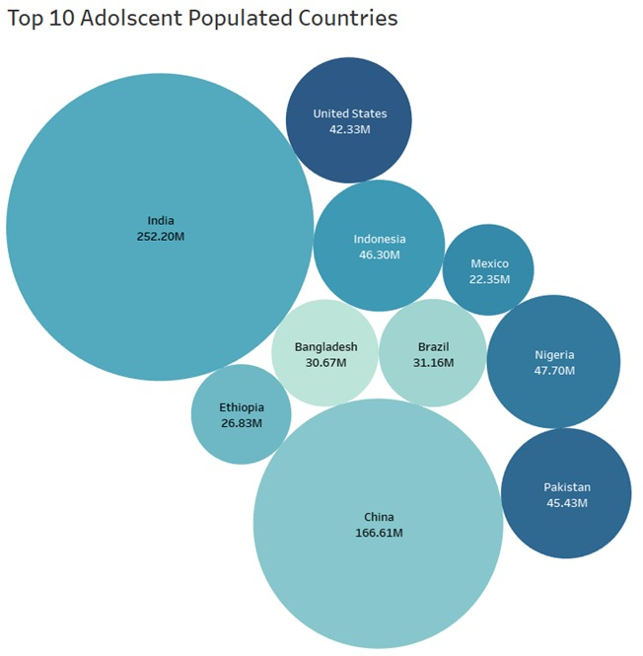
Demographics
The tree maps show the regions with their populations, and we can see that South Asia is the most populated region amongst the rest with 347.83M followed by East Asia and Pacific and Sub-Saharan Africa at 306.83M and 263.55M.
The bubble chart shows the top 10 adolescent-populated countries with India being the highest with 252M adolescent population and the second being China which has 65% of India’s adolescent population.
Bangladesh and Brazil have an almost similar proportion of adolescents (31 million approx.).

Slide 6
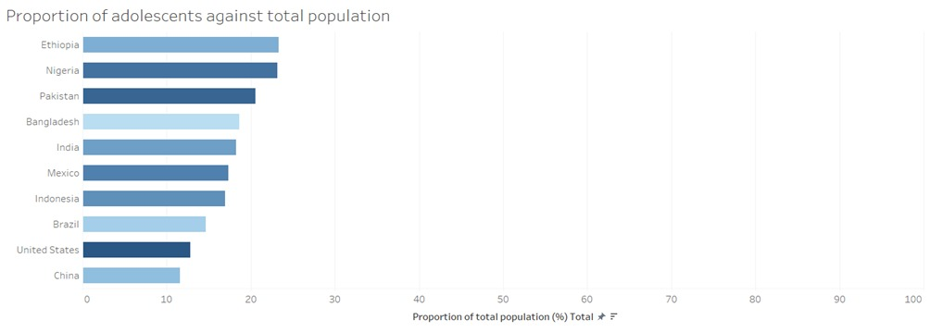
Demographics
The proportion graph indicates the percentage of the adolescent population in relation to the total population. Ethiopia and Nigeria have the highest adolescent populations at 23%.

Slide 7
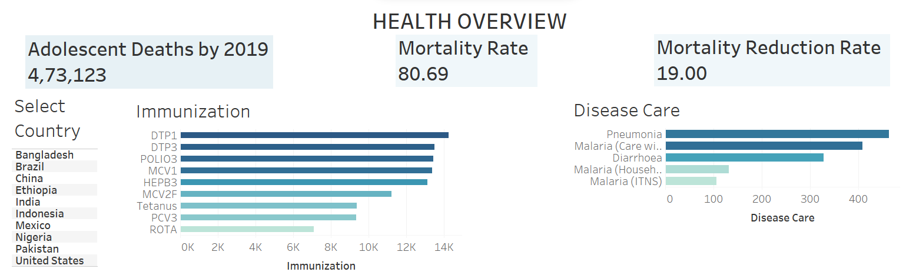
Health
Immunization and Disease care is a crucial aspect for the healthcare of Adolescent.
More than 90% of the population in China has been immunized, and the mortality rate for the country is also the least.
However, this is not the case with Bangladesh, 90% of the adolescents have been immunized but the mortality rate is still at 9.73%.
Hence, we can say that immunization is important for an adolescent’s health, but immunization is not the only factor affecting the mortality rate and mortality reduction rate. Risk factors are also contributing towards the mortality rate too.

Slide 8
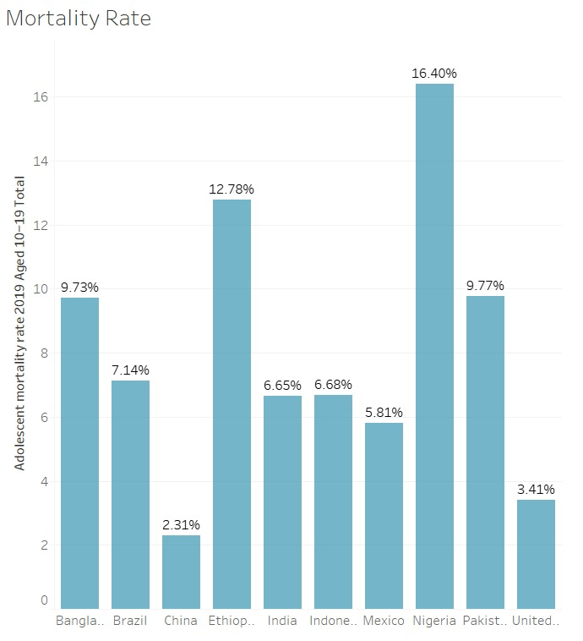
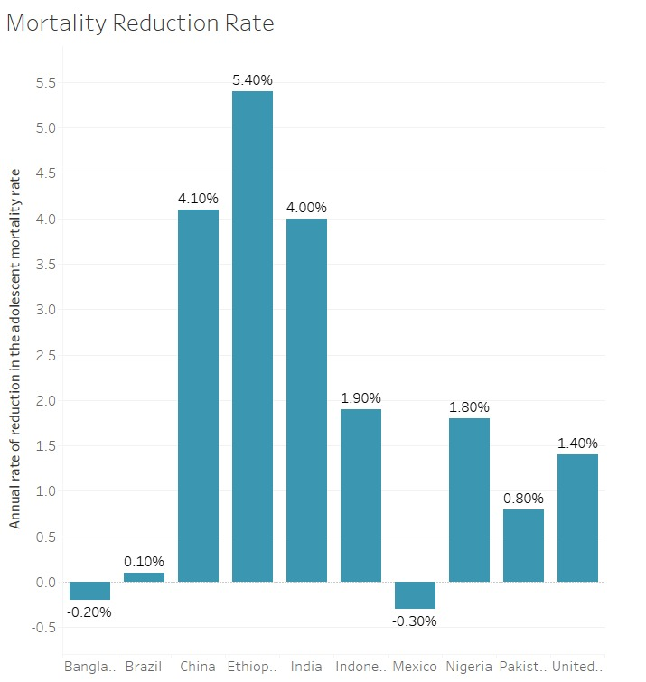
Health
Nigeria has the highest mortality rate followed by Ethiopia and Pakistan.
We can notice Ethiopia has the 2nd highest mortality rate but the reduction rate for Ethiopia is the highest, which is good sign since the country is trying to reduce the mortality rate.
We can notice that India and Indonesia have the same mortality rate despite a difference in immunizations numbers.
There can be 2 reasons for the mortality rate to be the same:
The population of India is twice the population of Indonesia, number of deaths in India is approximately 2.5lakhs while in Indonesia it’s only 40k.
The mortality reduction rate for India is higher than Indonesia’s mortality reduction rate despite the population.
Due to these reasons the mortality rate for both the countries might be same.
Countries like Bangladesh and Mexico has reduction rate in Negative, which is not good, these countries need to work on there healthcare system in order to reduce the mortality rate and increase the life expectancy for the adolescent population.

Slide 9
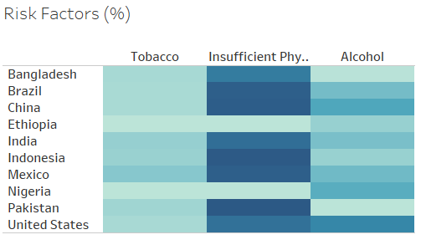
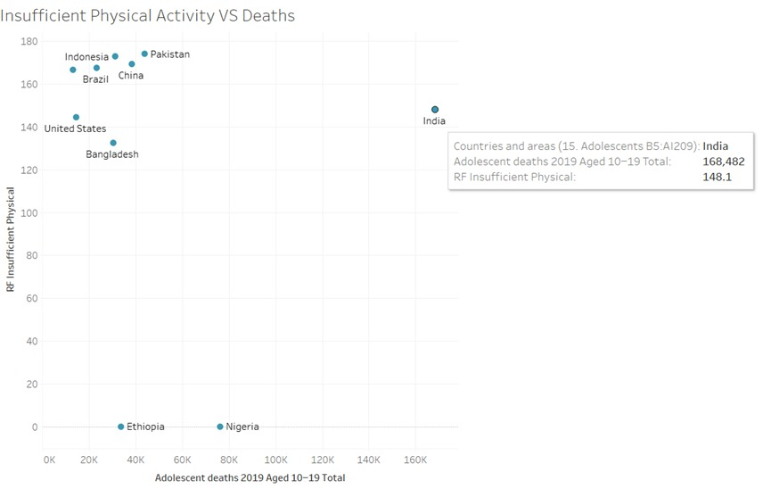
Health
Insufficient physical activity, alcohol use, and tobacco usage are among the main factors endangering adolescent’s lives.
Pakistan has the maximum impact due to insufficient physical activities(87%).
On an overall perspective, the usage of tobacco hasn’t affected the adolescents that much when compared to alcohol usage and insufficient physical activities.
The scatter plot shows the relationship between adolescent deaths and insufficient physical activity risk factor.
India has the highest number of deaths(168k approx.) due to insufficient physical activities.

Slide 10
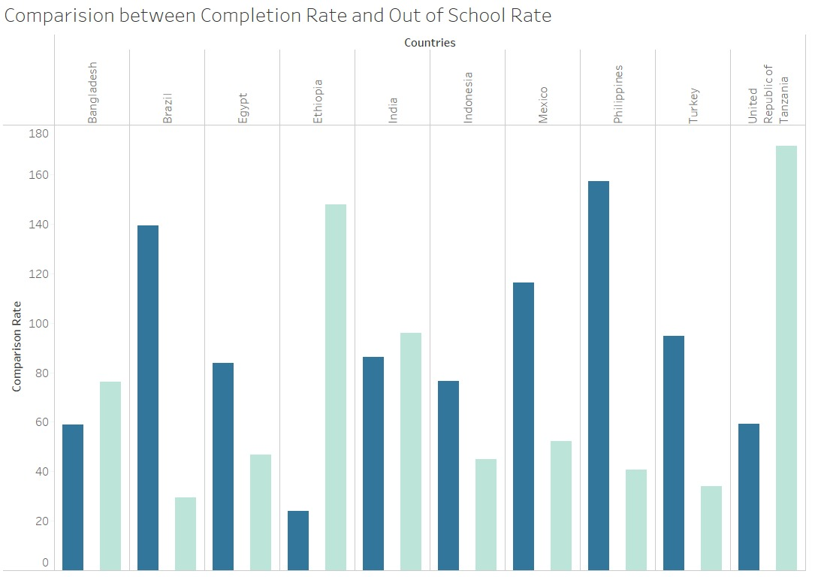
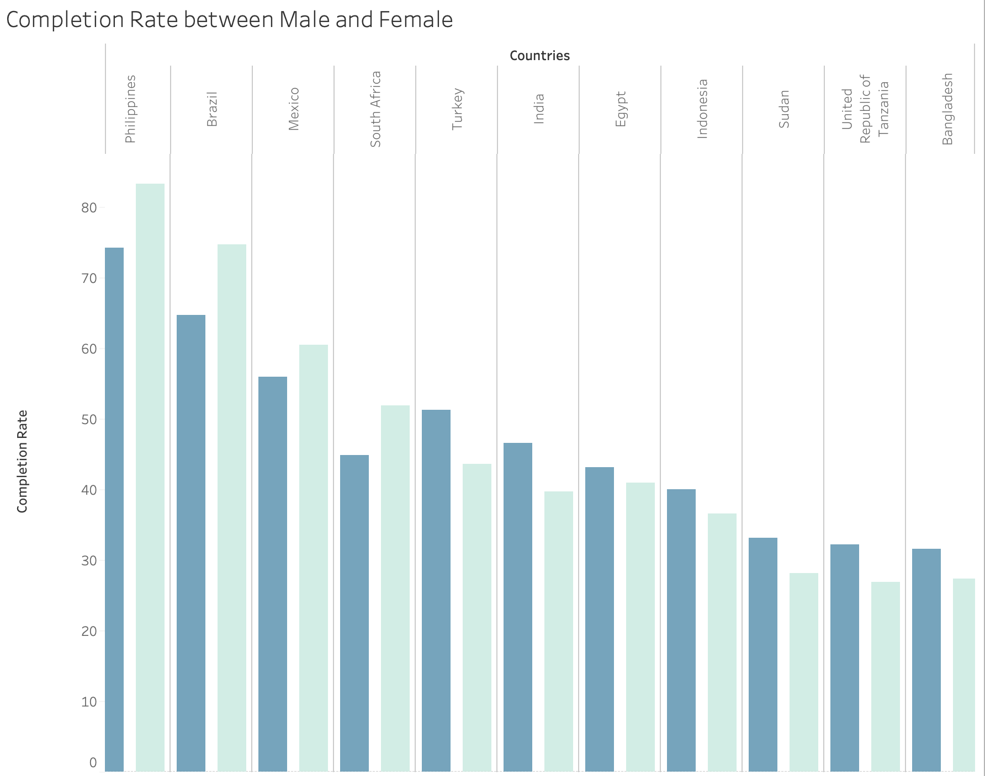
Education
From the graph completion rate of Male and female in different countries we notice the Philippines country have the completion rate higher than any other country with 83.26 percent of female and 74.14 percent of male. Myanmar and Ethiopia have the least educational rate with respect to gender. These two countries need educational support from their government.
From the second graph, we can see that the country Philippines has the highest education rate with a 160k educational percentage rate. And country Brazil and turkey have the least dropped out school rate. In the second graph, we can see the scatterplots of completion rate vs dropped out of school rate and how wealth affects the education completion rate.

Slide 11
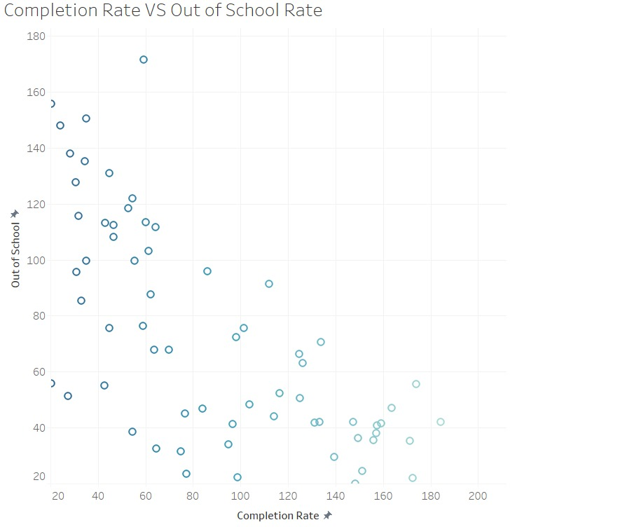
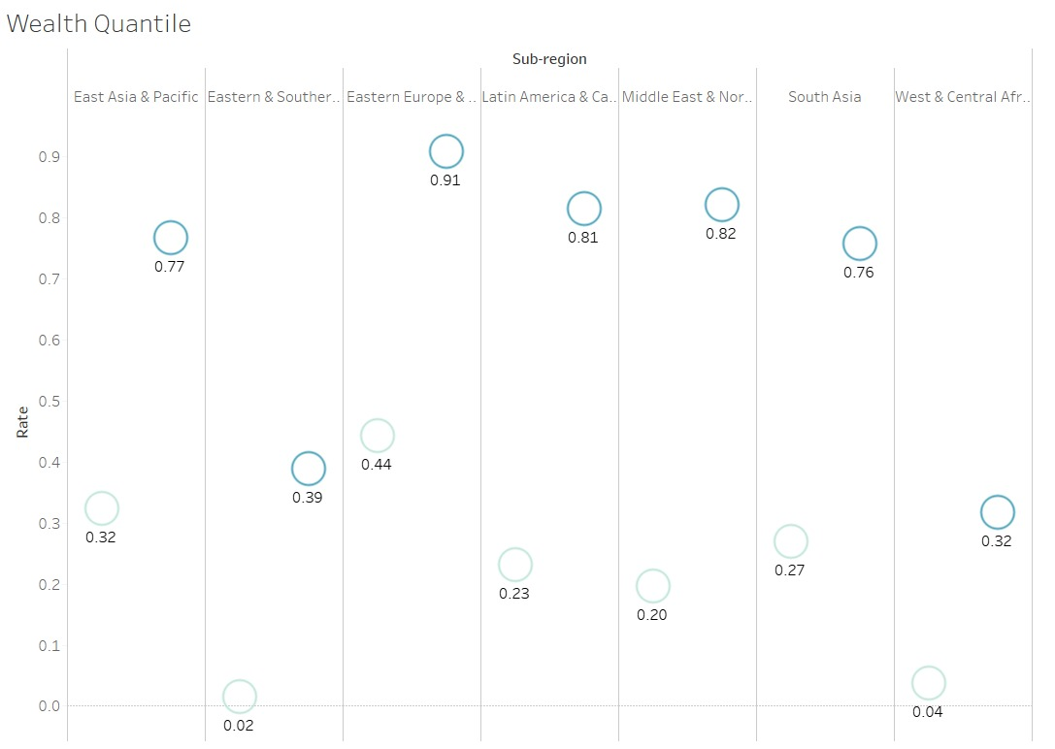
Education
From the first we can infer that United Republic of Tanzania has highest out of school rate compared to completion rate. And we notice that very few countries have adolescents who have successfully completed their education.
In second graph we notice that reason for high out of school is because of wealth. From the graph we can infer that completion rate is high if the adolescent is from rich family. Most of the poor adolescents drop out of school due to poverty and many other challenges faced in the family.

Slide 12
Conclusion
We get the answers to the following queries from the dashboard:
1. Using the demographics dashboard, we discovered the top 10 countries with an adolescent population, with India having the highest as well as South Asia having the greatest population overall (347.83M).
2. While immunization is vital for an adolescent's health, it is not the sole factor that influences mortality and mortality reduction rates. The mortality rate is also influenced by risk factors.
3. We can infer the completion rate of Male and Female in different countries from the graph education completion, where we can see that the Philippines has the highest completion rate of any country, with 83.26 percent of females and 74.14 percent of males, followed by Brazil, which has the second-highest education rate, with 74.40 percent of females and 64.70 percent of males.
4. Girls had a greater education rate than men till Turkey and after India.
5. We can state that poverty influences adolescents in dropping out of school due to which they will lack knowledge in taking care of themselves which results in mortality. Hence, Adolescents should get free education which results in gaining knowledge about health and impacts if neglected.

Slide 13
References
Interactive data visualizations archives - page 2 of 4. UNICEF DATA. (n.d.). Retrieved February 19, 2022, from https://data.unicef.org/resources/resource-type/interactive-data-visualizations/page/2/
Levels and trends in child mortality. UNICEF DATA. (2022, January 26). Retrieved February 19, 2022, from https://data.unicef.org/resources/levels-and-trends-in-child-mortality/
Adolescents statistics. UNICEF DATA. (2021, November 30). Retrieved February 19, 2022, from https://data.unicef.org/topic/adolescents/overview/

Slide 14


