Slide 1

ALY 6010 - Probability Theory and Introductory Statistics
Final Project
By,
Tanisha Srivastava
Sharon Appoline Rosary
Vishaka Mohan Mohana
Instructor: Amin Karimpour
Date: December 13, 2021

Slide 2

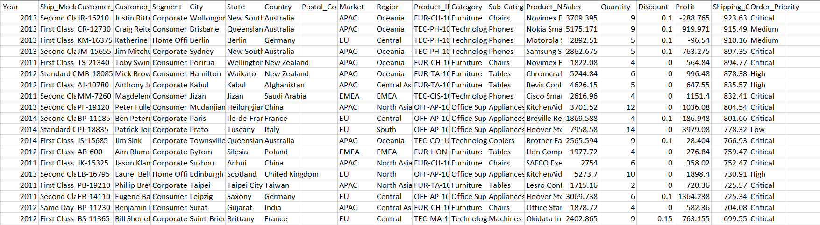
Data Collection:
Source:
Description :
Contains Sales data of retail firm
24,031 instances and 25 variables
Numerical variables like sales, profits, shipping cost, quantity, etc. and Categorical variables like Market, Region, Category, Sub-Category, etc.

Slide 3
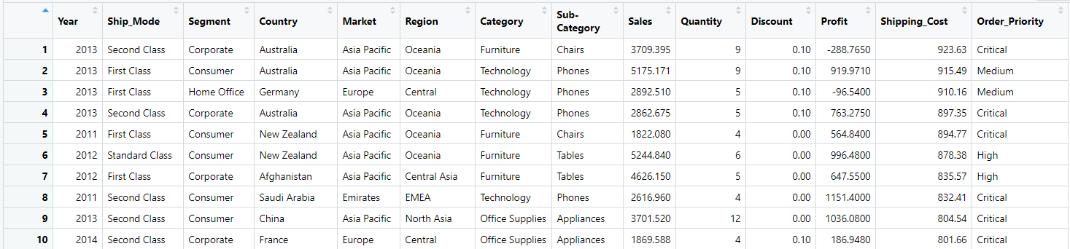
Data Cleaning:
Removed unwanted columns such as Row_ID, order_ID, Order_Date, Ship_Date, Customer_ID, Customer Name, City, State, Postal code, product_ID and Product Name.
Removed null values, rows and columns.
Removed duplicate values.
Removed Outliers.
Altered necessary records to gain a better understanding of the data. Updated “EU” to “Europe”, “APAC” to “Asia Pacific” and “EMEA” to “Emirates”

Slide 4
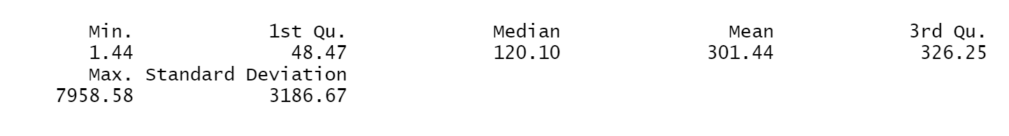
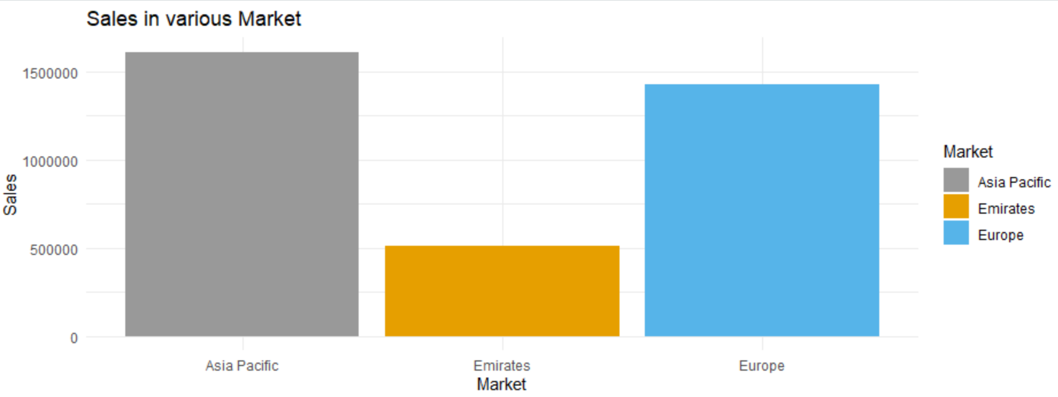
Initial Analysis:
Got Insight on sales, profit and discount as part of initial analysis.
Descriptive statistics calculation for Sales
Asia Pacific has highest sale compared to Emirates and Europe which is 84% higher than other two marketplaces. Next comes Europe.

Slide 5
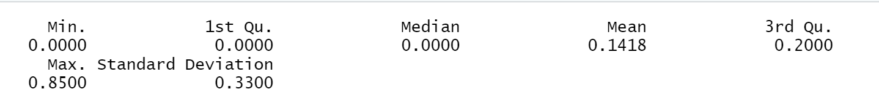
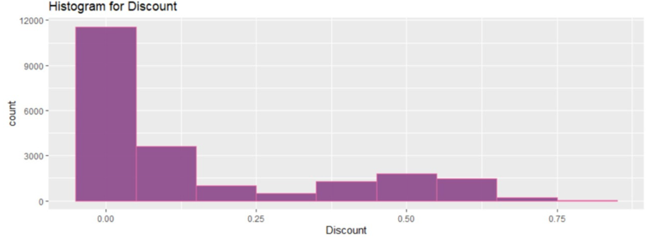
Descriptive statistics calculation for Discount
There were no discounts(i.e., 0.0%) for 54% of products in the given dataset.

Slide 6
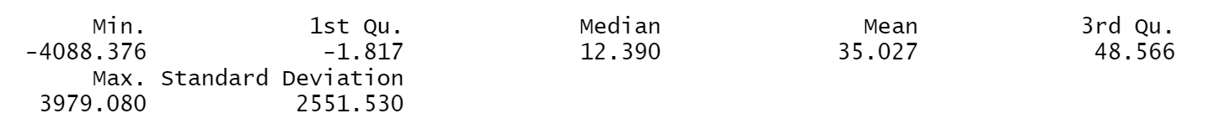
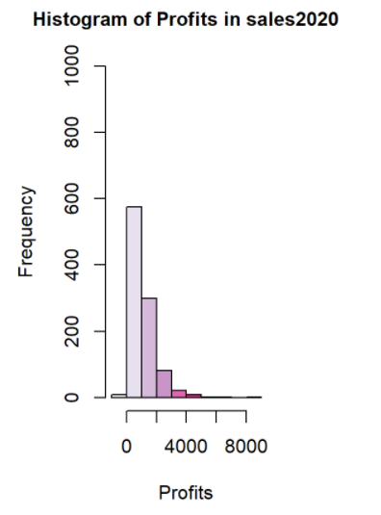
Descriptive statistics calculation for Profit
The majority of profit lie between 0 to 2000 approximately.
Also, we can observe that there are negative values in the histogram indicating negative profits.
We can focus on those products which attain negative profits for improving sales of the business.

Slide 7
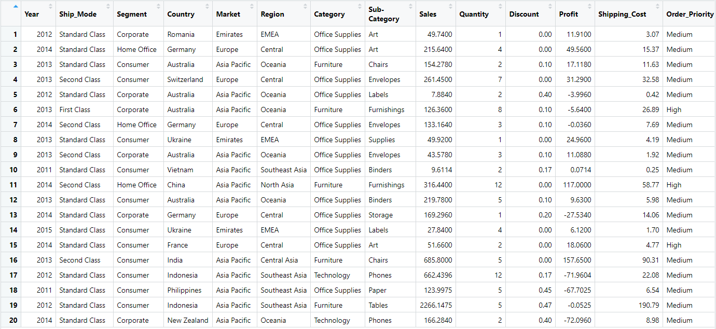
Initial Analysis:
Inferential statistics
Produced a random sample from dataset.
- A random sample with size N=20 rows using sample() function.

Slide 8
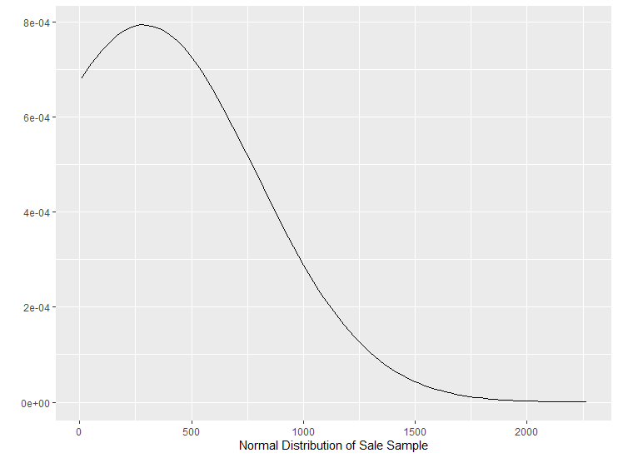
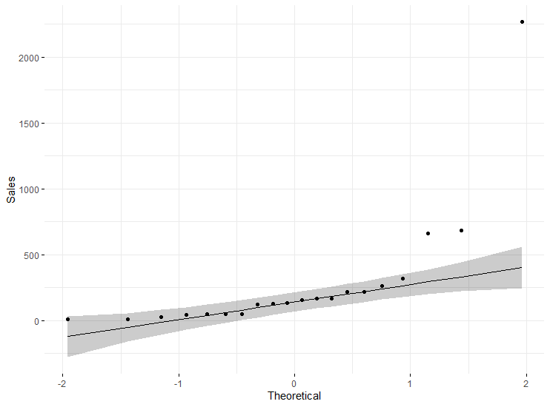
Normality check on sales, profit and shipping cost distribution
- A plot of the inverse of the standard normal cumulative versus the sales observations.
We can notice that bell shaped distribution constituting normal distribution.
The underlying distribution of the data is normal, the points fall along the regression line(y=x) constituting normally distribution
Similarly, the normality test is done for profit and shipping costs.

Slide 9
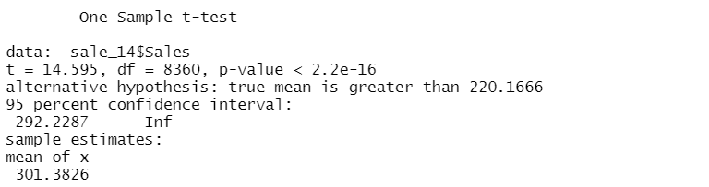
Hypothesis Testing
The company claims that the average sale in 2014 has improved as compared the average sale is 2013. Is it true?
- To check average sale during 2014 is greater than average sale during 2013 with 95% confidence level and 5% alpha.
The null and alternative hypothesis can be given as,
Null Hypothesis - H0: µ1 ≤ µ2
Alternate Hypothesis - H1: µ1 > µ2
where µ1 and µ2 are mean sales recorded during 2014 and 2013.
The statistically significant p-value 2.2^{-16} is less than 0.05 (2.2^{-16} ≤ 0.05). As a result, the null hypothesis is rejected, and the alternative hypothesis is accepted.
At 95% confidence level, mean of sales during 2014 is significantly greater than mean of sales during 2013 with a p-value 2.2^{-16}.

Slide 10
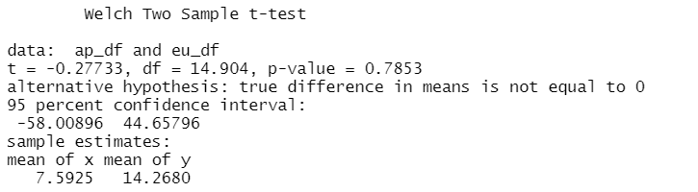
2. Is the average profit same for markets with maximum sales?
- To compare mean profits for Asia pacific and Europe markets with 95% confidence interval and 5% alpha.
The null and alternative hypothesis can be given as,
Null Hypothesis: H0: µ1=µ2
Alternate Hypothesis: H1: µ1 ≠µ2
where µ1 and µ2 denotes mean profit of Asia Pacific and Europe.
It does not provide enough evidence to reject the null hypothesis since statistically significant p-value 0.7853 is greater than 0.05 (0.7853>= 0.05). As a result, we fail to reject the null hypothesis.
At 95% confidence level, we can support the assumption that both Asia Pacific and Europe have same mean profit.

Slide 11
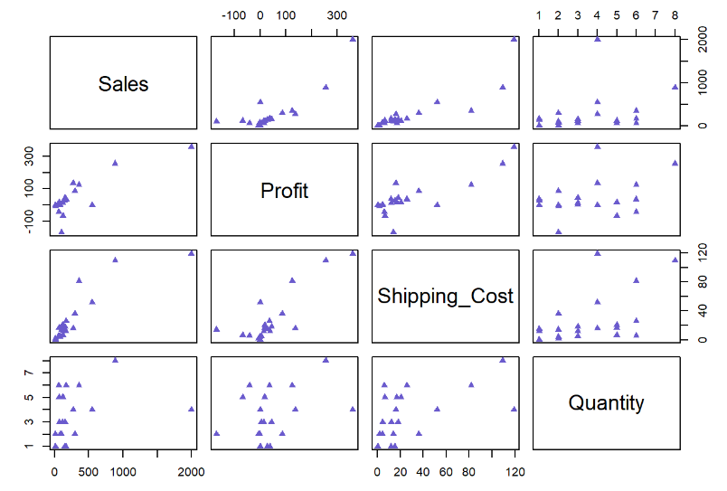
Regression Testing
- Correlation Plot to compare the relationship between numerical variables.
Profit and sales have a strong positive relationship since the data show an uphill pattern from left to right. i.e., As the profit increases, the sales also increase.
There is no correlation between Quantity and sales since there is no specific pattern.

Slide 12
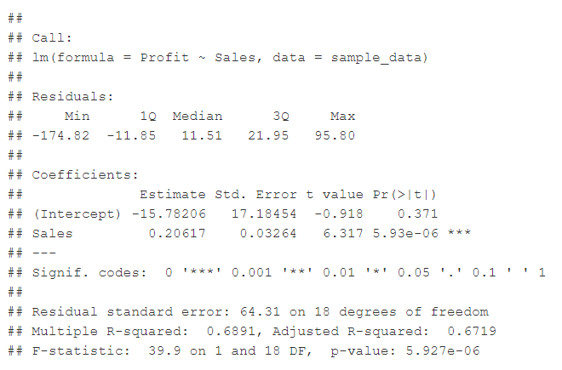
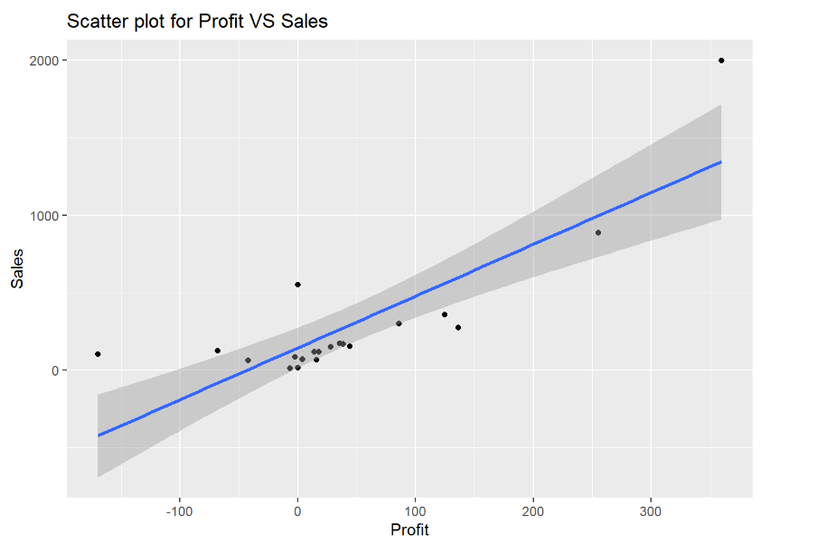
1. Does sales influence profit?
The hypothesis can be given as:
Null Hypothesis: H0: β1=β2
Alternate Hypothesis: H1: βj ≠0 for at least one j≠0
The model equation will be profit=0.20617*sales-15.78206.
For every 1000 sales, there will be an increase in profit by 0.20617.
The regression coefficient is 0.20617, which is positive and indicates a positive relationship.
The p-value is 5.93e-06 <<< significance level hence, we have enough evidence to reject the null hypothesis proving that Profit has significant influence on Sales.

Slide 13
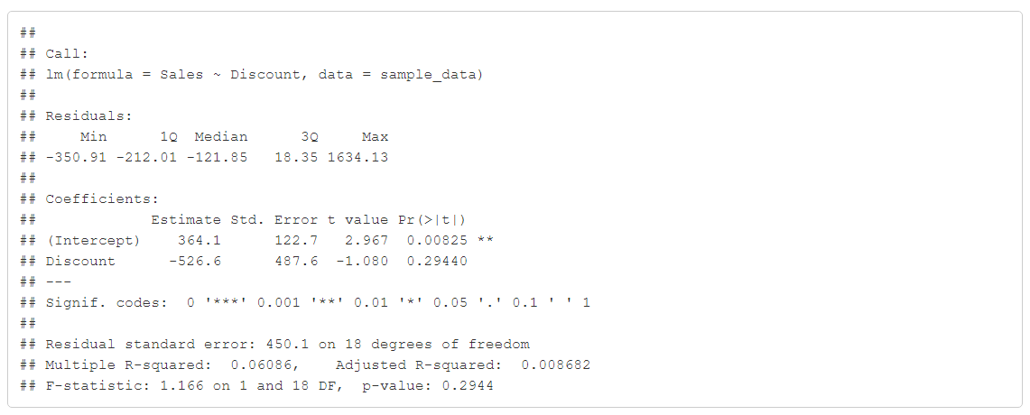
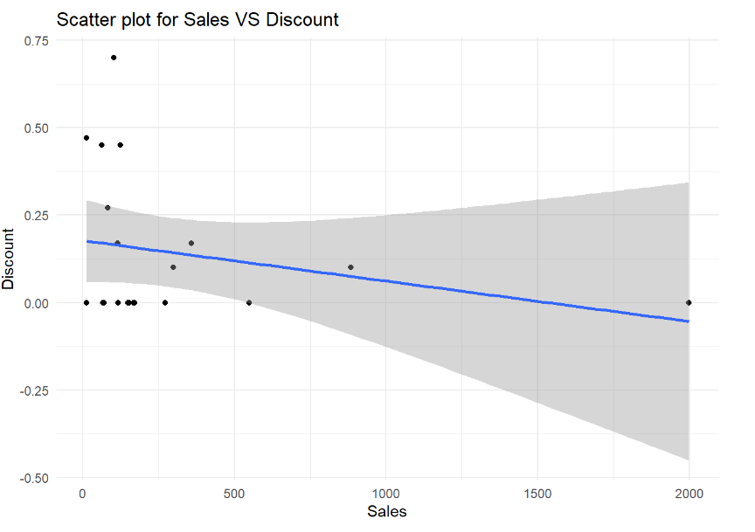
2. Does discount have an influence on sales?
The hypothesis can be given as:
Null Hypothesis: H0: β1=β2
Alternate Hypothesis: H1: βj ≠0 for at least one j≠0
p-value is 0.29>>significance level, hence there is not enough evidence to reject the null hypothesis. This indicates that there is no relationship between discount and sales.
Discount has no relationship with sales, we can conclude this by looking at the scatterplot which shows no pattern among the variables

Slide 14
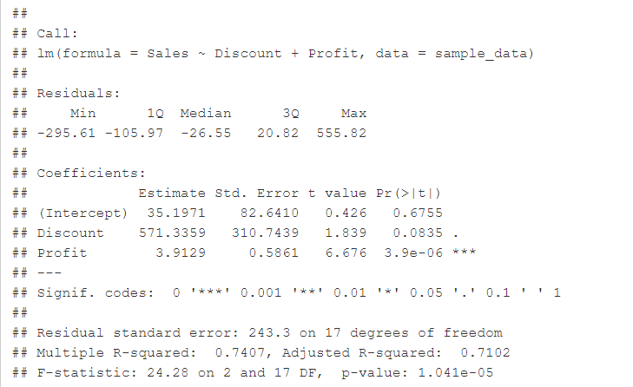
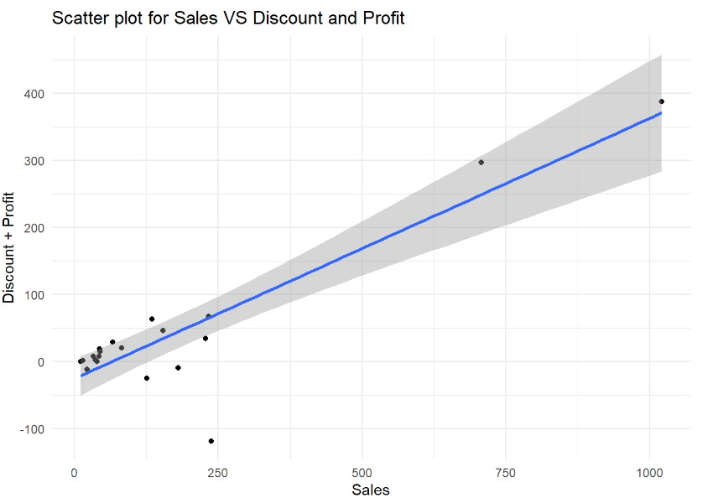
3. Do profit and discount have an influence on sales?
The hypothesis can be given as:
Null Hypothesis: H0: β1=β2
Alternate Hypothesis: H1: βj ≠0 for at least one j≠0
The coefficients are positive which indicates a positive relationship between Sales and Profits+Discount.
The p-value is 1.0421e-05 << significance level and hence we have enough evidence to reject the null hypothesis. Thus, Discount and Profit together have significant influence on Sales.

Slide 15
Summary
The key takeaways from the analysis include:
We have strong evidence to support the claim that the average sales recorded in 2014 is greater than the average sales incurred in 2013 i.e., 20.16666 USD.
When compared markets with maximum sales for same average profit, we failed to reject the null hypothesis since there wasn’t sufficient evidence to support the alternative hypothesis, i.e., the average profit of Asia Pacific and Europe aren’t same. Thus, the data support the assumption that both Asia Pacific and Europe have same average profit.
Profit and Sales have a positive relationship as the data is showing an uphill pattern and thus, if there is an increase in sales profits will also increase. The p-value<significance level which also tells us that there is a positive relationship between profit and sales.
Profit and Discount together has a positive influence on Sales. The p-value<< significance level hence it concludes that these is a positive relationship among the variables. Even from the scatterplot we can conclude the same as the data has an uphill pattern.
Discount alone has no relationship with sales, we can conclude this by looking at the scatterplot which shows no pattern among the variables. Also, the p-value > significance level which indicates that there is no relationship between them.

Slide 16
Thank You

