Slide 1

Email id and password validation
Presented by
P.Sharon roja

Slide 2
Three A’s of Information Security
Security is about differentiating among authorized accesses and unauthorized accesses
  Confidentiality, Integrity, Availability all require this
Authentication
  Figures out who is accessing
Access control
  Ensure only authorized access are allowed
Auditing
  Record what is happening, to identify attacks later and recover
Notes:
Shutting down to allow no access may be secure, but is not useful

Slide 3
Authentication & Access Control
Authentication is the act of establishing or confirming something (or someone) as authentic, that is, that claims made by or about the subject are true. This might involve confirming the identity of a person, tracing the origins of an artifact, ensuring that a product is what its packaging and labeling claims to be, or assuring that a computer program is a trusted one.
Access control is a system which enables an authority to control access to areas and resources in a given physical facility or computer-based information system.
Notes:
Example of authentication?

Slide 4
User Authentication
Using a method to validate users who attempt to access a computer system or resources, to ensure they are authorized
Types of user authentication
  Something you know
    E.g., user account names and passwords
  Something you have
    Smart cards or other security tokens
  Something you are
    Biometrics

Slide 5
Variants of Passwords
Password
Passphrase
  a sequence of words or other text used for similar purpose as password
Passcode
Personal identification number (PIN)

Slide 6
Threats to Passwords
Eavesdropping (insecure channel between client and server)
Login spoofing (human errors), shoulder surfing, keyloggers
Offline dictionary attacks
Social engineering (human errors)
  e.g., pretexting: creating and using an invented scenario (the pretext) to persuade a target to release information or perform an action and is usually done over the telephone
Online guessing (weak passwords)

Slide 7
Guessing Attacks: Two Factors for Password Strength
The average number of guesses the attacker must make to find the correct password
  determined by how unpredictable the password is, including how long the password is, what set of symbols it is drawn from, and how it is created.
The ease with which an attacker can check the validity of a guessed password
  determined by how the password is stored, how the checking is done, and any limitation on trying passwords

Slide 8
Password Entropy
The entropy bits of a password, i.e., the information entropy of a password, measured in bits, is
  The base-2 logarithm of the number of guesses needed to find the password with certainty
  A password with, say, 42 bits of strength calculated in this way would be as strong as a string of 42 bits chosen randomly.
  Adding one bit of entropy to a password doubles the number of guesses required.
  On average, an attacker will have to try half the possible passwords before finding the correct one

Slide 9
Estimating Password Entropy
People are notoriously remiss at achieving sufficient entropy to produce satisfactory passwords.
NIST suggests the following scheme to estimate the entropy of human-generated passwords:
  the entropy of the first character is four bits;
  the entropy of the next seven characters are two bits per character;
  the ninth through the twentieth character has 1.5 bits of entropy per character;
  characters 21 and above have one bit of entropy per character.
This would imply that an eight-character human-selected password has about 18 bits of entropy.

Slide 10
Towards Better Measurement of Password Entropy
NIST suggestion fails to consider usage of different category of characters:
  Lower-case letters, digits, upper-case letters, special symbols
Orders also matter:
  “Password123!” should have different entropy from “ao3swPd!2s1r”
State of art is to use Markov chains to model probability of different strings as passwords
  May rank “yqzjx” as very secure
Fundamental challange: there are different attack strategies out there

Slide 11
Example of Weak Passwords
Default passwords (as supplied by the system vendor and meant to be changed at installation time): password, default, admin, guest, etc.
Dictionary words: chameleon, RedSox, sandbags, bunnyhop!, IntenseCrabtree, etc.
Words with numbers appended: password1, deer2000, john1234, etc.,
Words with simple obfuscation: p@ssw0rd, l33th4x0r, g0ldf1sh, etc.
Doubled words: crabcrab, stopstop, treetree, passpass, etc., can be easily tested automatically.

Slide 12
Example of Weak Passwords
Common sequences from a keyboard row: qwerty, 12345, asdfgh, fred, etc.
Numeric sequences based on well known numbers such as 911, 314159, or 27182, etc.,
Identifiers: jsmith123, 1/1/1970, 555–1234, "your username", etc.,
Anything personally related to an individual: license plate number, Social Security number, current or past telephone number, student ID, address, birthday, sports team, relative's or pet's names/nicknames/birthdays, etc.,
  can easily be tested automatically after a simple investigation of person's details.
Notes:
Top 20 Passwords In 32 million RockYou.com passwords
http://www.tomshardware.com/news/imperva-rockyou-most-common-passwords,9486.html
The Top 500 Worst Passwords of All Time
http://www.whatsmypass.com/the-top-500-worst-passwords-of-all-time

Slide 13
Mechanisms to Avoid Weak Passwords
Allow long passphrases
Randomly generate passwords where appropriate
  Though probably inappropriate for most scenarios
Check the quality of user-selected passwords
  use a number of rules of thumb
  run dictionary attack tools
Give user suggestions/guidelines in choosing passwords
  e.g., think of a sentence and select letters from it, “It’s 12 noon and I am hungry” => “I’S12&IAH”
  Using both letter, numbers, and special characters

Slide 14
Using Passwords Over Insecure Channels
One-time passwords
  Each password is used only once
  Defend against passive adversaries who eavesdrop and later attempt to impersonate
Challenge response
  Send a response related to both the password and a challenge
Zero knowledge proof of knowledge
  Prove knowledge of a secret value, without leaking any info about the secret

Slide 15
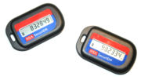
How to do One-Time Password
Shared lists of one-time passwords
Time-synchronized OTP
  E.g., use MAC_{K}(t), where K is shared secret, and t is current time
Using a hash chain (Lamport)
  h(s), h(h(s), h(h(h(s))), …, h¹⁰⁰⁰(s)
  use these values as passwords in reverse order

Slide 16
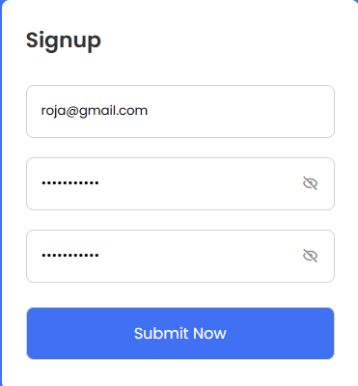
Out put

Slide 17
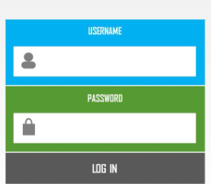

Slide 18


