Slide 1
Database Normalization
Sharon

Slide 2
What is Database Normalization?
Organizing data in a database
Removes redundancy
Improves data integrity & performance

Slide 3
Why Normalize?
Avoids duplicate data
Saves storage
Ensures data consistency
Faster maintenance

Slide 4
Normalization Forms
1NF – Atomic values, no repeating groups
2NF – 1NF + no partial dependency
3NF – 2NF + no transitive dependency

Slide 5
Example: Before Normalization
StudentID | StudentName | Course | Instructor
101 | Anita | DBMS | Rao
101 | Anita | Python | Mehta
102 | Rahul | DBMS | Rao

Slide 6
Example: After Normalization
StudentID | StudentName
101 | Anita
102 | Rahul
Course | Instructor
DBMS | Rao
Python | Mehta
StudentID | Course
101 | DBMS
101 | Python
102 | DBMS

Slide 7
1NF
RULE
Each cell should have atomic values(single values)
no repeating groups or arrays
each record is unique

Slide 8
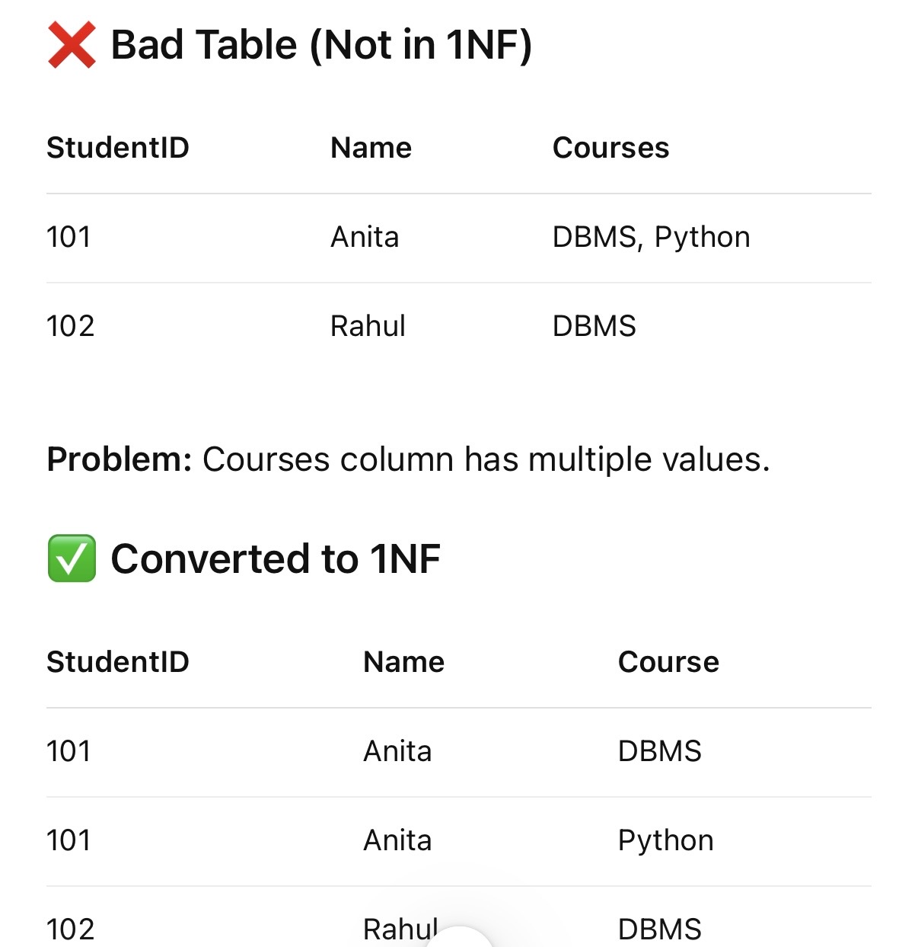

Slide 9
2NF
RULE
must already be in 1NF
no partial dependency(non key columns should depend on full primary key and not part of it)

Slide 10
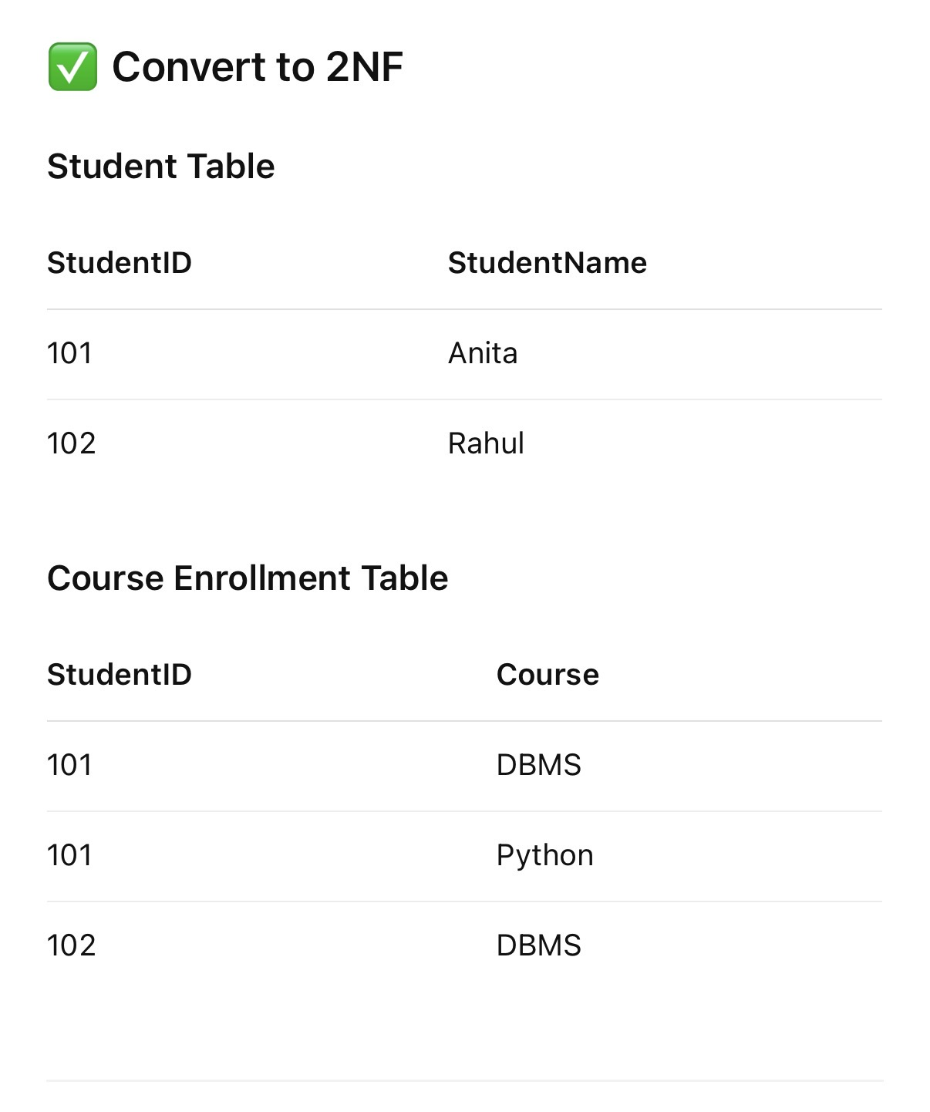
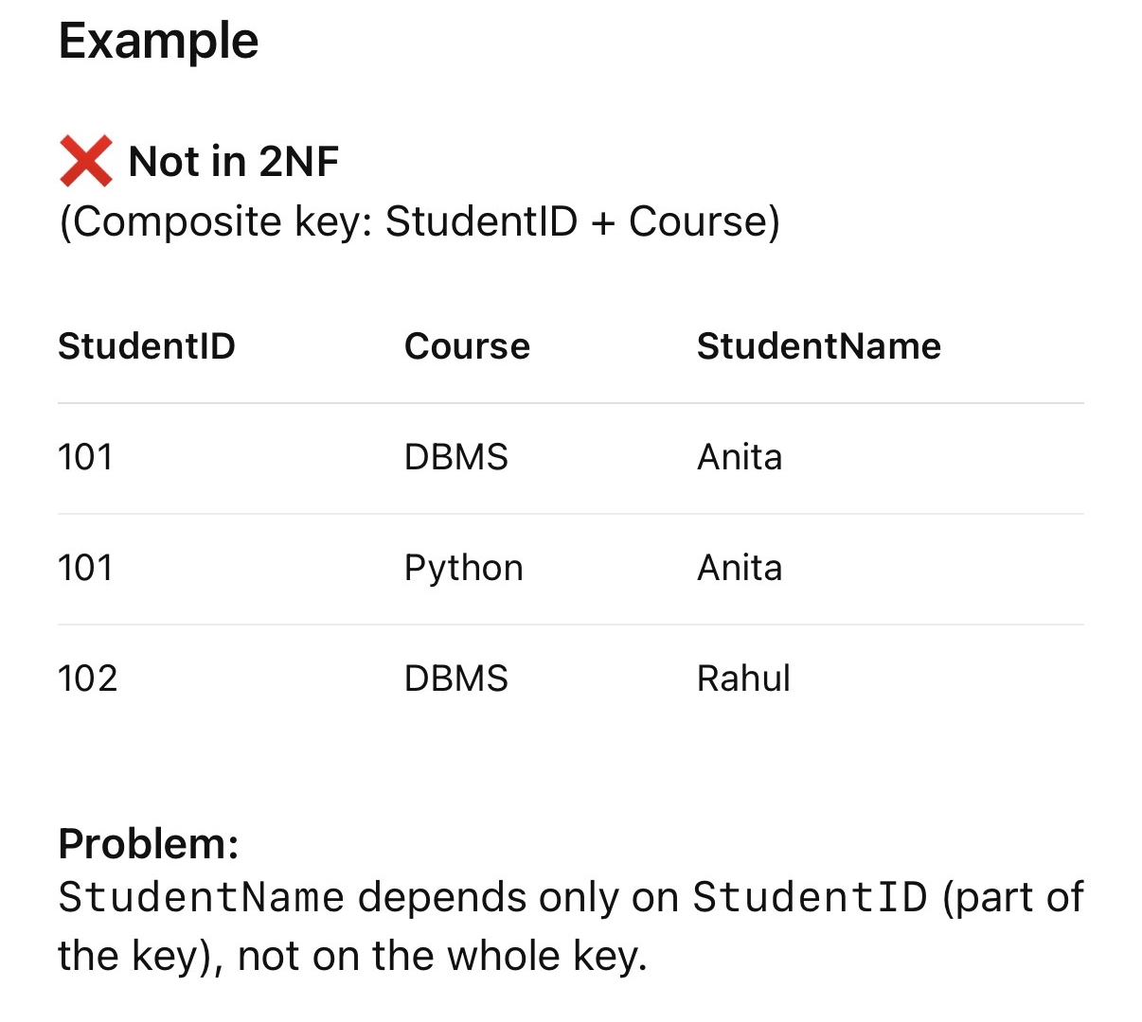

Slide 11
3NF
RULE
must be in 2NF
no transitive kay dependenct(non key column should not depend on another non key column)

Slide 12
