Slide 1
PERVASIVE COMPUTING IN HEALTH CARE

Slide 2
Pervasive Healthcare
Application of ubiquitous computing technologies for healthcare
Making healthcare available everywhere, anytime, and to anyone
Notes:
So far we have discussed some basic concepts related to ubiquitous computing.
In the second half of this lecture we will specifically look at applications of Ubicomp in healthcare. The term pervasive healthcare has two related but distinct meanings. On one hand it is used to refer to the application of ubiquitous computing technologies for healthcare domain. On the other hand, and somewhat more generally, it is used to refer to the way of healthcare delivery that makes it available everywhere, anytime and to anyone. It is the hope of many researchers working in this area that introducing ubiquitous computing technologies can help to achieve the vision of universally accessible healthcare.

Slide 3
Pervasive Healthcare
The notion of pervasive health monitoring presents us with a paradigm shift from the traditional event-driven model (i.e. go to doctor when sick) to one where we are continuously monitoring a person’s “well-being” through the use of bio-sensors, smart-home technologies, and information networks. This allows us to be more proactive in heath maintenance, as well as allowing the health care provider to make more informed decisions with a greater wealth of accurate data.

Slide 4
Pervasive Healthcare
Acute care settings – digital hospital
RFID for patient tracking
Context-aware clinical environments
Patient-centric technologies – health and wellness
Telemedicine (IDEATell)
Digital Family Portrait
MAHI
UbiFit Garden
Notes:
We will focus on two broad classes of applications. One includes those that support acute care settings, such as hospitals. Specifically, we will look at some examples of projects that use RFID tags for tracking patients, and some attempts to introduce context-aware computing in clinical environments. The other family includes technologies that are designed to assist individuals with management of their health and wellness outside of the clinical setting. We will look at a number of applications in this family.

Slide 5
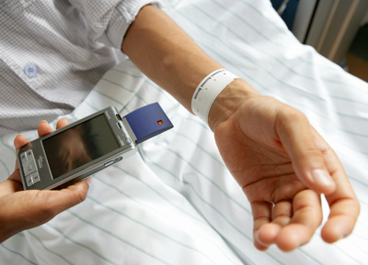
Improving Patient Safety
RFID patient tracking systems
Prevent errors (wrong medication to wrong patient)
Streamline billing (automatic tracking of procedures)
Notes:
In recent years, patient safety became an issue that attracted much attention. There is a focused effort to reduce the number of preventable errors, such as delivering medication to a wrong patient, or for a wrong dose. One solution to this problem is introduction of automated systems for patient tracking using, for example, RFID tags. These tags, when positioned on a patient, for example in their wrist band, could uniquely identify a patient. And when the unique identification is read by a portable computer, only the information pertaining to this patient could be made available. This could help to prevent some medical errors. This could also help to automatically track procedures, thus simplifying billing.

Slide 6
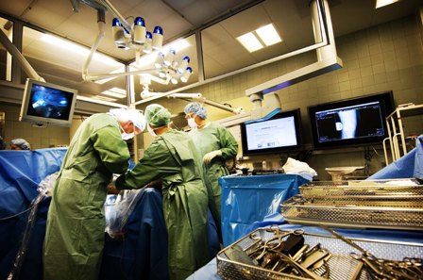
Context-Aware Surgery Room
Main focus: improving patient safety
Providing the right information at the right time in the right place (pertinent patient data)
Drawing attention to information of concern (warnings of drug allergies, etc.)
utilizing surgical context (physical and clinical)
Notes:
A similar concern is present in many diverse clinical environments. Here we see an example of a context-aware computing at work in the surgical ward. In this application, the schedule of procedures, the clinical personnel present in the room and the identity of a patient are all used to gather information pertaining to the case. Large screen displays enable hands-free lookup of data, as well as encourage communication among clinicians.

Slide 7
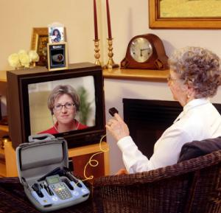
Patient-Centric Technologies
Remote monitoring
Case manager
Education, recommendations, adjustments to care-plan
Notes:
While ubiquitous computing is slowly becoming more common in acute care settings, its primary target remains health and wellness management outside of clinical environments. The applications often focus on remote monitoring of individuals’ health, often with the assistance of a clinical case manager, who could use the gathered data to generate appropriate education, recommendations, and make necessary adjustments to care plan. In the example on the screen, a patient at home is using a combination of devices to measure vital signs, such as blood pressure, blood glucose, among others. This data is transmitted to a nurse case –manager who can assess the data and recommend adjustments to the care.

Slide 8
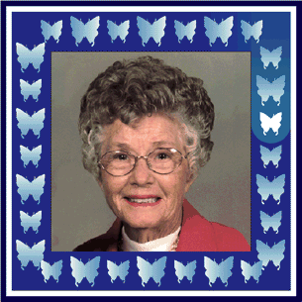
Health and Wellness
Digital Family Portrait
Helping adult children maintain awareness of well-being of their parents
Activity of parents is sensed by motion detection sensors
Abstract visualization creates pattern without violating privacy
Georgia Institute of Technology
Notes:
Other applications take a further step away from clinical settings and put majority of care in the hands of individuals and their family members. One of the early examples of such applications is Digital Family Portrait (DFP) developed by researchers at Georgia Institute of Technology. DFP is designed to help adult children maintain a level of awareness of well being of their aging parents. It relies on a set of motion detection sensors positioned in places of common activity at the house of an aging parent. The readings of the sensors are aggregated and are condensed to one iconic presentation, a butterfly in the frame of a parent digital picture. The frame includes a number of these icons each representing a day in a life of the parent, the size of the butterfly show how much activity was sensed during the day. The very coarse presentation of data does not allow for any focused inquiry, however, it allows the child to notice changes in activity levels and draws their attention to sudden increases or decreases they might want to follow up on. This type of interaction also helps to avoid privacy concerns.

Slide 9
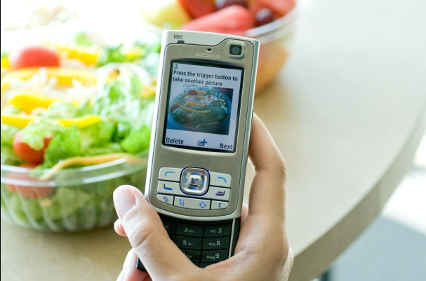
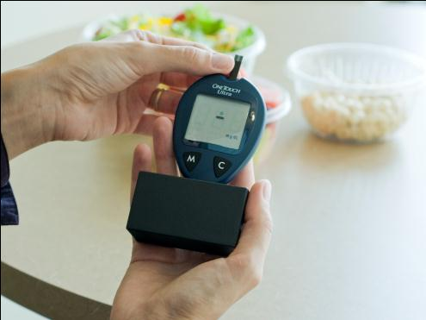
Health and Wellness
MAHI (Georgia Institute of Technology)
Assistance with diabetes management
Mobile phone for capture of experiences (pictures of meals, voice records)
Integration with glucose monitor
Website for review with diabetes educator
Notes:
MAHI, or Mobile Access to Health Information is another application from the Georgia Institute of Technology developed in collaboration with Siemens corporation. MAHI is designed for individuals with diabetes and is meant to help them learn from their daily experiences. MAHI is a distributed application that includes several components: a mobile phone with a custom application allows individuals to take pictures, for example of their meals and to record voice notes with their concerns and questions. A custom-built Bluetooth attachment to a conventional glucose meter helps them to transfer all the readings from the meter onto their phone. These records combined are then sent to a remote server and posted on individuals’ websites where they can view them and discuss them with a diabetes educator. In deployment studies, MAHI was shown to help individuals to gain better appreciation of how their choices affect their heath.

Slide 10
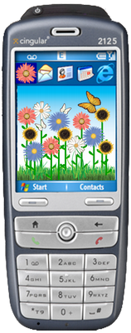
Health and Wellness
UbiFit Garden
Monitoring physical activity
On the body monitoring
A variety of physical activity types
Ambient display on a mobile phone
Aesthetically pleasing visualization
Monitoring accomplishments
Reward for achievement of goals
Intel
Notes:
The final application we will review, a UbiFit garden developed by researchers at Intel, takes advantage of many of the same technologies we discussed before. It utilizes a relatively sophisticated sensing platform that allows individuals to capture various types of physical activity, such as swimming or biking. Individuals use a custom application on their mobile phones to set up their weekly activity goals. The application then automatically monitors their progress towards their goals and visualizes their activity levels using a flower garden as a metaphor. This display has several important properties: it is aesthetically pleasing, making it appropriate for a device that often becomes an expression of an individual’s identity; it allows them to easily monitor their accomplishments, without having to login to a website or calculate daily progress manually; finally, it rewards individuals for achieving their goals. These rewards are not big and certainly not monetary; individuals get butterflies in their garden. But they might just be enough to motivate somebody get off a couch and walk for 30 minutes to refresh their garden.

Slide 11
Case Study 1:iHospital system:

Slide 12
iHospital system
– Large wall displays, PCs, mobile phones
Maintain shared view of available resources
Scheduling new surgeries
Tracking doctors/nurses and required resources
Coordination of resources
Monitoring procedures, doctors and resources
Uses location tracking and video streaming of info
Deployed in operating ward of small hospital (Horsens) in Denmark
Dates: about 1.5 years ending around Nov 2005

Slide 13
AwareMedia
displays information about work in operating rooms
Video stream provides overall awareness of operation’s state
Progress bar shows more detailed information about progress
Chat area allows people communicate unobtrusively
Schedule shows current operating schedule
Location-tracking system shows who is in operating room

Slide 14
AwarePhone
• Program that runs on Symbian mobile phones
• Provides
– Overview of people at work
– Status of surgeries in operating room
• Augmented phone book: people’s location, schedule and self-reported status

Slide 15
Location Tracking
Bluetooth used for tracking
Black item worn by staff
Sends bluetooth signal to infrastructure
Chips carried on shirt or pocket during work shift
Charged at night

Slide 16
Usage Scenario
• Example Scenario: Acute patient arrives. Head nurse
– Looks at AwareMedia on large display
– Finds empty operating room
– Touches screen to schedule surgery using that operating room
– Uses location-tracking to find available surgeon
– Sends message to surgeon’s mobile phone giving info about surgery
– Regularly scheduled surgery is informed about postponement

Slide 17
Deployment Issues Getting Infrastructure in Place
• Balance between cost, security, networking, etc
• Cost location tracking systems
• Limited space: hospitals already confined
• Wireless Interference between ubicomp equipment and hospital equipment

Slide 18
Deployment Issues: Installing and Launching Software
• How to deploy software
• How to keep software up-to-date
• How to debug running systems
• How to integrate different software systems
• How to ensure scalable system that performs adequately

Slide 19
Deployment Issues: Involving Users
End-user system: Designed for usability from start
Wanted minimal to no end-user training
All objects visually represented, drag and drop interface
• Training many people who work in shifts?
• Fully automated context aware vs requiring user input
• Privacy: many concerns. Users seemed not to care much

Slide 20
Wireless Pervasive Health Monitoring

Slide 21
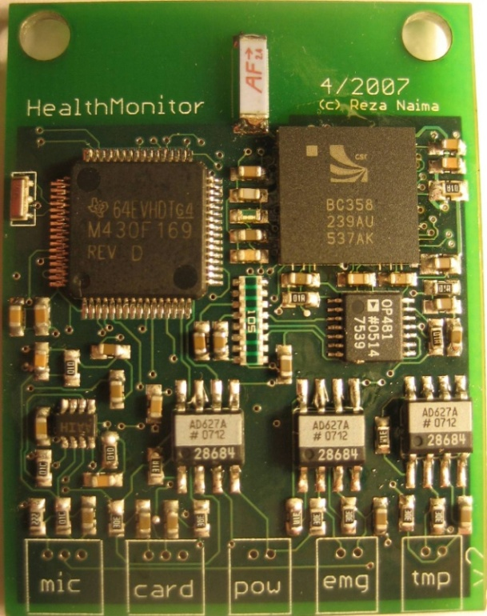
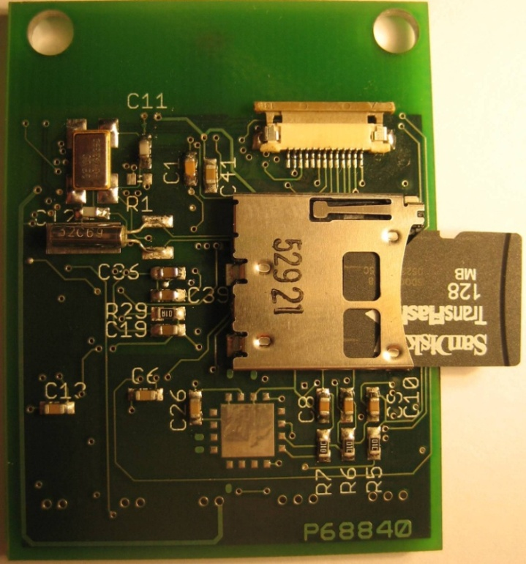
Implementation Overview
Small, chest worn (24h/day)
Capable of measuring many health-related parameters
Bluetooth enabled
Removeable FAT16 filesystem for local data storage (transflash)
Ability to do detect acute events and act on them

Slide 22
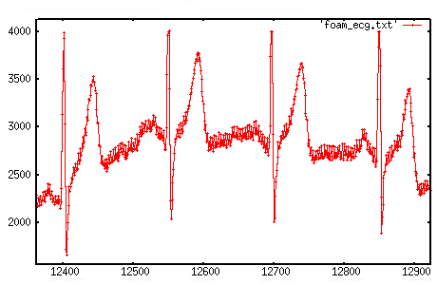
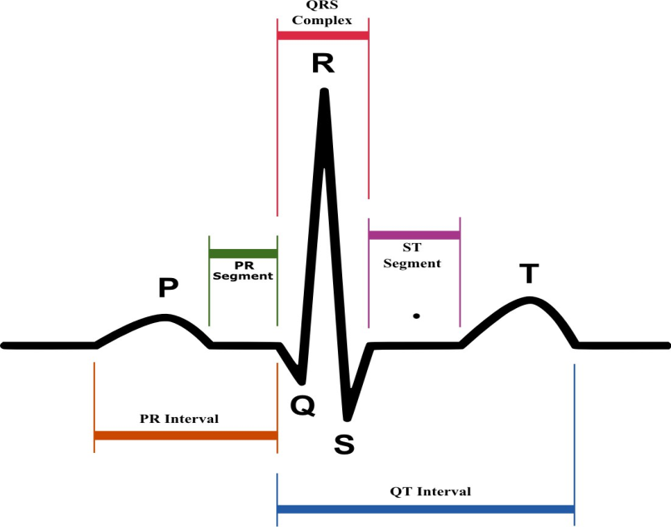
Parameters Monitored
EMG/GSR
Detect transient cardiac events for diagnostic purposes
Detect acute (life-threatening) events and alert
Correlate cardiac events with activity levels, or other parameters
Monitor variations in rhythm induced by medications

Slide 23
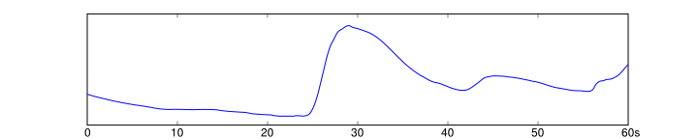
Parameters Monitored
EMG/GSR “Stress” Detection
Measures muscle tension (EMG) on back which is indicative of “stress”
Measures “skin resistance” (GSR) which varies with the involuntary production of sweat as a result of stress/emotion

Slide 24
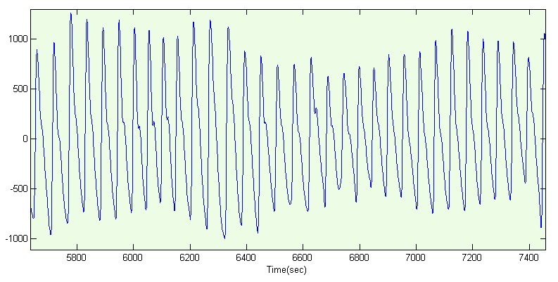
Parameters Monitored
Pulse Oximetry
Measure percentage of blood oxygenation
Correlate with breathing and heart beating
Detect hypo/hyper volemia
Detect range of cardiac problems
3-Axis Accelerometer
Orientation (i.e. Sleeping on back vs. standing)
Activity levels (sedentary or jogging)
Detect acute event (Falling)

Slide 25
Parameters Monitored
Audio
Record breathing sounds
Record heart beating sounds
Detect asthmatic events through frequency domain analysis
Skin Temperature
Coloration with internal body temperature
Long term trending, ability to correlate with other physical parameters

Slide 26
Bluetooth
Bluetooth
Transfer data to PC wirelessly
Transfer data to remote location via Dial-Up-Networking and a nearby cell phone
Real-time telemetry locally (cell phone) or remotely (DUN + web interface)
Real-time listening to breathing sounds (“handsfree” mode + cell phone)
USB interface
Note: Bluetooth is the highest power consuming component, and ideally
will be left off during the bulk of the data acquisition periods

Slide 27
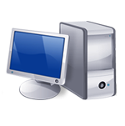

Overview
Microcontroller
ECG
Pulse Oximetry
EMG/GSR
USB
Interface
Audio
Filesystem
3-Axis Accelerometer

Slide 28
Applications
Continuous monitoring of elderly
Detect acute events (i.e. fall)
Detect transient events (i.e. temporary heart problems)
Long term health maintenance
Create portal to allow relatives/friends to monitor relatives
Diagnostic tool for developing regions
Monitor many parameters, send data to remote physicians for
diagnosis
Commercial applications
End-Consumer self-monitoring (trending/exercise)
“Un-tether” patient in hospital setting
Help physicians with better diagnosis
Research Applications
Investigate parameters (i.e. stress as a function of exercise)
Long term monitoring during drug trials

Slide 29
Examples of Personal Health Devices

Slide 30
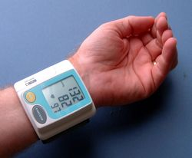
Blood Pressure/Pulse Monitors
Automatic large LED blood pressure systolic / diastolic / pulse readout with fuzzy logic.
Automatic inflation & deflation
48 sets of memory to monitor your progress plus date / time / average pressure
Requires 2 x AAA batteries.

Slide 31
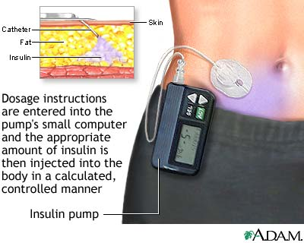
Wearable Insulin Pumps
The catheter at the end of the insulin pump is inserted through a needle into the abdominal fat of a person with diabetes.
Dosage instructions are entered into the pump's small computer and the right amount of insulin is injected in a controlled manner.

Slide 32
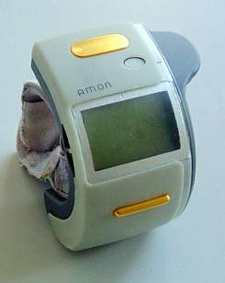
AMON - Advanced Telemedical Monitor
A European project from ETH, Zurich
Designed to be worn by cardiac outpatients, the device allows remote monitoring of blood pressure, pulse, oxygen saturation, body temperature and 2-channel ECG signals.
AMON: A Wearable Medical Computer for High Risk Patients,

Slide 33
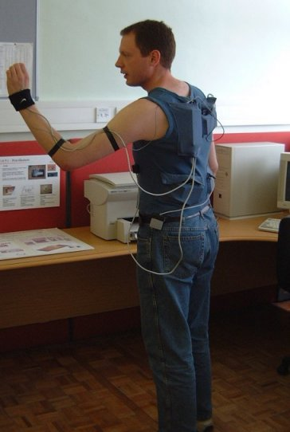
SensVest
C.Baber, A.Schwirtz and J. Knight
The “Lab of Tomorrow” EU project (C.Baber @ Birmingham) to enable students to capture and analyse “activity” sensor data.
Senses temperature Heart rate (ECG) and activity via accelerometers.

Slide 34
The “Digital Plaster”
A device meant to be embedded in ordinary plaster that includes sensors for monitoring health-related metadata such as blood pressure, temperature and glucose levels.
The “digital plaster” contains a Sensium silicon chip, powered by a small battery, which sends data via a cellphone or PDA to a central computer database.
If the results show any worrisome signs, patients and doctors alike would be notified of the change in the data patterns. They also plan to add a motion sensor to the device so it could additionally serve in the role of “granny monitor” by detecting things like falls or complete inactivity.

Slide 35
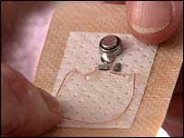

Slide 36
The Reasons for Vulnerability in Pervasive Healthcare
Paper-based health data storage is highly centralized and any copying of this information is tedious and a time-consuming process. With EPRs kept on networked systems for availability reasons, it is accessible from anywhere and is very easy to copy.
More and more sensitive information is being included in a patient’s EPR for faster and easier retrieval. Examples include HIV status, psychiatric records, and genetic information.
The networked nature of pervasive healthcare systems allows the EPRs to be moved across administrative or even national boundaries with ease, thereby circumventing any local legal issues

Slide 37
Threats in Pervasive Healthcare
Unauthorized access to health data.
Deliberate alteration of health data of specific patients, leading to incorrect diagnosis and treatment.
Deliberate generation of false alarms or suppression of real alarms raised by the system in case of emergencies.
Economic and social discrimination of patients (insurance companies offering health insurance with high premiums to people who have certain chronic problems).

Slide 38
Security Solutions for Pervasive Healthcare
Securing Medical-Sensor Communication
Controlling Access to EPRs
Legislative Solutions

Slide 39
THANK YOU

