Slide 1
Emotion Detection
Guide:
Ms. Preeja V
Asst. Professor
CSE Department
SCTCE
Thejas Krishnan 261
Gokul KP 231
Sharon Anna Thomas 252

Slide 2
Method
Emotion detection is broadly categorized in to three basic methods:
Face detection
Facial feature extraction
Emotion classification

Slide 3
Face detection and Feature extraction
Viola Jones Algorithm
The algorithm has four stages:
Haar Feature Selection
Creating an Integral Image
Adaboost Training
Cascading Classifiers

Slide 4
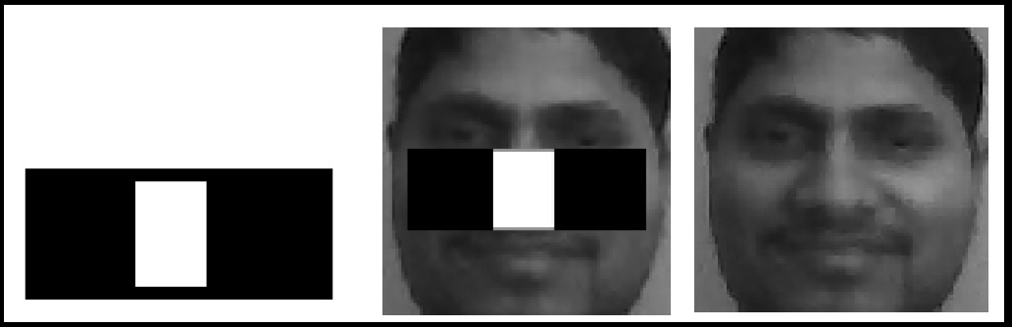
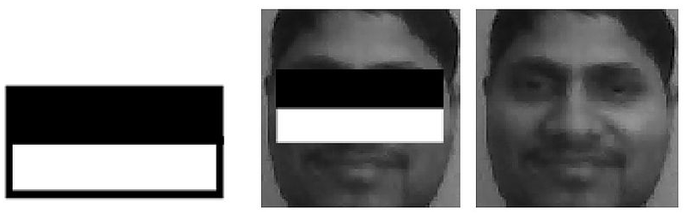

Viola jones algorithm
Haar Feature Selection | Create Integral Image | Adaboost Training | Cascading Classifiers
All human faces share some similar properties. These regularities may be matched using Haar Features.
Each feature results in a single value which is calculated by subtracting the sum of pixels under white value from the sum of pixels under black rectangle.
A few properties common to human faces:
The eye region is darker than the upper-cheeks.
The nose bridge region is brighter than the eyes.
Location and size: eyes, mouth, bridge of nose

Slide 5
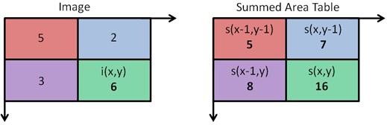
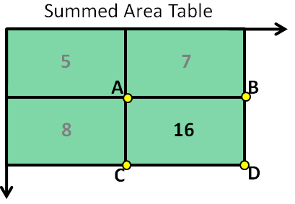
Viola jones algorithm
Haar Feature Selection | Create Integral Image | Adaboost Training | Cascading Classifiers
The Integral Image is used as a quick and effective way of calculating the sum of values (pixel values) in a given image .
The value at any point (x, y) in the summed area table is just the sum of all the pixels above and to the left of (x, y), inclusive.
i(x’, y’) = s(A) + s(D) – s(B) – s(C) = 5 + 16 – 7 – 8 = 6

Slide 6
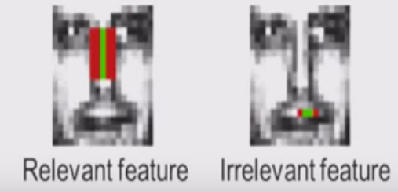
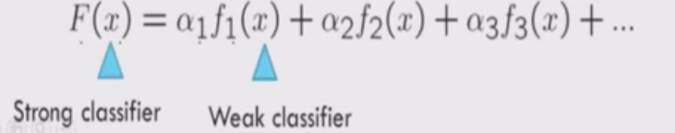
Viola jones algorithm
Haar Feature Selection | Create Integral Image | Adaboost Training | Cascading Classifiers
Distinguish between relevant and irrelevant feature.
Eliminate redundant features.
Best features are selected from the 160,000+ features.
Each feature given a particular weight.
Linear combination of these features provide a strong classifier.

Slide 7
Viola jones algorithm
Haar Feature Selection | Create Integral Image | Adaboost Training | Cascading Classifiers
Stage 1
Is input a face?
Stage 2
Is input a face?
Input
Maybe
Maybe
Definitely not!
Definitely not!
Discard
Discard

Slide 8
Viola jones algorithm implementation
Python is used for the development.
OpenCV-Python is a library of Python bindings designed to solve computer vision problems which is utilized for the same.
Object Detection using Haar feature-based cascade classifiers is an effective object detection method.

Slide 9
Python code for image manipulation
import cv2 import numpy as np img = cv2.imread('image.jpg') img_new1 = cv2.imread('road.jpg') img_new = cv2.imread('road.jpg',0) img_gray = cv2.cvtColor(img,cv2.COLOR_BGR2GRAY) kernal1 = np.ones((5,5))/float(25) kernal2 = np.array(((1,1,1),(1,-8,1),(1,1,1))) print kernal2 h,w,d = img.shape print h,w,d print h/2,w/2 img_bright = np.float32(img_gray)+40 img_bright[img_bright>=255]=255 img_smooth = cv2.filter2D(img_gray,-1,kernal1) img_edge = cv2.filter2D(img_gray,-1,kernal2) img_crop = img_gray[0:100,50:100] img_com = img_gray img_com[0:100,50:100]=img_new[0:100,50:100]
img_zoom1 = np.zeros((h/2,w),dtype=np.uint8) for i in range(0,h/2): img_zoom1[i,:] = img_gray[2*i,:] img_zoom = np.zeros((h/2,w/2),dtype=np.uint8) for j in range(0,w/2): img_zoom[:,j] = img_zoom1[:,2*j] cv2.imshow('figur1',img) cv2.imshow('figur2',img_gray) cv2.imshow('figur3',np.uint8(img_bright)) cv2.imshow('figur4',img_smooth) cv2.imshow('figur5',img_edge) cv2.imshow('figur6',img_crop) cv2.imshow('figur7',img_com) cv2.imshow('figur8',img_zoom) cv2.imshow('figur9',img_new) cv2.imshow('figur10',img_new1) cv2.imshow('figur11',img_zoom1) cv2.waitKey(0)

Slide 10
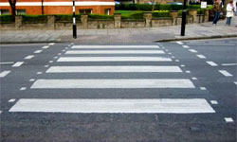

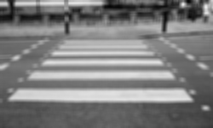

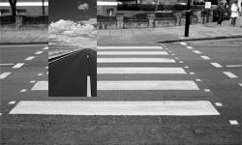
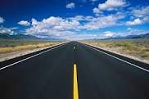
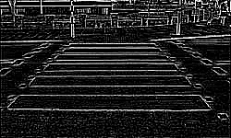

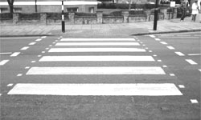
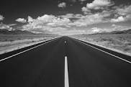

Slide 11
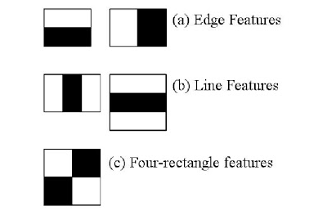
Face detection
Initially, the algorithm needs a lot of positive images (images of faces) and negative images (images without faces) to train the classifier. Then extract features from it.
Haar features shown in below image are used. They are just like the convolutional kernel.
Each feature is a single value obtained by subtracting sum of pixels under white rectangle from sum of pixels under black rectangle.

Slide 12
Face detection implementation

Slide 13
import cv2 import numpy as np rgb_img = cv2.imread('KA.AN1.39.tiff') eye_cascade = cv2.CascadeClassifier('haarcascade_eye.xml') mouth_cascade = cv2.CascadeClassifier('haarcascade_mcs_mouth.xml') nose_cascade = cv2.CascadeClassifier('haarcascade_mcs_nose.xml')
face_cascade = cv2.CascadeClassifier('haarcascade_frontalface_default.xml')
print rgb_img.shape gray_image = cv2.cvtColor(rgb_img,cv2.COLOR_BGR2GRAY) gray_image1 = gray_image
face_rects = face_cascade.detectMultiScale(gray_image)
for (x,y,w,h) in face_rects: print x,y,w,h cv2.rectangle(gray_image1,(x,y),(x+w,y+h),(255,0,0),2) roi_gray = gray_image[y:y+h, x:x+w] cv2.imshow('face',roi_gray)
eye_rects = eye_cascade.detectMultiScale(gray_image) for (x,y,w,h) in eye_rects: print x,y,w,h cv2.rectangle(gray_image1,(x,y),(x+w,y+h),(255,0,0),2) roi_gray = gray_image[y:y+h, x:x+w] cv2.imshow('eye',roi_gray) mouth_rects = mouth_cascade.detectMultiScale(gray_image, 1.3, 11) for (x,y,w,h) in mouth_rects: cv2.rectangle(gray_image1,(x,y),(x+w,y+h),(255,0,0),2) roi_gray = gray_image[y:y+h, x:x+w] cv2.imshow('mouth',roi_gray) nose_rects = nose_cascade.detectMultiScale(gray_image) print nose_rects for (x,y,w,h) in nose_rects: cv2.rectangle(gray_image1,(x,y),(x+w,y+h),(255,0,0),2) roi_gray = gray_image[y:y+h, x:x+w] cv2.imshow('nose',roi_gray) cv2.imshow('figure',gray_image) cv2.waitKey(0)

Slide 14

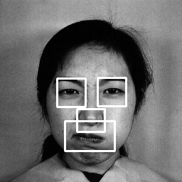



Slide 15
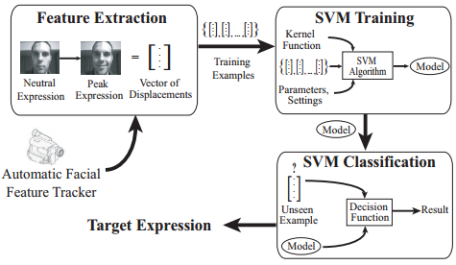
Emotion detection overview
Feature Extraction
SVM Training
SVM Classification

Slide 16
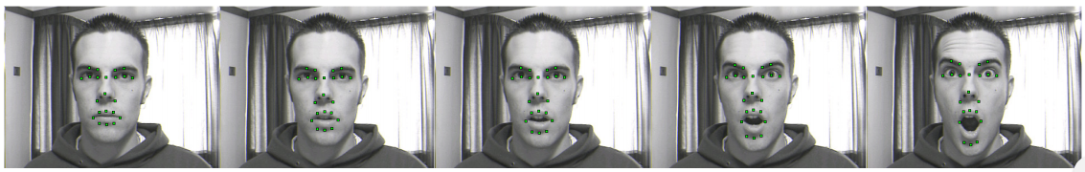
Feature tracking
A tracker uses a face template to initially locate the position of the 22 facial features of a face model in the video stream.
Filter used to track position over subsequent frames

Slide 17
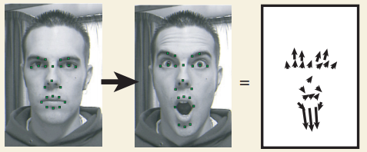
Feature Tracking
Feature displacements between neutral and peak expressive frames

Slide 18
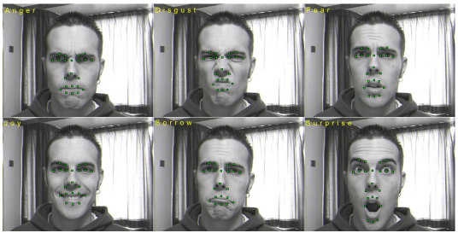
Feature tracking
For each expression, a vector of feature displacements is calculated by taking the euclidean distance between feature locations in a neutral and a “peak” frame representative of the expression.

Slide 19
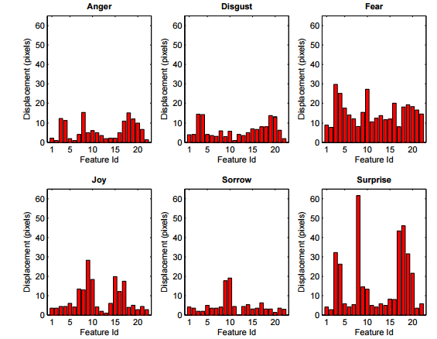
Feature tracking
Allows characteristic feature motion patterns to be established for each expression.

Slide 20
Training and classification
The vector of displacements of each example expression together with a user-supplied label is used as input to the SVM training stage.
The classifier is re-trained each time a new example expression is added. The SVM subsequently assigns unseen expressions the label of the target expression that has the most similar displacement pattern.
The user requests for training examples to be gathered at discrete time intervals and provides a label for each. This is combined with the displacements output by the feature extraction phase and added as a new example to the training set. The SVM is then retrained.
Unseen expressions to be classified pass the same feature extraction process and are subsequently assigned the label of the target expression that most closely matches their displacement pattern by the SVM classifier.

Slide 21
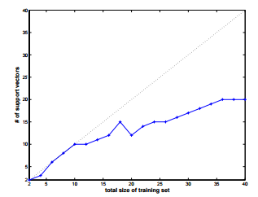
Training and classification
Number of support vectors defining the decision surface as training set size is increased.

