Slide 1

QUANTUM COMPUTING ASSIGNMENT 2
SHARON CHRISTABEL
MTECH DS AND AI

Slide 2
CONTENTS
QUANTUM TELEPORTATION
SUPERDENSE CODING
SCHMIDT DECOMPOSITION

Slide 3
QUANTUM TELEPORTATION
In quantum teleportation, the properties of quantum entanglement are used to send a spin state (qubit) between observers without physically moving the involved particle.
The particles themselves are not really teleported, but the state of one particle is destroyed on one side and extracted on the other side, so the information that the state encodes is communicated.
The process is not instantaneous, because information must be communicated classically between observers as part of the process.
The usefulness of quantum teleportation lies in its ability to send quantum information arbitrarily far distances without exposing quantum states to thermal decoherence from the environment or other adverse effects.

Slide 4

Process of Quantum Teleportation
Suppose Alice has state C, which she wants to send to Bob. To achieve this, Alice and Bob should follow the sequence of steps:
1) Generate an entangled pair of electrons with spin states A and B, in a particular Bell state:
2) Alice measures the Bell state of AC, entangling A and C while disentangling B. The process of measuring the Bell state projects a non-entangled state into an entangled state, since all four Bell states are entangled.

Slide 5
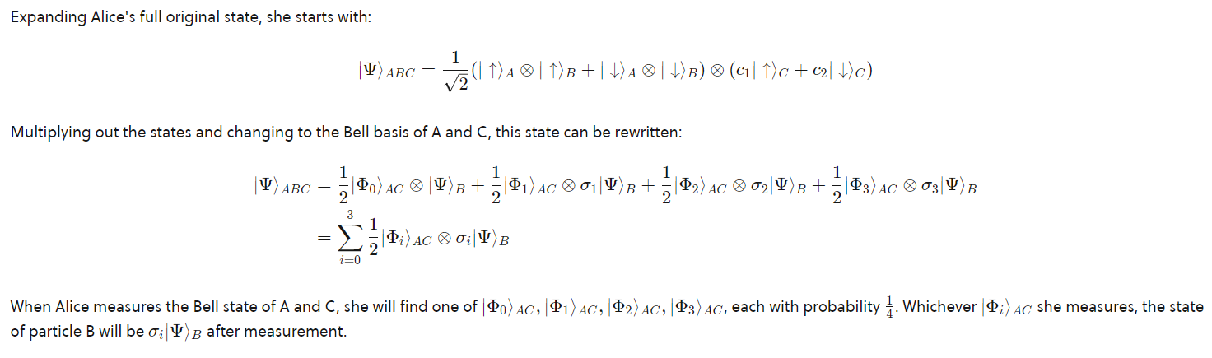

Slide 6
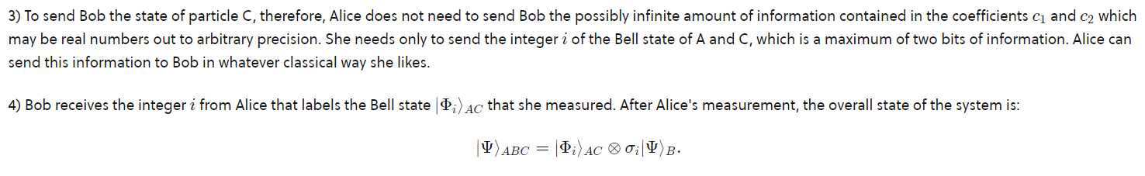
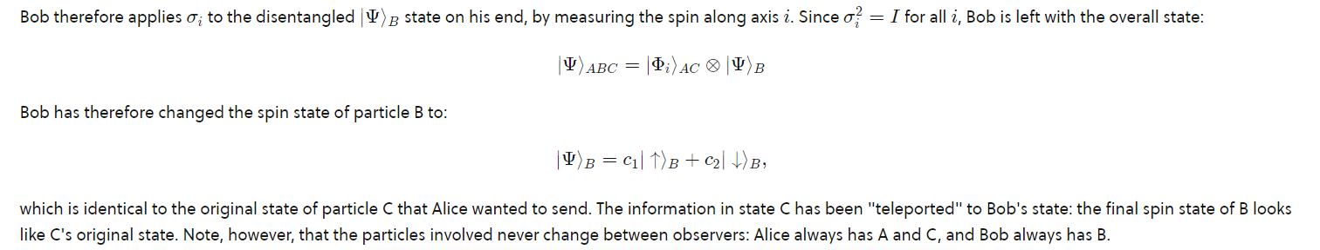

Slide 7
SUPERDENSE CODING
Superdense coding is a procedure that allows us to send two classical bits to another party using just a single qubit during communication. In a simplified way, this protocol replaces two classical bits with one qubit.
Steps Involved:
Preparation: Prepare (by convention) state; split the two pair among sender and receiver.
Transport: Sender physically moves away with h(is/er) pair of entangled qubit.
Encoding: Sender encodes classical bits of information to h(is/er) pair of qubit.
Transmission: Sender transmits h(is/er) qubit to receiver.
Decoding: Receiver decodes and measures h(is/er) qubit to retrieve sender's classical state.

Slide 8
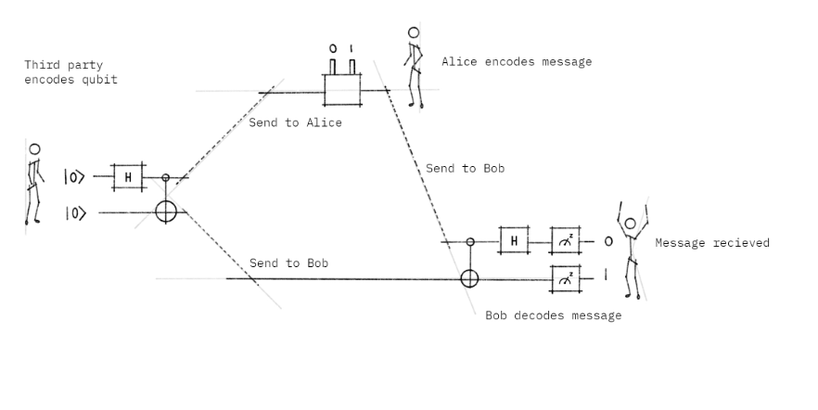

Slide 9
Step 1 : Preparation
It starts with a third party (say, Charlie) who prepares a pair of entangled states at |0⟩ Applying Hadamard gates to both the initialized qubits a CX gate is applied in order to create an entangled state. (First one as control and second one as the target).
Step 2 : Separation
Sender takes q0 and receiver takes q1, they travel far apart.

Slide 10
Step 3 : Encoding
Charlie sends the first qubit to sender and the second qubit to receiver. The goal of the protocol is for sender to send 2 classical bits of information to receiver using his/her qubit.
But before he/she does, sender needs to apply a set of quantum gates to his/her qubit depending on the 2 bits of information sender wants to send.
Thus if the sender wants to send a 00, he/she does nothing to the qubit (apply the identity (I) gate). If wants to send a 01, then applies the X gate.
Depending on what the sender wants to send, the sender applies the appropriate gate, then sends the qubit to the receiver for the final step in the process.

Slide 11
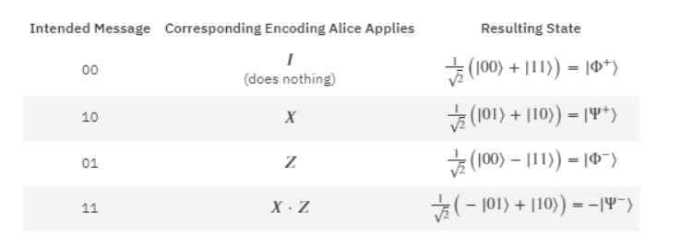

Slide 12
Step 4 : Transmission
Sender sends h(is/er) encoded qubit physically to receiver.
Step 5 : Decoding
The receiver receives the sender's qubit (leftmost qubit) and uses his qubit to decode the sent message. Notice that he/she does not need to have knowledge of the state in order to decode it — he/she simply uses the restoration operation.
The receiver applies a CNOT gate using the leftmost qubit as control and the rightmost as target.
Then he applies a Hadamard gate and finally performs a measurement on both qubits to extract transmitted message.

Slide 13
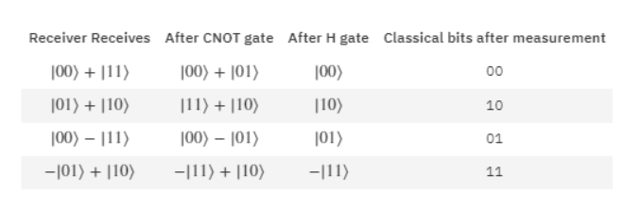

Slide 14
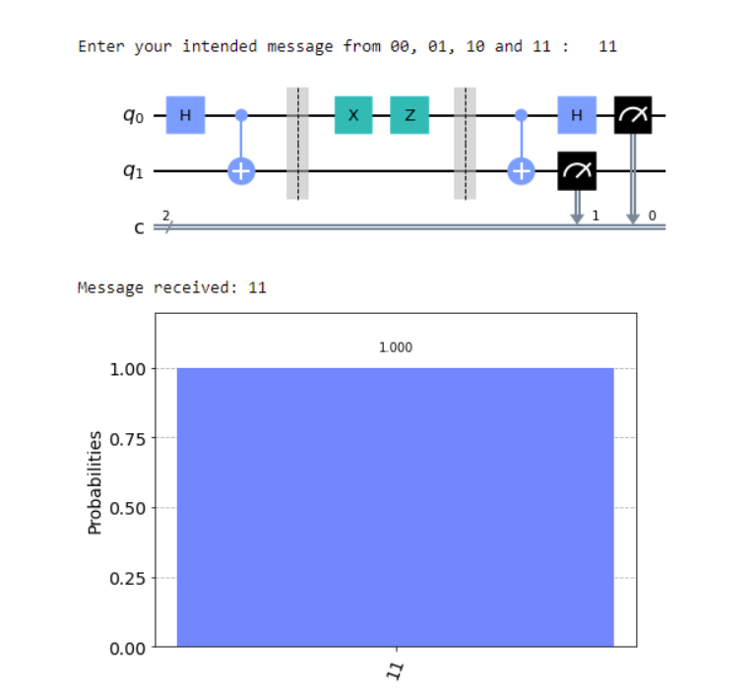
The Complete Protocol in a Simulator

Slide 15
Bipartite states and Schmidt decomposition
Bipartite states are one of the basic objects in Quantum Information Theory and will be defined as follows:

Slide 16
Pure States
Definition
Let H = H_{A} ⊗ H_{B} be a Hilbert space defined as a tensor product of two Hilbert spaces H_{A} and H_{B}. We call some pure state ∣ψ⟩_{AB} on the composite system A ∪ B Bipartite, if it is written with respect to the partition AB, which means |ψ⟩AB=∑ij χij |i⟩A ⊗ |j⟩B where ∣i⟩_{A} and ∣j⟩_{B} are bases in H_{A} and H_{B} respectively.

Slide 17
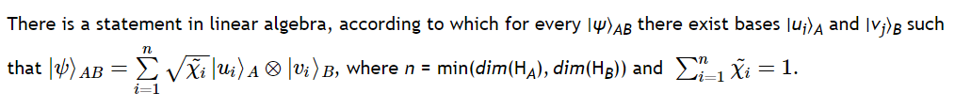
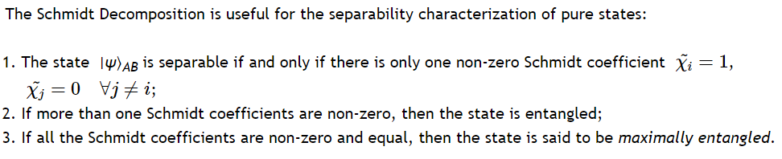
Schmidt Theorem (Schmidt Decomposition)

Slide 18
Mixed States
Definition

Slide 19
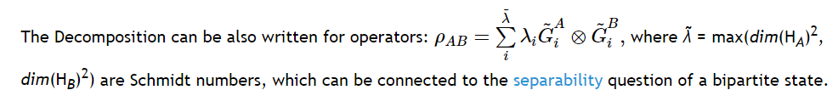
Schmidt Decomposition

Slide 20
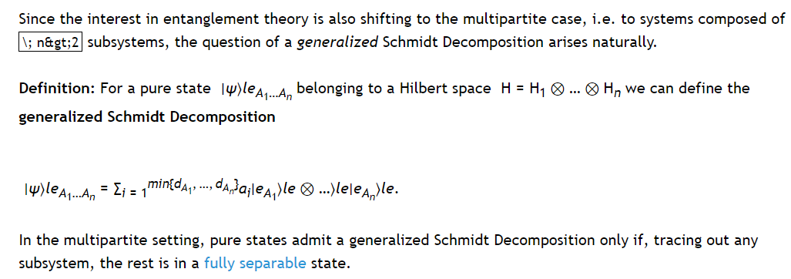
Generalization to multipartite states

